Slide 1
Final Project Evaluation
Team ID - 23
Varunav Singh, 21D070086
Vinay Sutar, 21D070078
Ananya Chinmaya, 210070008
Chinmay Jadhav, 210020057
28/11/2024

Slide 2
Semantic Analysis for Topic Modeling

Slide 3
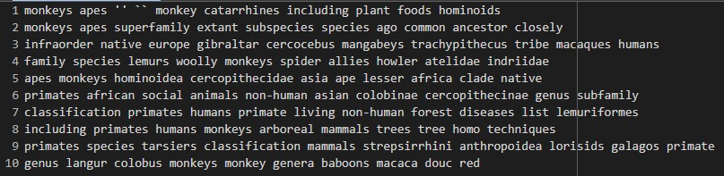
Problem Statement
Input: Document related to certain topic in .txt
Output: 10x10 matrix with each row independent in terms of relations
Example:
Input: Document related to monkeys and their relatives
Output:

Slide 4
Motivation
Information retrieval is a very relevant topic nowadays with the usage of RAG, hence we were interested in using NLP to engage in some sort of Data Retrieval/Science task using rule-based methods.

Slide 5
Literature Review
We started with our base paper Probabilistic Latent Semantic Analysis (Hoffmann, 1999), while we also used few articles for understanding the theory better (mentioned in the references section). In addition, we used another paper (Geiger and Park, 2024) for ideas for improvements on multinomial probability modeling, however our understanding was limited and hence we discarded our implementation related to it. Our final model used Gibb’s Sampling, which was understood via the Wikipedia page of the same.

Slide 6
Dataset
Datasets used were compilations of wikipedia pages, structured so as to avoid easy topic extraction by the model by using non sequential sections, parts of texts from different sections.
Training and testing datasets were also chosen such that there were common topics but not extremely related, such as mammals and primates, or primates and monkeys, where we tested on the latter so that the earlier will have more diverse relations which won’t be directly learned by the training dataset.
Our datasets were all 9000+ characters long. We didn’t use extremely large datasets as such datasets were not easily

Slide 7
Method/Technique
Preprocessing steps include tokenizing the input document, removing numerics and stopwords from the document and then using the rest of the words to make 2 dictionaries, word2id and id2word which are used to make document-text matrix which is the actual input to our model. Following this EM step occurs (training), we can set threshold for training step stopping condition and alpha for Gibb’s sampling and beta for priors.
We checked coherence scores and topic diversity as measurable scores for model selection, and experimented with using cosine similarity as a metric, and checked intra-row relations for all rows in the output bag of words manually.

Slide 8
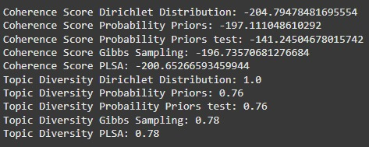
Results
Our final model’s results are the 2nd best in coherence score (Less in magnitude is better) and 2nd best in Topic Diversity
Chosen due to both scores being nearly the best and output relations clearly understandable

Slide 9
Analysis
We observed a trend of at most 1 or 2 words of the row being unrelated to the rest of the words, while the semantic relations of the words were usually the paragraph

Slide 10
Error analysis
Few outputs contain words that are not related with the other words in the same row (when they should be), for example -
“reptiles shrew underwent increase solely expansion rise true adaptations pigs”
This occurs due to proximity of their occurrence in text. All of these words exist in the same paragraph, but pig was only given as an example in a different context to the rest of the words, hence it has no relation.

Slide 11
Improvements over the paper
We implemented Gibb’s Sampling, which showed better results in both coherence scores and understability of relations (manually tested). It also performed as such without using Tempered Expectation Maximization, showing better results using less complex training method.

Slide 12
Learnings
We learnt about aspect models, specifically compared with cluster models to understand the different aspects of topic modeling with respects to metrics like coherence and diversity, as well as document topic modeling.
We also learnt about multinomial probability distribution relations with dirichlet distributions, however we did not use it in our final model as we did not fully understand it’s exact theory.
We also learned about semantic analysis in the context of information extraction.
We also learnt that English Semantic Analysis doesn’t work reasonably with Hindi text, probably due to the difference in how semantic relations between the words work.

Slide 13
Evaluation Scheme
Demo working- ((10) if not working or no GUI - (0))​
Literature understanding- (10)
Analysis- (10)
Improvement over paper- (10)
Note: Must have GUI, otherwise no mark will be given for demo.​

Slide 14
References
Hofmann, T., 1999, July. Probabilistic latent semantic analysis. In UAI (Vol. 99, pp. 289-296).
Geiger, B. and Park, P.J., 2024. On the Connection Between Non-negative Matrix Factorization and Latent Dirichlet Allocation. arXiv preprint arXiv:2405.20542.
https://en.wikipedia.org/wiki/Gibbs_sampling
https://nanonets.com/blog/topic-modeling-with-lsa-plsa-lda-lda2vec/
https://medium.com/analytics-vidhya/topic-modeling-using-lda-and-gibbs-sampling-explained-49d49b3d1045

