Slide 1
Systems of Equations

Slide 2
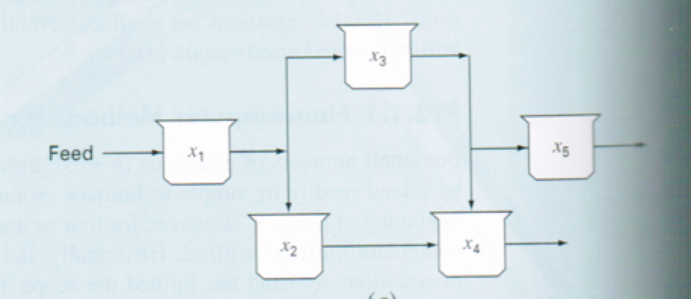
Why systems of equations:
- many fundamental engineering problems based on conservation (e.g. mass, energy, momentum)
- equations relate system behavior as represented by the levels or response of the quantity being modeled to the properties of the system and the external stimuli or forcing functions.

Slide 3
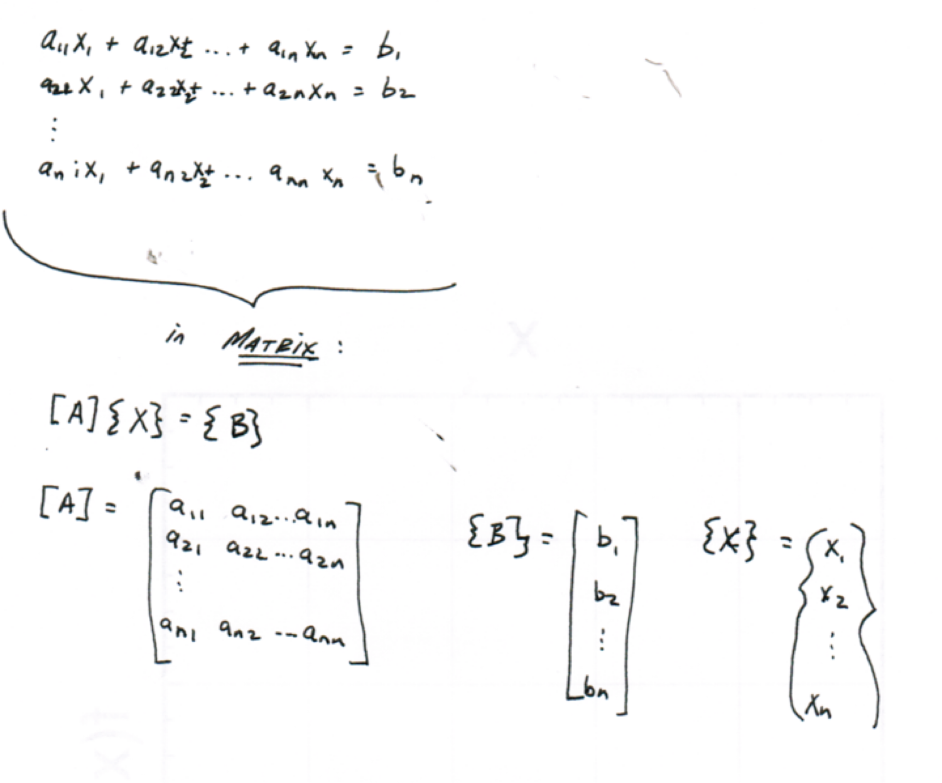

Slide 4
Notation:
o a₁₁x₁ + a₁₂x₂ + ….+ a_{1n}x_{n} = b₁
o a₂₁x₁ + a₂₂x₂ + ….+ a_{2n}x_{n} = b₁
o a_{n1}x₁ + a_{n2}x₂ + ….+ a_{nn}x_{n} = b_{n}
a’s = coefficients
b’s = constants
n = number of equations
♣ x’s = mass in reactor 1, mass in reactor 2, ….
♣ a’s = properties that bear on the interactions between compartments (in this example, a’s might be flowrates between reactors)
♣ b’s = forcing functions acting on the system, such as the feed rate of the system

Slide 5
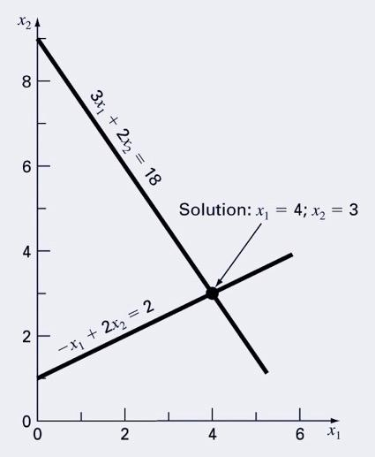
Example 1: Plotting

Slide 6
Graphical Method: Plot!

Slide 7
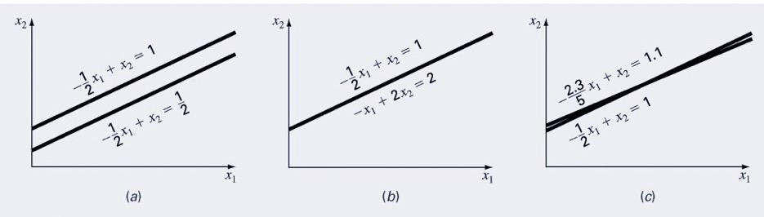
Problems
Which system(s) is singular? Which is ill-conditioned?

Slide 8
How to solve...
remember from last time...
going from equations to matrices
[A]*{X} = {B}
We can solve these in matlab using the following:
>>X = mldivide(A,B) or >> X = inv(A)%*%B

Slide 9
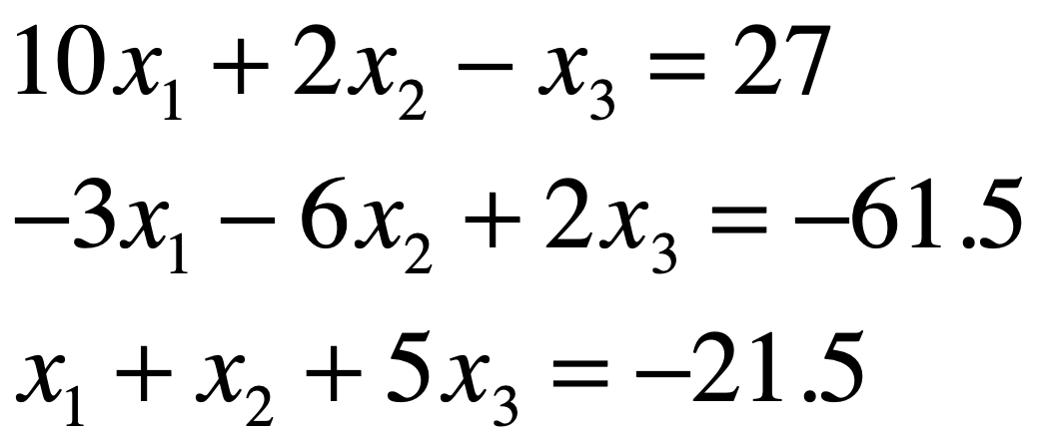
Example 2
1. Put into matrix notation.
2. Solve using R.

Slide 10

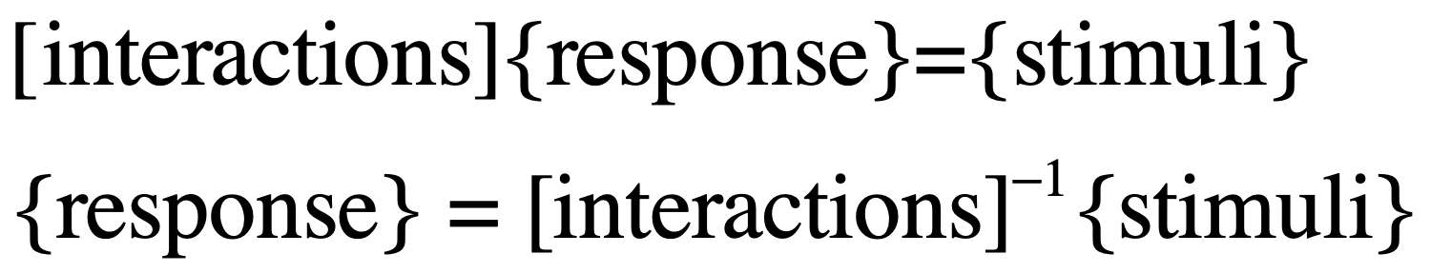
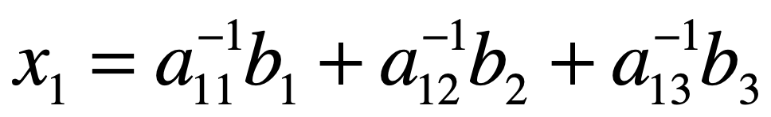
Stimulus - Response ➔ the why for matrix inverse
[A] {X} = {B}
How can this be used? Write out the resulting equations for a 3x3 matrix.

Slide 11
Each element represents response of a single part of system to unit stimulus from other part of system

Slide 12
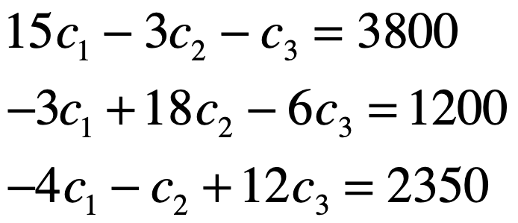
Example 3: Pr. 11.3
The following system of equations is designed to determine concentrations (g/m³) in a series of coupled reactors as a function of the amount of mass input (g/d) to each reactor:
Draw diagram.
Write matrices.
Determine inverse.
Use inverse to solve for concentrations.
What contribution does reactor 3 have on reactor 1’s concentration?
How much should rate of mass input to reactor 3 be increased to induce a 10gm⁻³ rise in concentration in reactor1?
How much will C₃ be reduced if loads to 1&2 are reduced by 500 and 250 g/day, respectively?

Slide 13

Draw diagram = keep notation consistent for incoming/outgoing from each individual mass balance.
1200
8
C1
3
C2
3800
3
14
1
4
1
6
C3
5
2350

Slide 14
Write matrices.
>> A = [15 -3 -1;-3 18 -6; -4 -1 12]
A =
15 -3 -1
-3 18 -6
-4 -1 12
>> b = [3800;1200;2350]
b =
3800
1200
2350

Slide 15
15 | -3 | -1
-3 | 18 | -6
-4 | -1 | 12
3800
1200
2350
A=
b=

Slide 16
Determine inverse.
>> invA = solve(A)
invA =
0.0725 0.0128 0.0124
0.0207 0.0608 0.0321
0.0259 0.0093 0.0902

Slide 17
Use inverse to solve for concentrations.
>> invA%*%b
ans =
320.2073
227.2021
321.5026

Slide 18
What contribution does reactor 3 have on reactor 1’s concentration?
invA =
0.0725 0.0128 0.0124
0.0207 0.0608 0.0321
0.0259 0.0093 0.0902
Impact of the mass input to reactor 3 on reactor 1 is given by a₁₃⁻¹ = 0.0124.
0.0124*2350

Slide 19
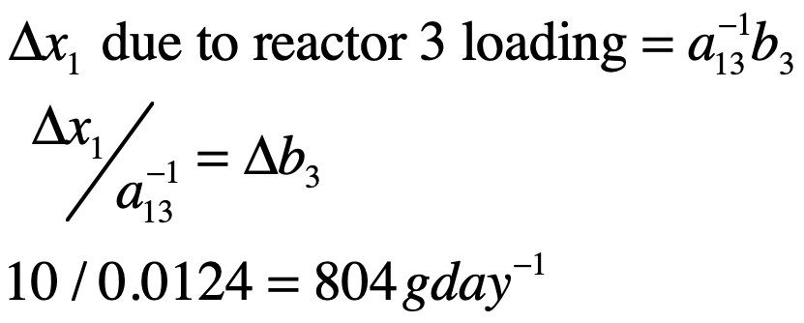
How much should rate of mass input to reactor 3 be increased to induce a 10gm⁻³ rise in concentration in reactor1?
invA =
0.0725 0.0128 0.0124
0.0207 0.0608 0.0321
0.0259 0.0093 0.0902
We know the following from matrix math:

Slide 20
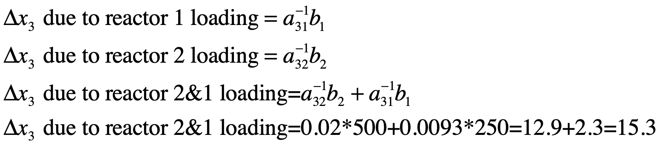
How much will C₃ be reduced if loads to 1&2 are reduced by 500 and 250 g/day, respectively?
invA =
0.0725 0.0128 0.0124
0.0207 0.0608 0.0321
0.0259 0.0093 0.0902
a₃₁⁻¹ = 0.0259
a₃₂⁻¹ = 0.0093

Slide 21
Error Analysis/System Condition
Scale A so largest element in each row is 1. Calculate A⁻¹. If elements of A⁻¹ >> 1, indicator of ill-condition.
Multiply A⁻¹by [A] --> is result close to [I]?
Invert A⁻¹ --> is result close to [A]?
Calculate matrix condition

Slide 22
Condition number
calculate norm = Provides a measure of the ‘size’ of matrix (||A||)
cond[A] = ||A|| * ||A⁻¹||
cond[A] >> 1, ill-conditioned

Slide 23
Matlab
norm(A,p)
Compute a norm of matrix A, where p can be 1, 2, inf, or ‘fro’ (for the Frobenius norm)
cond(X,p) or cond(A,p)
Calculate the condition number of vector X or matrix A using the norm specified by p.
For our purposes, set p = inf= row sum norm....

