Slide 1
CAPSTONE PROJECT · FINAL REVIEW
Do Brain-Inspired Mechanisms Help Continual Reinforcement Learning?
A controlled ablation study with spiking agents
Vaibhav Tiwari
Roll number: [to fill in]
Guide: [to fill in]
Department: [to fill in]
Institution: [to fill in]
Date: [to fill in]
NeuroPlast · final review
1 / 15
Notes:
Good morning. My project asks a simple question: when people add brain-inspired mechanisms to a reinforcement-learning agent, such as spiking neurons, local learning rules or a sleep phase, which of them actually help? I built one agent, switched each mechanism on and off against a matched control, and measured the effect. The short answer, which I will justify over the next fourteen slides, is: mostly no, with two specific exceptions. Every number in this talk comes from the frozen results and is the same number that appears in the paper.

Slide 2
THE PROBLEM
Learning a new task erases the old one
An agent learns tasks one after another: fetch the red ball, then the green key, then the blue box
Plain fine-tuning overwrites what earlier tasks needed: catastrophic forgetting
Standard fixes: penalise weight changes (EWC), replay stored experience, or one network per task
Brain-inspired fixes (spikes, local plasticity, sleep) are popular, but are usually added all at once
Return on task 1 as later tasks are learned
CNN agent, 3 tasks, mean of 3 seeds; replay (dashed) and sleep overlap near 1.0
NeuroPlast · final review
2 / 15
Notes:
Continual learning means the agent learns tasks in sequence. In my setting the agent sees a small room with three objects and must fetch a different object in each task. With plain fine-tuning, learning the second and third tasks destroys the first: on the right, the naive agent's return on task 1 drops from about 0.98 to 0.05. Replay and sleep keep it near 1. The standard remedies are regularisation like EWC, replaying stored experience, or giving each task its own network. Brain-inspired remedies are popular, but papers usually add several at once, so it is hard to say which one did the work. That is the gap this project addresses.

Slide 3
RESEARCH QUESTION
Which brain-inspired mechanisms actually help?
Switch each mechanism on alone and compare it with a control that is not brain-inspired but matches its resources.
Spiking encoder
STDP (local plasticity)
Homeostasis
DFA: learning without backprop
vs same-shape CNN, matched operations
vs a random update of the same size
vs the same agent without it
vs ordinary backpropagation
Sleep-like consolidation
One shared network
Transformer working memory
vs replay with an exactly matched replay budget
vs one network per task, at equal total memory
vs no memory, and a stack of recent frames
Negative results count: the aim is to find out which mechanisms contribute, not to make all of them win.
NeuroPlast · final review
3 / 15
Notes:
The research question is: which of these mechanisms actually helps, when each one is isolated? Each card shows a mechanism and the control it is compared against. The controls are chosen to remove the most obvious alternative explanation. For example, if STDP helps, is it because STDP is useful, or because any extra update of that size helps? So STDP is compared with a random update of exactly the same size. If sleep helps, is it because of sleep, or because it replays more old data? So sleep is compared with replay at the same number of replayed samples. The project was set up so that negative results are results, not failures.

Slide 4
WHERE THIS SITS
Related work
Continual RL
Sleep and consolidation
EWC: protect important weights (Kirkpatrick et al., 2017)
CLEAR: replay + behavioural cloning, a very strong baseline (Rolnick et al., 2019)
PackNet: isolate parameters per task (Mallya & Lazebnik, 2018)
Sleep-like unsupervised replay recovers forgotten tasks in classifiers (Tadros et al., 2022)
Ours: offline replay + distillation in RL, compared with CLEAR-style replay
Spiking networks for RL
Local learning rules
Surrogate gradients make SNNs trainable (Neftci et al., 2019)
The surrogate slope matters more in RL (Van den Berghe et al., 2025)
Spiking decision transformers (Pandey & Biswas, 2025)
Three-factor, reward-modulated STDP (Frémaux & Gerstner, 2016)
Direct feedback alignment: no weight transport (Nøkland, 2016)
Homeostatic plasticity (Turrigiano & Nelson, 2004)
Gap: these mechanisms are usually tested together, against an unmodified baseline, so it is unclear which one did the work.
NeuroPlast · final review
4 / 15
Notes:
Four strands of work. In continual RL, the standard baselines are EWC, replay, and parameter isolation; the CLEAR paper showed that replay with behavioural cloning is extremely strong, which is why it is my main comparator for sleep. Tadros and colleagues showed a sleep-like phase can recover forgotten tasks in classifiers; my sleep phase is inspired by that but is replay plus distillation in RL. On the spiking side, surrogate gradients make SNNs trainable, and recent work shows RL is sensitive to how they are set. Local rules like three-factor STDP, DFA and homeostasis are proposed as brain-like alternatives to backprop. The gap: they are usually tested together.

Slide 5
WHAT I BUILT
System architecture
Environment
Spiking encoder
Transformer memory
Actor-critic heads
MiniGrid, 7×7 view of the room
task ID given each episode
reward for the right object
3 conv layers of LIF neurons
4 spike steps per frame
control: same-shape CNN
1 layer, 4 attention heads
attends over the last 4 frames
SNN+Transformer agent only
policy + value head per task
task embedding on features
trained with PPO
action
Continual training of the sleep variant: wake and sleep phases alternate on the same shared network
Wake: online learning
Sleep: offline consolidation
PPO on the current task, acting in the environment
states stored in the buffer at the end of each task
Replay buffer
5,000 states / task
every 25 updates and at each task end: 700 gradient steps, no environment
distil old tasks' policies + rehearse the current task
NeuroPlast · final review
5 / 15
Notes:
This is the agent. The environment gives a 7 by 7 view of the room and the task ID. The encoder is a spiking network: three convolutional layers of leaky integrate-and-fire neurons, simulated for 4 time steps per frame; the control is an ordinary CNN with the same shape. Optionally a small Transformer attends over the last 4 frames. Actor-critic heads, one per task, are trained with PPO. For continual learning, the sleep variant alternates two phases: in the wake phase the agent learns the current task online; at the end of each task it stores 5,000 states in a replay buffer. Every 25 updates it sleeps: 700 offline gradient steps that distil its old policies from the buffer, with no environment interaction. Every part can be swapped independently, which is what makes the ablations possible.

Slide 6
HOW IT WAS TESTED
Experimental setup and fairness controls
Setup
Fairness controls
MiniGrid: fetch3 / fetch5 sequences (task ID given), DoorKey-6x6, Memory S7/S11/S13
PPO, small agents (159,864–327,800 parameters)
Metrics: final accuracy (ACC), forgetting, learning speed (AUC), solve rate
Same frames, seeds and learning rate in every arm of a comparison
STDP vs a random update of exactly the same size
Sleep vs replay with the number of replayed samples matched exactly
Memory counted as parameters plus replay buffer, not parameters alone
Pre-registered tests; Welch / Fisher; Holm correction; 95% CIs
3–10
289
110
seeds per arm
PPO runs
single-thread CPU hours, no GPU
NeuroPlast · final review
6 / 15
Notes:
The experiments use MiniGrid. The continual sequences are fetch3 and fetch5, where the agent is told which task it is doing. DoorKey is used for the plasticity questions, and the Memory maps for the Transformer question. All agents are small and train with PPO on a CPU; in total the frozen results are 289 runs and about 110 CPU hours. The right-hand side is the part I want to stress. Each comparison keeps everything else equal, and in two places I matched a resource that is usually ignored: the number of replayed samples, and total memory including the replay buffer. The final tests were written down before the runs, with Holm correction where several tests share a family.

Slide 7
MECHANISM SCORECARD
Results at a glance: mostly no, with two exceptions
MECHANISM
VERDICT
KEY NUMBER (95% CI)
Spiking encoder
⇄ Fewer operations, not more accuracy
works at 16.6k ops/frame where the CNN needs 33k; 5.2× CPU cost
Local learning rule (STDP)
○ No effect
vs random update: ΔAUC +0.033 [−0.260, +0.326], p = 0.818
Homeostasis, without backprop
◐ Faster learning, not more reliable
ΔAUC +0.326 [+0.101, +0.551], Holm p = 0.017; solved 7/10 vs 2/10 (n.s.)
Homeostasis, with backprop
○ Not significant after correction
ΔAUC +0.200 [+0.024, +0.377]; Holm p = 0.117
Sleep-like consolidation
○ Ties replay
sleep − replay ΔACC +0.017 [−0.026, +0.060], p = 0.415
One shared network
◐ Only with small replay buffers
200 states/task: similar mean ACC (0.838 vs 0.833; 3 seeds, wide CI) in 0.89 vs 1.92 MB
Transformer working memory
? Untested: no usable benchmark
no benchmark both required memory and was learnable in budget
NeuroPlast · final review
7 / 15
Notes:
This is the whole result on one slide. Three mechanisms had no effect beyond their control: STDP, which was indistinguishable from a random update of the same size; homeostasis with ordinary backprop, which looked positive but did not survive the multiple-comparison correction; and sleep, which removes forgetting but ties replay once the replay budget is matched. The spiking encoder is a trade-off: it works at fewer operations, but costs more CPU time to train and the energy savings are only an estimate. The two exceptions are homeostasis when the network is trained without backprop, and one shared network with a small replay buffer, which reaches a similar mean accuracy in less than half the memory, with only three seeds and a wide interval. The Transformer question could not be tested. The next slides go through each row.

Slide 8
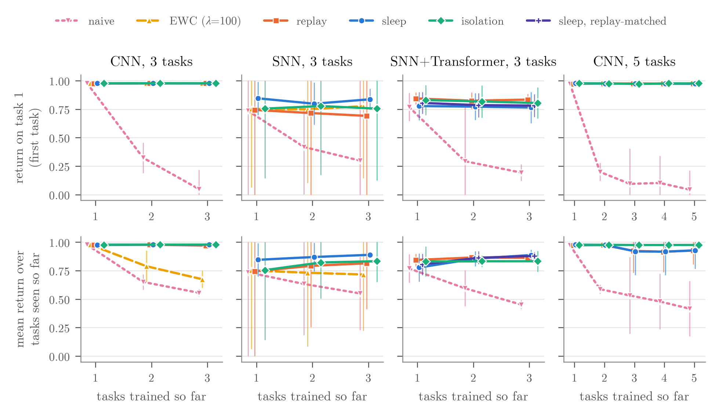
FORGETTING
Sleep and replay stop forgetting; sleep does not beat replay
0.555
naive fine-tuning, final ACC (CNN, 3 tasks)
0.970 · 0.978
replay · sleep, final ACC
+0.017
sleep − replay at an exactly matched replay budget, 95% CI [−0.026, +0.060], p = 0.415
NeuroPlast · final review
8 / 15
Notes:
The top row is the return on the first task as later tasks are learned; the bottom row is the average over tasks seen so far. Naive fine-tuning, in pink, forgets: its final accuracy on the 3-task CNN sequence is 0.555. Replay and sleep both remove almost all of that forgetting, reaching 0.970 and 0.978. On the SNN plus Transformer agent sleep originally looked slightly better than replay, but it was replaying 28 percent more data. In the pre-registered test with the replayed samples matched exactly, the difference is +0.017 [−0.026, +0.060], p = 0.415, with 8 seeds per arm. So in my implementation sleep is a way of scheduling replay, and at equal replay it is not better.

Slide 9
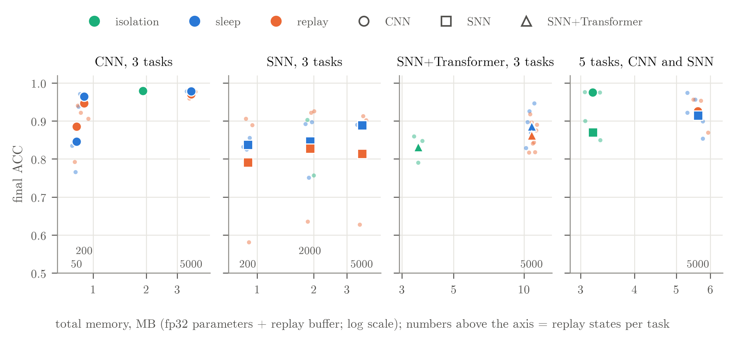
MEMORY TRADE-OFF
A shared network is competitive only with a small buffer
46%
of the memory: SNN sleep, 200 states/task, similar mean ACC to isolation (0.838 vs 0.833; 3 seeds, wide CI)
2.5–3.3×
more accuracy per parameter for the shared network
1.8–2.9×
more accuracy per MB for isolation at the default 5,000 states/task
Total memory = fp32 parameters + replay buffer. Numbers above the axis: replay states stored per task.
NeuroPlast · final review
9 / 15
Notes:
Isolation, one network per task, never forgets by construction, so the fair question is memory. Per parameter, the shared network looks 2.5–3.3 times more efficient, which is the usual way this is reported. But the shared network needs a replay buffer, and at the default 5,000 states per task the buffer outweighs the extra networks: isolation gets 1.8–2.9 times more accuracy per megabyte. The exception is a small buffer: on the SNN, sleep with 200 states per task reaches a similar mean accuracy to isolation, 0.838 against 0.833, in 0.89 instead of 1.92 megabytes, about 46 percent of the memory. But this is 3 seeds per arm, and the 95 percent interval for the difference runs from −0.167 to +0.177, so it is a similar mean, not evidence of equal accuracy.

Slide 10
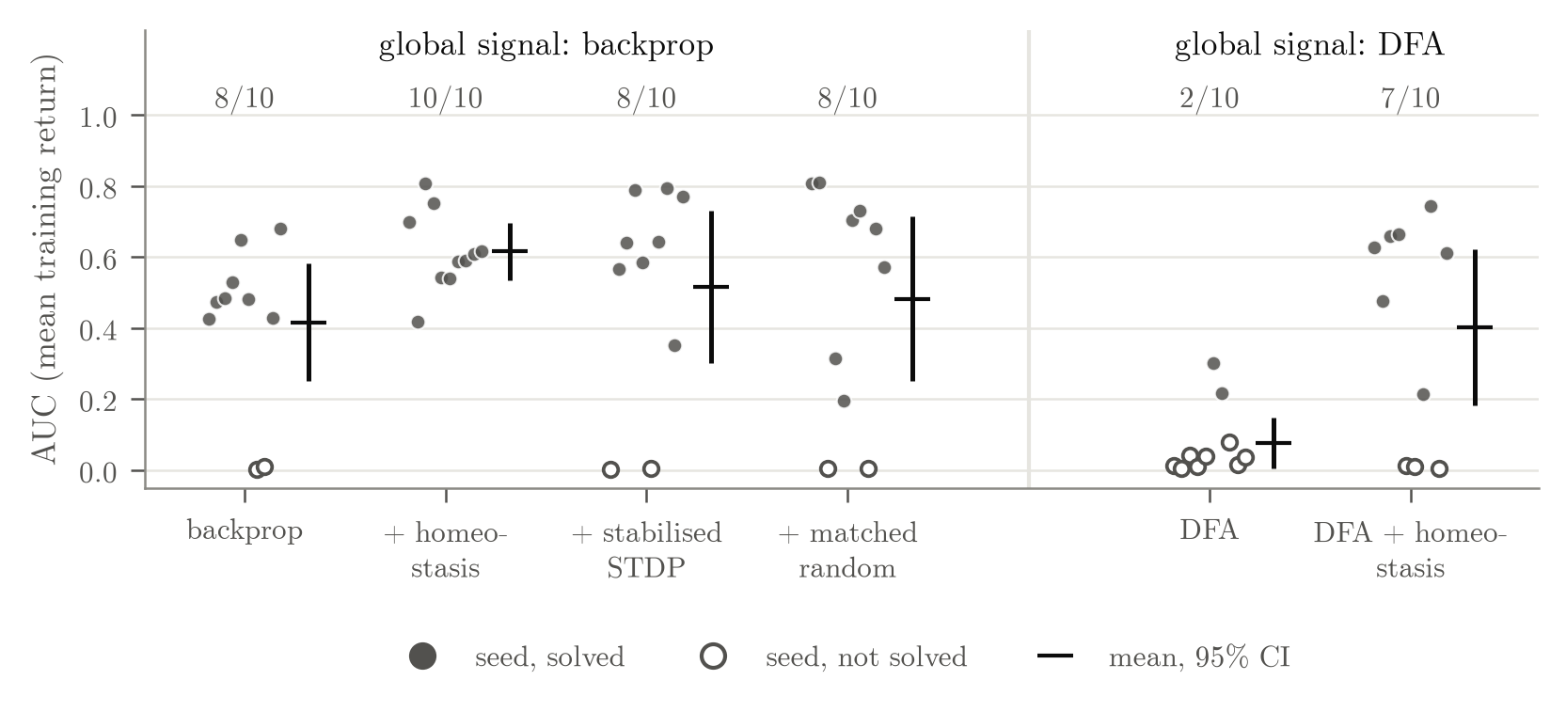
LOCAL PLASTICITY
STDP adds nothing; homeostasis speeds up DFA
STDP ≈ random update: ΔAUC +0.033 [−0.260, +0.326], p = 0.818
Unstabilised STDP hurts: solved 0/3 vs 3/3 with backprop (runaway firing)
Homeostasis + backprop: raw p = 0.029, Holm p = 0.117: not significant
Homeostasis + DFA: ΔAUC +0.326 [+0.101, +0.551], Holm p = 0.017; solved 7/10 vs 2/10 (Holm p = 0.070)
DoorKey-6x6, 10 seeds per arm, pre-registered. Dots: seeds (filled = solved); bars: mean and 95% CI; numbers: seeds solved.
NeuroPlast · final review
10 / 15
Notes:
This is DoorKey, a task where the encoder's learning matters. On the left, backprop is the learning signal. Adding stabilised, reward-modulated STDP does not beat a random update of the same size: the AUC difference is +0.033 [−0.260, +0.326], p = 0.818. Without stabilisation, STDP makes things worse through runaway firing. Homeostasis with backprop looked positive, raw p = 0.029, but not after Holm correction. On the right the encoder learns with direct feedback alignment instead of backprop. Here homeostasis clearly speeds up learning: AUC difference +0.326 [+0.101, +0.551], Holm p = 0.017. It solved 7/10 runs against 2/10, but that difference is not significant, so it makes DFA faster, not reliable. This is the first of the two exceptions.

Slide 11
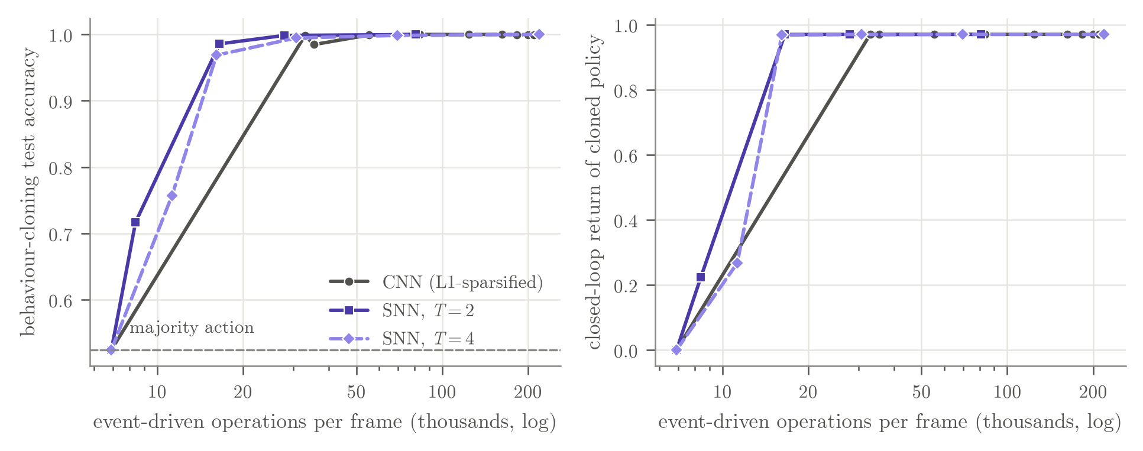
EFFICIENCY
Spiking encoder: fewer operations, not more accuracy
16.6k
ops/frame: the SNN still works (accuracy 0.986)
33k
ops/frame: below this the sparsified CNN stops working
5.2×
Behaviour cloning of a DoorKey-6x6 teacher, activity penalty swept; 2 seeds per point. Operations = synaptic events (SNN) or non-zero multiply-accumulates (sparsified CNN).
CPU time per training step (80 vs 16 ms); energy savings are only an estimate
NeuroPlast · final review
11 / 15
Notes:
To compare encoders without RL noise, both were trained to copy a DoorKey teacher, with a penalty that trades operations for accuracy. Where both work, they are equally accurate. The difference is at the low end: the sparsified CNN collapses below about 33k operations per frame, while the SNN still works at 16.6k, with accuracy 0.986. So the SNN reaches a lower-operation regime, not higher accuracy. Two caveats: on the CPU I actually used, the SNN is 5.2 times slower to train, because it simulates several time steps; and the energy numbers are estimates that assume neuromorphic hardware, which I did not measure.

Slide 12
HONEST ACCOUNTING
What didn't survive controls, and why
EARLIER FINDING
EVIDENCE THEN
AFTER THE CONTROL
CAUSE
Sleep beats replay (SNN+Transformer)
p = 0.072 with 3 seeds
tie at a matched replay budget: p = 0.415, 8 seeds
seeds; replay budget
Shared weights far more efficient
2.5–3.3× per parameter
isolation 1.8–2.9× better per MB
memory accounting
Sleep far beats isolation, 5 tasks (SNN)
gap +0.303 [+0.148, +0.457]
gap +0.044 [−0.009, +0.098] at a fair budget
training budget
Homeostasis helps backprop
p = 0.088 (3 vs 5 seeds)
Holm p = 0.117 with 10 seeds
seeds; multiple tests
Homeostasis makes DFA work
solved 3/3 vs 1/5
7/10 vs 2/10, p = 0.070 (AUC effect survives)
seeds
Transformer helps on a memory task
S7 pilot 0.970 vs 0.465
no memory needed on S7 (memoryless CNN 0.915)
benchmark validity
Effects shrank or disappeared once seeds, training budgets, replay budgets and memory accounting were made fair; the homeostasis-DFA speed-up survived.
NeuroPlast · final review
12 / 15
Notes:
This slide is, I think, the most useful part of the project. Six findings looked positive early on, and each shrank or disappeared once the right control was in place. Sleep beating replay came from three seeds and from sleep replaying more data. Shared weights looked far more efficient only because the replay buffer was not counted as memory. Sleep beating isolation on five tasks came from a training budget too small for fresh networks. The two homeostasis results came from small seed counts, and the Transformer result came from a benchmark that did not need memory at all. The common pattern: the effects shrank or disappeared once the seed counts, training budgets, replay budgets and memory accounting were made fair. The one that survived is the speed-up homeostasis gives DFA, in its area-under-the-curve, not its solve rate.

Slide 13
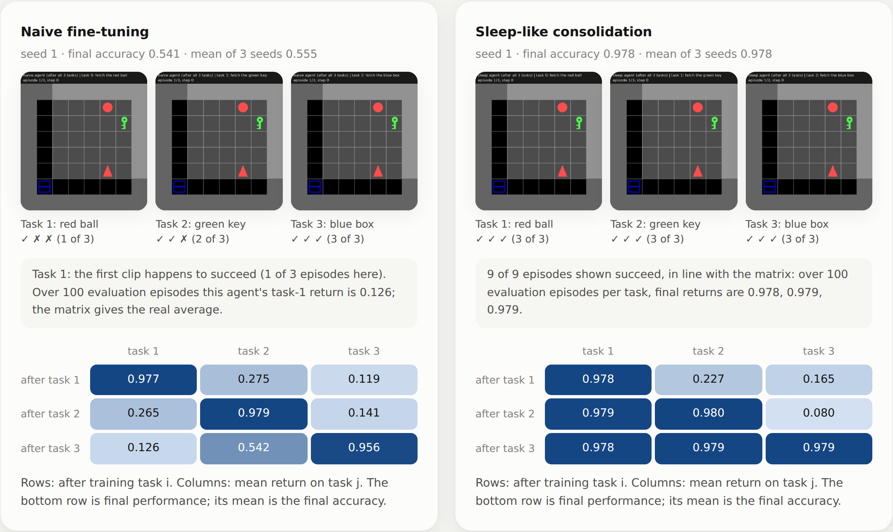
SEE IT YOURSELF
Live demo
1. Results dashboard
open demo/index.html (one file, works offline)
scorecard, agents, forgetting and memory charts
2. Run an agent on CPU
python demo/live_episode.py
--agent naive --task 0 --window
then the same with --agent sleep
prints each step and the real accuracy matrix
NeuroPlast · final review
13 / 15
Notes:
For the demo I will switch to the dashboard, which is a single offline HTML file built from the same frozen results. It shows the two CNN agents after learning all three tasks, in the same rooms, chosen before seeing the outcomes. The naive agent's first task-1 episode happens to succeed, but its average task-1 return over 100 evaluation episodes is only 0.126, while the sleep agent stays at 0.978. If time allows I will also run one live episode on the CPU with live_episode.py, first the naive agent, then the sleep agent, on task 0.

Slide 14
WHAT THIS DOES NOT SHOW
Limitations and future work
Limitations
Future work
Task ID is given (task-incremental), so this says nothing about task-agnostic learning
Small scale: MiniGrid, ≤327,800 parameters, 3–5 tasks
Few seeds: many continual arms have 3, so CIs are wide
Energy is an estimate from operation counts; no hardware was measured
Transformer memory untested: no benchmark both required memory and was learnable in budget
A memory benchmark agents can learn (the cue seen on the way to the choice)
Compressed replay (idea, untested): the buffer size decides the shared-vs-isolation trade-off, so shrink it: quantised targets, fewer but better-chosen states, or generative replay
Homeostasis target sweep: is the DFA effect robust?
More seeds for the operation-count frontier
NeuroPlast · final review
14 / 15
Notes:
The limitations are real. The agent is told which task it is doing, the scale is small, many continual arms have only 3 seeds, the energy numbers are estimates, and the Transformer question is untested because no benchmark we tried both required memory and was learnable within budget. For future work, the most direct next step is a memory benchmark that agents can actually learn. The idea I find most promising is compressed replay: since the size of the replay buffer is what decides whether a shared network beats one network per task, making the buffer cheaper moves that trade-off directly, for example by storing quantised targets, fewer but better-chosen states, or a small generative model. This is an idea, not a result.

Slide 15
CONCLUSION
Mostly no, with two specific exceptions.
1
No mechanism beat its matched control
on final accuracy or forgetting: STDP ≈ random update, sleep ≈ replay
2
Two exceptions
homeostasis speeds up learning without backprop; with a small replay buffer a shared network reaches similar mean accuracy in less than half the memory (3 seeds, wide CI)
3
The lesson is methodological
effects shrank or disappeared once seeds, training budgets, replay budgets and memory accounting were made fair; the homeostasis-DFA speed-up survived
Thank you. Questions?
NeuroPlast · final review
15 / 15
Notes:
To conclude. None of the brain-inspired mechanisms beat its matched control on accuracy or forgetting. There are two specific exceptions: homeostasis speeds up learning when the network is trained without backprop, and with a small replay buffer a shared network reaches a similar mean accuracy to one network per task in less than half the memory, although with three seeds that interval is wide. The broader lesson is methodological: in this project, effects shrank or disappeared once seed counts, training budgets, replay budgets and memory accounting were made fair; the speed-up homeostasis gives DFA is the one that survived. My suggestion for this field is to report and match those budgets. Thank you; I'm happy to take questions. There are backup slides with the full tables and references.

Slide 16
BACKUP
Backup: final accuracy and forgetting by method
 | CNN, 3 tasks | SNN, 3 tasks | SNN+Transformer, 3 tasks | CNN, 5 tasks
Final ACC (mean ± SD)
naive | 0.555 ± 0.013 | 0.550 ± 0.130 | 0.452 ± 0.016 | 0.416 ± 0.098
EWC (λ=100) | 0.674 ± 0.030 | 0.716 ± 0.199 | – | –
replay | 0.970 ± 0.009 | 0.814 ± 0.162 | 0.862 ± 0.038 | 0.926 ± 0.049
sleep | 0.978 ± 0.001 | 0.889 ± 0.003 | 0.887 ± 0.045 | 0.928 ± 0.065
sleep, matched | – | – | 0.879 ± 0.043 | –
isolation | 0.979 ± 0.001 | 0.833 ± 0.073 | 0.832 ± 0.037 | 0.976 ± 0.000
FORGET (mean)
naive | 0.631 | 0.321 | 0.536 | 0.612
replay | 0.002 | 0.023 | 0.019 | 0.006
sleep | 0.001 | 0.006 | 0.006 | 0.003
sleep, matched | – | – | 0.020 | –
Seeds: 3 per arm, except SNN+Transformer (replay 8, sleep 6, sleep matched 8). Paper Table 3.
NeuroPlast · final review
B1 / 15
Notes:
Backup: the full continual results table from the paper, final accuracy with standard deviation over seeds, and forgetting. Sleep, matched is the pre-registered budget-matched arm, run only on the SNN plus Transformer agent, where the replay budgets differed.

Slide 17
BACKUP
Backup: pre-registered local-plasticity contrasts
Contrast | Δ solve rate [95% CI] | Fisher p (Holm) | Δ AUC [95% CI] | Welch p (Holm)
STDP vs homeostasis alone | −0.20 [−0.51, +0.11] | 0.474 (1.000) | −0.101 [−0.323, +0.121] | 0.338 (0.724)
STDP vs matched random | +0.00 [−0.34, +0.34] | 1.000 (1.000) | +0.033 [−0.260, +0.326] | 0.818 (0.818)
homeostasis vs backprop | +0.20 [−0.11, +0.51] | 0.474 (1.000) | +0.200 [+0.024, +0.377] | 0.029 (0.117)
random vs homeostasis | −0.20 [−0.51, +0.11] | 0.474 (1.000) | −0.134 [−0.372, +0.104] | 0.241 (0.724)
DFA + homeostasis vs DFA | +0.50 [+0.07, +0.74] | 0.070 (0.070) | +0.326 [+0.101, +0.551] | 0.009 (0.017)
DoorKey-6x6, 10 seeds per arm. First four rows: one Holm family per statistic (backprop as the global signal). Last row: the DFA family (pre-registered separately). Newcombe CIs for solve rates, Welch for AUC.
NeuroPlast · final review
B2 / 15
Notes:
Backup: the exact pre-registered contrasts. The only effect that survives correction is the AUC effect of homeostasis under DFA, in the last row.

Slide 18
BACKUP
Backup: protocol constants
PPO
16 envs × 128 steps, 4 epochs, minibatch 256, clip 0.2, γ = 0.99, GAE λ = 0.95, KL stop 0.03
Learning rate
0.001 (CNN, SNN); 0.0003 (SNN+Transformer)
Frames per task
150k (CNN, SNN); 400k (SNN+Transformer); 450k (5-task SNN, fair budget)
SNN
4 time steps, learnable leak (init 0.9), surrogate slope 25, membrane reset each frame
Plasticity
α = 0.03; homeostasis target 0.15, rate 0.01
Sleep
every 25 updates + task end; 700 steps per phase; 5,000 states per task
Evaluation
100 episodes per task (continual); 200 (single task)
Memory accounting
188 B/state (CNN, SNN); 632 B/state (SNN+Transformer)
NeuroPlast · final review
B3 / 15
Notes:
Backup: the protocol constants, read from the stored run configurations (paper appendix A).

Slide 19
BACKUP
Backup: references
Bi & Poo (1998). Synaptic modifications in cultured hippocampal neurons. J. Neurosci.
Chaudhry et al. (2018). Riemannian walk for incremental learning. ECCV.
Chevalier-Boisvert et al. (2023). Minigrid & Miniworld. NeurIPS Datasets and Benchmarks.
Frémaux & Gerstner (2016). Neuromodulated STDP and three-factor learning rules. Front. Neural Circuits.
Holm (1979). A simple sequentially rejective multiple test procedure. Scand. J. Statistics.
Khetarpal et al. (2022). Towards continual reinforcement learning: a review. JAIR.
Kirkpatrick et al. (2017). Overcoming catastrophic forgetting in neural networks. PNAS.
Mallya & Lazebnik (2018). PackNet. CVPR.
Neftci, Mostafa & Zenke (2019). Surrogate gradient learning in SNNs. IEEE Signal Proc. Mag.
Nøkland (2016). Direct feedback alignment. NeurIPS.
Pandey & Biswas (2025). Spiking decision transformers. arXiv:2508.21505.
Rolnick et al. (2019). Experience replay for continual learning (CLEAR). NeurIPS.
Schulman et al. (2017). Proximal policy optimization algorithms. arXiv:1707.06347.
Tadros et al. (2022). Sleep-like unsupervised replay reduces catastrophic forgetting. Nat. Commun.
Turrigiano & Nelson (2004). Homeostatic plasticity in the developing nervous system. Nat. Rev. Neurosci.
Van den Berghe et al. (2025). Adaptive surrogate gradients for sequential RL in SNNs. NeurIPS.
Wołczyk et al. (2021). Continual World. NeurIPS.
NeuroPlast · final review
B4 / 15
Notes:
Backup: the main references. The full list, with the verification status of each entry, is in paper/refs.bib.

