Slide 1

Plant Disease Prediction System
Garvit Khurana
Tanya Malhotra
Vanshaj Goel
Mentor – Dr. Ravi Tomar

Slide 2
INDEX
S. No. | Title | Slide Number
1 | Problem Statement | 3
2 | Introduction | 4..5
3 | Motivation | 6
4 | SWOT Analysis | 7
5 | Literature Review | 8
6 | Objective | 9
7 | Working Model | 10..14
8 | Methodology & Deliverables | 15-20
9 | References | 21
10 | Team Details | 22

Slide 3
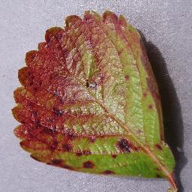
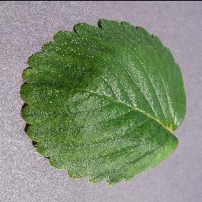
PROBLEM STATEMENT
Development of a plant disease identification system to constantly monitor the health of plants/crops, thus, minimizing misdiagnosis and manual workload.
Fig. 1: Diseased strawberry leaf
Fig. 2: Healthy strawberry leaf

Slide 4
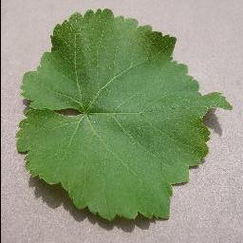
INTRODUCTION
Agriculture, with its associated sectors, is the chief source of livelihood in India.
According to FAO, UN, 70 percent of India’s rural households still depend primarily on agriculture for their living, with 82 percent of farmers being marginal^{[1]} .
Identifying plant diseases is an ongoing challenge for Indian growers of crops like apple, potato, corn, pepper, etc.
Misdiagnosing a crop disease can lead to loss of money and severe harm to the consumers of the crop.
Fig. 3: Healthy grape leaf

Slide 5
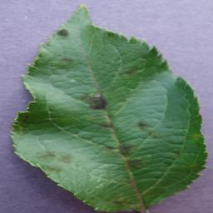
INTRODUCTION
Manually identifying plant diseases is not only hectic but also has high chances of being inaccurate.
Variation in symptoms due to the age of infected tissues, genetic variations, and light conditions decreases the accuracy of detection.
Neural Network models that would be used for the identification of the plants are –
a. Convolutional Neural Network (CNN)
b. Residual Network (ResNet)
c. UNet
Fig. 4: Scabbed apple leaf

Slide 6
MOTIVATION
In the agricultural sector, misdiagnosis of diseases impacting agricultural crops can lead to misuse of chemicals leading to increased input costs with significant economic loss and harmful impact on the environment.
Existing disease diagnosis based on human scouting is time-consuming and expensive.
During the time when Machine Learning and Deep Learning are so popular, it is necessary to understand that all this knowledge can be used in different areas to impact humanity in a useful manner.
Thus, the main motivation to pursue this project is to help people and farmers in observing the health of their plants easily.

Slide 7
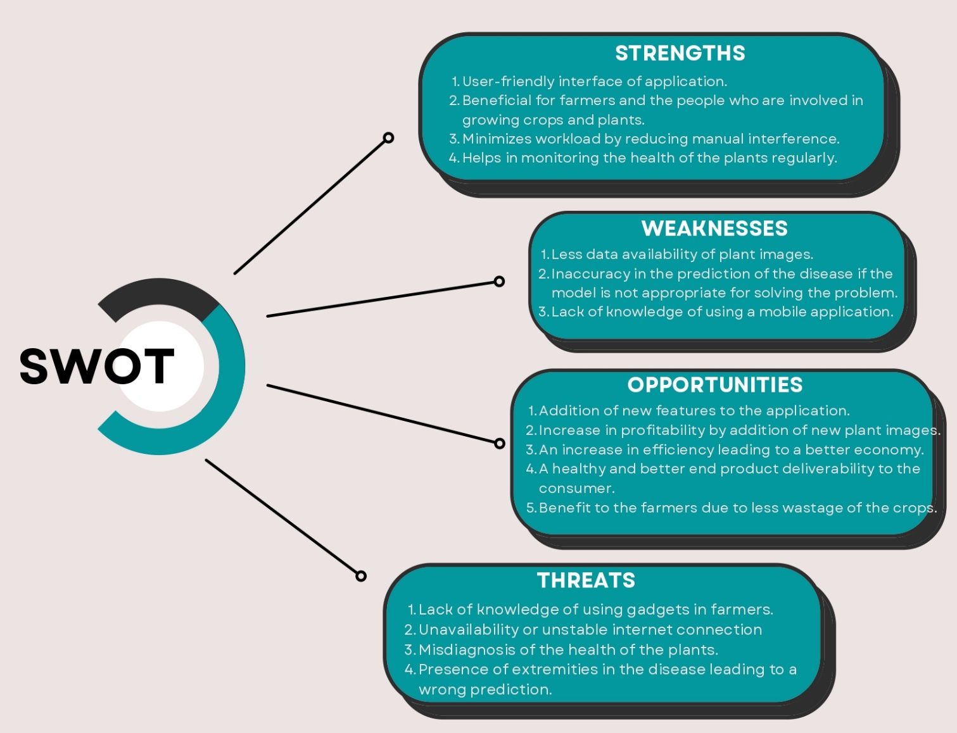
SWOT
ANALYSIS
Fig. 5: SWOT Analysis

Slide 8
LITERATURE REVIEW
S.No. | Existing Researches | Working Phenomenon | Gist
1. | Using Deep Learning for Image-Based Plant Disease Detection^{[2]} | CNN (AlexNet & GoogLeNet) | To demonstrate the technical feasibility using a deep learning approach utilizing 54,306 images of 14 crop species with 26 diseases (or healthy) made openly available through the project PlantVillage
2. | Forecasting Plant and Crop Disease: An Explorative Study on Current Algorithms^{[3]} | Forecasting based on weather & plant image data | To examine the specific approaches and methods adopted, pre-processing techniques and data used, performance metrics, and expected results, highlighting the issues encountered
3. | ResTS: Residual Deep interpretable architecture for plant disease detection^{[4]} | Model Training on ResTS Architecture | ResTS is trained to classify images into these 38 categories and to visualize signs of a specific disease
4. | IoT Based Smart Agriculture and Plant Disease Prediction^{[5]} | Remote Monitoring of sprinklers & sensors in field | An integrated application to control IoT system and Plant disease identification using Deep Neural Network model.
5. | Real-Time Detection of Apple Leaf Diseases Based on INAR-SSD^{[6]} | GoogLeNet Architecture | A novel real-time detection model that is based on the single-shot multi box detector (SSD) for apple leaf diseases is proposed
6. | Identification of Plant-Leaf Diseases^{[7]} | Mixture Model (CNN & kNN) | The implemented deep-learning model has better predictive ability in terms of both accuracy and loss
Table – 1 – Literature Review

Slide 9
OBJECTIVE
The project’s main objective is to benefit the plant/crop growers or farmers who manually identify the health of the crops.
The constant monitoring of the health of plants will help people like us in keeping a daily check on their kitchen gardens.
The user friendly application would not only ease the work, but also make the process interactive in nature.

Slide 10

WORKING MODEL
Requirement Analysis
Development Requirements
Programming Language: Python, JAVA
Solving Technique: Convolutional Neural Networks
Frameworks: Tensorflow, FastAPI
IDE: Jupyter Notebook, VS Code, Android Studio
Dataset: Merged from various sources on Kaggle & uploaded here
Performance Requirements
RAM : 2 GB
Operation System : Android 5.1 and above
Active Internet Connection
Link to SRS - https://tinyurl.com/2p8u6z65

Slide 11
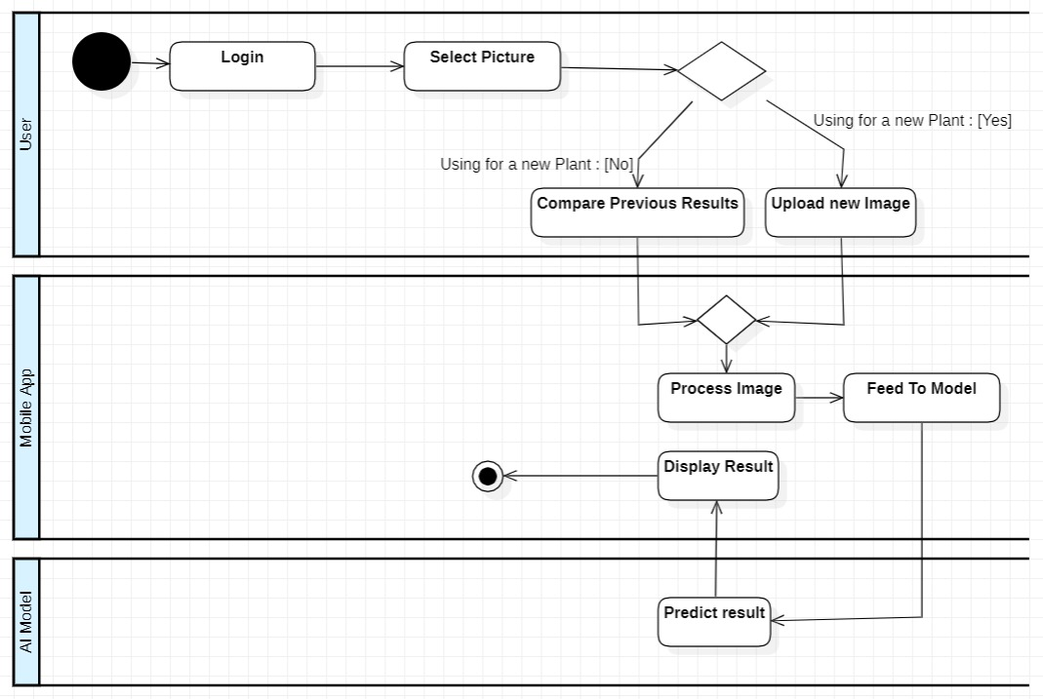
WORKING MODEL
Design
Diagram
Fig. 6: Swimlane Diagram

Slide 12
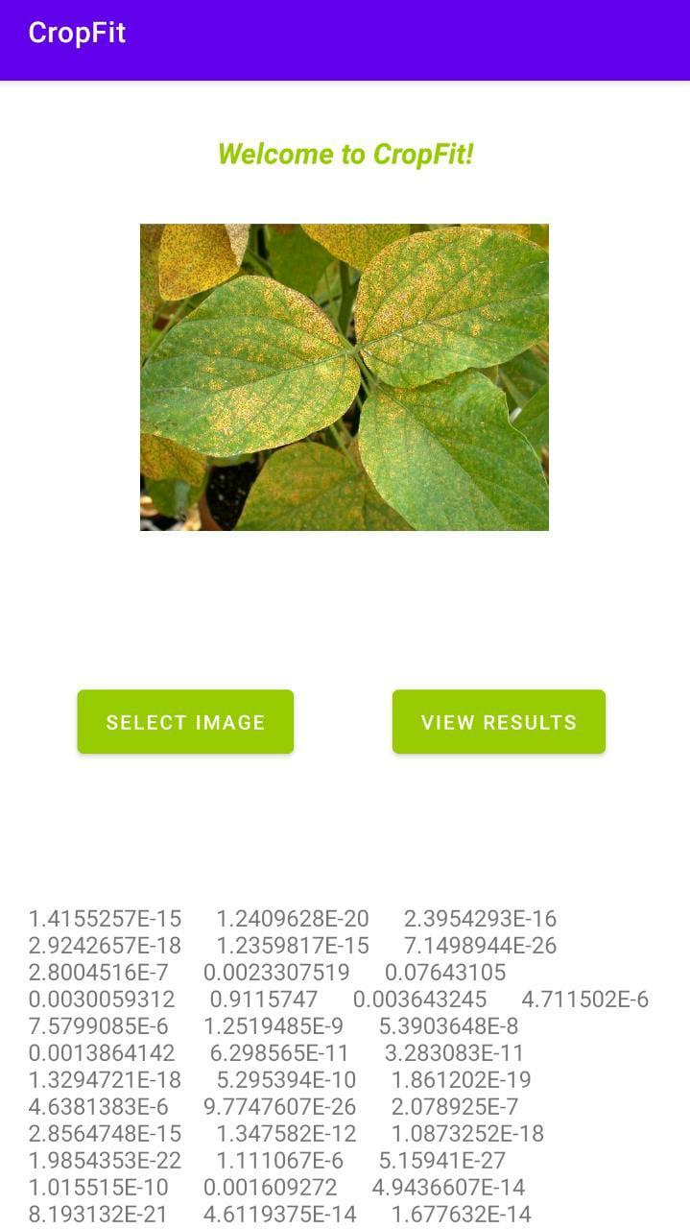

WORKING MODEL
Working Module
An android mobile application is currently under development.
The partial version of the application can make prediction by uploading the image from the device gallery.
Fig. 7: Mobile App Icon
Fig. 8: Partial Mobile Application

Slide 13
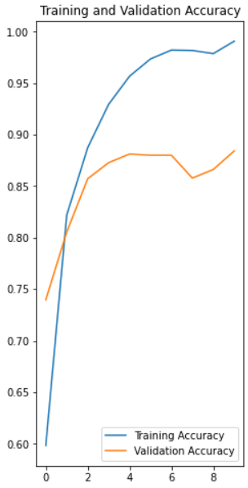
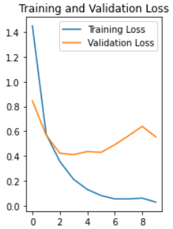
WORKING MODEL
Working Module
A basic CNN with three hidden layers is developed.
The training accuracy of CNN is 99 %
The validation accuracy of CNN is 88.4 %
Link To Notebook for this model
Fig. 9: Accuracy & Loss Graphs

Slide 14
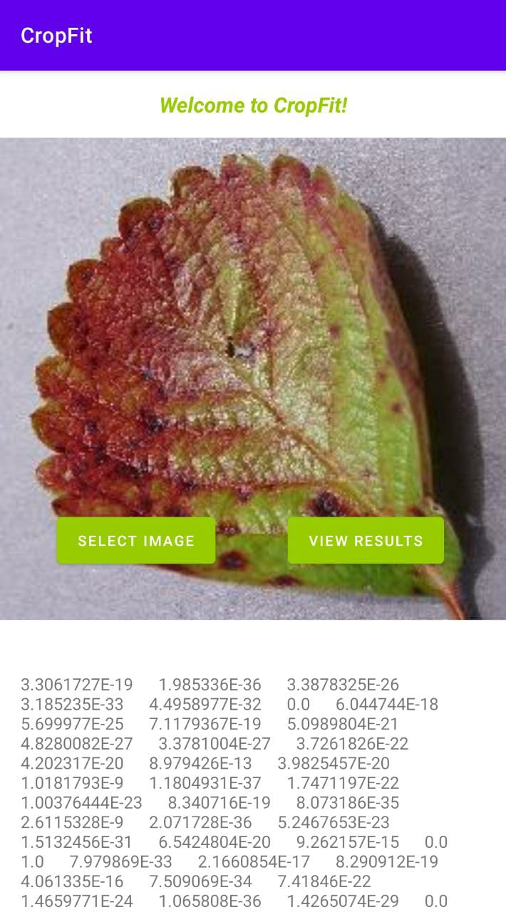
WORKING MODEL
Attained Deliverables
A comparative study between different architectures of neural networks.
An android application from which user can capture the image of infected plant and see the disease.
If a picture of the plant is found to have some disease, the application will send a notification to the user after a few days for capturing the photo of the plant again.
So, the application will monitor if the intensity of disease is decreasing or not.
Link To Implementation: GitHub Repo
Fig. 10: Partial Mobile Application

Slide 15
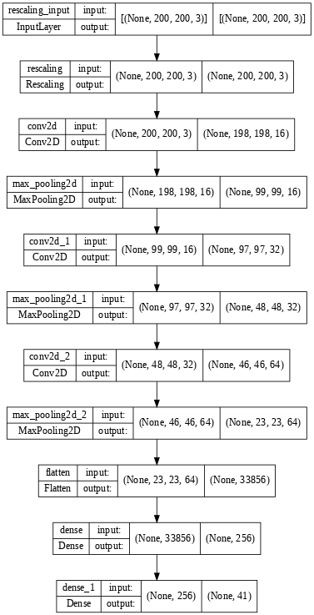
METHODOLOGY
Reference Software Model – CNN
Convolution Neural Network (CNN) – A neural network used for image classification tasks.
It is an advanced technique, requiring high computation powers.
A convolution is a linear operation, but images are non-linear, so we need to add non-linearity to them by using activation functions.
A CNN consists of –
Convolution Layer
Pooling Layer
Padding Layer
Fully Connected Layer
The architecture of the currently working model is shown in the figure.
Link To Implementation: GitHub Repo
Fig 11: CNN Architecture

Slide 16
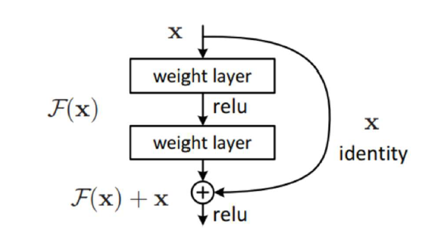
METHODOLOGY
Reference Software Model – Residual Net
In this network technique of skip connections is used.
The skip connection skips training from a few layers and connects directly to the output.
In ResNet, Instead of layers learn the underlying mapping, we allow network to fit the residual mapping.
Advantage - If any layer hurts the performance of architecture, then it will be skipped by regularization.
This results in overcoming vanishing/exploding gradient issues.
Fig 12: ResNet Architecture
Source: Deep Residual Learning for Image Recognition ^{[8]}

Slide 17
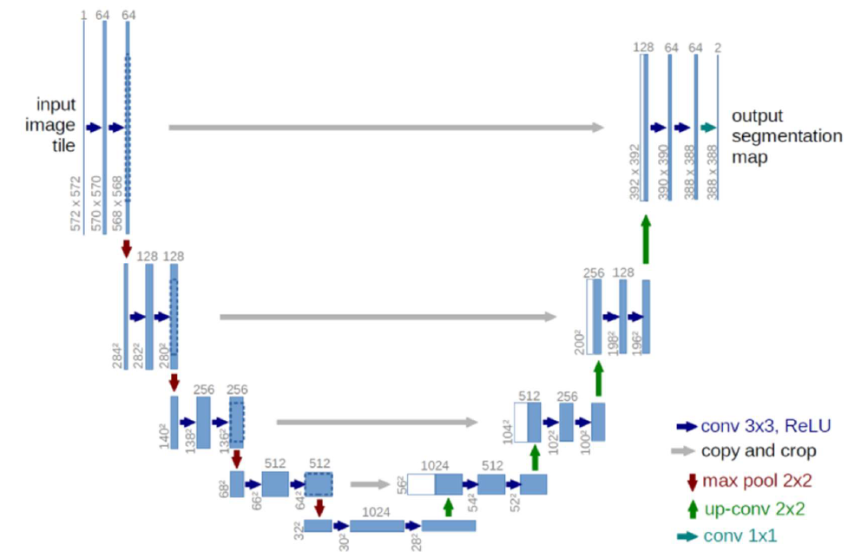
METHODOLOGY
Reference Software Model – UNet
UNet is an image segmentation architecture generally used for medical image segmentation.
It can give good results on complex images.
In this, we convert a feature map to a vector, then reconstruct the image from this vector.
The architecture looks like a ‘U’. This architecture consists of three sections-
The Contraction Section
The Bottleneck Section
The Expansion Section
Using U-Net, we can easily segment the infected area in the image to get more precise results
Fig 13: UNet Architecture
Source: UNet - Towards Data Science

Slide 18
METHODOLOGY
STEPS
First of all, the user has to select the image using the ‘Select Image’ button in the Android Application.
Then, the user has to click on ‘View Results’ button in the Android Application.
On clicking the View Results button, the image is processed by the application & converted in a BitMap & then it is sent to the deployed AI Model.
The AI Model then predicts the results & sends predictions to application.
Then, the application processes those predictions & display the result to the user.

Slide 19
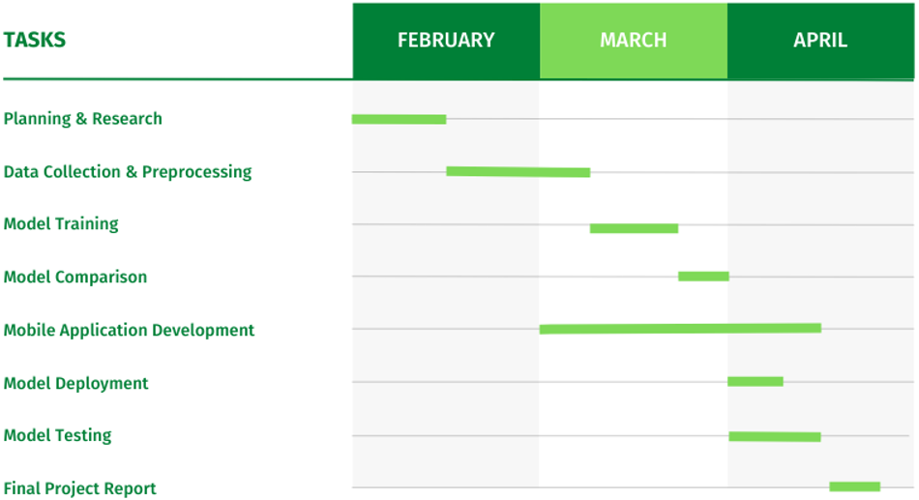
GANTT CHART
Fig – 14 Gantt Chart

Slide 20
DELIVERABLES
S.No. | Timeline | Deliverables | Status
1 | End of February | Project Plan, Collected & Processed Data | On Track
2 | End of March | Trained Models with Comparative Analysis, Partial Android App | On Track
3 | End of April | Model Testing, Full Fledge Android App, Final Documentation, | Yet To Be Started
Table – 2 Status of Deliverables

Slide 21
REFERENCES
[1] “India at a Glance” – Food & Agriculture Organization of the United States
[2] Mohanty SP, Hughes DP and Salathé M (2016) Using Deep Learning for Image-Based Plant Disease
Detection. Front. Plant Sci. 7:1419. doi: 10.3389/fpls.2016.01419
[3] G. Fenu and F. M. Malloci, “Forecasting Plant and Crop Disease: An Explorative Study on Current Algorithms,” Big Data and Cognitive Computing, vol. 5, no. 1, p. 2, Jan. 2021, doi: 10.3390/bdcc5010002.
[4] Dhruvil Shah, Vishvesh Trivedi, Vinay Sheth, Aakash Shah, Uttam Chauhan. “ResTS: Residual Deep interpretable architecture for plant disease detection, Information Processing in Agriculture”, 2021, ISSN 2214-3173, doi: 10.1016/j.inpa.2021.06.001.
[5] MS Bala Murugan et al 2021 J. Phys.: Conf. Ser. 2115 012017
[6] P. Jiang, Y. Chen, B. Liu, D. He and C. Liang, "Real-Time Detection of Apple Leaf Diseases Using Deep Learning Approach Based on Improved Convolutional Neural Networks," in IEEE Access, vol. 7, pp. 59069-59080, 2019, doi: 10.1109/ACCESS.2019.2914929.
[7] S. M. Hassan, A. K. Maji, M. Jasiński, Z. Leonowicz, and E. Jasińska, “Identification of Plant-Leaf Diseases Using CNN and Transfer-Learning Approach,” Electronics, vol. 10, no. 12, p. 1388, Jun. 2021, doi: 10.3390/electronics10121388.
[8] Kaiming He, Xiangyu Zhang, Shaoqing Ren, Jian Sun: Deep Residual Learning for Image Recognition, Dec 2015, DOI: https://arxiv.org/abs/1512.03385

Slide 22
TEAM DETAILS
S. NO | Student Name | Roll no. | SAP ID | Batch
1 | Garvit Khurana | R177219080 | 500076532 | B.Tech CSE AI&ML-B3
2 | Tanya Malhotra | R177219191 | 500075815 | B.Tech CSE AI&ML-B6
3 | Vanshaj Goel | R177219196 | 500076419 | B.Tech CSE AI&ML-B6
Table – 3 Team Details

Slide 23
THANK YOU

