Slide 1

Crop Disease Prediction System
Garvit Khurana
Tanya Malhotra
Vanshaj Goel
Mentor – Dr. Ravi Tomar

Slide 2
INDEX
S. No. | Title | Slide Number
1 | Introduction | 3..4
2 | Motivation | 5
3 | Related work | 6
4 | Proposed Method | 7
5 | Methodology | 8..9
6 | Gantt Chart | 10
7 | References | 11
8 | Team Details | 12

Slide 3
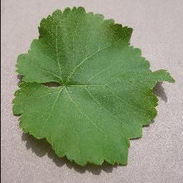
INTRODUCTION
Agriculture, with its associated sectors, is the chief source of livelihood in India.
According to FAO, UN, 70 percent of India’s rural households still depend primarily on agriculture for their living, with 82 percent of farmers being marginal^{[1]} .
Plant and crop diseases are a significant yield and quality constraint for Indian farmers.
Identifying plant diseases is an ongoing challenge for Indian growers of crops like apple, potato, corn, pepper, etc.
Fig – 1 Healthy grape leaf

Slide 4
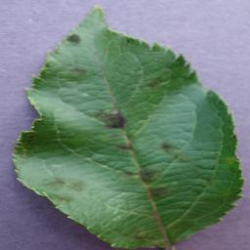
INTRODUCTION
Not only farmers, but the people living in urban cities who prefer to grow fruits in their kitchen gardens also face the issue of their plants and trees getting diseased.
The crop pathogens can be fungal, viral, or bacterial in nature.
Manually identifying plant diseases is not only hectic but also has high chances of being inaccurate.
Misdiagnosing a crop disease can lead to loss of money and severe harm to the consumers of the crop.
Fig – 2 Scabbed apple leaf

Slide 5
MOTIVATION
In the agricultural sector, misdiagnosis of diseases impacting agricultural crops can lead to misuse of chemicals leading to increased input costs with significant economic loss and harmful impact on the environment.
Existing disease diagnosis based on human scouting is time-consuming and expensive.
During the time when Machine Learning and Deep Learning are so popular, it is necessary to understand that all this knowledge can be used in different areas to impact humanity in a useful manner.
Thus, the main motivation to pursue this project is to help people and farmers in observing the health of their plants easily.

Slide 6

RELATED WORK
S.No. | Existing Researches | Working Phenomenon | Gist
1. | Using Deep Learning for Image-Based Plant Disease Detection^{[2]} | CNN (AlexNet & GoogLeNet) | To demonstrate the technical feasibility using a deep learning approach utilizing 54,306 images of 14 crop species with 26 diseases (or healthy) made openly available through the project PlantVillage
2. | Forecasting Plant and Crop Disease: An Explorative Study on Current Algorithms^{[3]} | Forecasting based on weather & plant image data | To examine the specific approaches and methods adopted, pre-processing techniques and data used, performance metrics, and expected results, highlighting the issues encountered
3. | ResTS: Residual Deep interpretable architecture for plant disease detection^{[4]} | Model Training on ResTS Architecture | ResTS is trained to classify images into these 38 categories and to visualize signs of a specific disease
4. | IoT Based Smart Agriculture and Plant Disease Prediction^{[5]} | Remote Monitoring of sprinklers & sensors in field | An integrated application to control IoT system and Plant disease identification using Deep Neural Network model.
5. | Real-Time Detection of Apple Leaf Diseases Based on INAR-SSD^{[6]} | GoogLeNet Architecture | A novel real-time detection model that is based on the single-shot multi box detector (SSD) for apple leaf diseases is proposed
6. | Identification of Plant-Leaf Diseases | Mixture Model (CNN & kNN) | The implemented deep-learning model has better predictive ability in terms of both accuracy and loss
Table – 1 – Literature Review

Slide 7





PROPOSED METHOD
The information regarding specifications for development of the application which can predict diseases in plants/crops
Programming Language: Python, JAVA
Solving Technique: Convolutional Neural Networks
Frameworks: Tensorflow, FastAPI
IDE: Jupyter Notebook, VS Code, Android Studio
Dataset: To be merged from different sources available on Kaggle

Slide 8
METHODOLOGY
A dataset of different plants and crops will be collected consisting of healthy ones and the ones that have been infected.
The collection of data will be done by visiting on field and capturing the photos as well as taking the data available on online sources.
Both parts of data will be merged and will be pre-processed.
Different architectures of neural network will be made and best model will be selected for deployment.

Slide 9
METHODOLOGY
An android mobile application will be made for the users.
Users will be able to capture the image of infected part of the plant and application will predict the disease
The AI model will be deployed on Heroku and connected with the mobile application with the help of API.
The mobile application will have the feature of constantly evaluating the health of plants.

Slide 10
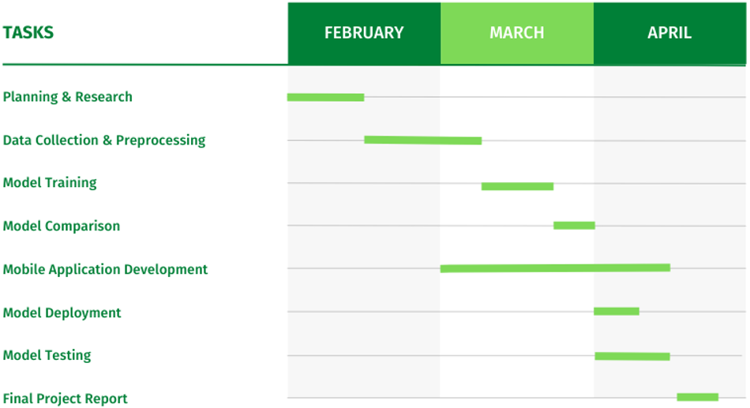
GANTT CHART
Fig – 3 Gantt Chart

Slide 11
REFERENCES
[1] “India at a Glance” – Food & Agriculture Organization of the United States
[2] Mohanty SP, Hughes DP and Salathé M (2016) Using Deep Learning for Image-Based Plant Disease
Detection. Front. Plant Sci. 7:1419. doi: 10.3389/fpls.2016.01419
[3] G. Fenu and F. M. Malloci, “Forecasting Plant and Crop Disease: An Explorative Study on Current Algorithms,” Big Data and Cognitive Computing, vol. 5, no. 1, p. 2, Jan. 2021, doi: 10.3390/bdcc5010002.
[4] Dhruvil Shah, Vishvesh Trivedi, Vinay Sheth, Aakash Shah, Uttam Chauhan. “ResTS: Residual Deep interpretable architecture for plant disease detection, Information Processing in Agriculture”, 2021, ISSN 2214-3173, doi: 10.1016/j.inpa.2021.06.001.
[5] MS Bala Murugan et al 2021 J. Phys.: Conf. Ser. 2115 012017
[6] P. Jiang, Y. Chen, B. Liu, D. He and C. Liang, "Real-Time Detection of Apple Leaf Diseases Using Deep Learning Approach Based on Improved Convolutional Neural Networks," in IEEE Access, vol. 7, pp. 59069-59080, 2019, doi: 10.1109/ACCESS.2019.2914929.
[7] S. M. Hassan, A. K. Maji, M. Jasiński, Z. Leonowicz, and E. Jasińska, “Identification of Plant-Leaf Diseases Using CNN and Transfer-Learning Approach,” Electronics, vol. 10, no. 12, p. 1388, Jun. 2021, doi: 10.3390/electronics10121388.

Slide 12
TEAM DETAILS
S. NO | Student Name | Roll no. | SAP ID | Batch
1 | Garvit Khurana | R177219080 | 500076532 | B.Tech CSE AI&ML-B3
2 | Tanya Malhotra | R177219191 | 500075815 | B.Tech CSE AI&ML-B6
3 | Vanshaj Goel | R177219196 | 500076419 | B.Tech CSE AI&ML-B6
Table – 2 Team Details

Slide 13
THANK YOU

