Slide 1
Offline Handwritten Text Recognition on the IAM Database using Deep Neural Networks
GROUP 8

Slide 2
Introduction and Background
Offline Handwriting Recognition Models
Classify and label handwritten text as words and sentences
"Off-line" refers to data collected manually using pen or pencil on paper
Accessibility Benefits
Convert handwritten notes into digital text
Make written information more accessible through assistive technologies
Help individuals with visual impairments or learning disabilities access content and participate in digital communication

Slide 3
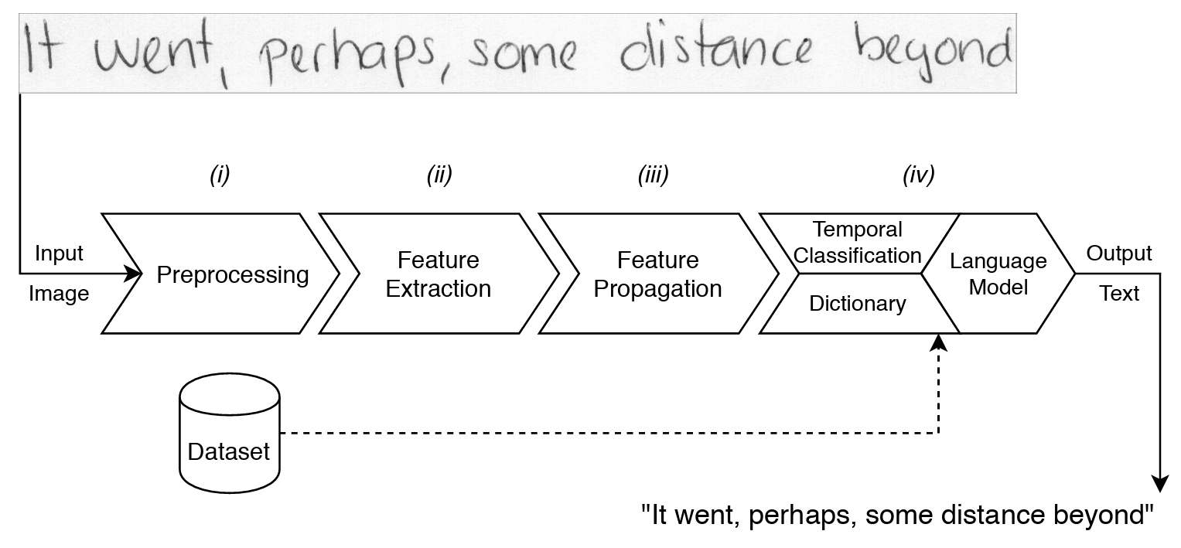
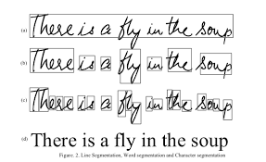
https://www.researchgate.net/figure/Workflow-of-the-offline-handwritten-text-recognition-system_fig1_345166167
https://cs.stanford.edu/people/adityaj/HandwritingRecognition.pdf

Slide 4
Project Proposal
Dataset Overview – IAM Handwriting Dataset
Handwritten English text, approximately 5GB in size
PNG images with 300 dpi resolution and 256 gray levels
657 writers; 5,685 isolated and labeled sentences; 115,320 isolated and labeled words
Dataset Preparation/Preprocessing
dataset splits: Training (70%), Validation (20%), Test (10%)
Preprocessing techniques: Data augmentation, image scaling, picture enhancement
Model Development/Architecture
CNN architecture, Hybrid Handwritten Text Recognition (H2TR), transfer learning from ImageNet
Model Training and Tuning
Evaluation and Comparison of Results

Slide 5
Literature Review – Overview & Motivation
Global Data published findings projecting the optical character recognition (OCR) market value at $11.7B with expected growth of 15.4% from 2023-2030.
Handwriting recognition (HWR) has applications across a wide range of industries and domains
Document digitization
Pharmaceutical drug prescriptions
Check verification (banking)
3 common approaches
CNN architectures
RNN architectures
Hybrid approach (CNN & RNN) and use of transfer learning

Slide 6
Literature Review – Current State of Knowledge
General approach in state-of-the-art
Develop input data / image digitization
Preprocessing (noise removal, binarization, resizing and/or image padding, etc.)
Boundary detection and segmentation (use of transfer learning)
Feature extraction
Classification and recognition
Post-processing and output results
CNN architectures
CNN layers w/ ReLU activation
Pooling layers (i.e., max pooling)
Fully connected layer followed by softmax layer
RNN & hybrid architectures
CNN layers w/ ReLU & max pooling
Implement long short-term memory LSTM (superior characteristics to vanilla RNN)
Potential for time savings, faster processing, and reduced probability for error compared to CNN architectures

Slide 7
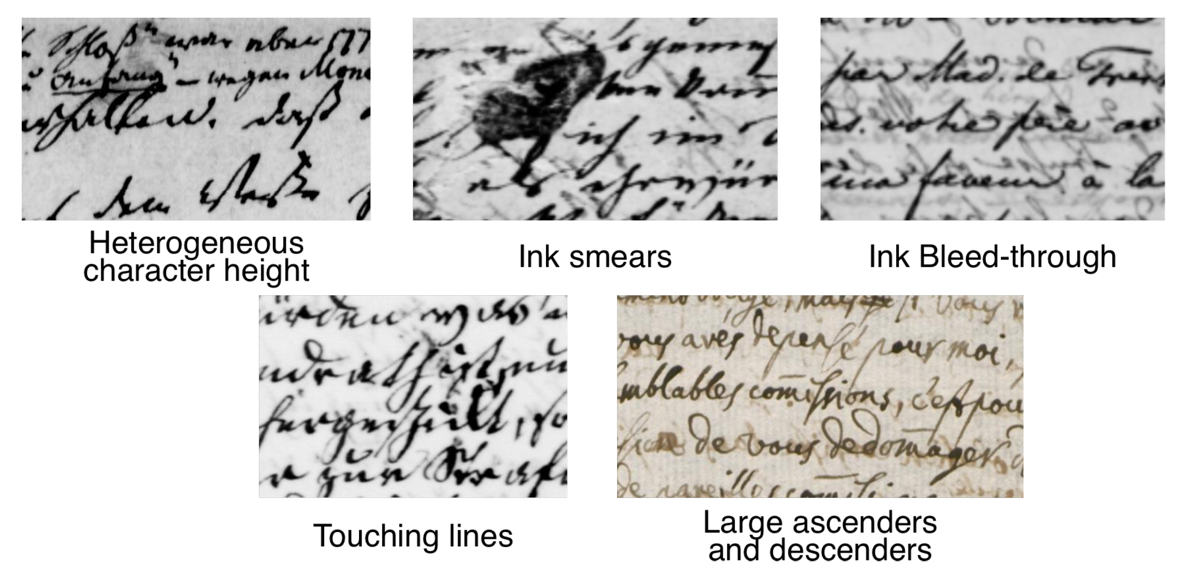
Literature Review – Methodological Issues
Data-specific challenges
Straight-line deviation
Character blending
Noise (pressure, irrelevant marks)
Unique features (symbols, abbreviations)
Variety of individual handwriting
Labeled data scarcity

Slide 8
Further Research
End-to-End Handwriting Recognition Systems:
Creating a standardized pipeline for handwriting digitization that streamlines both OCR and language models.
Robustness to Noise and Variability:
Models that can handle smudges, uneven strokes, varying writing styles, and writing that does not follow straight line patterns.
Low-Resource Handwriting Recognition:
Models developed with smaller amounts of data for lack of labeled datasets. Semi-supervised or unsupervised learning could be made possible by natural language processes incorporating contextual information.
Multilingual Handwriting Recognition:
Relies on both the development of effective HWR models and multilingual language models (independent of handwriting and faces its own challenges).

Slide 9
Instructions
Prepare 5-7 slides to capture your submissions for Milestone-I: Motivation and Proposed Approach.
Each team will have up to 5 mins to present and 1-2 mins to answer questions from members of the class.
Use this sheet Links to an external site to add a link to your deck before the class.
At least one representative from every other group must ask a question to the presenting group. You may use the other sheets in the file to document your questions and the presenting team will have up to 24 hours to provide answers.

