Slide 1
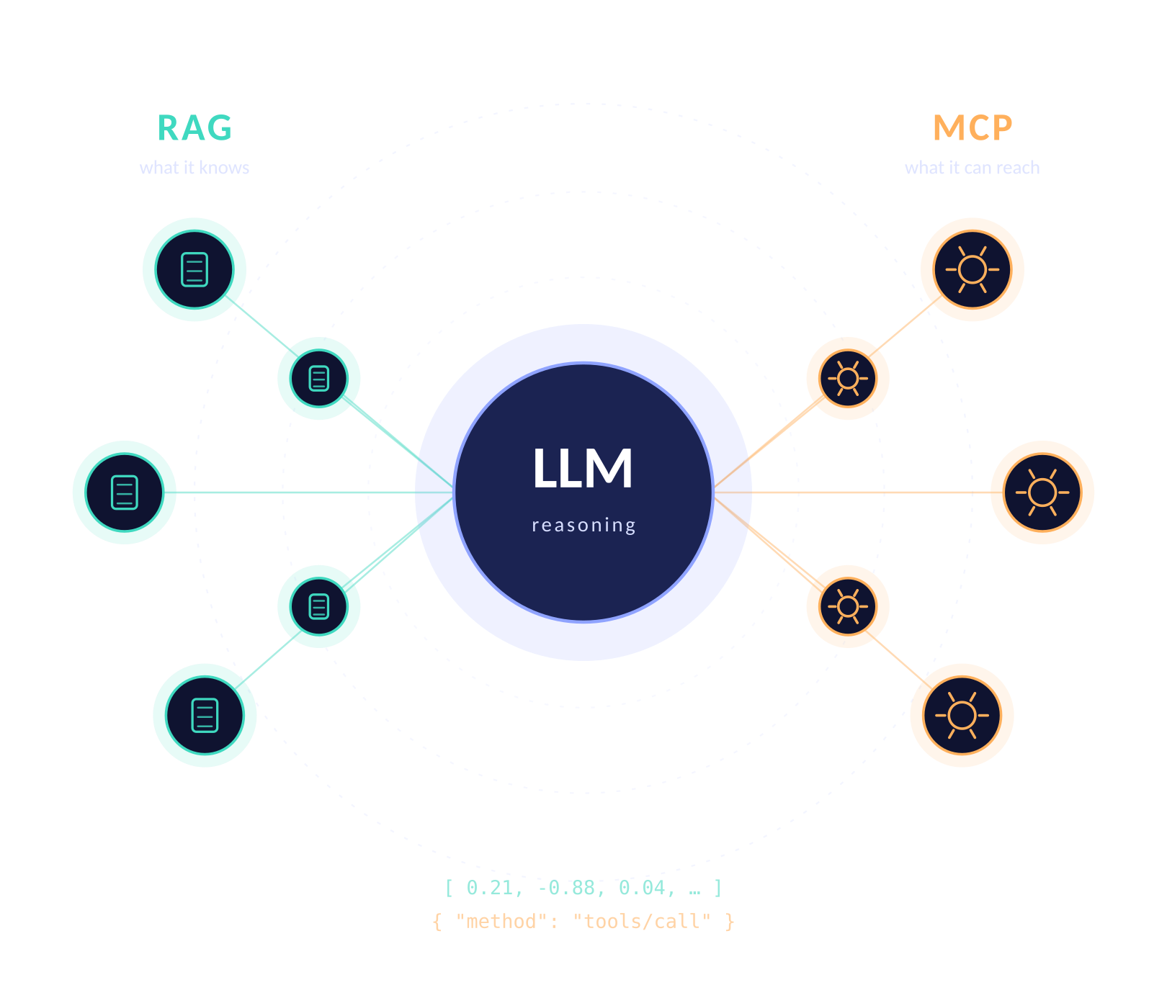
AI ENGINEERING · MODULE 07
RAG & MCP
Giving language models the knowledge they lack
and the hands they never had
Retrieval-Augmented
Model Context Protocol
A hands-on session for students who know Python and have used an LLM API.
No prior retrieval or protocol experience assumed.
1
Notes:
Frame the module in one line: RAG fixes what the model knows, MCP fixes what the model can reach. Everything today hangs off that sentence. Ask the room who has already built a chatbot that hallucinated a policy — that is the hook.

Slide 2
2
Where we're going
Three parts, one continuous example: an internal help desk assistant.
PART 01
PART 02
PART 03
RAG
MCP
Both together
Why retrieval beats fine-tuning for facts
Chunking, embeddings, vector stores
Ranking, re-ranking, hybrid search
Prompt assembly and grounding
Evaluation and failure diagnosis
The N × M integration problem
Host, client, server, transport
Tools, resources and prompts
The JSON-RPC handshake
Building a server; security
Wrapping a RAG pipeline as a tool
Agent loops over multiple servers
Choosing between them
Your lab brief for this week
Reading list and next steps
Slides 5 – 16
Slides 17 – 24
Slides 25 – 29
Running example: a help desk assistant that answers from the company handbook and can open a ticket.
Roadmap
2
Notes:
Set expectations on depth. Part 1 is the longest because retrieval quality is where most projects actually fail. Tell students the lab brief on slide 28 is the deliverable.

Slide 3
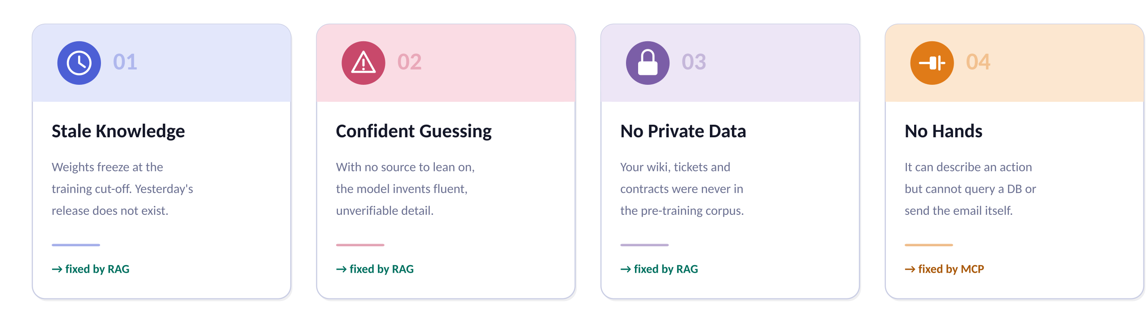
3
What a sealed model cannot do
The base model is a brilliant reasoner with no eyes, no memory of your world, and no hands.
The problem
3
Notes:
Work through each card. Emphasise that these are four distinct failures with two distinct fixes — students routinely try to solve a tooling problem with more prompt engineering. Ask: which of these four would fine-tuning actually fix? (Only partially the first three, and expensively.)

Slide 4
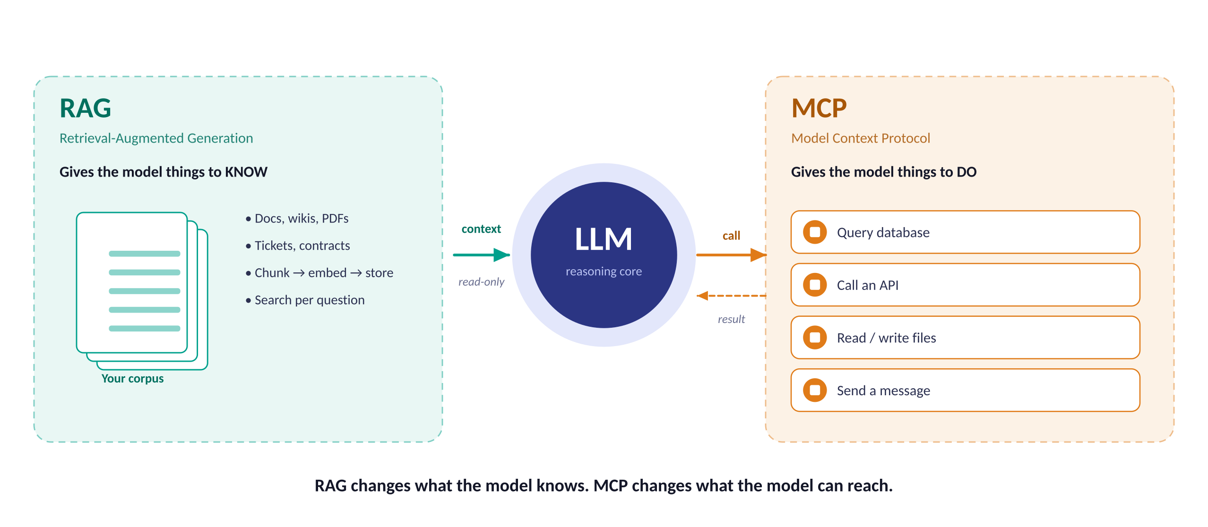
4
Two problems, two protocols
Retrieval pushes information in. The protocol lets the model reach out.
The problem
4
Notes:
The single most important slide for orientation. RAG is read-only context injection. MCP is a bidirectional capability channel that can also write. Students often think MCP replaces RAG — it does not; it is a delivery mechanism that a RAG system can live behind.

Slide 5
01
Retrieval-Augmented Generation
Answer from evidence you fetched, not from memory you might be inventing.
The open-book exam analogy
Indexing: chunk, embed, store
Query: search, rank, ground
Measuring whether it works
Part 1 · RAG
5

Slide 6
6
Why retrieval, not retraining
Three ways to give a model knowledge it wasn't born with — and why one of them wins for facts.
OPTION A
OPTION B
OPTION C
Fine-tuning
Stuff the context window
RAG
Teaches style, format and behaviour well
Teaches facts badly — and expensively
Every update means another training run
No citations; you cannot audit an answer
Stale the moment the source changes
Simple: paste everything into the prompt
Breaks past a few hundred pages
Cost and latency scale with every token
Accuracy drops in the middle of long inputs
Fine as a baseline to beat
Fetch only the few passages that matter
Update knowledge by updating the store
Every claim traces to a source document
Access control travels with the metadata
Cheap: no gradients, only a search
Use it to change how the model speaks
Use it when the corpus is genuinely small
Use it to change what the model knows
Rule of thumb — fine-tune for behaviour, retrieve for facts. In practice you often do both.
Part 1 · RAG
6
Notes:
The open-book exam analogy: fine-tuning is making the student memorise the textbook; RAG is letting them bring it into the exam and teaching them to look things up. Long-context stuffing is photocopying the whole book onto the desk. Note the 'lost in the middle' effect for option B — a real, measured phenomenon.

Slide 7
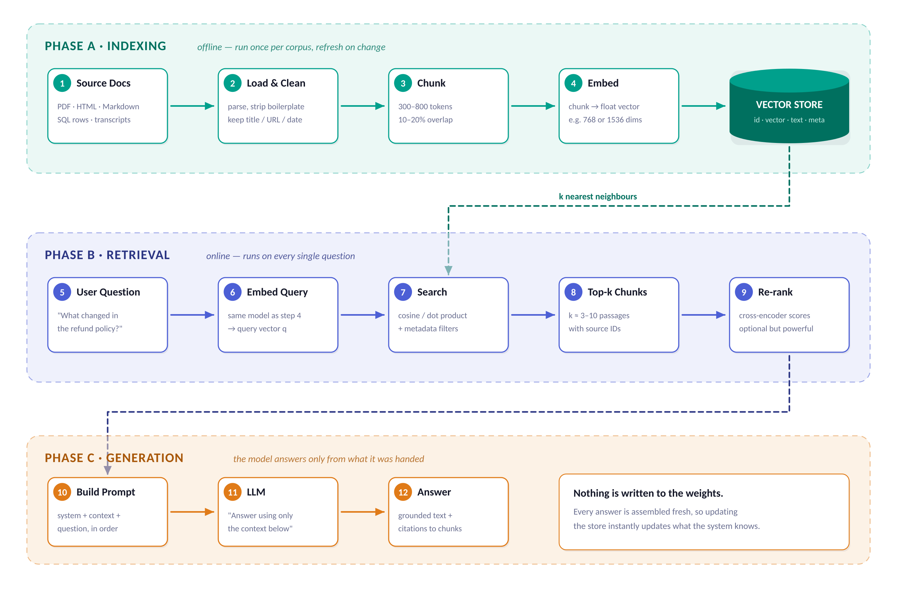
7
The whole pipeline, end to end
Twelve steps in three phases. Everything else in Part 1 is a zoom-in on one of these boxes.
Part 1 · RAG
7
Notes:
Walk left to right, top to bottom. The key structural insight: Phase A is offline and runs rarely; Phase B and C run on every single question and are latency-critical. The vector store is the only shared state. Have students screenshot this slide — it is the map for the rest of the module.

Slide 8
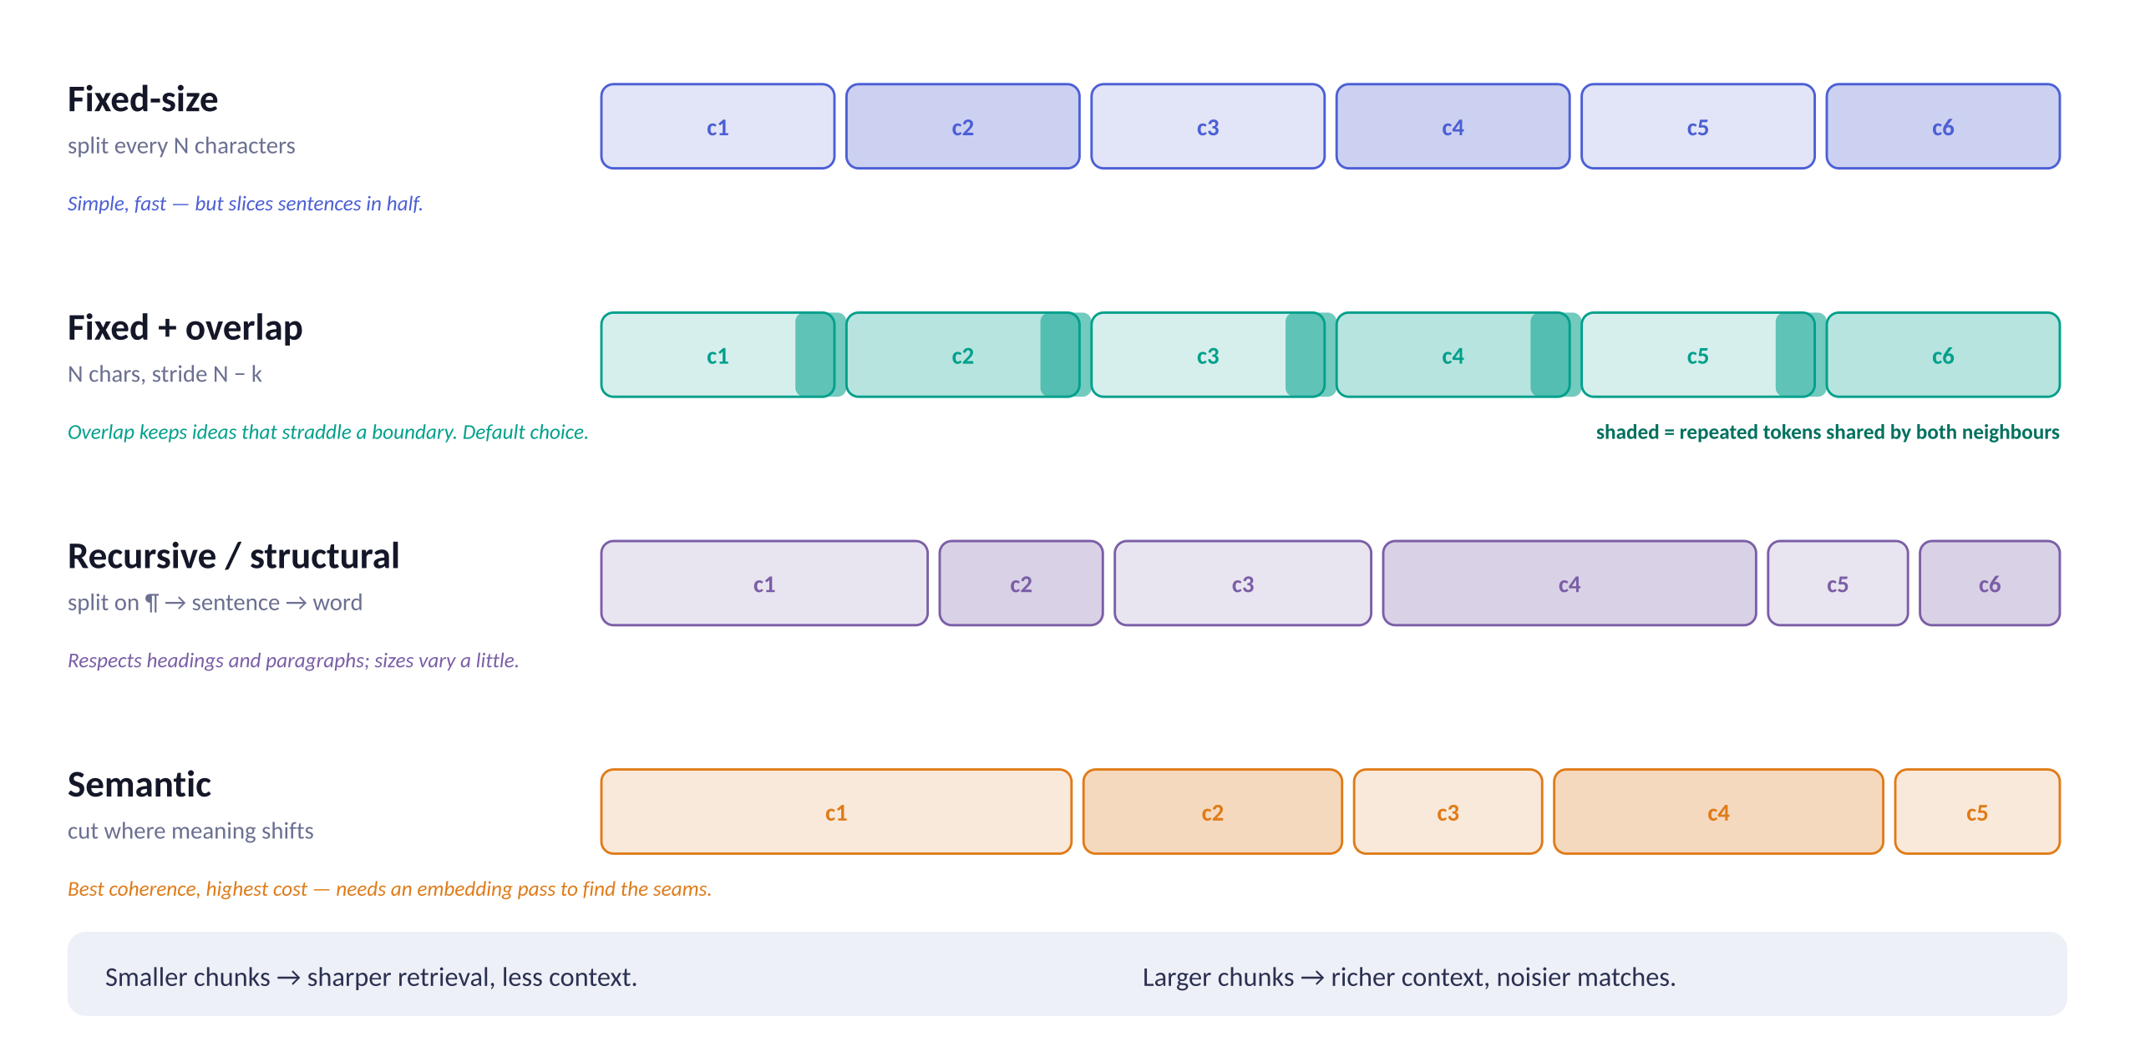
8
Chunking: the decision that quietly sets your ceiling
Retrieval can only return chunks you created. Bad splits cannot be recovered downstream.
Part 1 · RAG
8
Notes:
Most demos ship fixed-size chunking and never revisit it. Start at 500 tokens with 15% overlap, then measure. Emphasise: always keep source metadata (title, URL, section, date) attached to each chunk — you need it for citations and for filtering. A chunk that loses its heading is often unusable out of context.

Slide 9
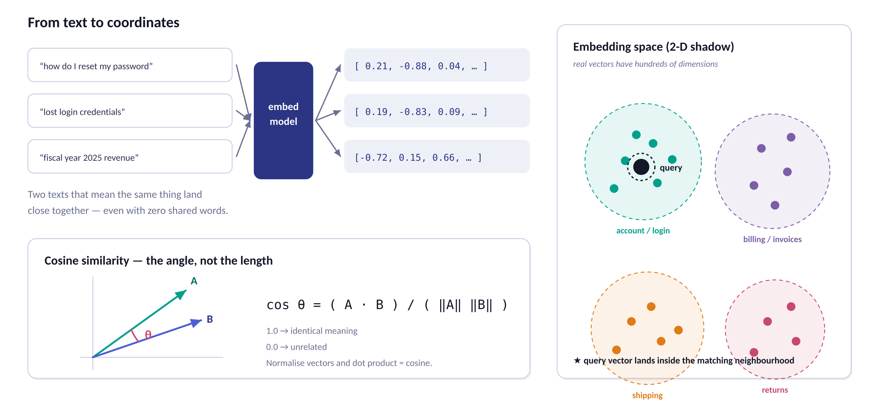
9
Embeddings: turning meaning into geometry
An embedding model maps text to a point. Similar meaning, nearby point — regardless of shared words.
Part 1 · RAG
9
Notes:
Two demos worth running live: (1) show that 'reset my password' and 'lost login credentials' score ~0.85 cosine with no words in common; (2) show that a rare product code scores badly, which motivates hybrid search on slide 11. Stress that query and document must use the SAME embedding model — mixing them silently destroys retrieval.

Slide 10
10
Inside the vector store
It is a search index, not a database of truth — three things determine whether it performs.
WHAT IS STORED
HOW IT SEARCHES
WHICH ONE
One row per chunk
Approximate nearest neighbour
Pick for your stage
id — stable, so you can re-index safely
vector — the embedding, e.g. 768 floats
text — the chunk itself, returned verbatim
metadata — source, section, date, ACL tags
Exact scan is O(n) — fine to ~50k chunks
HNSW: graph index, fast, memory-hungry
IVF / PQ: clustered + compressed, scales bigger
You trade a little recall for a lot of speed
Learning / prototype: Chroma, FAISS, LanceDB
Already on Postgres: pgvector
Managed at scale: Pinecone, Weaviate, Qdrant
Hybrid + filters built in: Elasticsearch, Vespa
Metadata is not optional
Tune ef_search / nprobe, then measure recall
The store is rarely your bottleneck
Filter before you search. A metadata filter (team = finance, date > 2024) is cheaper and safer than hoping the ranker sorts it out.
Part 1 · RAG
10
Notes:
Warn students against premature scaling. A 50,000-chunk corpus runs fine on FAISS flat in memory on a laptop. Also flag access control: if two users must not see the same documents, that filter belongs in the query, not in the prompt.

Slide 11
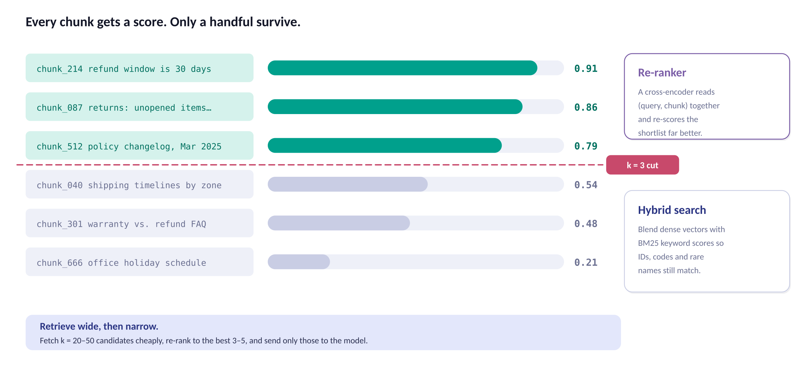
11
Retrieval: score everything, keep almost nothing
Recall first, precision second. Fetch a wide shortlist cheaply, then spend compute narrowing it.
Part 1 · RAG
11
Notes:
The two-stage pattern (cheap bi-encoder recall, expensive cross-encoder re-rank) is the highest-value upgrade to a naive pipeline and usually the cheapest to add. Mention BM25: dense vectors are bad at exact identifiers — order numbers, error codes, surnames — and keyword search is excellent at them. Reciprocal Rank Fusion is the standard way to merge the two lists.

Slide 12
12
Grounding the model in what you retrieved
The prompt is where retrieval becomes an answer — and where hallucination is usually invited in.
WHY EACH LINE EARNS ITS PLACE
# ---- system ----------------------------------------------
You are a help desk assistant for Acme Corp.
Answer ONLY from the CONTEXT block below.
If the context does not contain the answer, reply:
"I could not find that in the handbook."
Cite the [source] tag after every factual sentence.
Never use knowledge from your training data.
# ---- context (assembled from the top-k chunks) -----------
CONTEXT:
[handbook.md #refunds] Refunds are issued within 30 days
of delivery for unopened items ...
[policy-changelog.md #2025-03] As of March 2025 the window
was extended from 14 to 30 days ...
# ---- user -----------------------------------------------
QUESTION: How long do customers have to request a refund?
An explicit escape hatch
Without a sanctioned way to say "I don't know", the model will invent one.
Tagged sources
Citations are only possible if the tag is in the context to begin with.
Context before question
Instructions first, evidence next, question last reads most reliably.
Order your chunks
Put the strongest match first and last — attention sags in the middle.
Part 1 · RAG
12
Notes:
Have students delete the 'ONLY from the CONTEXT' line and re-run — the model will happily blend in training-data trivia. That live failure teaches grounding better than any slide. Also note: token budget. If context plus question exceeds the window, drop chunks by score, never truncate mid-chunk.

Slide 13
13
A complete RAG system in forty lines
Everything from Phase A to Phase C. Run this before you reach for a framework.
RUN IT, THEN BREAK IT
# pip install sentence-transformers chromadb
from sentence_transformers import SentenceTransformer
import chromadb
encoder = SentenceTransformer("all-MiniLM-L6-v2")
col = chromadb.Client().create_collection("handbook")
# ---------- PHASE A: index once ----------------------------
chunks = split(open("handbook.md").read(), size=600, overlap=90)
col.add(ids = [f"c{i}" for i in range(len(chunks))],
documents = chunks,
embeddings = encoder.encode(chunks).tolist())
# ---------- PHASE B + C: answer a question -----------------
def answer(question: str, k: int = 4) -> str:
q_vec = encoder.encode([question]).tolist()
hits = col.query(query_embeddings=q_vec, n_results=k)
context = "\n\n---\n\n".join(hits["documents"][0])
prompt = f"""Answer using ONLY the context below.
If it is not there, say you could not find it.
CONTEXT:\n{context}\n\nQUESTION: {question}"""
return llm(prompt) # any chat completion call
Same encoder, both sides
Indexing and querying must use one model. This is the #1 silent bug.
k is a dial, not a constant
Try k = 1, 4, 20. Watch precision and cost move in opposite directions.
Keep the ids stable
So you can re-embed a single document without rebuilding the collection.
Frameworks come later
LangChain and LlamaIndex wrap exactly this. Learn the shape first.
Part 1 · RAG
13
Notes:
This runs entirely locally — MiniLM is ~90MB and needs no API key, so the whole class can execute it. Assign: swap the encoder for a larger model and measure the retrieval difference on a fixed set of ten questions.

Slide 14
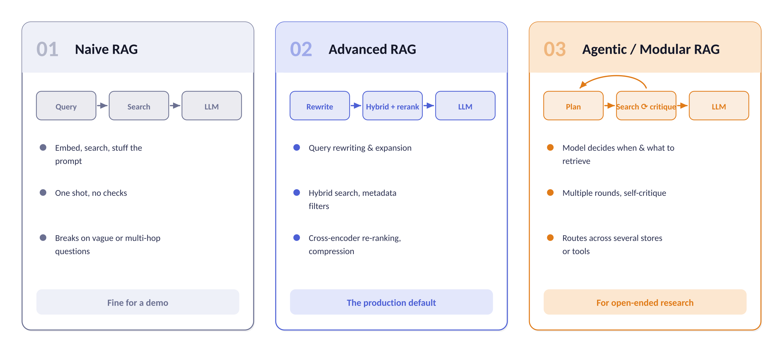
14
Naive, advanced, agentic
Almost every production system starts at column one and gets dragged to column two by real users.
Part 1 · RAG
14
Notes:
Where the jump usually pays off: query rewriting (users ask terrible questions), and re-ranking. Agentic RAG is worth it when a question genuinely needs several lookups — 'how did our refund policy change and how many tickets did it cause?' cannot be answered by one search.

Slide 15
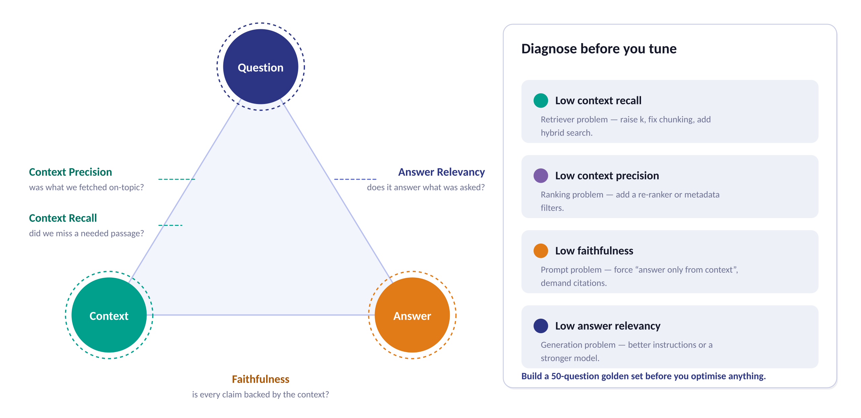
15
Evaluating a RAG system
Four metrics on three vertices. Each one points at a different component to fix.
Part 1 · RAG
15
Notes:
The discipline to teach: never tune blind. Build a golden set of 50 real questions with known-correct source passages before touching parameters. RAGAS and TruLens automate the scoring, often using an LLM as judge. Retrieval metrics (precision, recall) do not need an LLM at all — they only need labelled passages.

Slide 16
16
Six ways RAG goes wrong in the wild
Read the symptom, find the stage. Almost every complaint maps to one of these.
SYMPTOM
SYMPTOM
SYMPTOM
"It says it doesn't know"
"It cites the wrong page"
"It made that up"
The passage exists but never surfaced. Raise k, add hybrid keyword search, or re-chunk — the answer may be split across a boundary.
Retrieval is fetching plausible-but-off passages. Add a cross-encoder re-ranker and metadata filters before blaming the model.
The context was empty or thin and the model filled the gap. Enforce the refusal path and require a citation per claim.
Stage: retrieval recall
Stage: ranking precision
Stage: grounding prompt
SYMPTOM
SYMPTOM
SYMPTOM
"Answers are out of date"
"It leaked another team's doc"
"It's too slow and too expensive"
The index drifted from the source. Schedule re-indexing, store a date in metadata, and prefer recent chunks on ties.
Permissions were applied after retrieval, or not at all. Filter by ACL inside the query — never rely on the prompt to keep a secret.
Too many chunks in the prompt. Re-rank down to three, compress passages, and cache embeddings for repeated queries.
Stage: ingestion freshness
Stage: access control
Stage: context budget
Part 1 · RAG
16
Notes:
Turn this into a diagnostic exercise: read out a user complaint and have the class name the stage before you reveal it. The leak card deserves a pause — it is the failure that ends projects.

Slide 17
02
Model Context Protocol
One open standard so any model can reach any tool, without bespoke glue for every pair.
Why the industry needed a protocol
Host, client, server and transport
Tools, resources and prompts
Writing your first server
Part 2 · MCP
17

Slide 18
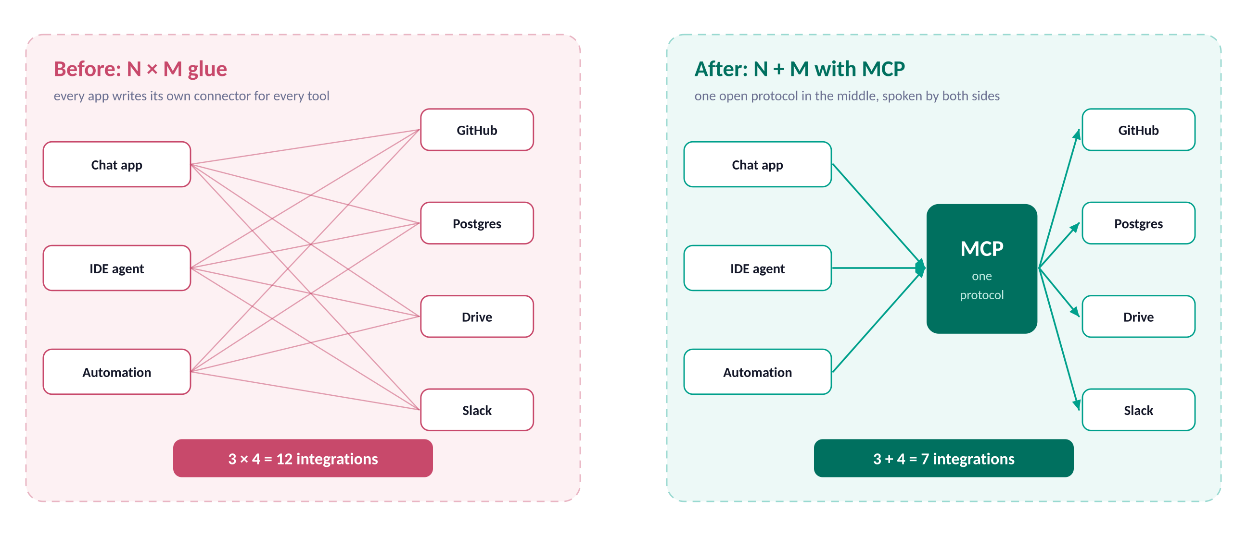
18
The problem MCP was built to kill
Every AI app writing its own connector for every tool is a combinatorial dead end.
Part 2 · MCP
18
Notes:
The historical analogy that lands best: this is USB. Before it, every peripheral shipped its own port and driver. MCP was published by Anthropic as an open specification in late 2024 and has since been adopted well beyond it — the value of a protocol is precisely that it is not owned by one vendor.

Slide 19
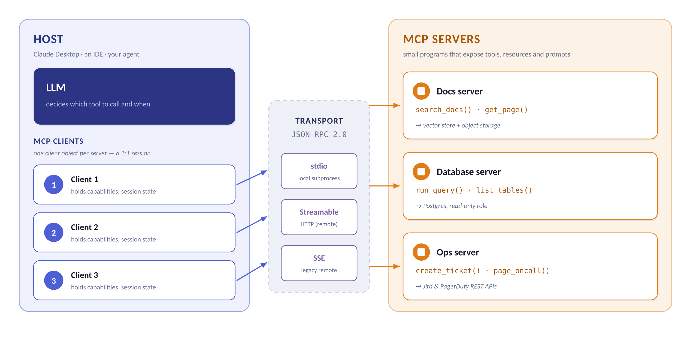
19
The four moving parts
A host runs one client per server, and speaks JSON-RPC over a transport. That is the whole design.
Part 2 · MCP
19
Notes:
Insist on the vocabulary — students conflate host and client constantly. Host = the application (Claude Desktop, your agent script). Client = the connection object inside it, one per server. Server = the separate program exposing capabilities. Transport = stdio for local subprocesses, Streamable HTTP for remote.

Slide 20
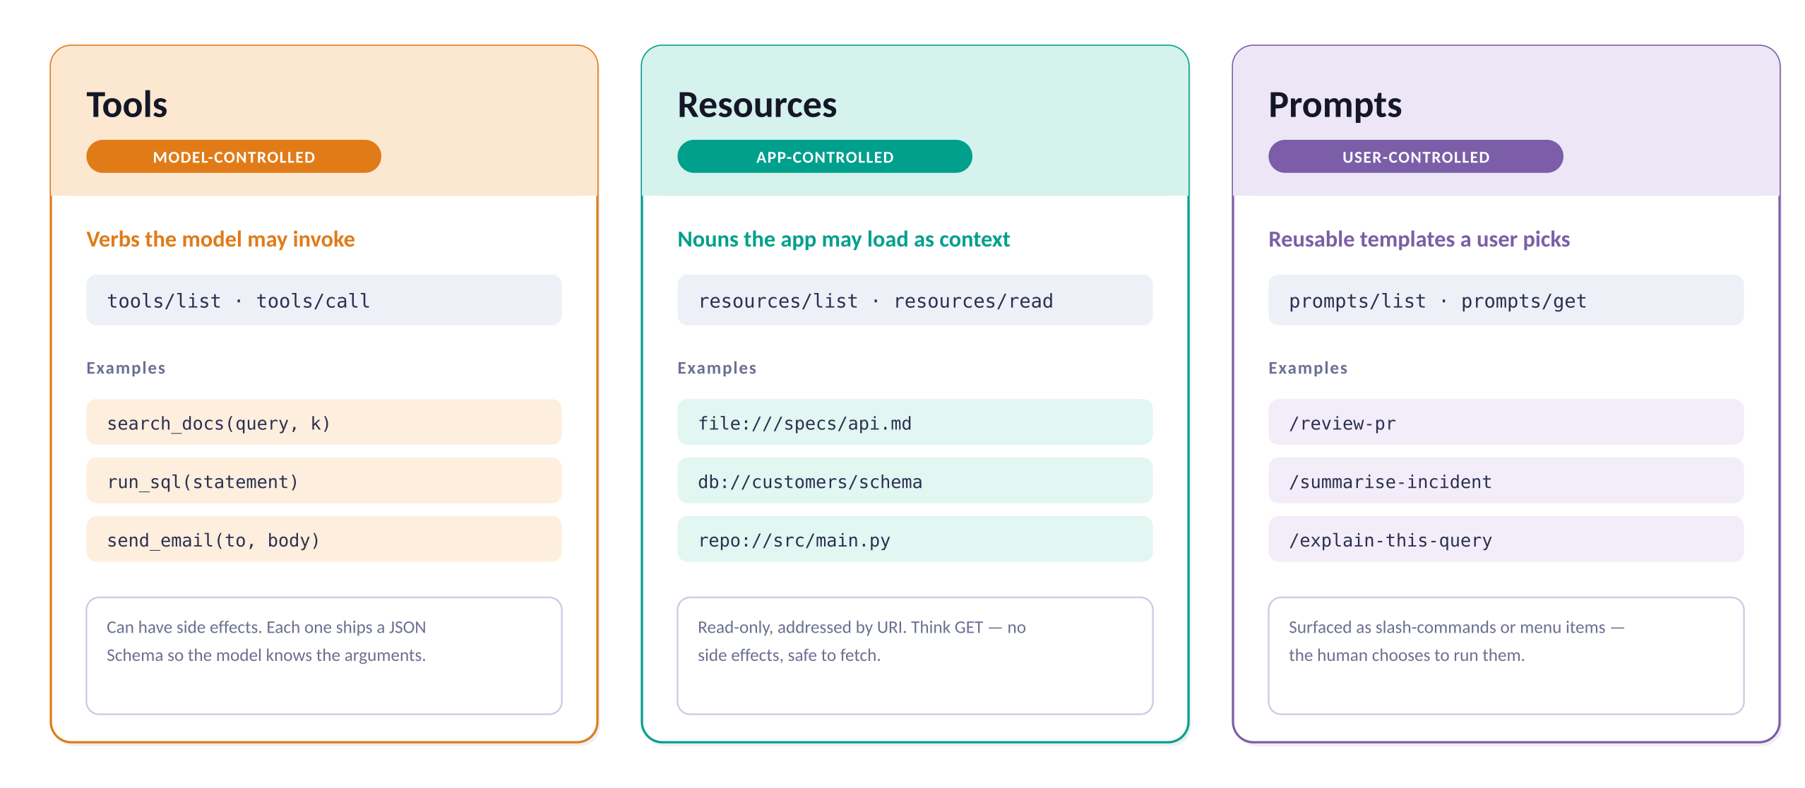
20
Three primitives, three owners
Who decides when it fires is the distinction that matters — not what it returns.
Part 2 · MCP
20
Notes:
The control axis is the exam question. Tools: the model decides (so they need good descriptions and can have side effects). Resources: the application decides what to load (read-only, URI-addressed). Prompts: the user decides (slash commands). Also mention the reverse direction — sampling lets a server ask the host's model for a completion, and roots tell a server which directories it may touch.

Slide 21
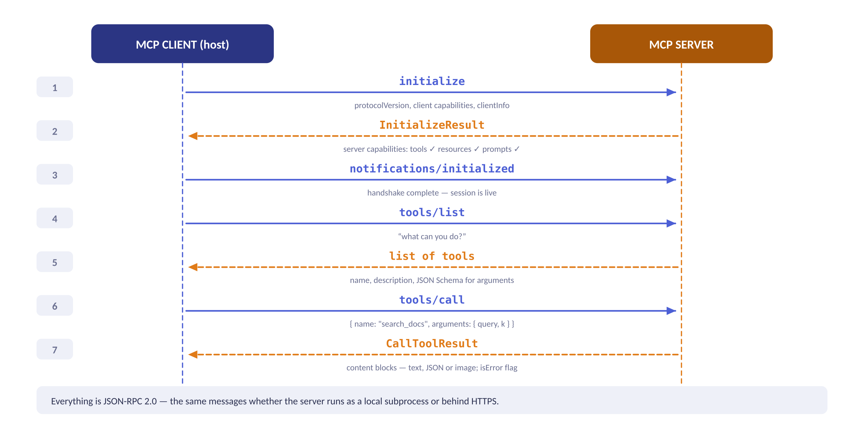
21
The handshake, message by message
Seven messages take you from 'nothing connected' to 'the model just called your function'.
Part 2 · MCP
21
Notes:
Emphasise that tools/list is what makes MCP dynamic: the host discovers capabilities at runtime rather than compiling them in, which is exactly why one host works with servers it has never seen. Also point at the JSON Schema in the tool definition — that schema is what the model reads to decide the arguments.

Slide 22
22
Your first MCP server
The Python SDK turns decorated functions into a fully described protocol surface.
WHAT THE DECORATORS DO
# pip install "mcp[cli]"
from mcp.server.fastmcp import FastMCP
mcp = FastMCP("company-docs")
@mcp.tool()
def search_docs(query: str, k: int = 4) -> list[str]:
"""Search the company handbook and return the k
most relevant passages, each with its source tag."""
vec = encoder.encode([query]).tolist()
hits = col.query(query_embeddings=vec, n_results=k)
return hits["documents"][0]
@mcp.resource("docs://handbook/toc")
def table_of_contents() -> str:
"""The handbook's table of contents."""
return open("toc.md").read()
@mcp.prompt()
def onboarding(topic: str) -> str:
return f"Explain how {topic} works here, citing sources."
if __name__ == "__main__":
mcp.run() # stdio transport by default
Type hints → JSON Schema
query: str, k: int = 4 becomes the argument schema the model reads.
Docstring → description
This is prompt engineering. A vague docstring means a misused tool.
Return → content blocks
Strings, lists, dicts and images are serialised for you.
Test it standalone
mcp dev server.py opens the Inspector — no host required.
Part 2 · MCP
22
Notes:
Verified on mcp 1.28.1 (negotiated protocol version 2025-11-25): search_docs(query: str, k: int = 4) generates inputSchema {'query': {'type':'string'}, 'k': {'type':'integer','default':4}} with required: ['query'] — show that output next to the source. Pin the SDK version in requirements.txt; the MCP spec is still moving and minor releases have changed decorator behaviour. Stress the docstring point hard: students write 'searches docs' and then wonder why the model never calls their tool. The description is the model's only documentation.

Slide 23
23
Plugging the server into a host
Same server, two audiences: a desktop app via config, or your own agent via the SDK.
COMMON FIRST-RUN SNAGS
// claude_desktop_config.json — register a local server
{
"mcpServers": {
"company-docs": {
"command": "/abs/path/to/venv/bin/python",
"args": ["/abs/path/to/server.py"]
}
}
}
# ---- or drive it yourself from Python ---------------------
import sys
from mcp import ClientSession, StdioServerParameters
from mcp.client.stdio import stdio_client
# sys.executable, never a bare "python": the name resolves against
# the host's PATH, which may not be the venv that has mcp installed.
params = StdioServerParameters(command=sys.executable, args=["server.py"])
async with stdio_client(params) as (read, write):
async with ClientSession(read, write) as session:
await session.initialize()
tools = await session.list_tools() # discovery
out = await session.call_tool( # invocation
"search_docs", {"query": "refund window", "k": 3})
print(out.content)
"Connection closed"
Nearly always a bad interpreter or cwd — the server died on startup. Run it directly to see the real traceback.
stdout is the wire
A stray print() corrupts the JSON-RPC stream. Log to stderr.
Restart the host
Config changes are read at launch, not hot-reloaded.
Remote servers
Swap stdio for Streamable HTTP and add auth — the code above barely changes.
Part 2 · MCP
23
Notes:
Verified against mcp 1.28.1: a bare command="python" inside a venv fails with McpError: Connection closed and a long, unhelpful ExceptionGroup traceback — worth triggering deliberately so students recognise it. The stdout warning saves an hour per student too: add a print() to the server and watch the host silently drop the connection.

Slide 24
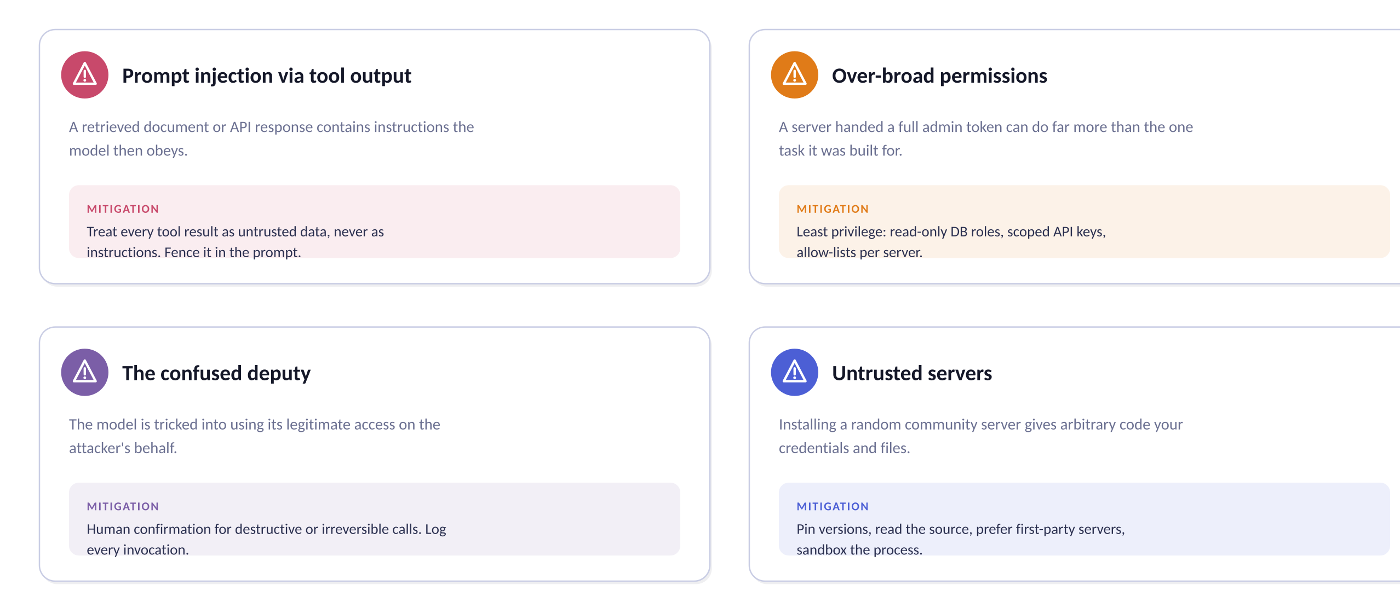
24
Security is not an appendix
You are handing a probabilistic system real credentials. Design for that on day one.
Part 2 · MCP
24
Notes:
Prompt injection through tool results is the genuinely new risk class and the one students underestimate: a poisoned wiki page can instruct the model to exfiltrate data via a later tool call. The mitigation is architectural, not a better prompt — least privilege, human confirmation on destructive actions, and full audit logs.

Slide 25
03
Putting them together
A retrieval pipeline behind a protocol socket is the shape most serious assistants converge on.
RAG as one clean MCP tool
Agent loops across several servers
Choosing between the two
Your lab brief for this week
Part 3 · Together
25

Slide 26
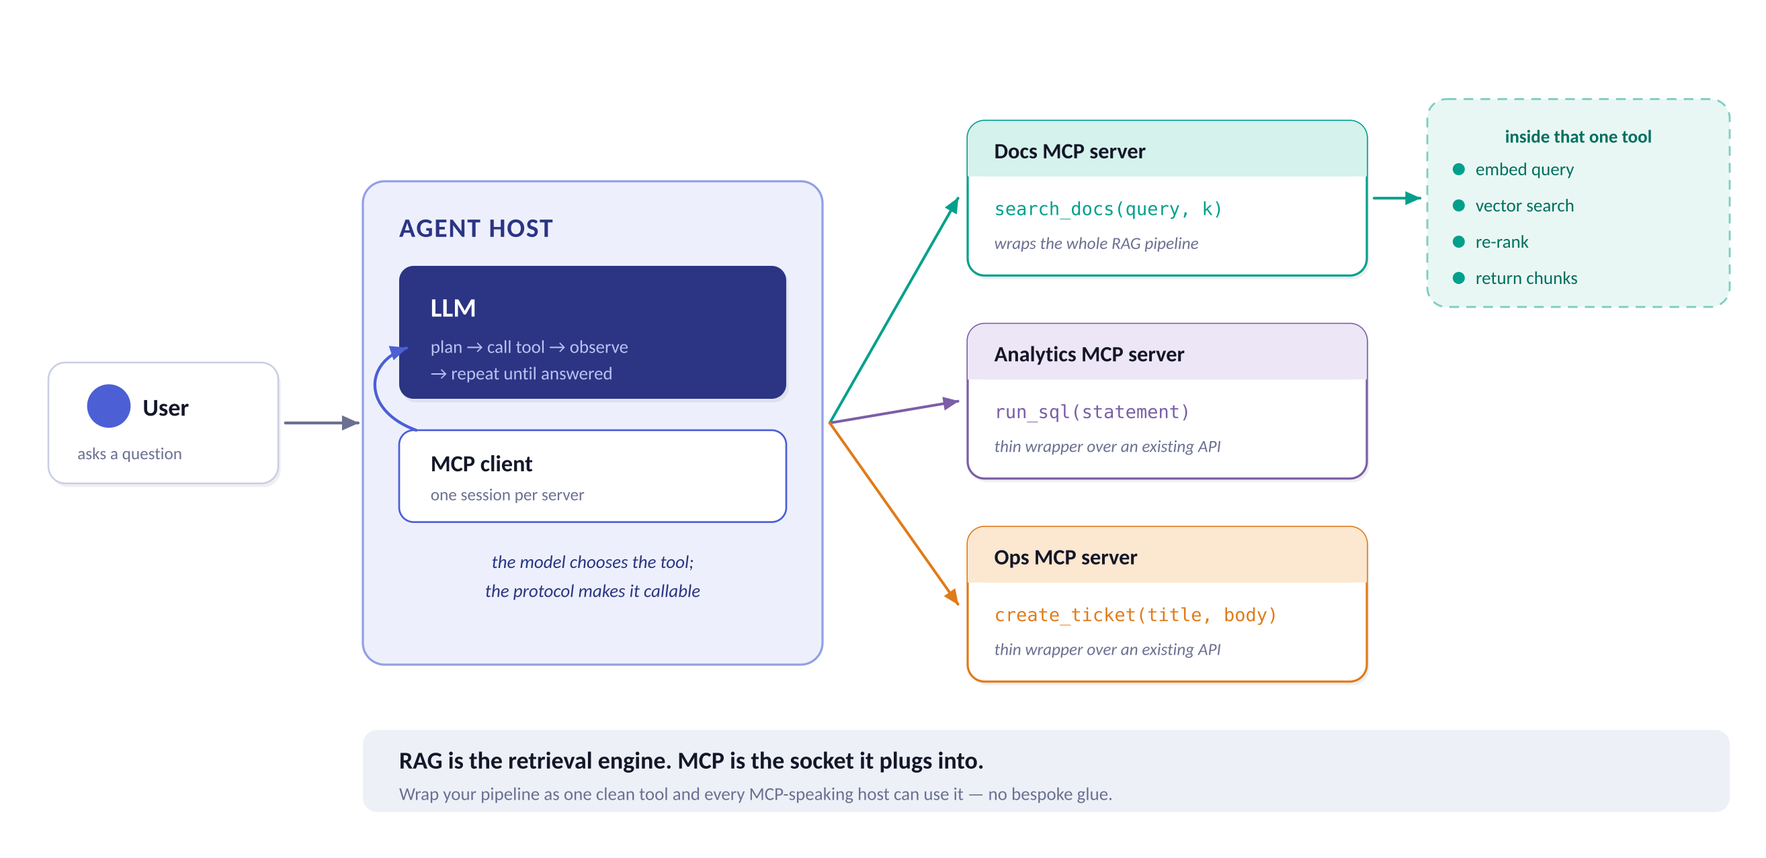
26
RAG as a tool the model can choose
Wrap the whole pipeline behind one function and every MCP-speaking host can use it.
Part 3 · Together
26
Notes:
The architectural punchline of the module. Note the subtle upgrade this brings: in classic RAG you retrieve on every turn whether or not it helps. Behind a tool, the model decides — 'thanks!' does not trigger a vector search, and a hard question can trigger three.

Slide 27
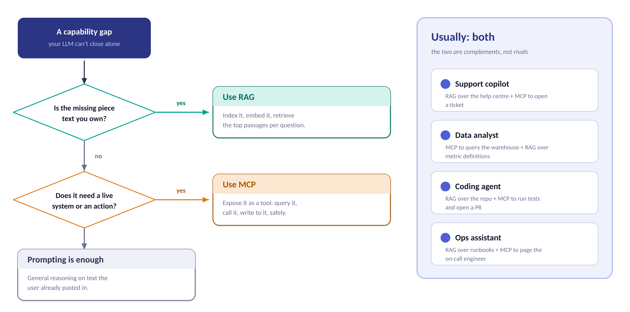
27
Which one do I reach for?
Two questions get you to the right answer, and the answer is usually 'both'.
Part 3 · Together
27
Notes:
Push back on the framing that these compete. The honest summary: RAG is a technique for grounding, MCP is a protocol for connectivity. You can do RAG with no MCP and MCP with no RAG, but a capable assistant almost always ends up with both.

Slide 28
28
This week's build
One job, three tools, one demo. Ship something that runs on a laptop by Friday.
DAY 1 – 2
DAY 3
DAY 4 – 5
Index a real corpus
Measure and improve
Expose it over MCP
Pick 30–100 documents you actually care about
Write the loader and the chunker yourself
Embed with MiniLM, store in Chroma
Deliverable: a notebook that answers 5 questions
Write 20 golden questions with expected sources
Score context recall at k = 1, 4, 10
Add one upgrade: overlap, hybrid or re-ranking
Deliverable: a before/after table
Wrap the pipeline as search_docs(query, k)
Add one resource and one prompt template
Connect it to a host and record a demo
Deliverable: server.py + a 2-minute screen capture
Checkpoint: retrieval before generation
Checkpoint: a number, not a vibe
Checkpoint: someone else can run it
Scope rule: one job, one to three tools, one concrete deliverable. Resist adding a second data source until the first one scores well.
Lab brief
28
Notes:
Grade on the day-3 measurement, not on the demo polish — that is where the learning is. Offer an extension for fast students: add a second MCP server (SQL or ticketing) and let the model choose between them.

Slide 29
Take these five with you
1
RAG changes what the model knows.
Fine-tune for behaviour; retrieve for facts.
GO DEEPER
Lewis et al., 2020
2
MCP changes what the model can reach.
"Retrieval-Augmented Generation for Knowledge-Intensive NLP" — the original paper
One protocol instead of N × M connectors.
Chunking sets your ceiling.
Gao et al., 2023
3
"Retrieval-Augmented Generation for LLMs: A Survey" — the naive/advanced/modular taxonomy
You can only retrieve chunks you chose to create.
4
Measure before you tune.
modelcontextprotocol.io
A golden set of 50 questions beats any amount of intuition.
Specification, SDKs and the Inspector
5
Treat tool output as untrusted.
RAGAS documentation
Least privilege, confirmation on writes, log everything.
Reference implementation of the four metrics
Questions? Then open a terminal — the lab brief is on slide 28.
Wrap-up
29
Notes:
Close by returning to the opening sentence: RAG for knowledge, MCP for reach. Then get them building — the concepts only stick once retrieval returns something wrong and they have to work out why.

