Slide 1
Week 9 Distributions

Slide 2
Review
We learned about general linear models
We did some diagnostics about linear models
What have we learned?
What can we do when our data isn’t linear?

Slide 3
Generalized Linear Models
Used for response variables where the error distribution is not normal
GLMs can be used to cover situations where response variables have arbitrary distributions with some function (called the “link function”) that varies linearly with the predicted values
The difference between this and a regular lm is that we don’t assume the response itself will vary linearly

Slide 4
Example – Infection and temperature
We want to model the effect of Temperature on Probability of Infection (e.g. the response variable is an infected individual 0/1)
We know that as temperature increases, infection is higher
Probabilities are bounded on both ends (0,1)
If a change of 5 degrees makes an individual twice as likely to be infected, what does this mean in terms of probability?
If probability of infection is 70%, and temperature increases 5 degrees, what happens?

Slide 5
Distributions
We need other distributions to describe the world!
In the previous example, what would be the correct distribution to use?
What is another name for this type of analysis?

Slide 6
Another example
If infection is higher by 4% (52:48%)
What are the odds a bat will be infected in a population of 100? 1,000? 1,000,000?
Use code like this to find out the “results” (the fraction of bats infected) from 10 sites of 100 bats, with a 48% chance that a bat will be infected
rbinom(10,100,0.48)/100
What does this tell you about infection? About the world? About the recent election :-) ?

Slide 7
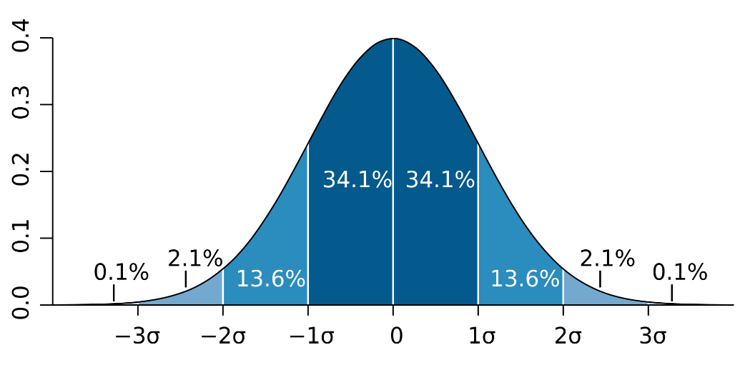
Distributions
A way to characterize chance events
Most people are familiar with at least one distribution
R has a standard set of functions for each distribution:
dnorm, pnorm, qnorm, rnorm
Density, (cumulative) distribution function, quantile function and random number generation
Try: curve (dnorm,-5,5),curve(pnorm,-5,5), curve(qnorm,0,1)
Given what you know about the normal distribution, what do each of these do?

Slide 8
Density function (dnorm, dbinom, dgamma, dpois, etc.)
dnorm is the function that calculates the probability density function (pdf) of a normal distribution (for discrete distributions this is called the probability mass function)
Density functions in R are generally more useful for discrete events than continuous (e.g. binomial distributions rather than normal) because in order to get the probability of a continuous value, you need to integrate
This is because the probability of any given value in a continuous distribution is 0, so you need a range, and you need to add up all the probabilities within that range under the curve (e.g. integrate)
The PDF is (basically) used to specify the probability of a random variable (e.g an outcome, like number of lizards perching) falling within a particular range of values, as opposed to taking on any other value

Slide 9
dbinom
dbinom calculates the PDF of the binomial distribution
Suppose that I know that infection prevalence (e.g. probability of infection) is 20% (e.g. 0.2). What is the probability that one bat out of 25 is infected?
dbinom(x = 1, size = 25, prob = 0.2)
Can also write dbinom(1,25,0.2)
#we use x=1 because we want to know the probability that exactly one 1 bat of 25 is infected at a global infection prevalence of 20%

Slide 10
P functions (e.g. pnorm, pbinom, etc)
Pnorm gives the cumulative distribution function
This means that is gives the sum of all the probability from the lower end of the distribution (e.g –Inf) to q (the value you are interested in a cut off)
Pnorm is the function that replaces the table of probability values and z-scores you might see at the back of a statistics text book

Slide 11
pnorm example
Suppose a weight of a lizard is normally distributed with a mean of 17 grams, and a standard deviation 3. What is the probability than a lizard in a given population weighs less than 19 grams?
pnorm(q = 19, mean = 17, sd =3)
#what is the probability a lizard weighs MORE than 19 grams?
pnorm(q = 19, mean = 17, sd =3, lower.tail = F)

Slide 12
pbinom example
Suppose that I know that infection prevalence (e.g. probability of infection) is 20% (e.g. 0.2). What is the probability that NO MORE THAN one bat out of 25 is infected?
What is your intuition?
Suppose that I know that infection prevalence (e.g. probability of infection) is 20% (e.g. 0.2). What is the probability that NO MORE THAN five bats out of 25 are infected?
What is your intuition?
This is a useful way of thinking about sample sizes (e.g. the probability of not detecting a single infected bat given my sample and a presumed prevalence)

Slide 13
quantiles functions (e.g. qnorm, qbinom, qpois)
The quantile functions calculates the inverse of the cumulative distribution function (which you can think of as the inverse of pnorm)
Given a p between 0 and 1, qnorm will like up the p-th quantile of the normal distribution

Slide 14
qnorm example
Suppose that femur length of fossilized mammoths is normally distributed with a mean of 115 cm, and a standard deviation of 15 cm. What would the 85th percentile of femur length be?
qnorm(p =0.85, mean=115, sd=15)

Slide 15
Random draws (rnorm, rbinom, rgamma, rpois)
This function will simulate random variates from a specified distribution with certain attributes
These are very useful for simulation, bootstrapping, etc.

Slide 16
Random draw examples
Let’s take 100 random draws from a Poisson distribution
This distribution has a single parameter! Lambda.
rpois(100, lambda = 3)
Take 50 random draws from a negative binomial distribution
x = rnbinom(50, size = 10, mu = 2)
Ecological parameterization is usually size (dispersion /k) and mu (mean)
Non-intuitively, a smaller “size” means more overdispersion

Slide 17
Two (or more) levels of understanding of distributions
Pragmatic/utilitarian understanding
Properties of distributions
When to use them
Deeper understanding
Theoretical derivation

Slide 18
A tree of distributions (Ch 4, P182)
curve(dgamma(x,1),0,20)
curve(dgamma(x,10),0,20)
curve(dbeta(x,1,1),0,1)
curve(dbeta(x,10,10),0,1)
curve(dbeta(x,2,5),0,1)
curve(dbeta(x,5,2),0,1)

Slide 19
Distribution properties (ch 4, p192)

Slide 20
Gamma
Two parameter right skewed continuous distribution
Important: R’s parameterization of this distribution is wacky.
The gamma distribution typically has a shape parameter k and a scale parameter θ .
In R, it has the shape parameter α , and an inverse scale parameter β = 1 / θ
I use the Gamma quite a bit – lots of things are right skewed and continous
Something to be careful of – the canonical link function (the function that makes the outcome linear) is inverse. Therefore, when you interpret your coefficient output, it is the OPPOSITE of what you think – negative coefs are positive, and vice versa.
0 is not included in the gamma distribution; it is not uncommon to add a small “continuity correction” to make your zero values >0 (e.g. add 0.0001 to all values). (Note: I wouldn’t do this is you have a lot of 0s, or if zero means something very specific in your dataset.)
For glms, it would be glm(lambda~species, data=batdat, family=“Gamma”)

Slide 21
Negative Binomial
This is most commonly used for overly dispersed count data (discrete)
(Most count data in ecology seem to be overly dispersed!)
It is a special case of the Poisson
Two parameters indicating mean (mu) and dispersion (k/size). As the k goes down, dispersion goes up!
glm.nb in MASS package

Slide 22
Zero-inflated distributions
Zero-inflated probability distributions are called “mixture distributions”
Often, they model the probability of transitioning from 0 to 1, and 1 to Inf separately (called a “hurdle model”)
The most common version of this is the zero-inflated negative binomial
zeroinfl in pscl package - https://www.rdocumentation.org/packages/pscl/versions/1.5.2/topics/zeroinfl
Options are all discrete!
It is not that complicated though to extend to continuous – see http://seananderson.ca/2014/05/18/gamma-hurdle/

Slide 23
What would these be?
Counts of bats, trees, eye lesions
Density of lizards, trees
Size of fossils / crayfish
Rate (not #) of prey captured
survival time of plants/birds/ extinct organisms (?)
presence/absence of pathogens at different sites
Concentration of plant toxin, pathogens, water toxins
Presence / absence of bats, birds

Slide 24
Exercises
A wolf population has 500 pairs remaining. If each wolf pair normally has around a 4 pups, but the fraction of wolves born with a lethal recessive allele is 0.2, how many live offspring are likely to be born alive? (Hint – you need to draw randomly from 2 different distributions!)
If there are 1000 seeds in a seedbank and each seed has a 2% chance of being eaten and a 1% probability of sprouting each day, how many seedlings would we expect to see sprouting each day? Over 100 days?
The number of eggs laid by squid varies dramatically among individuals. The mean number of eggs is 300, but the dispersion is 1. What is the 85th percentile of the number of eggs laid?
I census 15 populations of pikas on 15 mountains. I find that the average population size is 10. What is the probability of a population of more than 12 individuals? (Hint – there is information here that you don’t need…)

