Slide 1
Comparing Models

Slide 2
Housekeeping
Next Tues: Spring Break Day!
Next Thursday:
Discussion, papers posted on Canvas
Worst ggplots contest

Slide 3
Contest rules
Entries will receive 5 bonus points on lowest grade
Must use ggplot2
Can be accidental or on purpose
Send to me on canvas and I will share them
Class will be encouraged to caption them

Slide 4
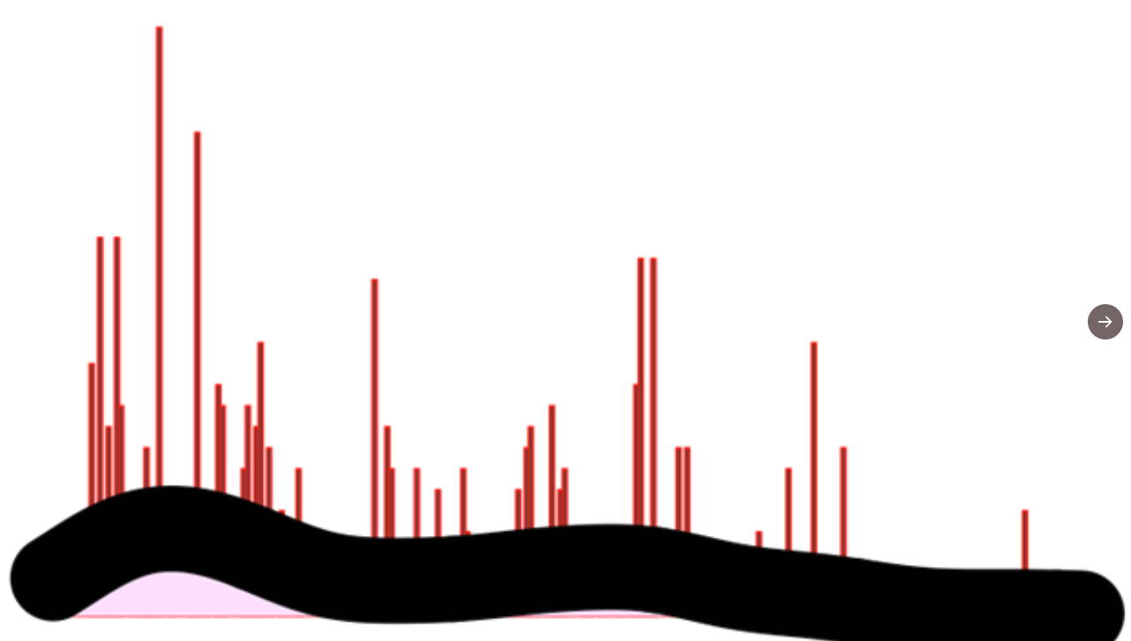
Examples
Caption: Giant sand worm attacks Dubai
https://twitter.com/remington_moll/status/1367524035240759296?s=20

Slide 5
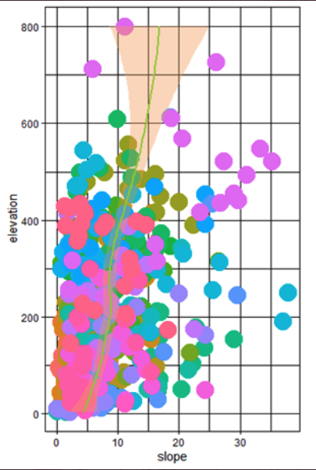
Example
Caption: Tornado attacking giant bowl of skittles
https://twitter.com/remington_moll/status/1367524035240759296?s=20

Slide 6
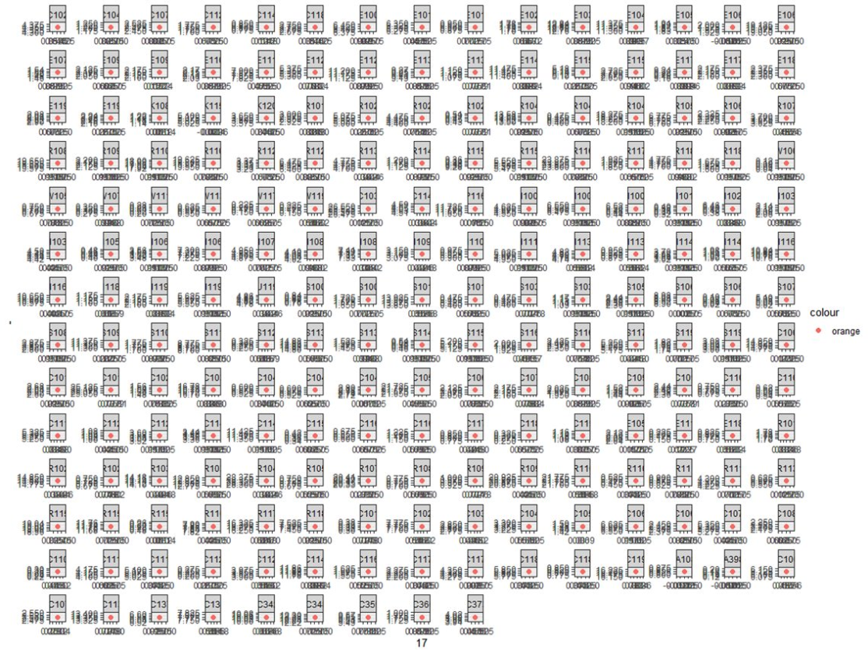
Example
https://twitter.com/remington_moll/status/1367524035240759296?s=20

Slide 7
Goals
Determine how to distinguish support among multiple different models
Understand nested models and null models
Learn model selection philosophy and the strengths and weaknesses of different approaches

Slide 8
Theory
We often have multiple hypotheses about which factors are most important in influencing something
Related to this, we often have multiple working hypotheses about how things interact
How do we know which models are best at explaining our data?

Slide 9
Parsimony
This is sometimes called Occams razor
This is a general argument for choosing simpler models even though we know the world is complicated
Model selection approaches usually go beyond parsimony to try and determine whether a more complex model is better than a simpler one
This is usually done by seeing whether there is some threshold of “betterness” to be worth the added model complexity

Slide 10
Model complexity and prediction – the bias variance tradeoff
As we add more variables to our models, we can get an increasingly accurate fit to the particular data we have observed (e.g. a higher R squared)
However, the precision of our predictions decreases as we add more variables
This is because data contain a fixed amount of information and as we add more predictors, we spread the data thinner and thinner
The gain in accuracy from having more details in the model is outweighed by the loss of precision in estimating the effect of each variable

Slide 11
Model Comparisons
Comparing models might be one of the most deeply divisive issues within quantitative ecology
This is in part because all of the methods get things wrong
However, in most cases these approaches will give reasonably consistent answers.
It is important to watch out for these inconsistencies to avoid wrongness

Slide 12
Model Selection Challenges
In perfectly designed full factorial experiments
There aren’t many challenges!
All approaches will produce similar results, because predictors are uncorrelated and hypotheses are clear
In the real world in Ecology and Evolution
Predictor variables are often partially correlated
A priori hypotheses may be less clear
This creates challenges in model fitting, interpretation, and prediction, regardless of statistical approach

Slide 13
Model Comparison Approaches
Stepwise Approaches
Likelihood Ratio Tests
Information Criteria
Bayesian Approaches

Slide 14
The goal of statistics
Try to extract biological insight or make predictions from data by fitting models to data.
Univariate analysis: often null hypothesis testing
Multivariate analysis: multiple regression
In both cases we are usually asking the question: does X₁ (or X₁ and/or X₂) influence Y, or what is the influence of X on Y?
Approaches
Fit full model and interpret coefficients
Challenge: weak “noise” predictors can create bias in other parameter estimates, and result poor predictions (“overfitting”)
Stepwise regression
Forward/Backward/Both with criteria – p-value, F/t-value, AIC
Likelihood Ratio Test
Requires that models are nested versions of each other
AIC (or other IC) model comparison of selected models
Bayesian approach

Slide 15
Stepwise regression
There are two major approaches for stepwise regression:
1. Forward stepwise regression
2. Backward stepwise regression

Slide 16
Forward Stepwise regression
Procedure
Correlate all predictors with response individually
Select strongest predictor (by F, t, p-value) to be included in model, assuming it passes threshold (e.g. p<0.05, t>2, F>4)
Add this predictor to your model, and then correlate the remaining predictors. Select next strongest predictor and add to model and test it against threshold; keep it if it passes
Repeat until no additional variables are added

Slide 17
Forward Stepwise Example
See R code

Slide 18
Forward Stepwise regression challenges
Major difficulty
If two predictors are even weakly correlated it is quite possible for neither to be significantly related to response by themselves, but highly significant when in a model together
Resolution: Don’t ever use this version of forward stepwise regression

Slide 19
Backwards stepwise regression
Procedure
Fit model with all predictors
Select weakest predictor (by F, t, p-value) and remove it from model unless it passes threshold (e.g. p<0.05)
Repeat until no additional variables are removed
Advantages
Simple, quick, few total models are examined
Low to moderately correlated “important” variables will be retained, unlike in forward step-wise regression

Slide 20
Backwards stepwise example
See R code

Slide 21
Backwards Stepwise Regression - Challenges
If predictors are correlated, the presence of one predictor in the model will always change the coefficient, and sometimes change the significance
As a result, the order in which predictors are removed can alter the resulting model
In a model with Y and X1, X2, and X3, X3 may be non-significant with X1 and X2 in the model, but significant with just X1 in the model.
Eliminating predictors from models based on a threshold can lead to large differences in the final model (i.e. if predictors have p-values just above or below the threshold), and this can lead to a changes in all coefficients in the model

Slide 22
Should we also throw out backwards stepwise regression?
Some resolution:
To better estimate the effect sizes of removed variables they can be re-added one by one to the reduced model
This is a good check to make sure the order of removal hasn’t influenced your results
We can resample from our original data using bootstrapping to make new models to test model performance
Cross-validation: data-splitting and prediction of outside sample dataset is a great test of model predictive ability (but often requires moderate-large dataset)

Slide 23
Bootstrapping Model Validation Approach
Resample with replacement from the original variables (same number of observations).
Apply the model from the original dataset to the resampled dataset
Use the updated model to refit to original data and calculate a goodness of fit statistic (e.g. R2)
Compare R2 between bootstrapped models and original model
See more info here: https://www.r-bloggers.com/bootstrap-and-cross-validation-for-evaluating-modelling-strategies/

Slide 24
Repeated K-fold cross validation
Divide your data into 5-10 (k) parts.
Take turns to fit the model on 90% of the data and using that model to predict the remaining 10%
The average of the 10 goodness of fit statistics (e.g. Rsquared) becomes your estimate of the actual goodness of fit. OR
Compare area under the curve across different models. Model with higher AUC is better than smaller.
Issue – this is difficult for small datasets!

Slide 25
Likelihood ratio tests
Statisticians have long used LRTs to compare nested models

Slide 26
Nested Model
All the terms in the smaller model occur in the larger model
Ex:
glm(N ~ light*time)
glm(N ~ light + time)
glm(N~light)
glm(N~1) – null model

Slide 27
Are these nested?
N~light
N~time

Slide 28
Running a LRT on models
The anova() function in R performs LRT on nested model fits (among other tests)
It will automatically calculate the difference in numbers of parameters (e.g. df)
This will test whether the extra goodness of fit is worth the additional complexity of adding parameters

Slide 29
Model comparison - LRT
When you do an anova() on a regular lm or glm (e.g. Poisson, Gamma, Binomial) you need to list the null model first
The LRT (anova()) for these “objects” will always consider the null model as the first argument
This isn’t the case for all types of objects – hence the confusion
If you do not list the null model first, you may get wonky output because it is doing the subtraction incorrectly resulting in negative values with no meaning in the chi-squared distribution!
I suggest stepping through your models from simplest as null to increasingly more complex
E.g. N ~ 1 vs N~light, then N~light vs N~light+time, then N~light+time vs N~light*time

Slide 30
LRT examples

Slide 31
Information Criteria
These are also called information theoretic approaches
These are commonly used, but still have many disadvantanges
IC methods find the model that minimizes some criterion that is based on the likelihood and a penalty term, which is usually based on the number of parameters

Slide 32
AIC (BIC, etc.) model selection
Proposed philosophy is inherently different
but it is often (ab)used to answer the same questions as null hypothesis testing
Frequentist/Null hypothesis testing: do predictor variables X1, X2, and/or X3 influence Y?
IC approach: which of the proposed models fit the data best?
E.g. AIC = 2k - 2ln(L); k = # parameters, L = likelihood

Slide 33
AIC Procedures
Build a priori candidate model set
Fit models to data
Rank by AIC, calculate weights (based on ΔAIC)
Can estimate model coefficients and make predictions by model averaging using AIC weights of all models making up X% of weights (e.g. X = 95%)
Can select models with greatest support (must be >2 AIC away)

Slide 34
AIC Examples

Slide 35
AIC advantages
Results in 1 or more final models that have “some support” from the data
Comparing non-nested models is easy
Combining results from multiple models is straight forward

Slide 36
AIC challenges
What is the candidate model set? Omissions or biases in forming model set can result in poor inference/prediction
Using “all possible model subsets” can produce an enormous number of models that is difficult to interpret and results in spurious correlations
If we fit models with several “versions” of a predictor (e.g. Temp, Temp², Log(Temp)) and only one model without this predictor, we are much more likely to find that this predictor is present in one of the best fitting models.
AIC will select models as “plausible” (within 2 AIC) that contain non-significant (P>0.05) predictors.
Need to examine “goodness of fit” of best models to avoid selecting the best of a bunch of terrible models
When a predictor makes a model better by AIC, this is equivalent to stepwise regression based on a threshold p-value of 0.157 which is much larger than 0.05.
It is difficult to get prediction error and Cis from model averaged predictions

Slide 37
Automatic model selection algorithm (dredging)
https://stats.stackexchange.com/questions/20836/algorithms-for-automatic-model-selection/20856#20856
Tip: Don’t do this.

Slide 38
Model averaging challenges
https://theoreticalecology.wordpress.com/2018/05/14/model-averaging-in-ecology-a-review-of-bayesian-information-theoretic-and-tactical-approaches-for-predictive-inference/
Lots of points here, but model averaging cascades error in bad ways
And see Bolker paper on canvas (will discuss)

Slide 39
Bayesian approaches
Bayesians consider model selection in a very different way. Dropping parameters from a model is the equivalent of saying the value of the parameter is exactly 0
This isn’t how Bayesians think about the world (an effect centered on 0 with a range and probability distribution)
Bayesian methods often center priors on 0 anyway so will intentionally hypothesize a 0 effect
They do use Bayes factors which is the ratio of the marginal likelihoods, essentially the odds in favor of one model vs another
Challenge: the marginal likelihood can be challenging to calculate and Bayesian methods are less approachable to many ecologists

Slide 40
Challenges for all approaches
Including a large list of predictor variables will guarantee that your final or best model includes variables that are correlated with the response simply due to chance
multiple regression is a form of multiple comparisons!
Any time there is any correlation among predictors, removing or including a predictor will change the coefficient of other correlated predictors
No approach fixes these problems

Slide 41
Everyone’s a critic…
First it was LRT
Then it was stepwise
Now it is AIC
What should we do??

Slide 42
Conclusions
There is no substitute for a priori hypotheses, carefully designed studies or experiments that maximize orthogonality of predictors
These experiments should have clear-cut hypotheses and measure important variables (consider exclusion of likely “nuisance” variables)
E.g. Do you need to have soil moisture and daily precip in your model?
We have to accept that in some cases, the limited (observational) data we have collected simply cannot provide a simple clear cut answer to the questions we are posing.

Slide 43
Summary
LRT’s are very useful and well-established, but choosing a path through a complex nest of factors can be challenging
Things to be concerned about:
when one factor is significant only when another factor is in the model
when predictor variables are highly correlated
What to do:
What interesting biology might this be explaining?
Do you need both variables?

Slide 44
Summary
AIC is well-established, very easy to implement, and appeals to our desire to rank things
Things to be concerned about:
Data dredging and thoughtless model selection
Overfitting (adding too many variables)
Bad candidate model sets
When AIC tells you remove something you know is important
What to do:
Use for exploratory analysis, but take results with a big grain of salt
Use as final results only if it agrees with other methods

Slide 45
My Own Recommendations
Avoid automatic procedures for stepwise methods based on AIC or P-values because they mask the dropping of variables that have P-values or AIC values just barely over the threshold
Compare AIC and P-value approaches to understand what is producing the results you are getting
Don’t remove variables you think are important just because of a p-value or AIC threshold
Never use forward stepwise regression
If you use a manual version of backwards stepwise regression, do it knowledgeably
Examine correlation among predictors
Acknowledge that marginal results (e.g. P-values between 0.2 and 0.01) may not be robust in either direction
Don’t remove variables with a p-value of < 0.25 unless biological validity could actually be considered to be 0
Use cross validation or bootstrapping to assess model accuracy
Interpret analyses honestly and accurately in publications

Slide 46
Links
Rants about AIC
https://dynamicecology.wordpress.com/2015/05/21/why-aic-appeals-to-ecologists-lowest-instincts/
https://onlinelibrary.wiley.com/doi/full/10.1111/j.1420-9101.2010.02210.x
Bolker: Multimodel approaches are not the best way to understand multifactorial systems (posted on canvas)
Rants about stepwise
Mostly too numerous to list
http://andrewgelman.com/2014/06/02/hate-stepwise-regression/
https://www.stata.com/support/faqs/statistics/stepwise-regression-problems/
https://besjournals.onlinelibrary.wiley.com/doi/pdf/10.1111/j.1365-2656.2006.01141.x

