Slide 1
Week 13 – Advanced models

Slide 2
Housekeeping
Peer review – in class on Tuesday May 7. You NEED to upload your materials by 12:30 PM!
Auditors – please participate!
Final project due Monday May 13 at midnight
Last time to meet with me in person: Wednesday May 8 (8 AM – 12PM).

Slide 3
SPOT surveys
SPOT surveys are available on Canvas
Please complete these as it helps me both justify and improve the course

Slide 4
An important point about model comparison!
When you compare models, it is very, very important to compare models that all have the same number of observations!!!!
For example, if you want to predict bat infection by species and temperature.
Your models look like this: infection~temp+species, infection~species
You might have forgotten to take a temperature from every individual (but you always recorded species). You will need to drop all measurements where you don’t have temperature to compare models USING ANY METHOD.

Slide 5
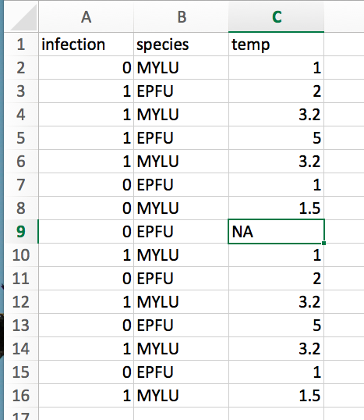
If we fit the models, infection~species, we would have 16 observations
Infection~species+temp, we have 15 observations
We can not validly compare these models.

Slide 6
Goals
Introduce zero-inflated models
Understand the difference between mixture and hurdle models
Learn to assess whether your data is a better fit for one type of model of the other
Examine the output of a zero-inflated model in R
Introduce correlated data problems
Discuss time-series problems

Slide 7
The Zero Problem
Too many zeros can cause models to fit poorly, including over/under dispersion
This is a BIG problem because it one of the few issues in which we are MORE likely to get a significant result because we haven’t properly accounted for dispersion

Slide 8
Negative Binomial
We can frequently solve this problem by using the negative binomial distribution – this will allow us to have a more dispersed count dataset than Poisson
However, too many 0s can muck with your fits resulting in either
1) an underdispersed nb fit (which may indicate a zero-inflated poisson would be best)
2) a negative-binomial model that doesn’t fit the data well (or perhaps doesn’t even run!)

Slide 9
Zero-inflated models
We use zero-inflated models to account for “excess” zeros in the dataset
These start with a probability distribution that underestimates the number of zeros in a data set and then "corrects" this distribution in a particular way to account for the extra zeros.
While an excess zero model can be tacked onto almost any distribution, zero-inflated Poisson and zero-inflated negative binomial are most common (and well-implemented in R)

Slide 10
Types of zero-inflated models
Excess zeros models fall into two broad categories depending on how the "correction" is done. They are the following.
Mixture models (zero-inflated models proper).
Lambert (1992) is the usual citation
Conditional models (called hurdle models).
In ecology Welsh et al. (1996) is often cited.
Notes:
https://www.unc.edu/courses/2006spring/ecol/145/001/docs/lectures/lecture18.htm#excess

Slide 11
Mixture model
In the mixture model we assume the observed zero counts are a heterogeneous mixture and come from two sources.-
Some of the observations are zero just by chance, i.e., the Poisson law predicts that some proportion of events will yield zero counts. This proportion is given by the g₂ distribution.
The rest of the zeros are generated by a different probability generating mechanism altogether. This is the g₁ distribution.
A good example of where a heterogeneous population of zeros might arise is in habitat suitability models.
If we're dealing with a rare species then we would expect there to be zero counts in our sample because some of the sampled habitat is simply unsuitable for the species to exist, either for biological or non-biological reasons.
On the other hand even if we restrict ourselves to suitable habitat, the species might by chance still fail to occur in some of our samples. We would classify these sites as locations where the species could theoretically thrive, but for whatever reason doesn't, either because it hasn't reached the site yet or perhaps it has reached the site but was then locally extirpated, or any number of other reasons.

Slide 12
Hurdle Models
Hurdle models are easy to motivate when it makes sense to separate processes into those that lead to the presence or absence of a population and those that facilitate continued maintenance of a population. This would be the case in habitat suitability models that treat colonization and growth as separate processes and treat the possibility of subsequent extinction as unlikely.
Often in both mixture and conditional models the primary goal is to develop separate regression models for two processes.
However, hurdle models use separate log-likelihoods for the parameters explaining 0/not zero and those involved in explaining the rest of the distribution. This facilitates estimation because the presence-absence portion of the model is fit separately from the model for the nonzero counts.
The parameters also have a clean interpretation. The parameters related to presence-absence deal with habitat invasion while those used to predict the non-zero data relate to sustaining the population once it gets established and there is no overlap between them.

Slide 13
In R
The R package pscl provides implementations of excess zero models.
Poisson and negative binomial distributions for the nonzero counts are supported.
There is the suggestion in the literature that zero-inflated negative binomial (ZINB) models often have convergence problems (Famoye and Singh 2006).
It's worth noting that Warton (2005) argues that many of the published uses of excess zero models may be unnecessary - he argues that the negative binomial probability model is often for environmental and ecological data.

Slide 14
Go to R…

Slide 15
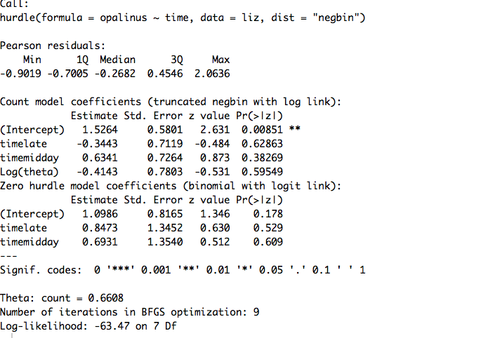
What does this give us?

Slide 16
This is a two-component model:
A truncated count component, such as Poisson, geometric or negative binomial, is employed for positive counts
A (binary) component models zero vs. larger counts.

Slide 17
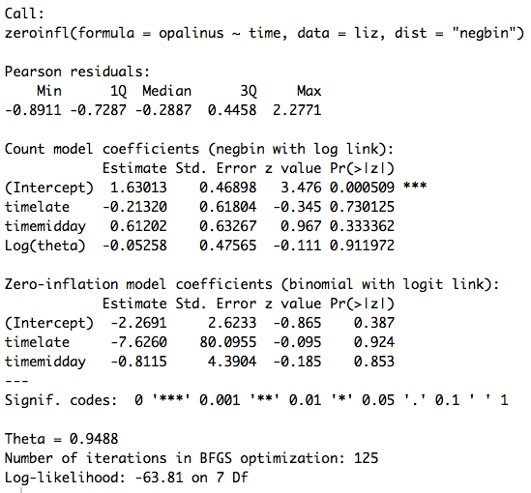
What does this give us?

Slide 18
This is still a two-component models
But the neg. bin. distribution is not truncated (e.g. some zeros are part of the neg. bin. process, and some are part of the binomial process)

Slide 19
Which model is best?
Note that the model output does not indicate in any way if our zero-inflated model is an improvement over a standard nb regression.
We can determine this by running the corresponding nb model and then performing a Vuong test of the two models.

Slide 20
Vuong test
The Vuong tests the null hypothesis that the two models are equally close to the true data generating process, against the alternative that one model is closer. It cannot make any decision whether the "closer" model is the true model. It can be used for non-nested models and seems to be what is in vogue for testing zero-inflated models.
There is some evidence to suggest the Vuong test might not be appropriate for this because the models aren’t truly nested. (The authors of this paper seem to suggest we should just use negative-binomial methods).
AIC is another possibility, but I found a post on stack exchange where someone referred the poster to the Vuong test and said AIC isn’t good!
In general, there seems to be some uncertainty.
You could always double check predictive accuracy through cross-validation. Even if you don’t think, a good check is to plot your model and your data using all different models.
As with all model comparisons, it is not a bad idea to use multiple methods to determine whether they agree.

Slide 21
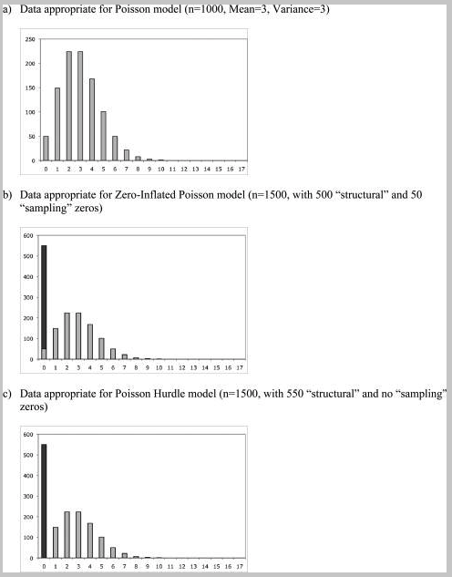
Comparison of data for model types - Poisson
Hu 2012, paper on canvas

Slide 22
Zero-inflated problems
Using the opalinus~time lizard data, examine the difference between a zero-inflated Poisson and a zero-inflated negative binomial. Compare these models (how?)
Predict the better model and plot the model and data using ggplot.

Slide 23
Outline – Correlated Data
Lack of independence among data points in a serious issue in statistics
These processes can be driven by any number of factors. Two important processes we will cover are:
1) Time-series issues (temporally auto-correlated data)
2) Phylogenetic issues (species are not independent data points)
What is another super important correlation in much of ecology/evolution?

Slide 24
Generalized least squares (GLS)
GLS models are a generalization of linear models (ordinary least squares)
They allow us to include matrices which explicitly account for correlation in data. For it to work, we need to have enough data to be able to accurately estimate correlations.
For this reason generalized least squares is especially suitable for temporal data that consist of long time series. Because it's least squares, it is most appropriate when the response variable can be assumed to be normally distributed.
We will start with temporal data (because it is simpler) but can also be used with phylogenetic data

Slide 25
Temporal data (time-series)
Temporal correlation is one-dimensional and unidirectional. We only have to worry about the effect that the past has on the present, not vice versa.

Slide 26
Generalized least squares (GLS)
Because it generalizes ordinary least squares, generalized least squares (GLS) is largely restricted to situations in which a normal distribution makes sense as a probability model for the response.
But remember, normal models are often robust to violation of assumptions.
For non-normal correlated data the choices are a bit murkier.
But what are some things we could do?

Slide 27
How does GLS work?
Generalized least squares (GLS) generalizes ordinary least squares to the case where the residuals (errors) have a normal distribution with an arbitrary covariance matrix.
So as was the case with ordinary least squares we end up with an exact formula for the regression parameters, this time in terms of the design matrix and the unscaled covariance matrix V. Unfortunately the formula requires that we know V, so typically we'll need to estimate it first.
To make this problem feasible and to avoid overparameterization, the usual approach is to assume that V has a very simple form, a correlation structure that is based on a small number of parameters, and to jointly estimate the regression parameters and the covariance parameters. There are specific algorithms for special correlation structures, but a general approach is to use maximum likelihood estimation.

Slide 28
How does GLS work?
Imagine fitting a regression model to some temporal data (e.g. number of mosquito species over years)
We can make some assumptions about the residuals (e.g. the error that is left over after fitting)
These assume that:
1) Their mean is not changing.
2) The correlation between the residuals is only a function of their relative temporal position and is not related to their absolute temporal position.
Because of the second assumption, we can identify the autocorrelation among residuals by examining time lags.

Slide 29
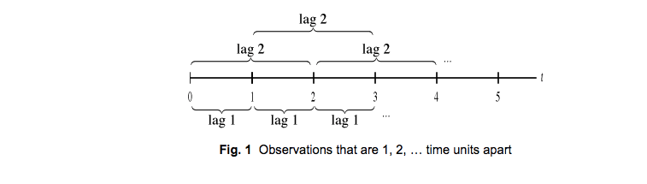
Lags

Slide 30
Autocorrelation
Autocorrelation is the linear dependence of a variable with itself at two points in time
e.g. The average number of bats in 2001 should be predicted by the average number of bats in 2000
The temperature today depends on the temperature yesterday (usually)

Slide 31
Partial autocorrelation
Partial autocorrelation is the autocorrelation between y_{t} and y_{t–lag} after removing any linear dependence.

Slide 32
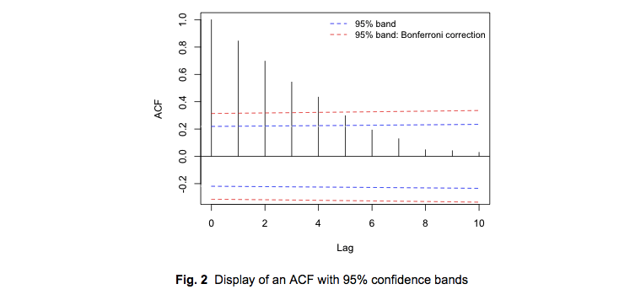
ACF Plot
We expect with temporally ordered data that the correlation will decrease with increasing lag. Here the correlation decreases exponentially with lag.
This says what is the correlation between 1 v. 2, 1 v. 3, 1 v 4, 1 v 5, etc.

Slide 33
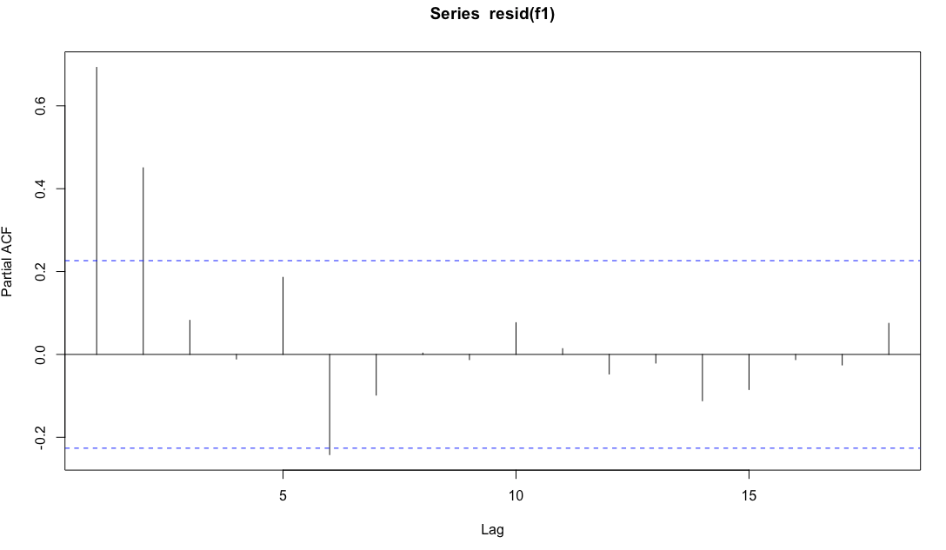
Partial autocorrelation
Another useful diagnostic the partial autocorrelation function (PACF).
Here, you can regress each residual against lagged residuals at different time points.
Significant spikes will help to inform you about when the autocorrelation disappears between lags
This says what is the correlation between 1 v. 2, 1 v. 3 (after accounting for correlation between 1 and 2).

Slide 34
Some types of autocorrelation models
AR(p, autoregressive) models, where p is a given lag number
Examine the lag residuals to determine when the significant correlation among residuals disappears
Autocorrelation often decreases exponentially to 0
Often just a single spike
MA (q, moving average models)
Autocorrelation with one or more significant spikes, and the rest of the spikes are near 0
Autoregressive moving average (ARMA, p,q)
ACF exhibits a few significant spikes followed by a decay.
The ACF and PACF are hybrids of the AR(p) and MA(q) patterns

Slide 35
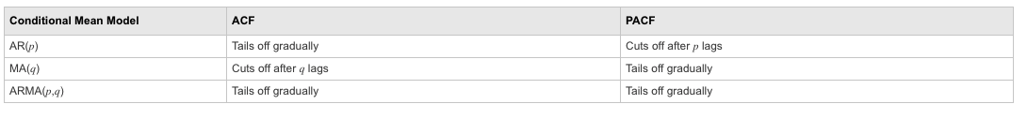
Summary of what plots look like for different models

Slide 36
Digger deeper
This is a REALLY brief introduction to time-series models (which are complicated!)
Additional resources:
http://www.unc.edu/courses/2010spring/ecol/562/001/docs/lectures/lecture9.htm
http://www.unc.edu/courses/2010spring/ecol/562/001/docs/lectures/lecture10.htm
https://socialsciences.mcmaster.ca/jfox/Books/Companion/appendix/Appendix-Timeseries-Regression.pdf
http://www.stats.uwo.ca/faculty/braun/ss359a/2004/notes/Chapter14/glsnotes.pdf
People seem to like this book: https://www.amazon.com/dp/144197864X/?tag=stackoverflow17-20
And see this post: https://stats.stackexchange.com/questions/20514/books-for-self-studying-time-series-analysis

Slide 37
Go to R…

