Slide 1
What is R?
R is a programming language.
It’s open-source, which means any of us could write an contribute packages for R.

Slide 2
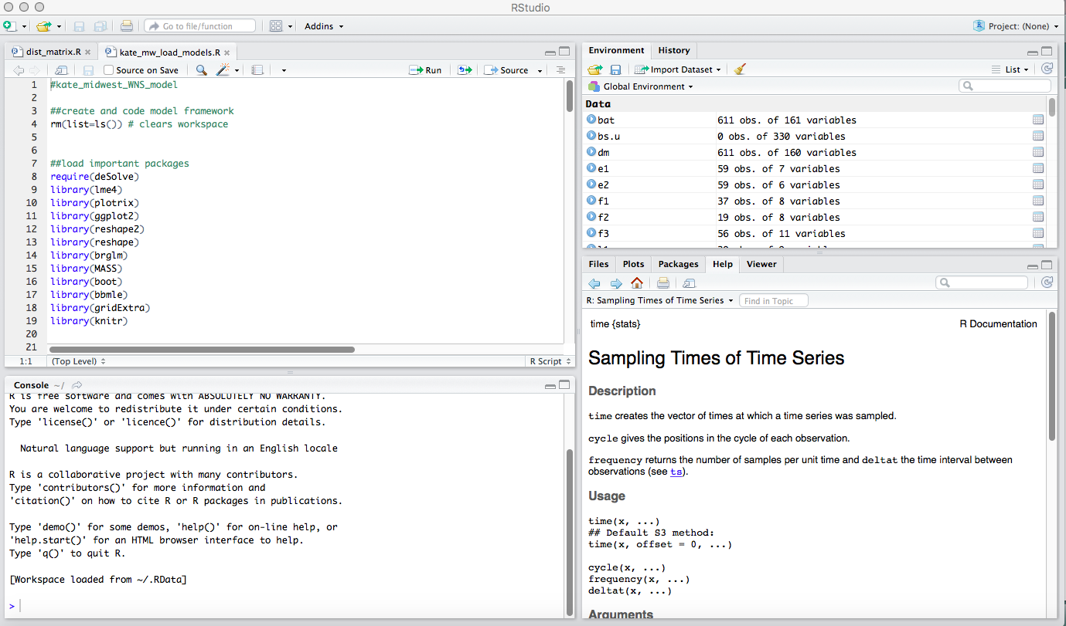
Exploring R
Write your commands here (command + enter) to run

Slide 3
Exploring R
They will be executed here, in the console.
You can also enter stuff directly into the console. (enter to run, esc to quit)

Slide 4
Exploring R
R studio tells you what is currently loaded here

Slide 5
Exploring R
This window is where you visualize most things, also help window

Slide 6
Reading data into R
r2 <- read.csv("/Users/klangwig/Dropbox/Contact rate MS/Network graph/Network data/enviro_master.csv")
Replace with your own directory (can check with right click and “get info”)

Slide 7
Referring to a column in a data frame
$ (the dollar sign) is used to refer to a column within a data frame
(switch to console - #dataframes)

Slide 8
Objects in R
R keeps track of a variety of objects and functions : Dataframes, Values, Factors, Vectors, Lists, and Functions
You can see all of your user-defined objects by typing objects() (the parentheses mean that you are calling a function; more on this later).
This should also be what is listed in the environment (top right)

Slide 9
Values
In addition to numbers, R has other kinds of values (also known as “atomic types”).
The main ones we’re interested in are character, numeric, factor and logical (ie., TRUE or FALSE). str() is one way to try to figure out what your R object is.
Eg. str(x)
When you read in data, R automatically assigns your field a value type. Sometimes, this value type is wrong. You can often convert among data types with new.x <- as.numeric(x) but BE CAREFUL!

Slide 10
Factors
Factors are used to describe items that can have a known set of values (gender, social class, etc.) - categorical variables in statistical terms.
When you read data into R, many variables containing text will be automatically stored as factors
This is helpful for analyses, but can be kind of annoying if you want to make a change in your data
(Switch to console)

Slide 11
Assigning things in R
<- vs. =
Both assign things in R, but some people think the “=“ is sloppy coding
I also use <- when writing functions
(switch to R console)

Slide 12
Functions
Functions are “called” using parentheses. A function is a set of commands that uses whatever “arguments” are inside the parentheses and does things (including possibly “returning” a result).
Functions (often written by others) are the fundamental backbone of the R environment. They will let us do most of the things we want to in R.
Many functions are part of the base environment – e.g. they come pre-installed with R
Others are part of packages that are installed separately. Some of these packages are particularly useful for ecologists, and we will be using these instead of the base R packages (e.g. ggplot2 instead of plot).

Slide 13
Function examples
Example: mean() in its simplest form takes a vector argument and returns the mean.

Slide 14
Getting help on functions
You can learn about any built-in function by using R’s help:
type ?"mean" or help("mean").
Arguments can be passed to functions in order, or by using names. For example, mean takes an optional argument trim.
A major complaint about R is that help pages can be indecipherable, especially for beginners.
Quick-R often has more helpful information when you are just starting:
https://www.statmethods.net/index.html
(switch to console)

Slide 15
Installing and loading packages
Can search packages to install using “Packages” tab in lower right, and then clicking “Install” button
Load packages with library() – e.g. library(ggplot2)
Most frequently used R packages by us:
Outside of R: xcode (mac only) – see HappyGitWithR
ggplot2
tidyverse
dplyr
reshape2
reshape
gridExtra
officer
Knitr

Slide 16
Writing a .csv file
write.csv(df1, file = "/Users/mkailing/Dropbox/Kailing_Projects/DATA/newfile.csv", row.names = F)
“df1” is the dataframe object you are wanting to make a .csv
“file = ” tells R where to store (file path) the new .csv and to name it newfile
Similar to reading in your file, you can paste in your file directory from “Get info” in Finder (or file explorer for PCs)

