Slide 1
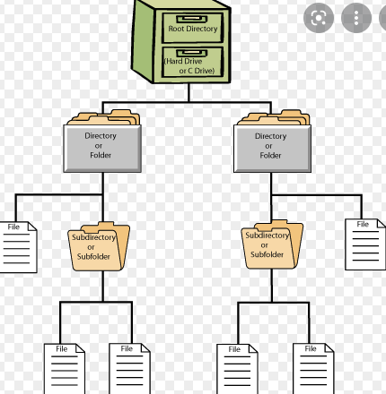
File system overview

Slide 2
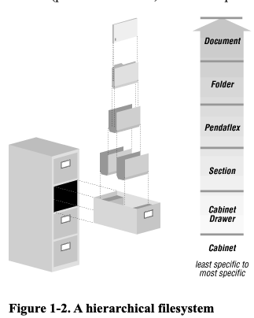
File system overview

Slide 3
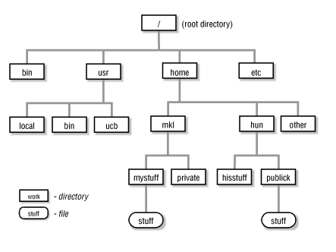

Slide 4
Article on the change in file structure
https://www.theverge.com/22684730/students-file-folder-directory-structure-education-gen-z

Slide 5
For this course, you need to understand hierarchical file structure

