Slide 1
Week 12 - Assignment Mixed Models

Slide 2
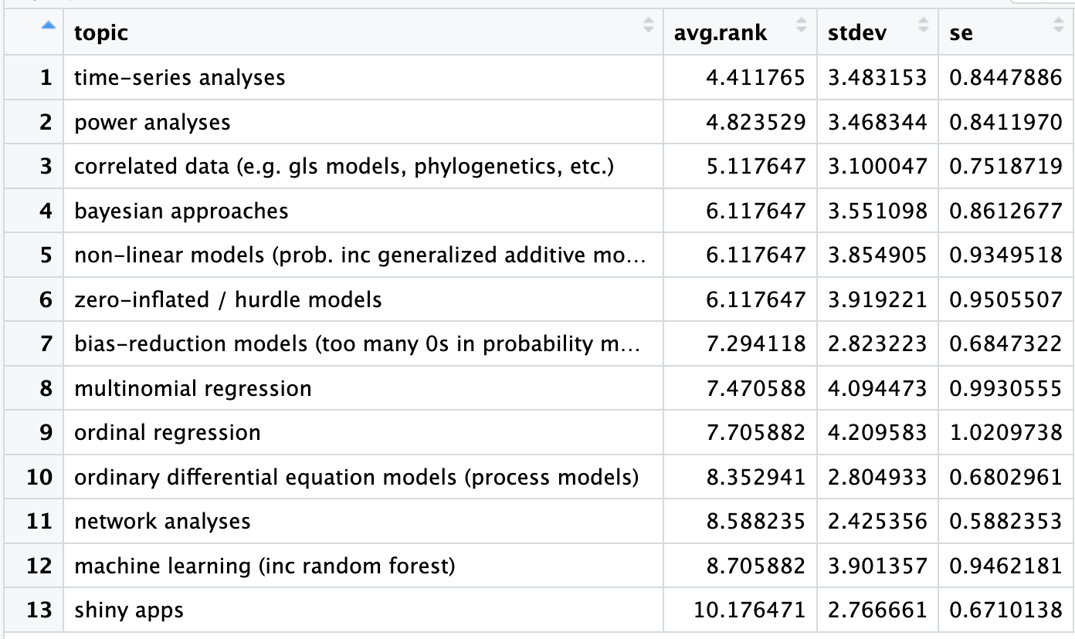

Slide 4
Reference on writing results
There is a document on canvas with some tips for writing results statements

Slide 5
Feedback
If you need feedback urgently in order to progress with your project, please email me so we can prioritize

Slide 6
Assignment
1. Run a mixed model on one (or more) of your hypotheses.
If you model does not run w/o a warning or if you violate the assumptions, please note this.
2. In a separate document that you upload to canvas, write a results statement based on your model output. You can include any tables you need to reference in your results statement.
It is okay to just include some results and not all (and preferable to me!)
3. Remember to update your README file, annotate your code, and push your changes to github. I will also check your code.

