Slide 1
Reading for next week
Next Thursday we will have a class discussion
Please read articles 1-4. They should not be too hard to get through. Think about your own statistical philosophy and be prepared to talk about what statistical inference means to you.
Consider looking through articles 5 -8. Different articles will speak to different people.

Slide 2
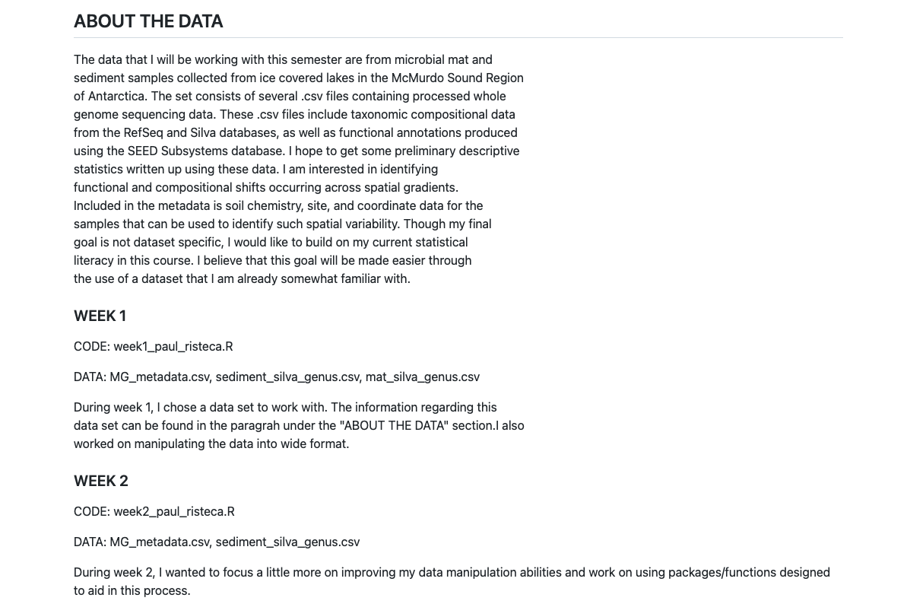
README reminder
Paragraph about your data
Week by week log of code & data files, short description of what you did
Notes:
https://github.com/VTQuantMethodsEEB/pristeca/blob/main/README.md

Slide 3
Read ‘Tips for turning in assignments’
I promise not to start grading until Saturday, so please take this time to make sure you have followed these directions exactly.
Paper handout + available online
Do not just type ‘DONE’ in canvas. You need to tell me where your assignment is stored (e.g. the name of your repo).

Slide 4
Exercises week 3 – type DONE and your repo name on canvas when completed
Construct some (i.e., more than one) ggplots using your data. Explain what you are trying to show and some of the choices that you have made. (ANNOTATE THIS IN YOUR CODE).
Remember our lecture – be sure to honestly depict the datapoints (e.g. boxplots with points on them)
Advanced users: Add thematic elements and color to compose a publication worthy figure.
You should put your code on GitHub. Make sure that the runs from beginning to end. You can test this by clearing your R workspace and running it from beginning to end.
Send to GITHUB:
Call your script file “week3_firstnamelastname.R”
Update your README to tell me how these things go together (e.g. I am making some plots of x, y, and z because I am interested in blah)
Reminders:
I will run your scripts and I want to understand them
Make sure any special packages that you call are included in your script!
Make sure you have set up your .Rproj file so that I can read in your data on my computer

