Slide 1
QMEE
Class notes
klangwig
Jhoyt (you)
You don’t need to make this folder – you will clone this folder into your local system from GitHub. Every class – dbl click .Rproj file and press ‘pull’.
You don’t need to make this folder – you will clone this folder from GitHub. Every time you work in this folder – dbl click .Rproj file and press ‘pull’. Make change. Type something in the commit box, then press ‘commit’. The push.
Store earlier files you made for the class here and any notes you take while listening to lectures.

Slide 2
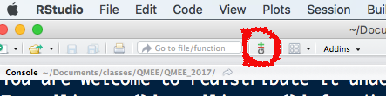
Exercise Week 2 – Tidy &Git
ON GITHUB: VTQuantMethodsEEB
Make a ‘New Repository’ in the class repo (you should all be invited) named after yourself. (Make sure you are inside the organization account!)
Check the box to initialize with a README file. It doesn’t matter what this says.
Add your data, and your week 1 script
Add me as a collaborator, go to “Settings -> Collaborators & Teams -> Search By UserName -> klangwig”
On your computer:
1., Make sure you have followed the instructions here: https://happygitwithr.com/install-git.html#install-git
2. Advance and to follow the instructions here: https://happygitwithr.com/hello-git.html
3. Optional: Install a Git Client (I recommend GitHub Desktop) https://happygitwithr.com/git-client.html
4. Create a personal access token following instructions here: https://happygitwithr.com/https-pat.html
I have made it easy for you but creating an R script that lets you do this:
https://github.com/VTQuantMethodsEEB/klangwig/blob/master/lectures/week_2_managing_data/git_token_help.R
Now, with Rstudio open (it should be because you just created an access token):
In the menus, go to File > New Project > Version Control > Git
Enter https://github.com/VTQuantMethodsEEB/your_repo.git - you can copy and paste the location from the browser – ensure it is a subfolder inside VTQuantMethodsEEB
For the project directory – use the name you called your repo on github (don’t let Rstudio correct it!). This should be a folder that doesn’t yet exist on your computer (e.g. an empty folder)
For the where to put it – this is the is the place on your computer that your project will live. I store mine here: /Users/klangwig/Dropbox/teaching/quant grad course/github . Be thoughtful about this because this is where you will be storing all your assignments for this course as well as code, etc.
When you press okay, this will create a new directory on your local machine, and copy things from the github folder to your local folder.
You should now see whatever you have put in github on your local machine. If not, copy your code file, your readme file, and data file into this folder.
Open up your code from your new folder, and make a small change (it could be something like “#testing code change”. Save the file.
Locate the git icon on the menu bar in R studio.
Click the icon to select Commit from the drop-down menu. This is taking a snapshot of your change.
Check the boxes next to your new files. Rstudio will automatically notice files that have changes.
Type a commit message in the box – this is the snapshot – so it is like captioning the edits you made to the document.
Click the Push icon in the upper right. This is sending the document to GitHub.
Now, whenever you make a change to your code, you will follow this process of commit and pushing to your Github directory. Everytime you open your project folder after not working on it for a little bit, you will need to first PULL. Pulling will integrate any changes I made to your code on my computer.
To summarize, in the future you will always: (1) pull, (2) do your thing (e.g. code, add data, update README), (3) commit, (4) Push.
Notes:
OLD STUFF HERE
and the new README.md file you just created using the upload file button.
NOW FOR THE GIT STUFF….
6. Go to file, new file, Rmarkdown. Choose – From Template – Github.
- this is an Rmarkdown file. When you knit, it will make a .md that you can upload to github.
7. In your markdown doc – call your title “README”. Leave the header in gray alone. Where it says “##Github Documents – replace this with the name of your project. Where it says “This an R Markdown…” Replace with the paragraph you turned in about your data. Describe the type of investigations you might do with your data, and how you will break them up into different components (this can be changed and is just for practice, but the goal here is I will do xx analysis, and then I will make xx figure..). You can delete the rest of the text in the file.
8. Start a log of what you have done for your project. 8. Save this in a place you can find it later. Press the knit button on the top of your script. This will render a .md file.

Slide 3
README and Tidy assignment
Creating a README
You should have a file called “README.md” in your project folder that was initialized when you made your repository.
Open this document in Rstudio. At the top of the document, paste the paragraph about your data.
Below the paragraph about your data, start a log of what you did each week.
Each week, you will update this log by describing the type of investigations you might do with your data, and how you will break them up into different components (e.g. I will do xx analysis, and then I will make xx figure..), and you will always include: (1) what data file you used (2) what you called your R script.
For example ##WEEK 1## - Intro to R, I made this and that, I used this file and these scripts. See file https://github.com/VTQuantMethodsEEB/klangwig/blob/master/README_example.md.
Commit your changes. Push to Github as described above.
Navigate to your repo on GitHub via your web browser. Check to see if you can see your README file with your changes. If you can’t, (1) read through everything again and make sure you didn’t missing anything, (2) ask for help.
Week 2 Coding Stuff –This is the actual assignment part
1. Put your data in tidy format
2. Input your data into R.
3. Examine your data for mistakes.
4. Experiment with “group by” in dplyr to do some calculation.
5. Use mutate and summarise on your data. How are these different?
6. Commit and push to GitHub. Be sure to update your README!
When you have completed the assignment, please let me know by submitting a message through canvas assignments tab which is “DONE – github repo name”. (That way I won’t grade something that is incomplete).

Slide 4
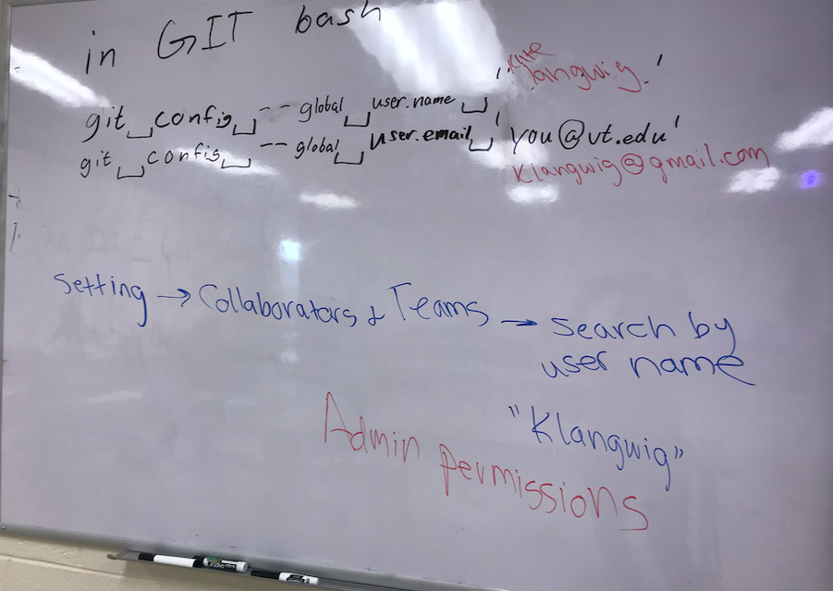
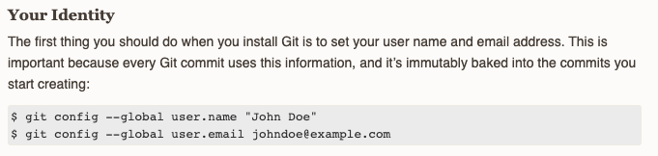
For PC people when Git won’t work
Click the Windows or Start icon
In the Programs list, open the Git folder
Click the option for Git Bash.
https://help.github.com/en/github/using-git/setting-your-username-in-git

Slide 5
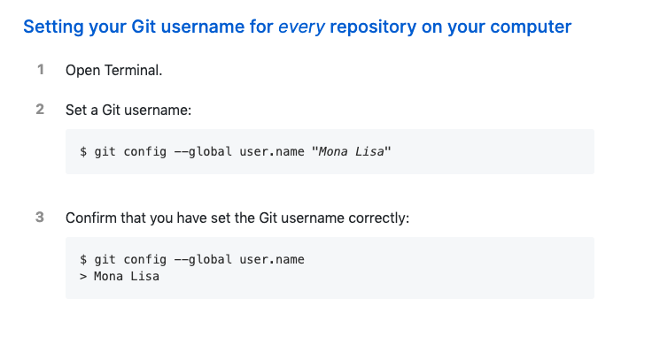
User name first:

