Slide 1
Week 1 Intro to R Exercises
Thursday Pre-lecture

Slide 2
Reading data
r2 <- read.csv("/Users/klangwig/Dropbox/Contact rate MS/Network graph/Network data/enviro_master.csv")
Replace with your own directory (can check with right click and “get info”)

Slide 3
Creating a project
Creating project allows for directory free reading of files and is more generalizable across users
This will also allow us to better synchronize and share code
A project is associated with a folder on your computer. The folder can contain sub-folders. Next week, we will learn how to use Git to work on projects using version control.

Slide 4
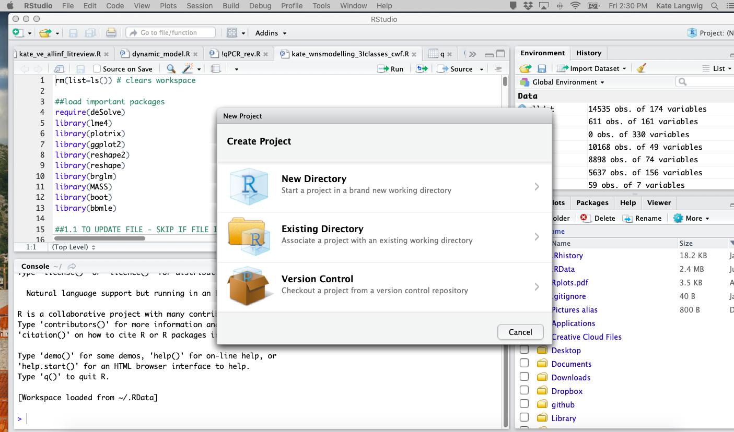
Instructions for creating an R project
File -->New Project
Click either “New Directory” or “Existing Directory” if you already have a named folder. Next week we will create a new project directory for the course that will be compatible with GitHub, but for now, we will demonstrate how to do this on your local computer.
[GO TO R]

Slide 5
What should my dataset look like?
Preferably you have a dataset with a couple different variables with some numerical quantity that you have measured
Most datasets should therefore have at least 3 columns
The predictor variables can be very simple – e.g. site, species, collector or date are all fine.
Most of the time, you won’t need a minimum number of observations, although you might need to simulate (e.g. fake) some data for some analyses if your dataset is very small.
For example, you have weighed animals, you have identified each animal to a species (of which you have more than one), and you caught those animals on different dates.

Slide 6
Packages to install
ggplot2
tidyverse
dplyr
reshape2
reshape
gridExtra
officer
knitr
Load packages with library() – e.g. library(ggplot2)
Can search packages to install using “Packages” tab in lower right, and then clicking “Install” button

Slide 7
Installing Git and Github - DUE WED!
Register for a GitHub account: you can just go straight to https://github.com to do this (by clicking on either of the green “Sign up” buttons). The one thing you may want to read first is this advice on picking a GitHub user name.
Install Git on your machine. This website provides some helpful instructions for getting started with Git:
http://happygitwithr.com/install-git.html#install-git
if you’re on MacOS, it can be helpful to install Xcode ahead of time (https://developer.apple.com/download/) if you aren’t comfortable with command line
Please send me your github user name (via canvas)

Slide 8
%>% (Piping)
Piping makes code more readable
It passes the object on the left side as the first argument of the function on the right side
You can think of the pipe as saying the word “then”
It can save you from using a bunch of parentheses
They are implemented via the magrittr package
http://blog.revolutionanalytics.com/2014/07/magrittr-simplifying-r-code-with-pipes.html
https://www.datacamp.com/community/tutorials/pipe-r-tutorial
Next week, we’ll start the dplyr package

Slide 9
Assignment – if you don’t have data yet, you can use some of the data on canvas, but the paragraph you turn in should be about YOUR data
Choose a data set that will be fun to explore for this class, and possibly for the final project. Acquire the data
Do the following:
reading data into R
Use View to viewing the data
Selecting a column
Selecting a row.
Type summary(yourdata). What does this give you?
Do a calculations with your data whre you add a column (e.g. log a variable, add 1 to a columns value)
Use base R to aggregate your data. See ?”aggregate” for help. Also, make a data table.
Basic code: f1 <- aggregate(tally~site+date+species,FUN=sum,data=dm) tab1 <- table(dm$site_date,dm$species)
Modify your functions for aggregate – don’t just use sum. Do a couple of different style tables as if you were writing a report. See R script for example.
For all students
5. Send in a paragraph describing your data. You can copy and paste your output and summary tables into the file to provide some additional context. In this paragraph: Include a list of goals you would like to make for your dataset/thesis project. 6. You will upload your annotated code and data file of the above on GitHub on week 2 where you have completed the above. Be sure to also upload your data file.
For more advanced R users:
6. Using the cheatsheets on canvas, use tidyverse functions paired with piping to make the same table I do with base R. 7. Using the officers package, output your tables into a word document (see the code in files for example with officer). Try something fancier than I have in my example and play around with table formatting. If you have a mac, you will need xquartz to get officers to work.
For the very advanced R users:
8. All the steps above, but make an Rmarkdown file, knit your document and upload the .html too.

