Slide 1

Vel Tech Rangarajan Dr. Sagunthala R&D Institute of Science and Technology
School of Computing
Department of Computer Science and Engineering
10211CS224 / FULL STACK APPLICATION DEVELOPMENT (JAVA)
PROJECT REVIEW : MILESTONE PROJECT – 1
Date: 25-03-2026
Full-Stack Skill Learning Academy MarketPlace With Secure Authentication
SDG: 4 – Quality Education
Presented By:
Shaik Mansoor – VTU26005 – Reg.No. 23UECS1202
Courses Handling Faculty:
Dr. S. HEMAMALIN I, M.E. , Ph.D. ,
Assistant Professor (Senior Grade)

Slide 2
INTRODUCTION
Online learning platforms are growing rapidly.Many students depend on digital platforms for education.
Many systems lack structured learning paths.Users can access any content without proper order.
Users often skip basics and face difficulties.This leads to weak understanding of advanced topics.
Need for controlled and guided learning system.A step-by-step learning approach is required.
Project provides step-by-step course progression.Ensures users follow proper learning sequence.
Uses secure authentication with Firebase.Provides reliable and industry-level login system.
Tracks user progress effectively.Helps users monitor their course completion status.
Provides premium-based advanced learning.Advanced courses are unlocked through premium access.
1
2
3
4
5
6
7
8
9

Slide 3
PROBLEM STATEMENT
The existing online learning systems lack a structured and effective approach to guide users through the learning process. Many platforms do not enforce a proper learning sequence, allowing users to jump directly to advanced topics without completing the basics, which reduces understanding, clarity, and overall learning effectiveness. Additionally, there is a lack of proper progress tracking mechanisms, making it difficult to monitor completed courses and user advancement. Most systems also do not include a structured course unlocking feature, resulting in all content being freely accessible without any logical progression. Furthermore, manual processes in such systems are inefficient, requiring more effort and lacking automation. Security is another concern, as many platforms do not integrate strong authentication methods, leading to potential risks. Therefore, there is a need for an automated and intelligent learning platform that ensures a guided learning path, secure access, proper tracking, and an improved user learning experience with better engagement and understanding.
1
2
3
4
5
6
7
8
9

Slide 4
OBJECTIVE(S)
To design and develop a structured learning platform.Create a system that enforces step-by-step learning.
To implement secure authentication and course progression.Ensure safe login and controlled course access.
1
2
3
4
5
6
7
8
9

Slide 5
PROPOSED SYSTEM
1
Provides user registration and login using Firebase.Ensures secure and reliable authentication process.
Allows users to enroll in courses.Users can select and start learning easily.
Tracks course completion status.Maintains record of completed courses.
Restricts access to advanced courses.Prevents users from skipping basic learning.
Unlocks advanced courses after basic completion.Ensures proper knowledge flow.
Includes premium feature for advanced access.Adds additional control for advanced content.
Stores user data securely in database.Maintains data integrity and safety.
Improves learning efficiency and structure.Provides better user experience.
2
3
4
5
6
7
8
9

Slide 6
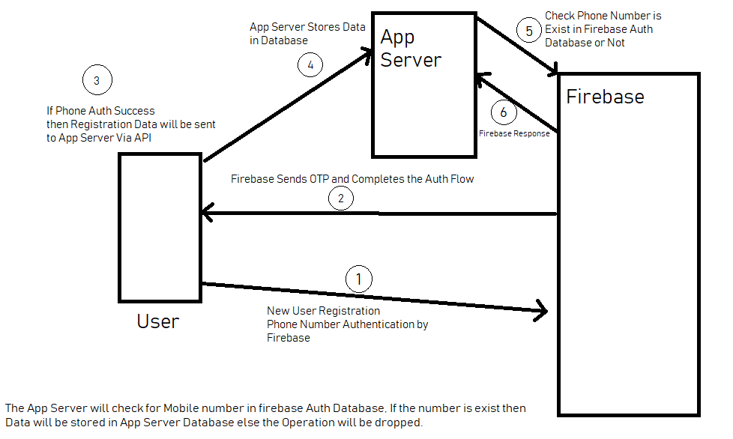
PROPOSED SYSTEM ARCHITECTURE
1
Input: User login (Admin, Lecturer, Student) Users enter their credentials through the homepage interface.
Processing: User authentication and role verification The system checks whether the user exists in the database and identifies their role (admin or lecturer/student).
System Functions: Role-based operations Admin can create users, upload/edit/delete data, and manage live streaming. Lecturers and students can access the interface, watch live streams, and interact with the system.
Database: Central database storage Stores user details, course data, and system information for retrieval and updates.
Output: User interface with features Displays lecturer/student interface, live streaming, data access, and chat application for communication.
2
3
4
5
6
7
8
9

Slide 7
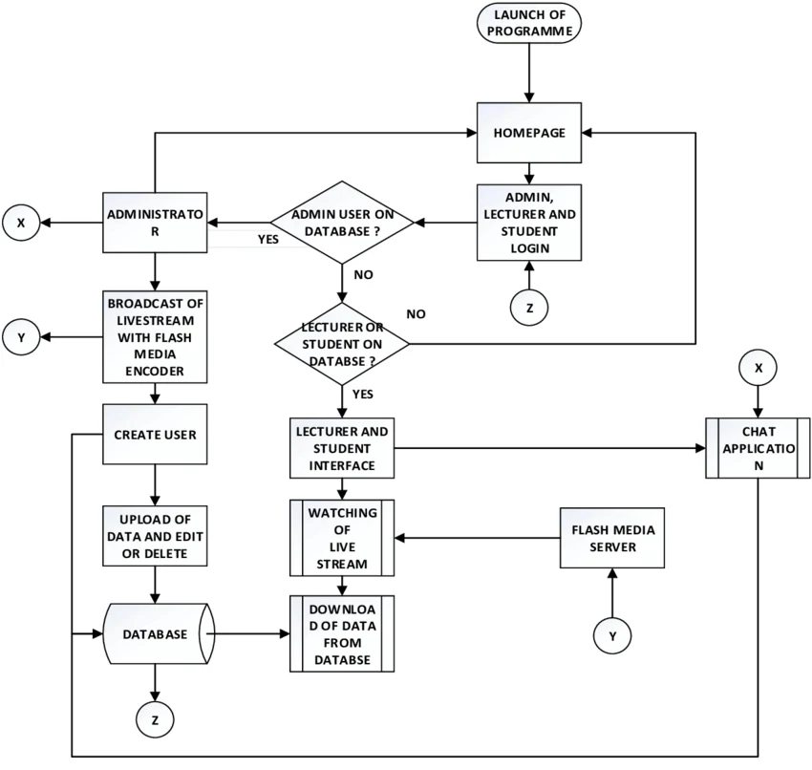
WORKFLOW
1
The workflow begins with the launch of the program, leading to the homepage where users log in as admin, lecturer, or student. The system verifies user details from the database and directs them accordingly. Admin users manage system activities such as creating users, uploading or editing data, and broadcasting live streams. Lecturers and students access their interface to view content, watch live streaming through the media server, and download data from the database. Additionally, a chat application is provided for communication, ensuring smooth interaction and efficient system operation
2
3
4
5
6
7
8
9

Slide 8
TECHNOLOGIES USED
Frontend: HTML, CSS, JavaScript Used to design user interface and interactions.
Backend: PHP Handles server-side logic and processing.
Authentication: Firebase Provides secure and scalable login system.
Database: MySQL Stores user data and course information.
Scripting: Python Used for token verification process.
Tools: XAMPP / VS Code Used for development and testing.
Software Requirements: Web browser Required to run and access the system
1
2
3
4
5
6
7
8
9

Slide 9
MODULE DESCRIPTION
1
Module 1: User Authentication
Handles user registration and login Uses Firebase for secure authentication.
Ensures secure user access Prevents unauthorized login attempts.
Module 2: Course Management
Displays available courses Allows users to select and enroll.
Controls access to advanced courses Based on completion and premium status.
Module 3: Progress Tracking
Tracks completed courses Updates user progress in database.
Displays progress in dashboard Helps users monitor learning.
Module 4: Premium System
Enables advanced course access Unlocks restricted content.
Simulates premium upgrade Controls user permissions
effectively.
2
3
4
5
6
7
8
9

Slide 10
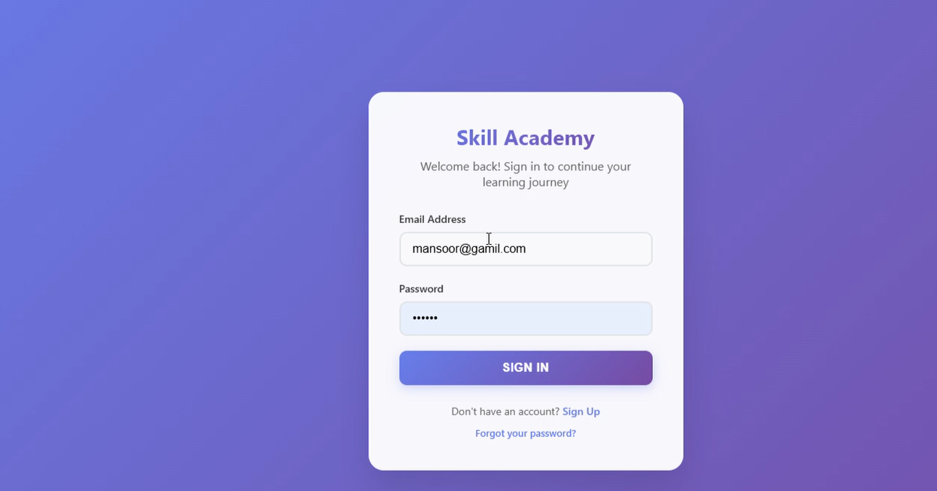
IMPLEMENTATION SCREENSHOTS
.
1
2
3
4
5
6
7
8
9

Slide 11
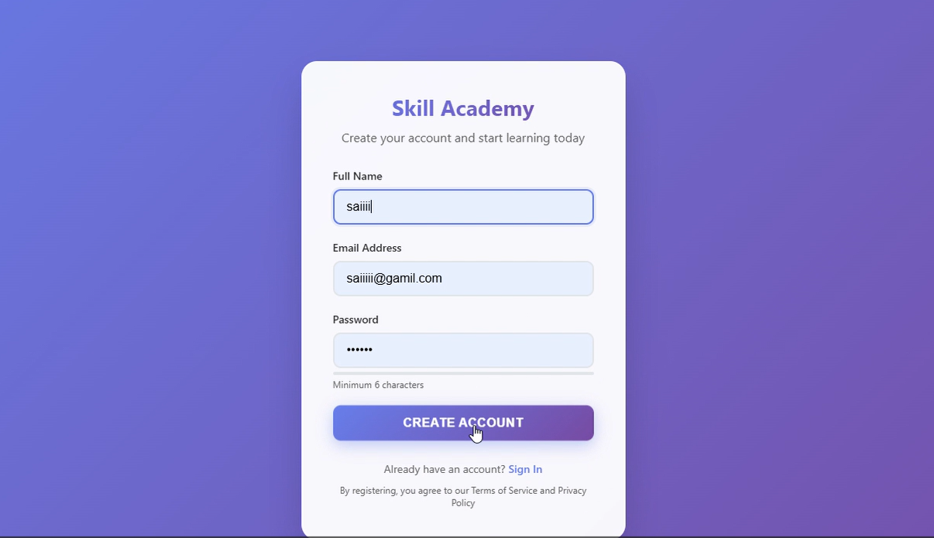
IMPLEMENTATION SCREENSHOTS
.
1
2
3
4
5
6
7
8
9

Slide 12
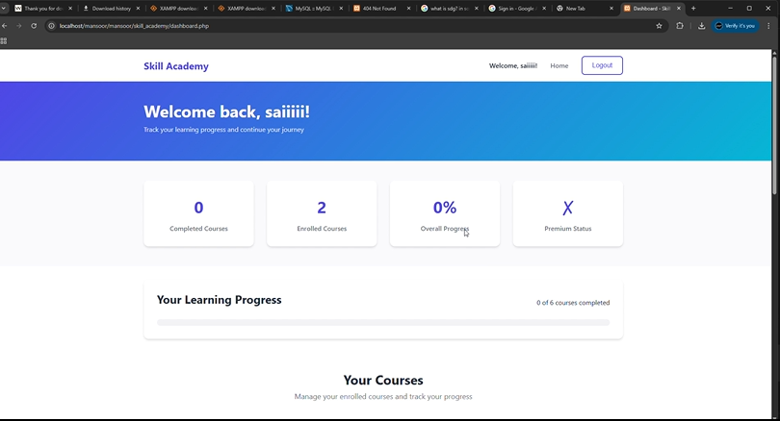
IMPLEMENTATION SCREENSHOTS
.
1
2
3
4
5
6
7
8
9

Slide 13
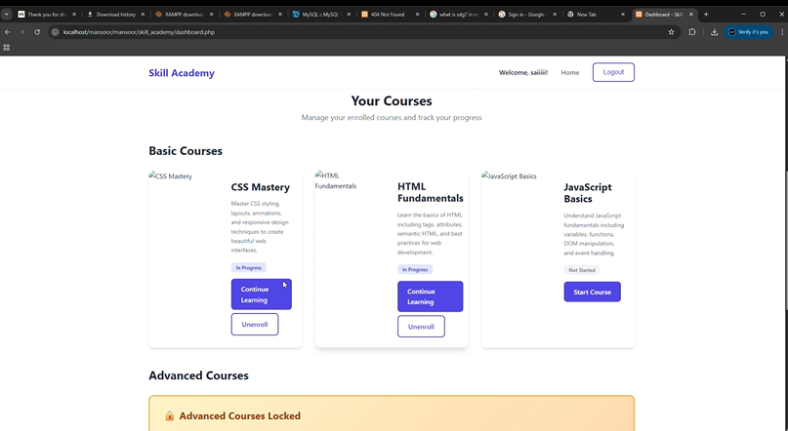
IMPLEMENTATION SCREENSHOTS
.
1
2
3
4
5
6
7
8
9

Slide 14
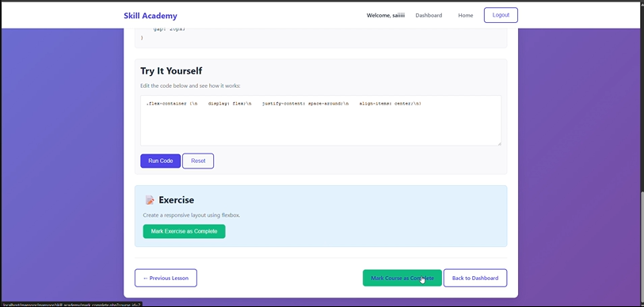
IMPLEMENTATION SCREENSHOTS
1
2
3
4
5
6
7
8(A)
9

Slide 15
ADVANTAGES & LIMITATIONS
1
ADVANTAGES
LIMITATIONS
2
Secure authentication using Firebase Ensures safe and reliable user login.
Structured learning path Prevents skipping of important topics.
Easy to use interface Simple design improves usability.
Real-time progress tracking Keeps users updated with their progress.
Scalable system design Can be expanded with more features.
No real payment gateway integration Premium feature is only simulated.
UI is basic and can be improved Needs better design and responsiveness.
No admin panel for course management Cannot add or edit courses dynamically.
Limited course content Needs more learning materials.
Depends on internet connectivity Cannot work in offline mode.
3
4
5
6
7
8
9

Slide 16
Thank you

