Slide 1

Vel Tech Rangarajan Dr. Sagunthala R&D Institute of Science and Technology
School of Computing
Department of Computer Science and Engineering
10211CS224 / FULL STACK APPLICATION DEVELOPMENT (JAVA)
PROJECT REVIEW : MILESTONE PROJECT – 2
Date: 21-04-2026
Job Portal Management System
SDG: SDG No – Decent Work and Economic Growth
Presented By:
Sk. Mansoor– VTU26005 – 23UECS1202.
Courses Handling Faculty:
Dr. Hemamalini .S

Slide 2
INTRODUCTION
Web-based application built using React
Connects job seekers and employers in one platform
Employers can post and manage job openings
Job seekers can search and apply for jobs easily
Provides simple and user-friendly interface
Reduces time and effort in hiring process
Improves access to employment opportunities
1
2
3
4
5
6
7
8
9

Slide 3
PROBLEM STATEMENT
raditional job search process is time-consuming and inefficient
Lack of a centralized platform for job seekers and employers
Difficulty in finding relevant job opportunities
Employers face challenges in reaching suitable candidates
Manual hiring processes lead to delays and errors
Limited access to job information in rural or remote areas
Lack of transparency in application and selection process
Need for a simple, digital solution to streamline recruitment and job searching
1
2
3
4
5
6
7
8
9

Slide 4
OBJECTIVE(S)
1
Develop a user-friendly web application for job seekers and employers
Provide a centralized platform for job posting and job searching
Enable employers to post, update, and manage job listings efficiently
Allow job seekers to search, view, and apply for jobs
Simplify and automate the recruitment process
Improve accessibility to employment opportunities
Ensure faster communication between employers and candidatesSupport equal job opportunities and reduce hiring barriers
Enhance overall efficiency of the job hiring system
2
3
.
4
5
6
7
8
9

Slide 5
PROPOSED SYSTEM
Develop a web-based application using React
Provide a centralized platform for job seekers and employers
Enable user registration and login for secure access
Allow employers to post, edit, and delete job listings
Allow job seekers to search and apply for jobs online
Display job details with role, company, location, and requirements
Implement simple and intuitive user interface
Store and manage data using local storage or backend database
Provide real-time updates on job postings and applications
Ensure faster and more efficient recruitment process
Improve transparency and accessibility in job hiring
Support scalable design for future enhancements
1
2
3
4
5
6
7
8
9

Slide 6
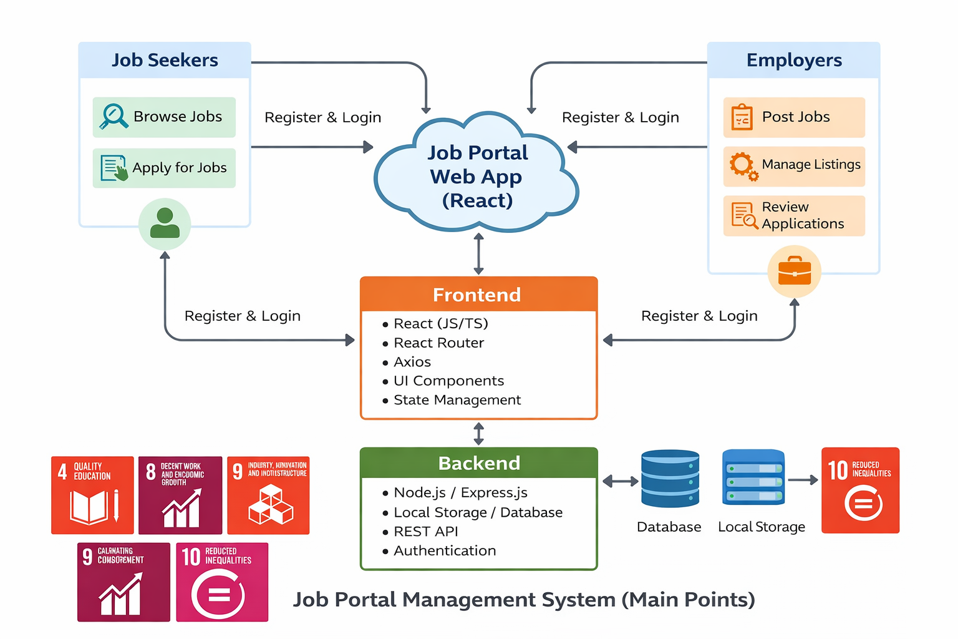
PROPOSED SYSTEM ARCHITECTURE
Input:
Student login & signup
Course selection
Payments & Enrollments
Processing:
Secure login (JWT)
Manage course delivery
Handle rules and APIs (Express)
Manage users and roles
Database:
Store user info (profiles, login)
Store course info (materials)
Track progress and scores
Use MongoDB
Output:
Access courses (videos, notes)
Get certificates for completing courses
1
2
3
4
5
6
7
8
9

Slide 7
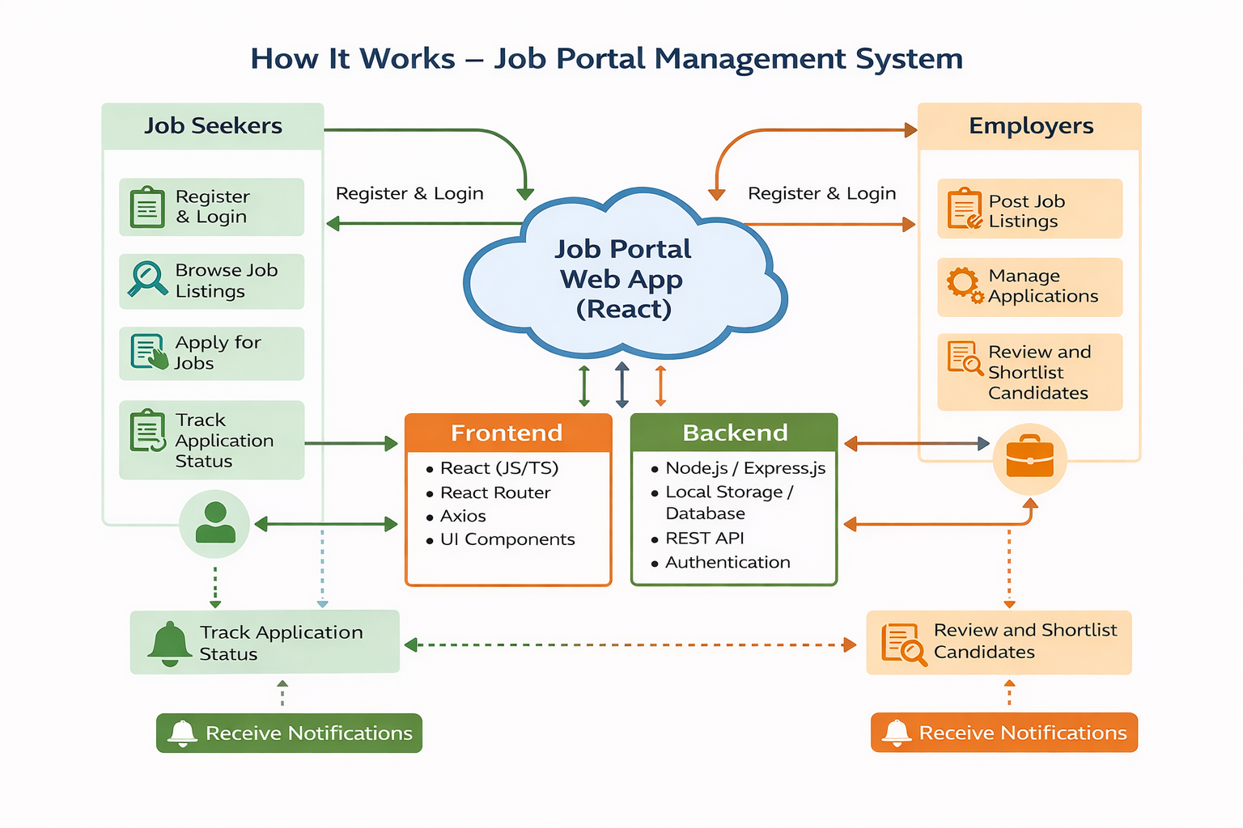
WORKFLOW
1
2
3
4
5
6
7
8
Data Flow Diagram: Shows how data moves between users, backend, and database. Includes processes like login, course selection, enrollment, and payments. Outputs personalized dashboards with courses, progress, and recommendations.
9

Slide 8
WORK FLOW
1
User registers and logs into the system
Job seeker browses available job listings
Job seeker selects a job and applies
Application is stored in the system
Employer logs in and posts job openings
Employer views applications received
Employer reviews and shortlists candidates
System updates application status
Job seeker tracks application status
Notifications are sent to both user and employe
2
3
4
5
6
7
8
9

Slide 9
TECHNOLOGIES USED
Frontend:
React.js
HTML5
CSS3
JavaScriptReact
Router
Backend:
Node.js
Database:
Local Storage / MongoDB (optional)
Tools:
Git
GitHub
VS Code
npm (Node Package Manager)
1
2
3
4
5
6
7
8
9

Slide 10
MODULE DESCRIPTION
1
2
Module 1: User Management Handles user registration, login/signup, profile management, and secure authentication for both job seekers and employers.
Module 2: Job Seeker Management Allows users to browse jobs, search and filter listings, apply for jobs, and track application status.
Module 3: Employer Management Enables employers to post job openings, manage job listings, and review and shortlist candidates.
Module 4: Backend Processing Implements core logic, processes requests, validates data, and manages communication between frontend and database.
Module 5: Database Management Stores and manages user data, job details, and application records, ensuring data security and integrity.
Module 6: Notification & Reporting Provides updates on job applications, alerts for new jobs, and basic reports on job postings and applications.
3
4
5
6
7
8
9

Slide 11
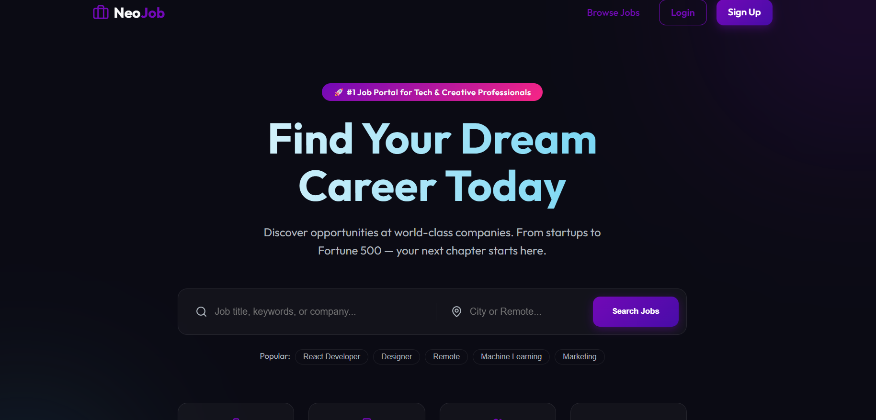
IMPLEMENTATION SCREENSHOTS
1
2
3
4
5
6
7
8
Homepage:
.The Home Page displays all available job listings in a clear and user-friendly interface. It allows users to quickly browse, search, and access job details or apply directly.
9

Slide 12
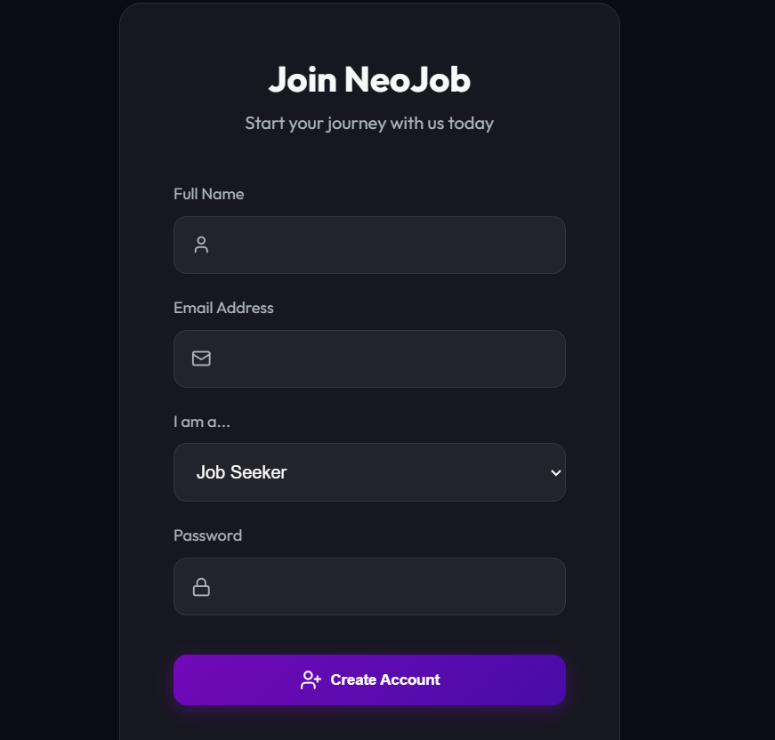
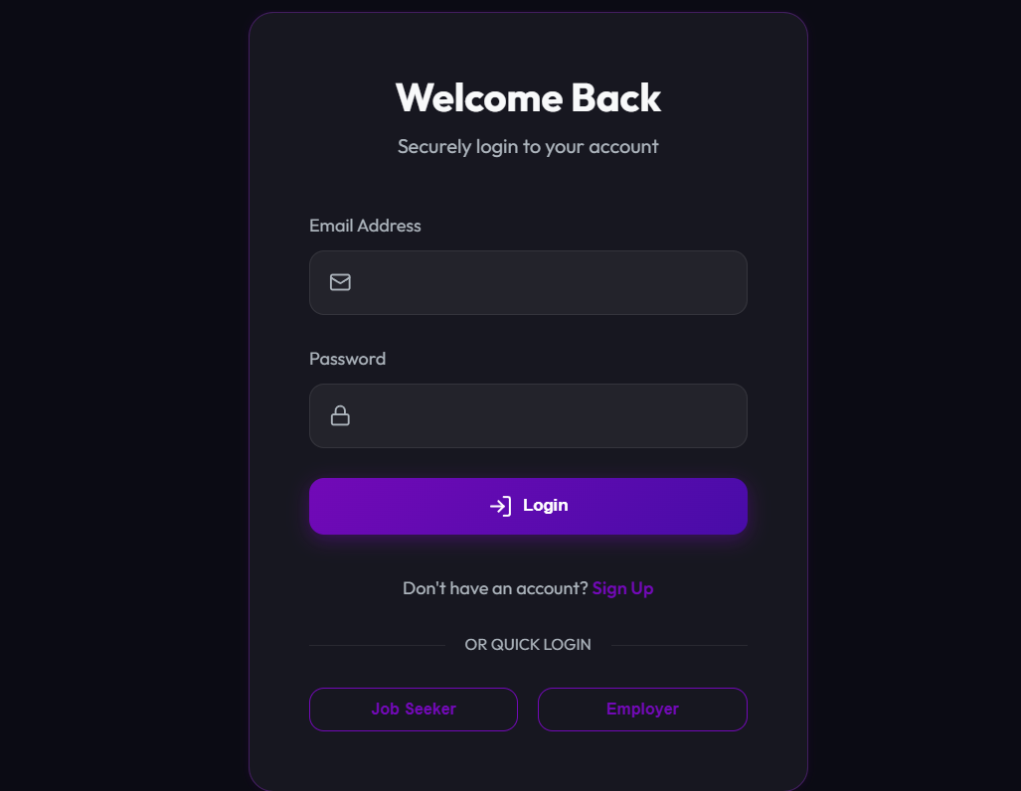
IMPLEMENTATION SCREENSHOTS
si
1
2
3
4
5
6
7
8(A)
Login &SIGN Page:
The Sign In/Login page allows users to securely access their accounts using registered credentials. It verifies user details and redirects them to their respective dashboard after successful login.
.
9

Slide 13
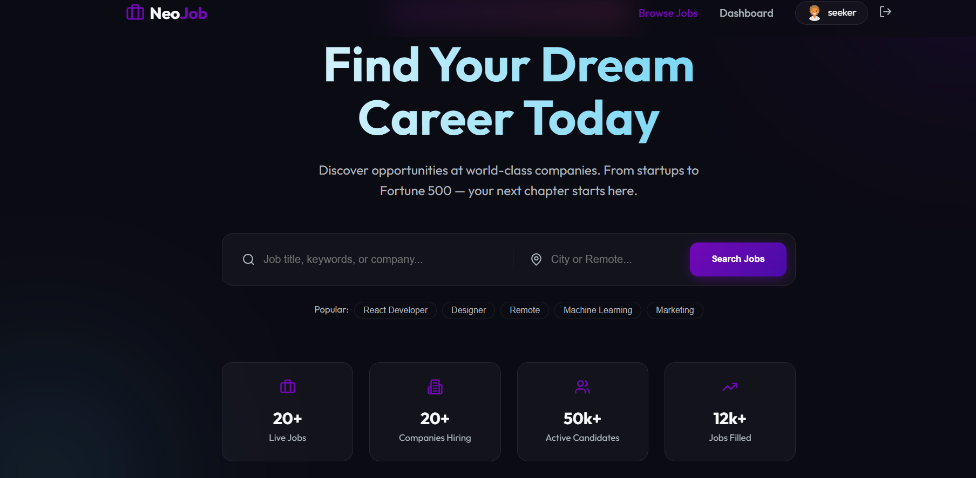
IMPLEMENTATION SCREENSHOTS
1
2
3
4
5
6
7
8(B)
9
Main Module:
The Main Module acts as the central part of the system that connects all other modules and manages overall functionality. It controls user interactions, coordinates between frontend and backend, and ensures smooth flow of job posting, searching, and application processes.
.

Slide 14
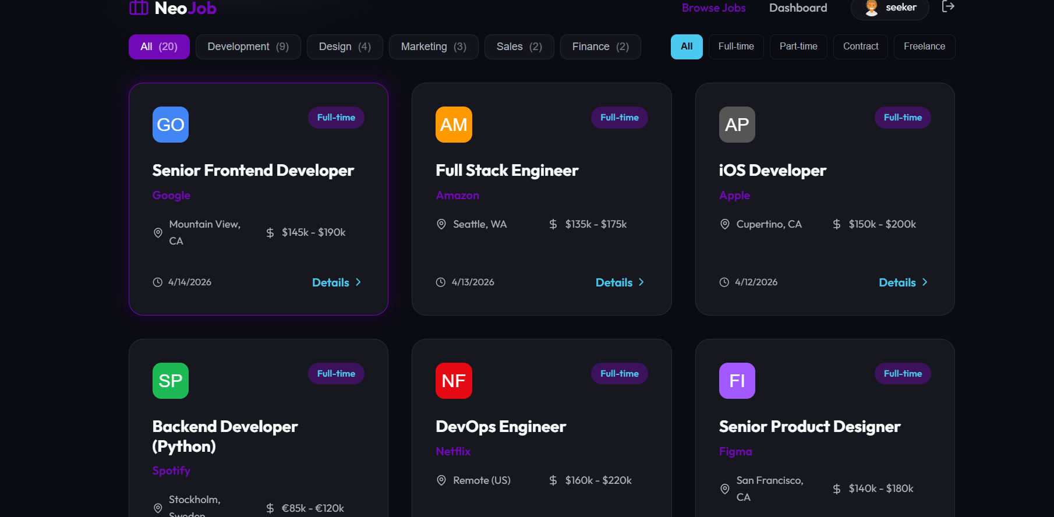
IMPLEMENTATION SCREENSHOTS
1
2
3
4
5
6
7
8(C)
9
Output:
Displays job listings, allows applications, and enables employers to manage applicants efficiently.

Slide 15
ADVANTAGES & LIMITATIONS
1
Advantages:
Easy access to job opportunities
Saves time and effort in hiring process
User-friendly and centralized platform
Faster communication between users and employers
Disadvantages:
Requires internet access
Data privacy and security concerns
Limited features without backend integration
Dependence on system maintenance and updates
2
3
4
5
6
7
8
9

Slide 16
Thank you

