Slide 1

Vel Tech Rangarajan Dr. Sagunthala R&D Institute of Science and Technology
School of Computing
Department of Computer Science and Engineering
10211CS224 / FULL STACK APPLICATION DEVELOPMENT (JAVA)
PROJECT REVIEW : MILESTONE PROJECT – 1
Date: 26-05-2026
End-to-End Event Lifecycle & Ticketing Platform
SDG: SDG No – SDG Title(Example: SDG 4 – Quality Education)
Presented By:
P. AARON SATHWIK – VTU26637 – 23UECS1165.
Courses Handling Faculty:
Dr. Nateshan N.V.S

Slide 2
INTRODUCTION
Eliminates manual coordination across multiple platforms.
Provides seamless experience from discovery to check-in.
Enables real-time data synchronization across bookings and payments.
Scales from small workshops to large concerts.
Prevents ticket fraud with QR/RFID verification.
Delivers post-event analytics for continuous improvement.
Reduces ticket counterfeiting with digital authentication.
Supports multi-channel marketing and promotions.
1
2
3
4
5
6
7
8
9

Slide 3
PROBLEM STATEMENT
Existing event management solutions are fragmented, requiring organizers to use separate tools for ticketing, marketing, access control, and analytics.
This disjointed approach leads to manual data reconciliation, operational inefficiencies, and inconsistent attendee experiences.
Organizers lack a unified dashboard to monitor real-time sales, entry metrics, and post-event insights.
Additionally, current systems often lack robust fraud prevention, leaving events vulnerable to ticket duplication and unauthorized access.
There is a need for a single, integrated, and automated platform that streamlines the entire event lifecycle from creation to post-event analysis.
1
2
3
4
5
6
7
8
9

Slide 4
OBJECTIVE(S)
1
2
To design and develop a scalable End-to-End Event Lifecycle & Ticketing Platform that enables seamless creation, management, and tracking of events, ticket sales, and attendee interactions in real-time across multiple users and devices.
To evaluate the performance of the system by ensuring data accuracy, security, and reliability while reducing manual effort, enhancing ticketing efficiency, and improving overall event management experience.
3
4
5
6
7
8
9

Slide 5
PROPOSED SYSTEM
Unified Event Management – A single platform combining event creation, ticketing, marketing, payment processing, and access control, eliminating the need for multiple disjointed tools.
Automated Ticketing & Fraud Prevention – Secure QR code and RFID-based digital tickets with real-time validation, preventing duplication, scalping, and unauthorized entry.
Real-Time Analytics Dashboard – Live monitoring of ticket sales, attendee demographics, entry traffic, and revenue streams for data-driven decision-making during events.
Contactless Access Control – RFID/NFC-based entry system with mobile scanning, reducing check-in time from minutes to seconds and eliminating manual verification errors.
How It Solves Existing Issues – Replaces fragmented manual workflows with end-to-end automation, eliminating data silos, reducing administrative overhead, and ensuring accurate real-time visibility across all event stages.
Advantages Over Current Systems – Offers a single source of truth instead of juggling separate tools; provides built-in fraud protection absent in basic ticketing platforms; delivers real-time insights rather than post-event reports only.
1
2
3
4
5
6
7
8
9

Slide 6
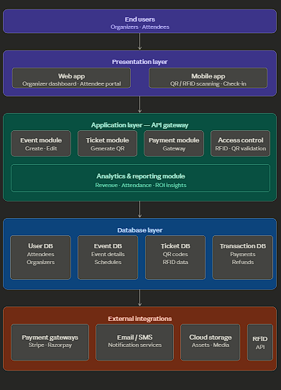
PROPOSED SYSTEM ARCHITECTURE
1
2
3
4
5
6
7
8
9

Slide 7
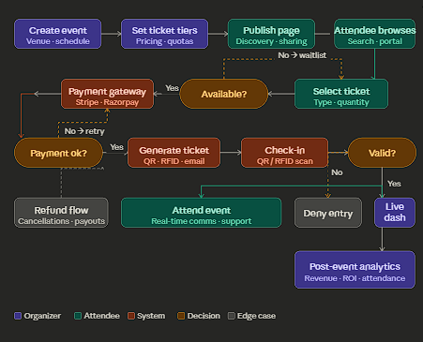
WORKFLOW
1
2
3
4
5
6
7
8
9

Slide 8
TECHNOLOGIES USED
Frontend: HTML, CSS, JavaScript
Backend: Node.js (VS Code + CMD)
Database: MySQL
Tools: VS Code, CMD
Hardware: Laptop, Internet, QR/RFID scanner
Software: VS Code, Node.js, MySQL, Web Browser
Database Tables:** users, events, tickets, transactions
1
2
3
4
5
6
7
8
9

Slide 9
MODULE DESCRIPTION
Module 1: User Management Handles organizer and attendee registration, login, role-based access, and profile management with secure authentication.
Module 2: Event Management Manages event creation, scheduling, venue setup, capacity settings, and event details for organizers.
Module 3: Ticketing & Payment Handles digital ticket generation (QR code), payment processing, order confirmation, and automated invoicing.
Module 4: Access Control & Check-in Manages QR code scanning and RFID-based entry validation for real-time attendee verification.
Module 5: Database Management Handles data storage, retrieval, and integrity for users, events, tickets, and transactions.
Module 6: Analytics & Reporting Generates real-time dashboards and post-event reports for sales, attendance, and revenue insights.
1
2
3
4
5
6
7
8
9

Slide 10
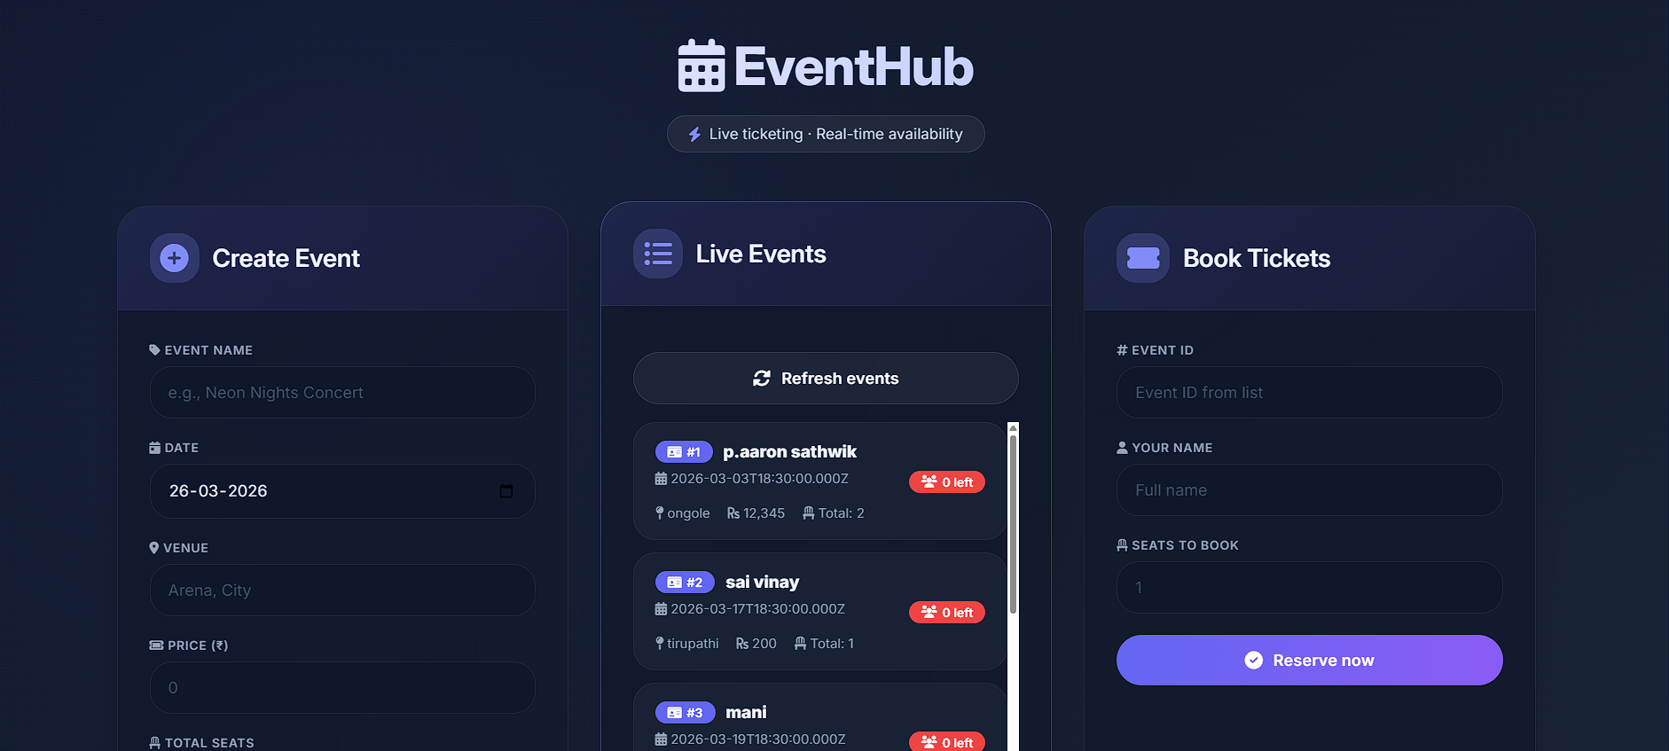
IMPLEMENTATION SCREENSHOTS
1
2
3
4
5
6
7
8
9

Slide 11
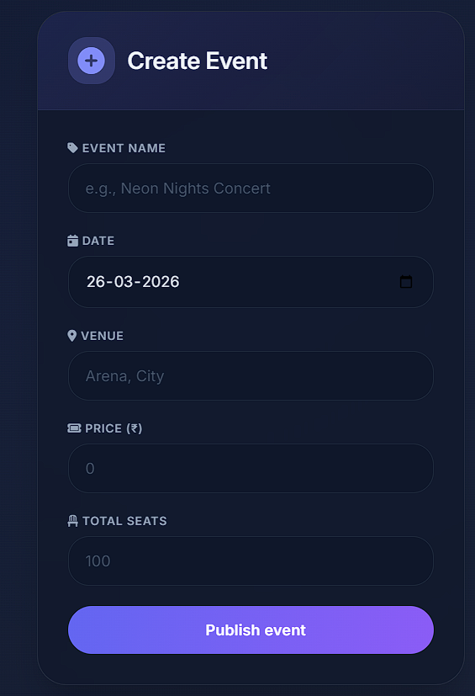
IMPLEMENTATION SCREENSHOTS
1
2
3
4
5
6
7
8(A)
9

Slide 12
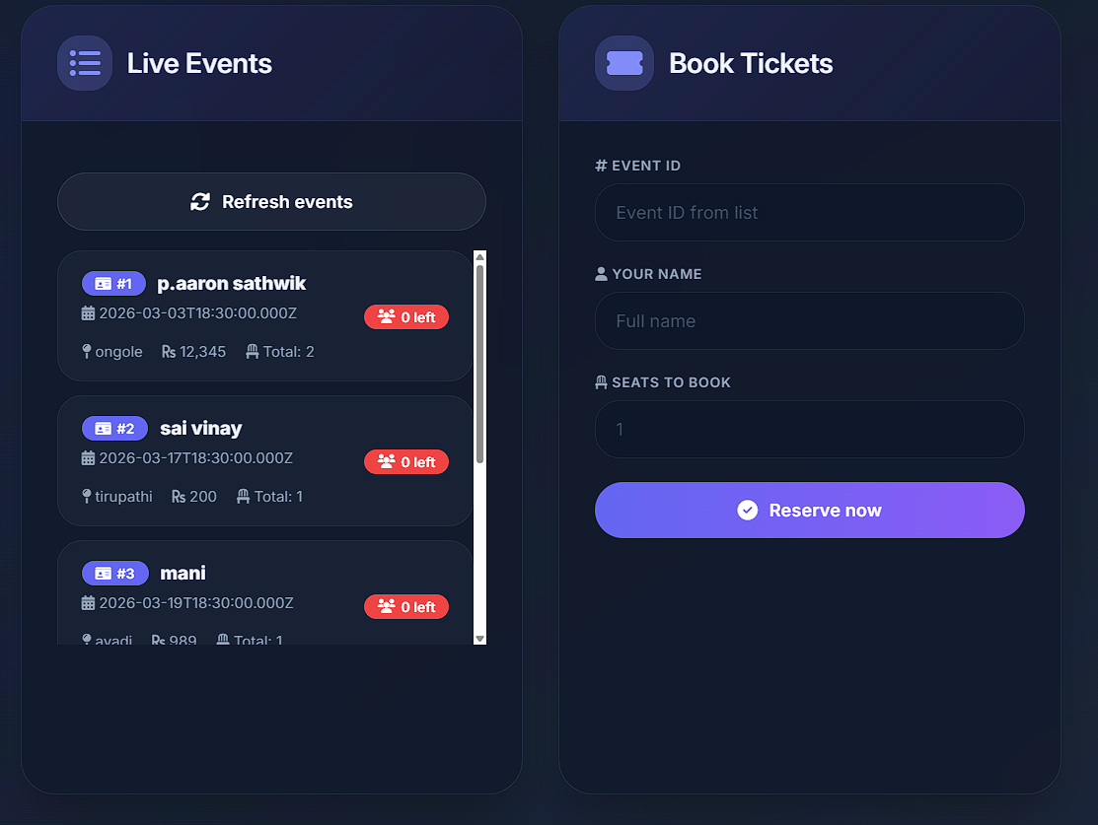
IMPLEMENTATION SCREENSHOTS
1
2
3
4
5
6
7
8(B)
9

Slide 13
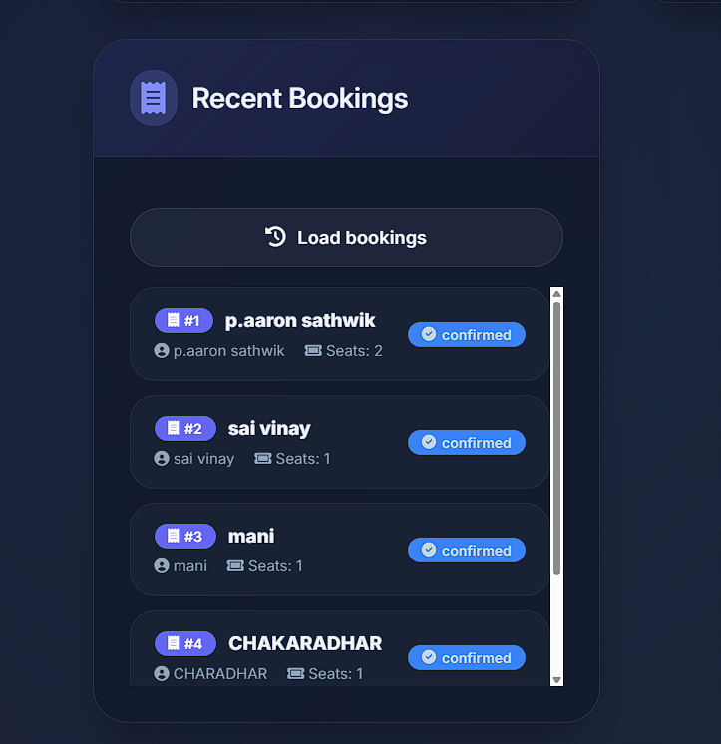
IMPLEMENTATION SCREENSHOTS
1
2
3
4
5
6
7
8(C)
9

Slide 14
ADVANTAGES & LIMITATIONS
✅ Advantages
1. Centralized platform eliminates disjointed tools for event management.
2. Real-time ticket availability and booking status tracking.
3. Reduces manual work and human errors in ticketing and check-in.
4. Easy to generate sales reports and attendee analytics for decision making.
5. Improves efficiency with automated notifications and QR-based entry.
6. Scalable to handle events of any size from small to large-scale.
❌ Limitations
1. High initial development and setup cost.
2. Requires technical expertise to manage and maintain the system.
3. Internet dependency for real-time booking and check-in functionality.
4. Security risks like payment fraud or data breaches if not properly secured.
5. Difficult to modify database structure once deployed with live data.
6. User adoption challenges for non-tech-savvy organizers and attendees.
1
2
3
4
5
6
7
8
9

Slide 15
Thank you

