Slide 1


Slide 2
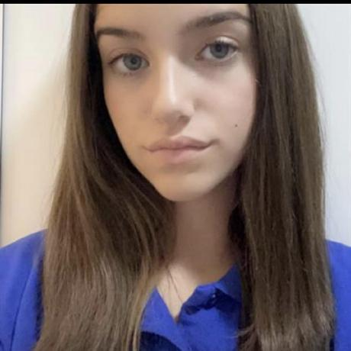

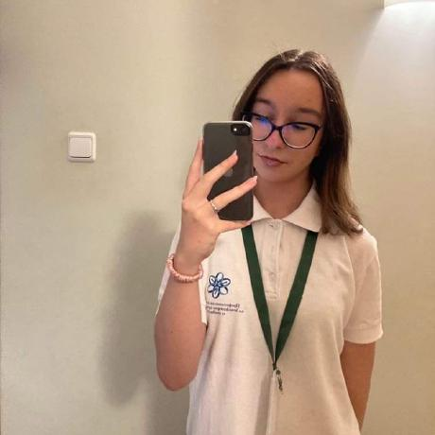

Our Team
Veselina Varadeva 10V
Georgi Stoyanov 10V
SCRUM Trainer
Back-end Developer
Gabriela Encheva 10V
Georgi Georgiev 10V
Back-end Developer
Back-end Developer

Slide 3
Stages of Creation
Work on the project
Choose an idea
Finish the project

Slide 4
The Idea
SpendTrack is a simple C++ app for tracking your money. You can manage your expenses and income, set budgets, and see your spending habits. SpendTrack helps you understand your finances better so you can make smarter money choices.

Slide 5






Technologies

Slide 6
Let’s get to the Project

