Slide 1

Factors Affecting Health Insurance Charges for an Anonymous Insurance Company
Varsha Tomar
Varsha Tomar

Slide 2
Introduction
Problem Statement: An Insurance company is seeking the key factors that can affect their customer’s insurance charges.
Variables: The data set includes 1338 entries on costumer’s information on ‘Age’, ‘Sex’, ‘BMI’, ‘Children’, ‘Smoker’, ‘Region’, and ‘Charges’.
Approach: Data Cleaning -> EDA -> PDA

Slide 3
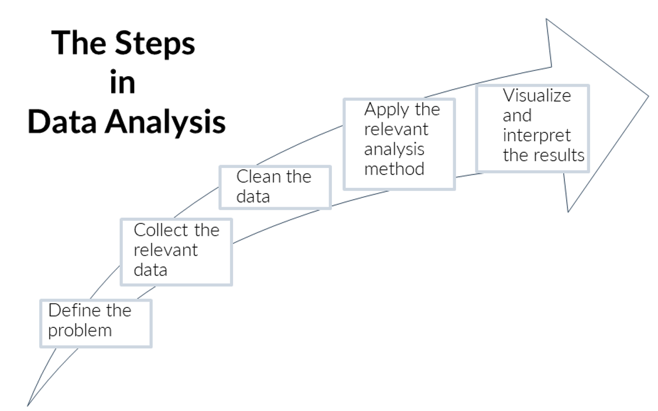
Method

Slide 4
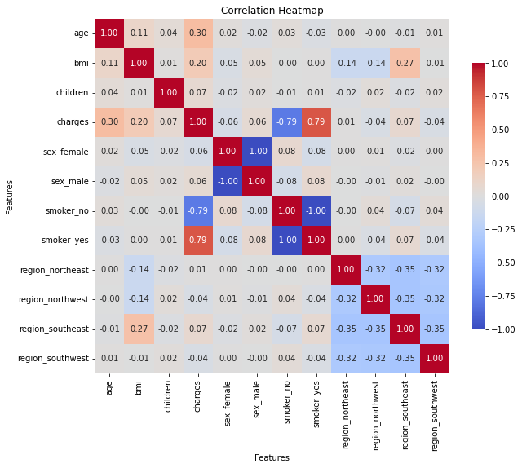
Results

Slide 5
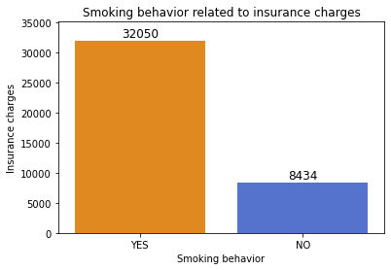

Slide 6
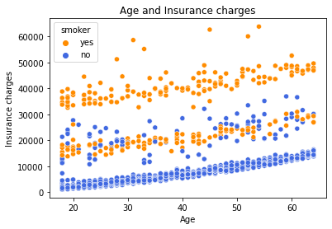

Slide 7
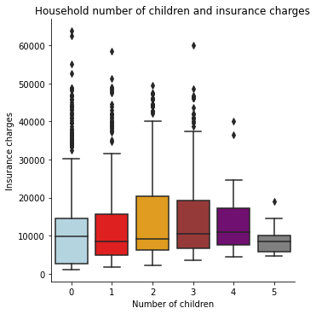

Slide 8
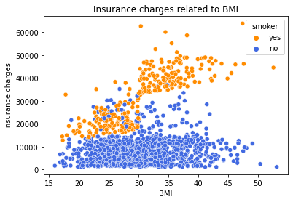

Slide 9
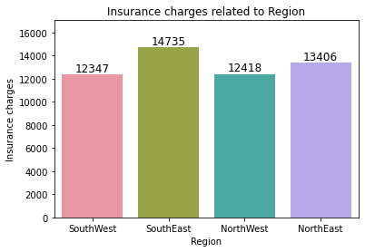

Slide 10

Linear Regression Model

Slide 11


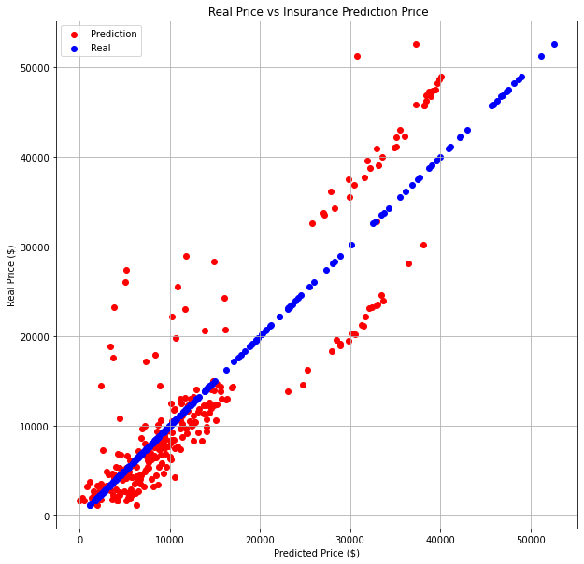
The prediction stays within 20% of actual charges!

Slide 12
Ethical Concerns and Risks
Privacy
Bias
Discrimination
Misuse of results
Informed consent

Slide 13
Conclusions
Build the predictive powerhouse
Accurate predictions, better decisions
Empowering our insurance company
Beyond the horizon!

Slide 14

Thank You

