Slide 1
ScaleHD: Robust Brain-Inspired Hyperdimensional Computing via Adapative Scaling
Sizhe Zhang*, Mohsen Imani#, Xun Jiao*
*Villanova University, #UC Irvine

Slide 2
Outline
HD Computing Background
Robustness of HD Computing
Proposed Approach
ScaleHD
Experimental Results
Enhanced Robustness
Conclusion

Slide 3
Outline
HD Computing Background
Robustness of HD Computing
Proposed Approach
ScaleHD
Experimental Results
Enhanced Robustness
Conclusion

Slide 4



Brain-Inspired HD Computing (HDC)
[-1, +1, +1, -1, -1, +1, … ]
Dog vector
[+1, +1, -1, +1, -1, -1, … ]
Cat vector
HD Computing (HDC)
High-dimensional vector (HV)-based computing
One/Few-shot learning
Small model size
Energy-efficient/real-time/robust processing
High parallelism
Tang, Evelyn, et al. "Effective learning is accompanied by high-dimensional and efficient representations of neural activity." Nature neuroscience 22.6 (2019): 1000-1009.

Slide 5



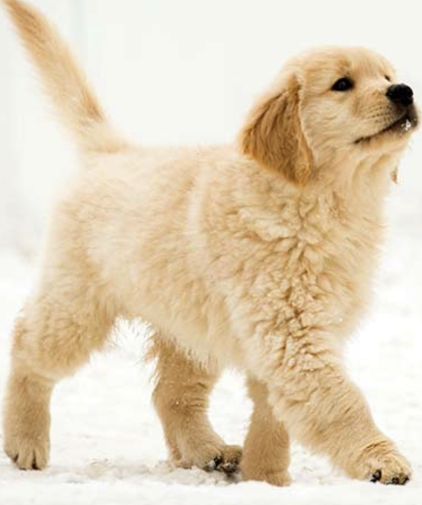
HDC Process: Encoding, Training, Inference
HDC
Encoding
HDC
Training
Dog HV
Similarity
Check
Dog
[1 -1 1 … -1 1]
…
It is a dog!
(Because query HV is
most similar to dog HV.
Cat HV
Cat
[1 1 -1 … -1 -1 ]
…
?
[-1 -1 1 … 1 -1]
Query (?) HV

Slide 6

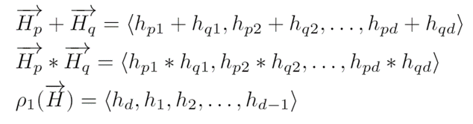
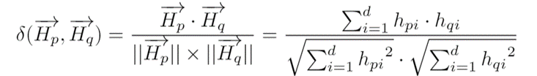
HDC Basics: HVs and Operations
Hypervectors (HVs) are the basic elements of HDC
High-dimensional (~10,000)
(pseudo)-random with i.i.d components
[-1, +1, +1, -1, -1, +1, … ]
HV Operations:
Addition
Multiplication
Permutation
Cosine similarity

Slide 7
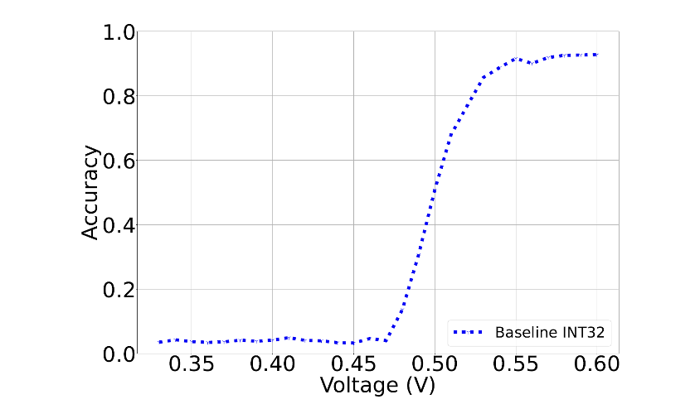
Robustness of HDC to Hardware Errors
HDC is already implemented in multiple HW platforms (FPGA, ASIC, GPU, emerging memory, etc).
Source of hardware errors
Voltage scaling
Soft errors
Variations, non-idealities …
0
1
0
1
0
1
0
0
Zhang et al, DATE 2022
0
1
0
0
0
0
0
1
Bits Flip

Slide 8
Our Previous Work on HDC Robustness
Sizhe Zhang, Ruixuan Wang, Jeff (Jun) Zhang, Abbas Rahimi, Xun Jiao, “Assessing Robustness of Hyperdimensional Computing Against Errors in Associative Memory”, ASAP 2021.
Characterize error impact
Sizhe Zhang, Ruixuan Wang, Dongning Ma, Jeff Jun Zhang, Xunzhao Yin, Xun Jiao, “Energy-Efficient Brain-Inspired Hyperdimensional Computing Using Voltage Scaling”, DATE 2022 (best paper candidate).
Extra error correction hardware (Razor)
Notes:
Can we have approaches that have less overhead?

Slide 9
Outline
HD Computing Background
Robustness of HD Computing
Proposed Approach
ScaleHD
Experimental Results
Enhanced Robustness
Conclusion

Slide 10
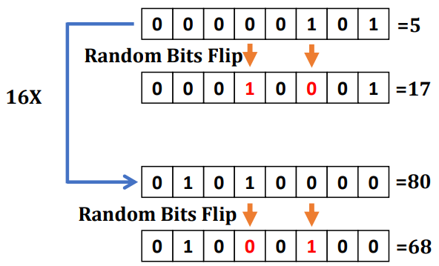
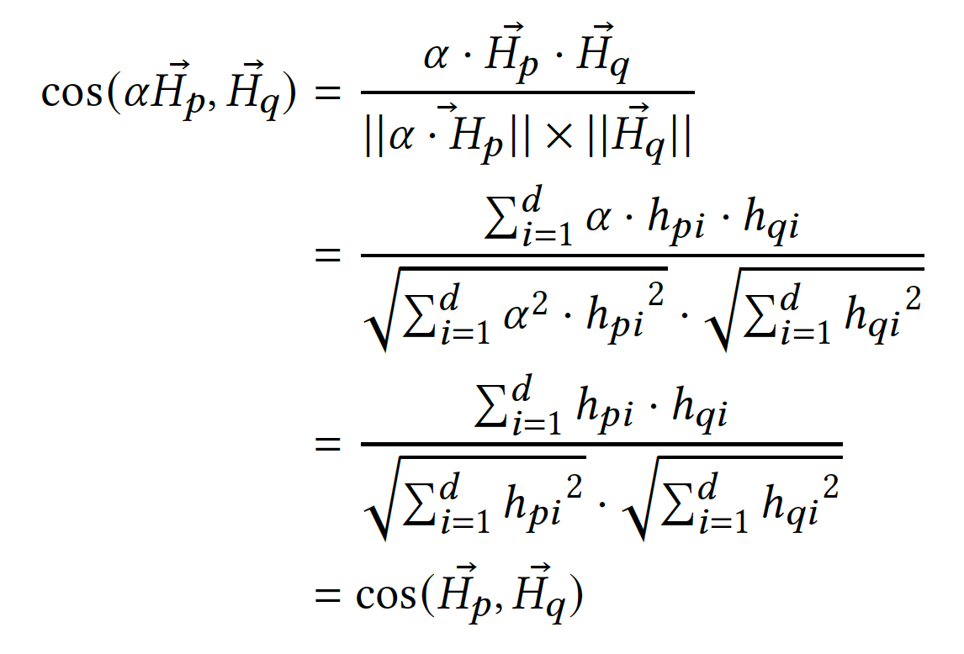
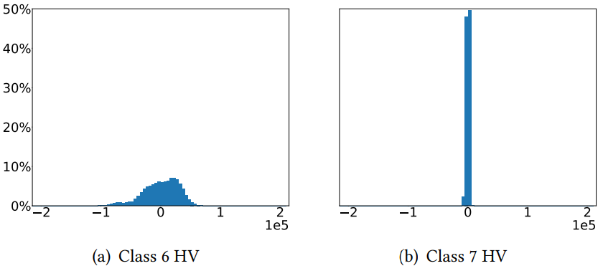
Key Observation
Bit flip has less impact with larger value (same data-width).
Good news for HDC:
(1) Linear scale do not affect HDC inference (Cosine Similarity)
(2) Lots of spare space (empty bit).
3.4X
0.85X
INT32 (-2.1E+09, 2.1E+09)

Slide 11
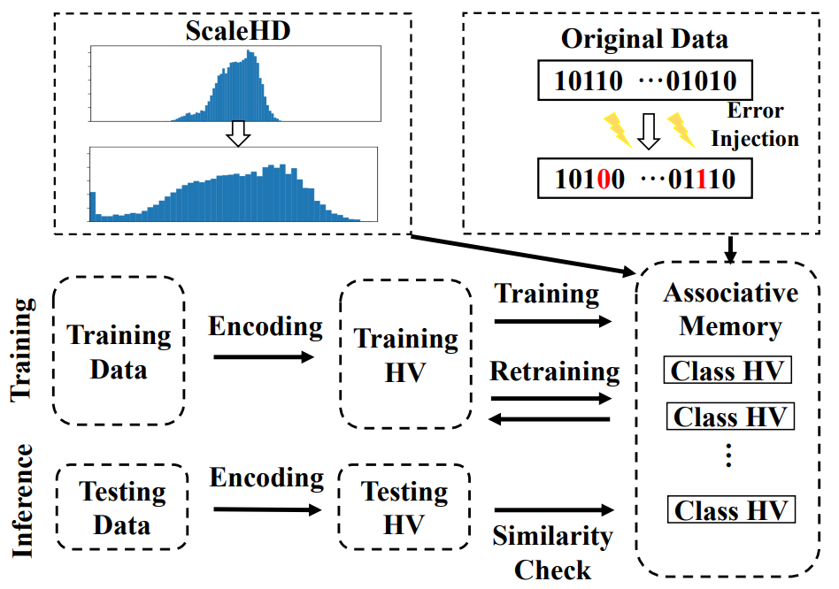
ScaleHD Approach
Three levels of ScaleHD
Global scaling
Class scaling
Class + Clip scaling
Apply once after training and before deploy (Overhead can be ignored)

Slide 12
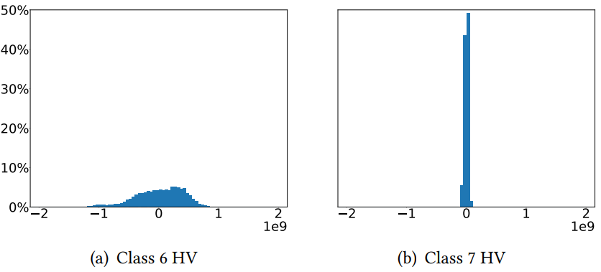
Global-ScaleHD
Find the max value among all class HVs
Find the max value of the given bit representation (2^32)
Calculate the ratio
Scale up all class HVs with the calculated ratio
Original distribution histogram of class HVs
Data distribution histogram with Global-ScaleHD

Slide 13
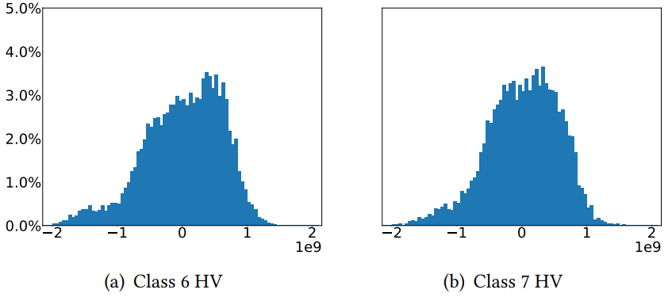
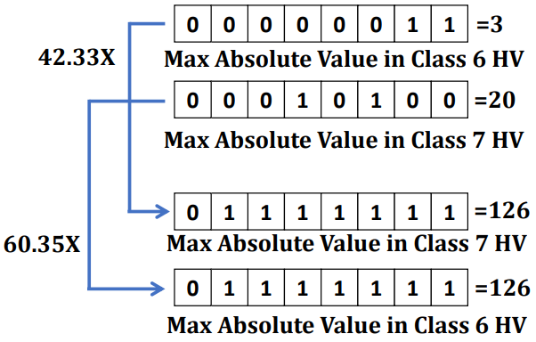
Class-ScaleHD
Each class HV is independent with each other
Different Class HV has different value distribution
Find extreme value of each class HV and scale individually

Slide 14
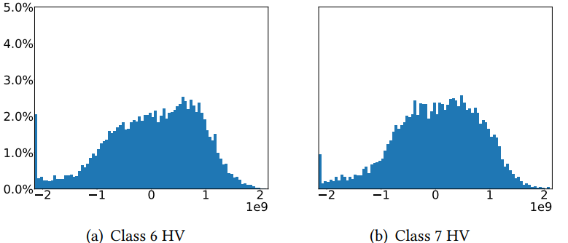
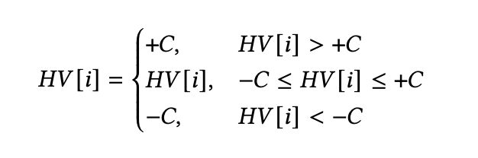
(Class+Clip)-ScaleHD
 | Number clipped values | Robustness enhancement | Accuracy
Larger clip value | ↑ | ↑ | ↓
Smaller clip value | ↓ | ↓ | ↑
Clip partial extreme values
Perform class HV scale after clip
Find the balance clip value between accuracy and clip value for each dataset

Slide 15
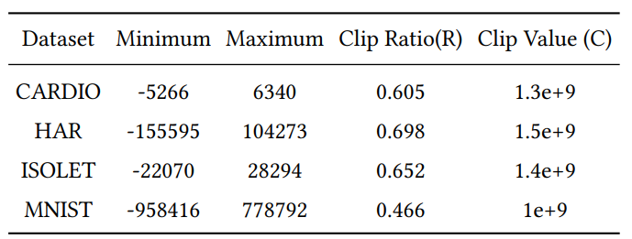
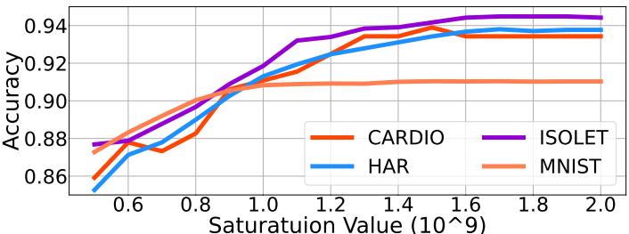
(Class+Clip)-ScaleHD
Perform experiments across different models to find the suitable clip value for each application (less than 1% accuracy loss)

Slide 16
Outline
HD Computing Background
Robustness of HD Computing
Proposed Approach
ScaleHD
Experimental Results
Enhanced Robustness
Conclusion

Slide 17
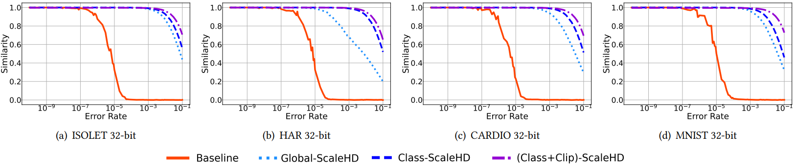
Similarity vs. Error Rate
Similarity between error-injected model vs. original model
More similar → less impact of errors

Slide 18
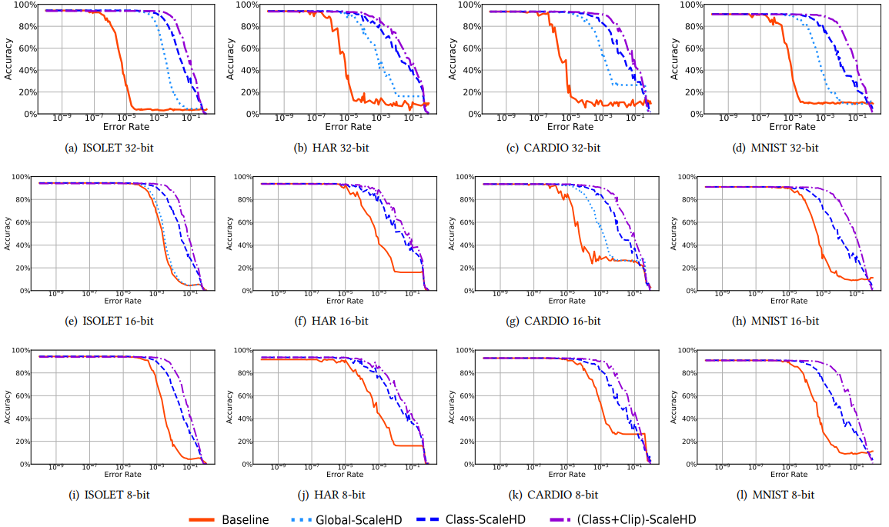
Accuracy vs. Error Rate
Simulation Setup
32/16/8-bit integer
Four datasets
Average of 10 Times
Result
Robustness Enhancement: (Clip+Class) ScaleHD > Class ScaleHD > Global ScaleHD
Around 100X~10000X robustness enhancement

Slide 19
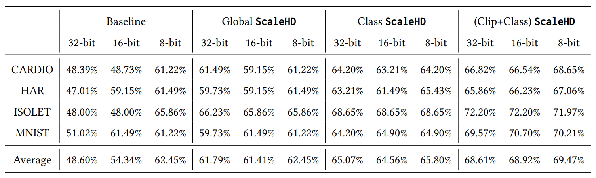
Increased Robustness -> Improved Efficiency
22nm SRAM Simulation
Lower voltage cause higher bit error rate but save more energy
Less than 1% accuracy loss

Slide 20
Conclusion
HDC is vulnerable to hardware errors.
ScaleHD enhances the robustness of HDC to memory errors by scaling up HV values.
ScaleHD has three levels of scaling: global, class, class+clip.
ScaleHD achieves up to 10,000X robustness enhancement.

Slide 21
Thank you!

