Slide 1


Slide 2

Presentation Database Lab
Project: Student Managerment System

Slide 3

Nguyen Van Nam 20194808
Vu Tri Sy 20194830
Le Van Thanh 20194843
Vu Quang Thanh 20194848
Team Members

Slide 4
INTRODUCTION
OUTLINE
ANALYSIS
DEMO

Slide 5


INTRODUCTION

Slide 6



Introduction
Traditional management solutions also contain many shortcomings when all must be done manually. An administrator is someone who has to deal with a huge amount of work. But the efficiency is not as high as when using educational management software.
The advent of intelligent management software will help troubleshoot quickly. Not only the cost is cheap, but the effect is very great

Slide 7




Techniques
Node JS
SQL server
HTML
CSS

Slide 8

ANALYSIS

Slide 9
Functions
Admin
Add
Remove
Modify
Get information: Students Lectures Subjects Departments

Slide 10
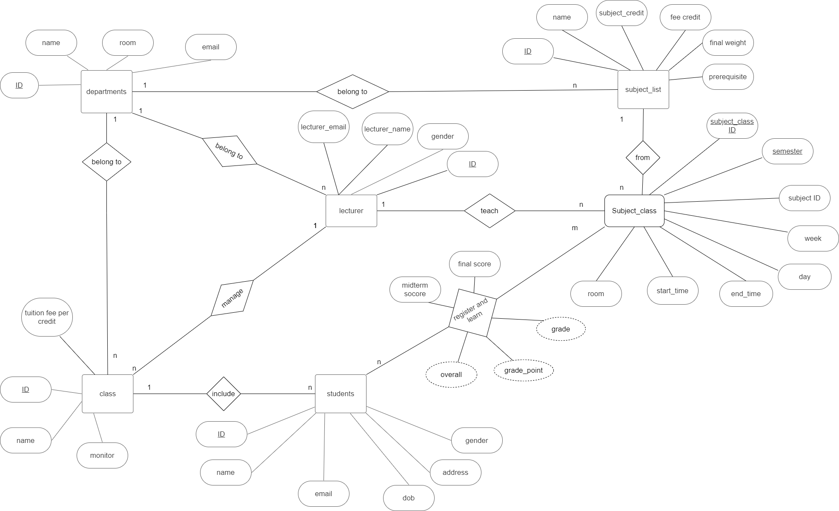
Entity Relationship Diagram Design

Slide 11
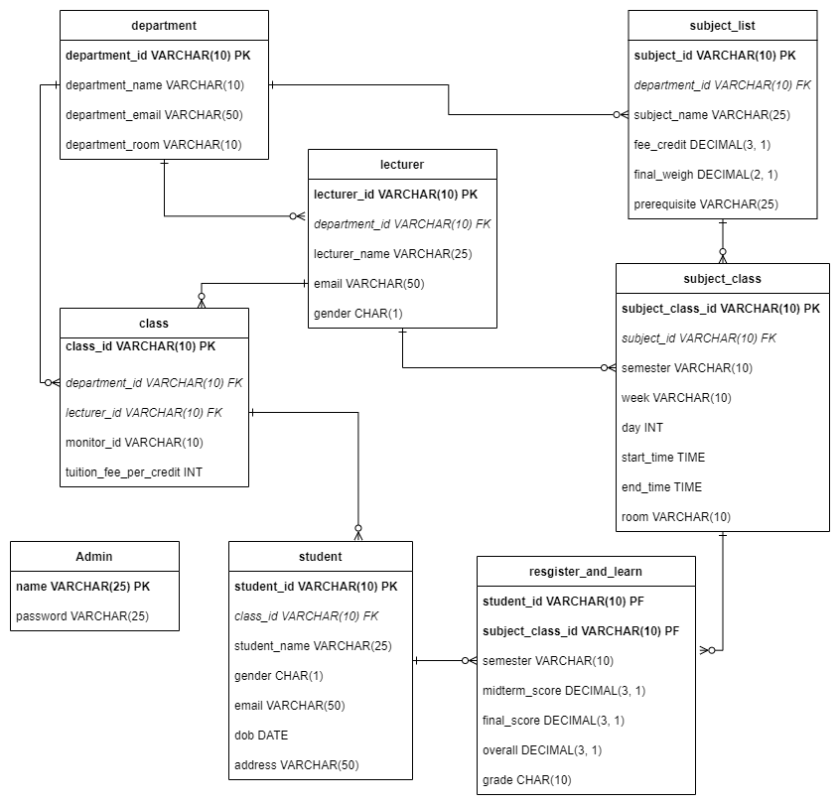
Database Design

Slide 12

DEMO

Slide 13

THANK YOU
for your attention!

