Slide 1
The rise of Private Practice Teaching
Angela Cox
Exploratory Data Analysis
November 2, 2023

Slide 2
Motivation
School choice movements have given rise to market logics in the public sphere
Private school voucher programs, public schools of choice – magnet schools, charter schools, schools not linked to students by residence
Most school choice policies and reforms revolve around parent or family choice
Policy shifts and reframing of expectations around school may be leading to increased choice for employees – introduction of external contracting and staffing agencies in public schools
Do teachers have to be public employees in public schools?
Are teachers working in public schools as private practice employees?
Are these teacher different from traditionally contracted, tenured teachers?

Slide 3
Traditional teacher contracting
Teachers are contracted by the governing body, district, or school to serve in a teaching role indefinitely. Typically involves duties and responsibilities other than teaching. Often unionized
Fixed-term teacher contracting
Resembles traditional contract in most ways, but teacher is a fixed-term contract subject to periodic review. Eg. Charter schools. Seldom unionized.
Private Practice Teachers

Slide 4
Data
S 275 administrative dataset – yearly accounting of all education sector employees in Washington state
Panel data 1995 -2021 (analysis limited to 2005-2021)
First ten years excluded due to inconsistences in reporting around demographics
This data contains information on all district employees in Washington state
Duty codes provide information about employment – externally contracted employees
Primary focus - the small subset of teachers not employed by a district or university, but rather a third-party employer, ie. staffing agencies, educational consulting groups

Slide 5
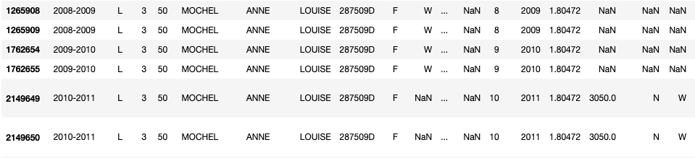
Data – Structure of Panel Data

Slide 6
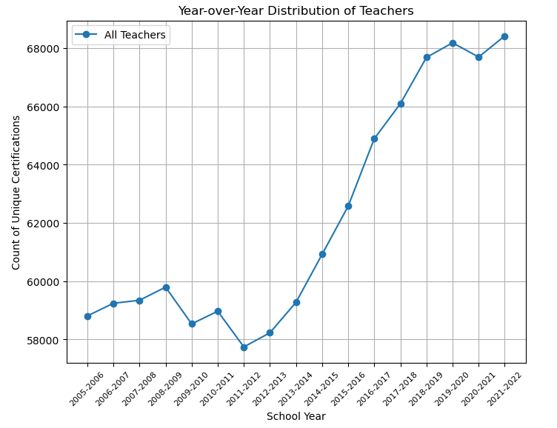
Analysis – spread of Teachers Over Time

Slide 7
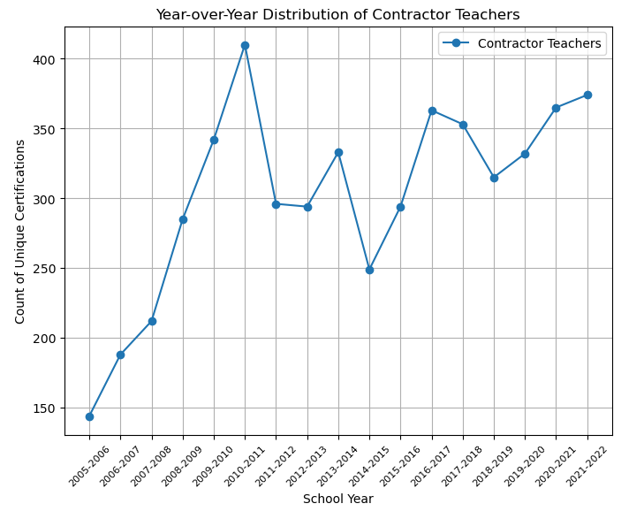
Analysis – Contractor Teachers over time

Slide 8
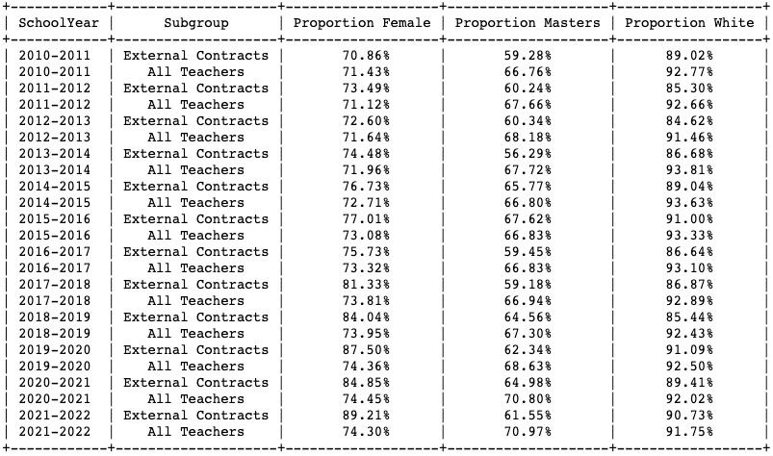
Analysis - Demographic Characteristics

Slide 9
Takeaways
The use of external contracts in public education has grown over time
The characteristics of educators working on external contracts differs from those of the total educator pool
More research is needed to identify the labor implications and educational implications of private labor/market logics in the public employment sector

