Slide 1
Carbon Dioxide Emissions of the World
Chloe Miao
Nov 07

Slide 2
Introduction
Carbon dioxide: primary contributor to climate change
Produced from burning fossil fuels for energy and transportation, deforestation, and industrial processes
Questions: What trends in CO2 emissions have been observed globally and in different countries over the past decades?

Slide 3
Data
C02 emission for all the countries from 1990 to 2018
From Climate Watch (https://www.climatewatchdata.org/)
measuring unit for CO2 emission: MtCO2e

Slide 4
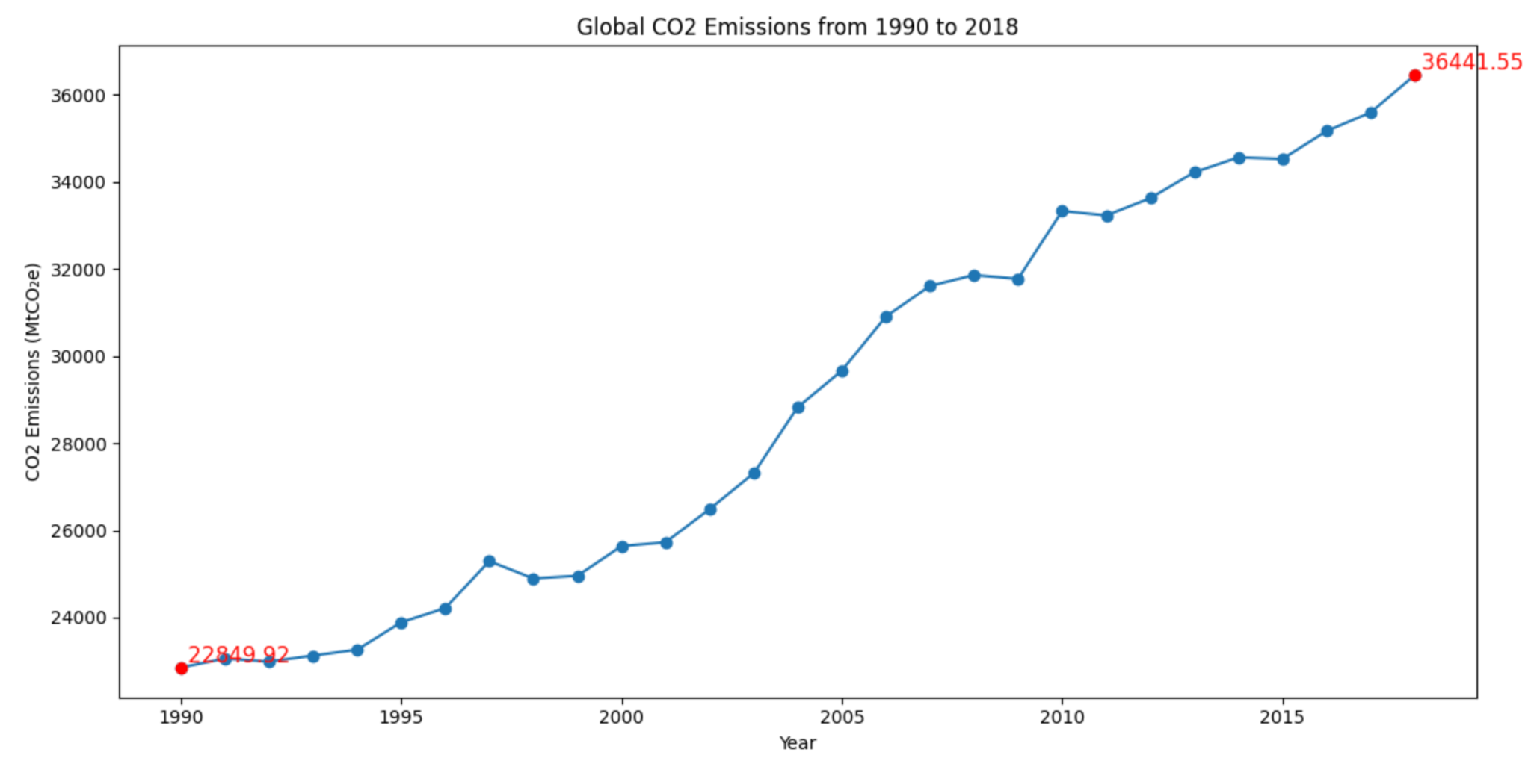
Global CO2 Emissions from 1990 to 2018
A rapid increasing trend
CO2 emission level nearly doubled

Slide 5
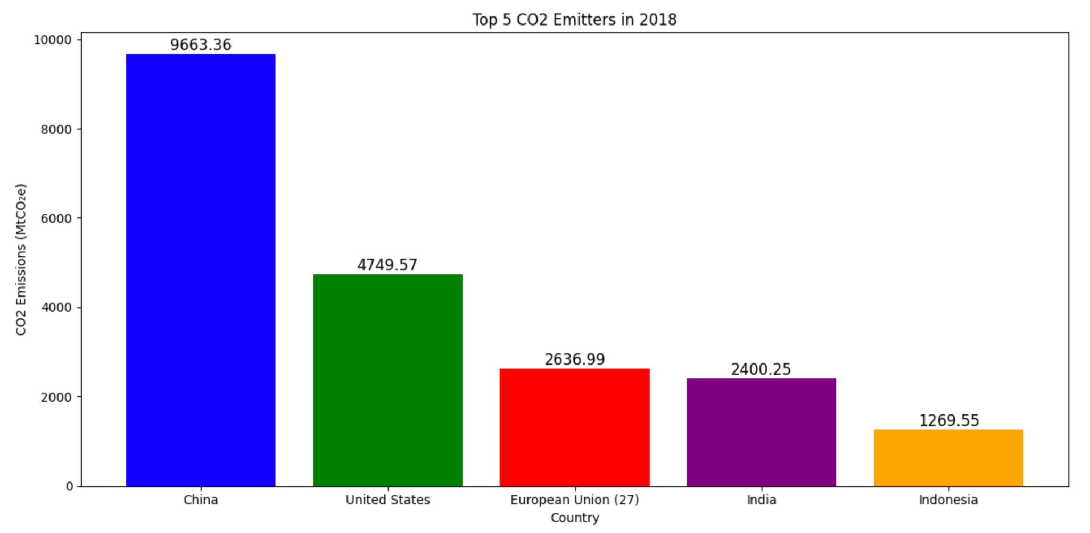
Top 5 CO2 Emission Countries in 2018
China had twice as much CO2 emissions as the United States

Slide 6
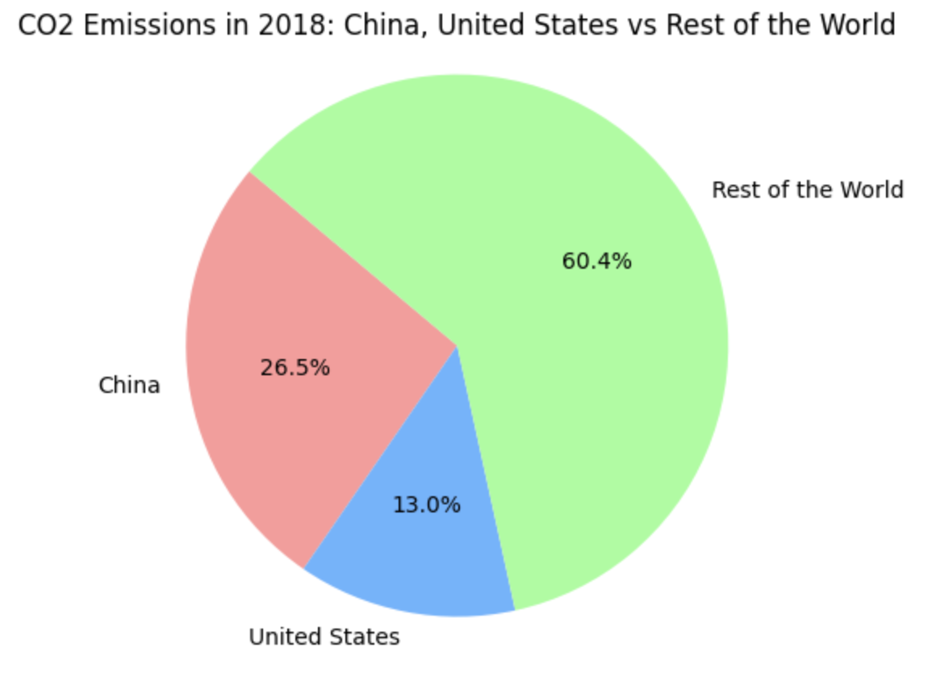
C02 Emissions in 2018: China, United States vs Rest of the World
China and the United States are accountable for approximately 40% of CO2 emissions

Slide 7
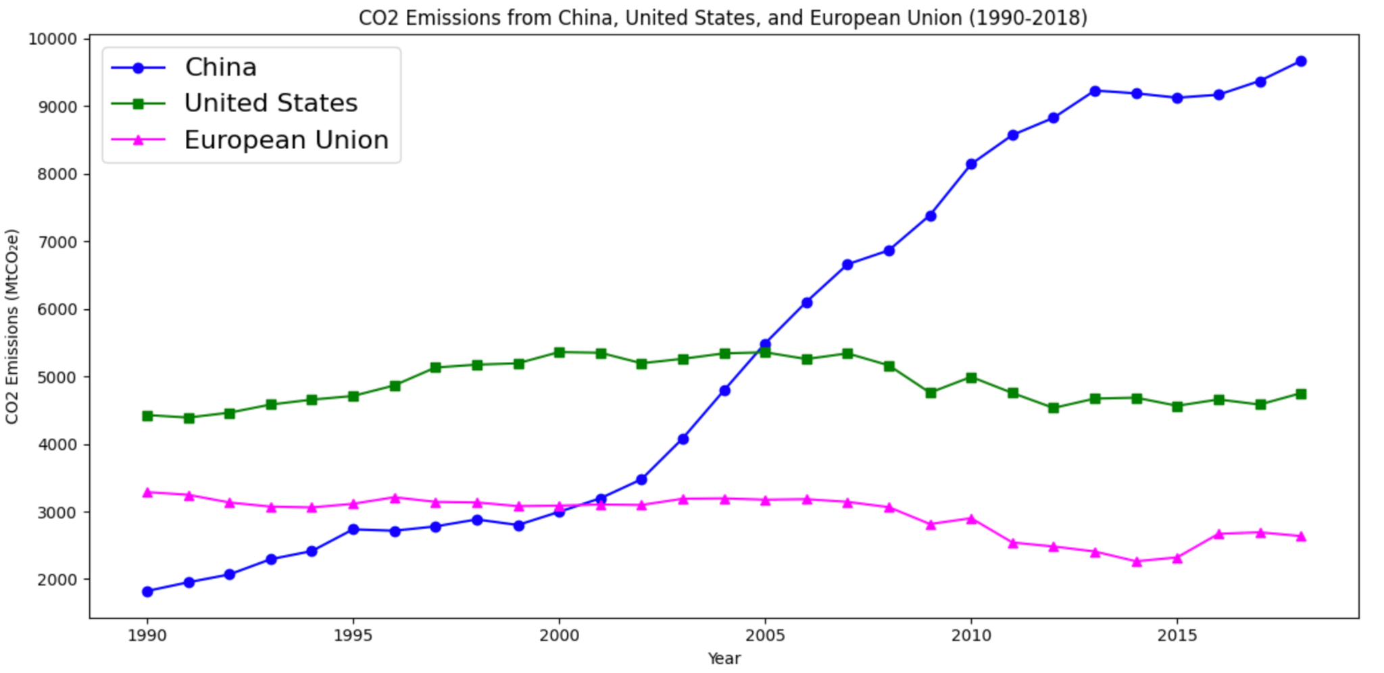
C02 Emissions from China, United States, and European Union
China had a rapid increase
United States and European Union maintained stable, with a minor decrease

Slide 8
Key takeaways:
Increasing trend of CO2 emissions worldwide
China had the highest CO2 emissions follow by United States, European Union, and India
China had a rapid increase of CO2 emissions due to rapid industrialization
The United States and the European Union have maintained stable emissions levels, with a minor decrease due to evolving awareness and environmental policies
Important for large countries to develop policies to reduce CO2 emissions

Slide 9
Thank you!
]]

