Slide 1

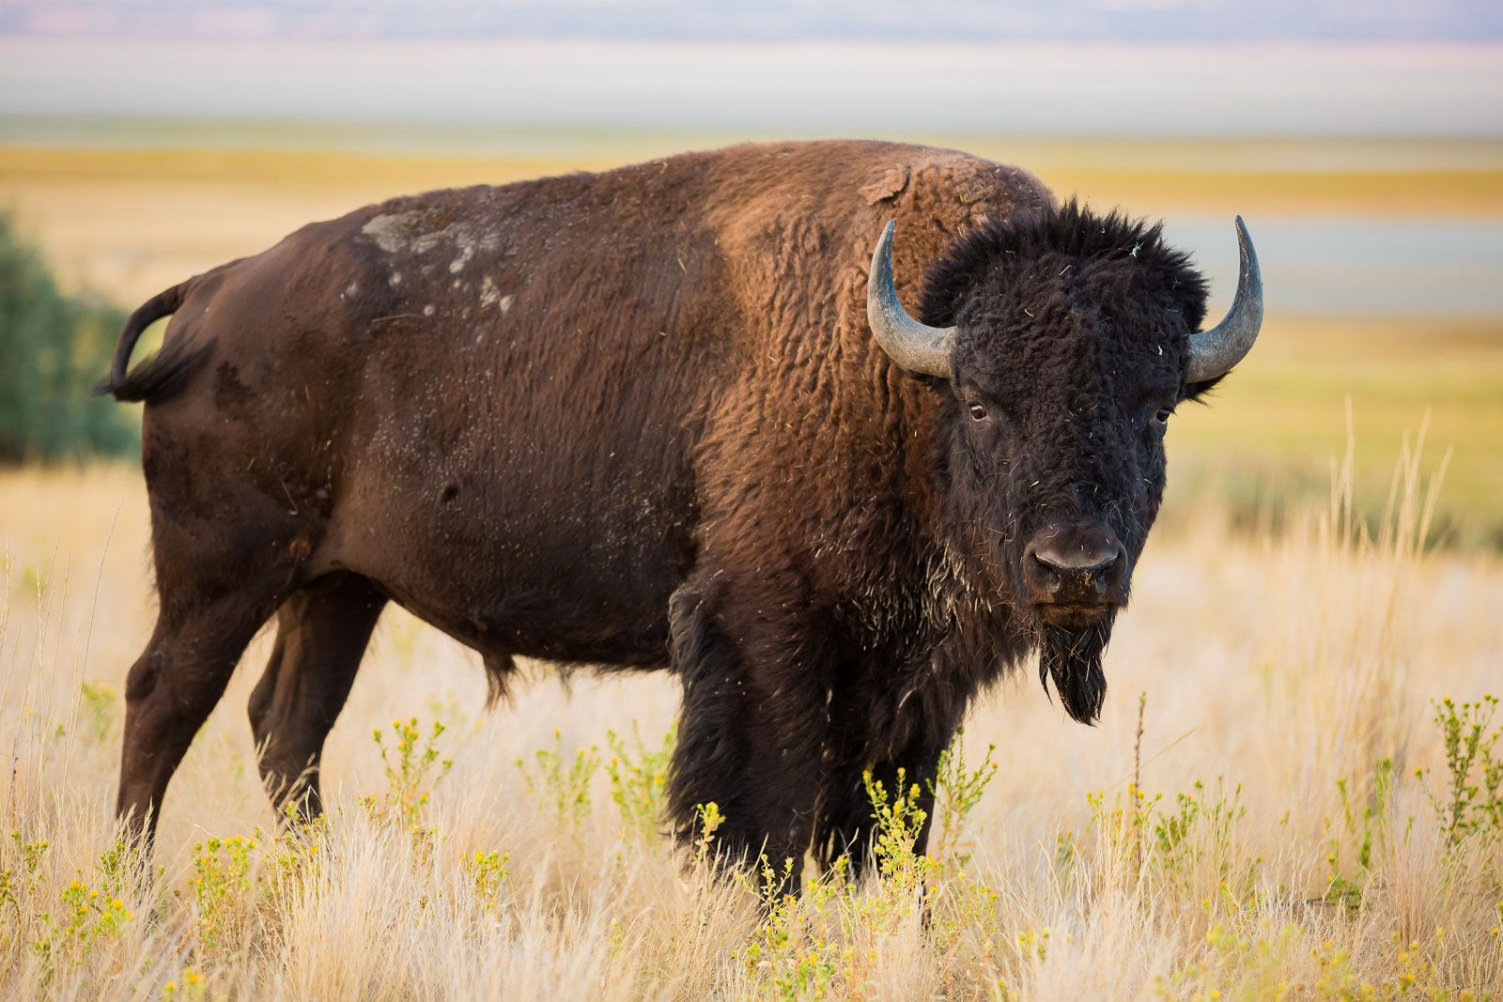
Does the dominant-subordinant relationship of male North American bison affect the number of breeding during the breeding season？
Speaker: Siyu Yang Data type: Network Data

Slide 2
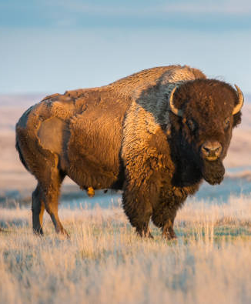
Dataset Overview
Collected by Prof. D. F Lott (1979)
Kind: Directed
Mode: Unipartite
Edges: 314, the edges factors are initiator(challenge initiator), the challenged and the event count between them. The edges shows the dominance relation between each bisons.
Nodes: 26 single bison, attribute include observed coordinate, age and breeding number.

Slide 3
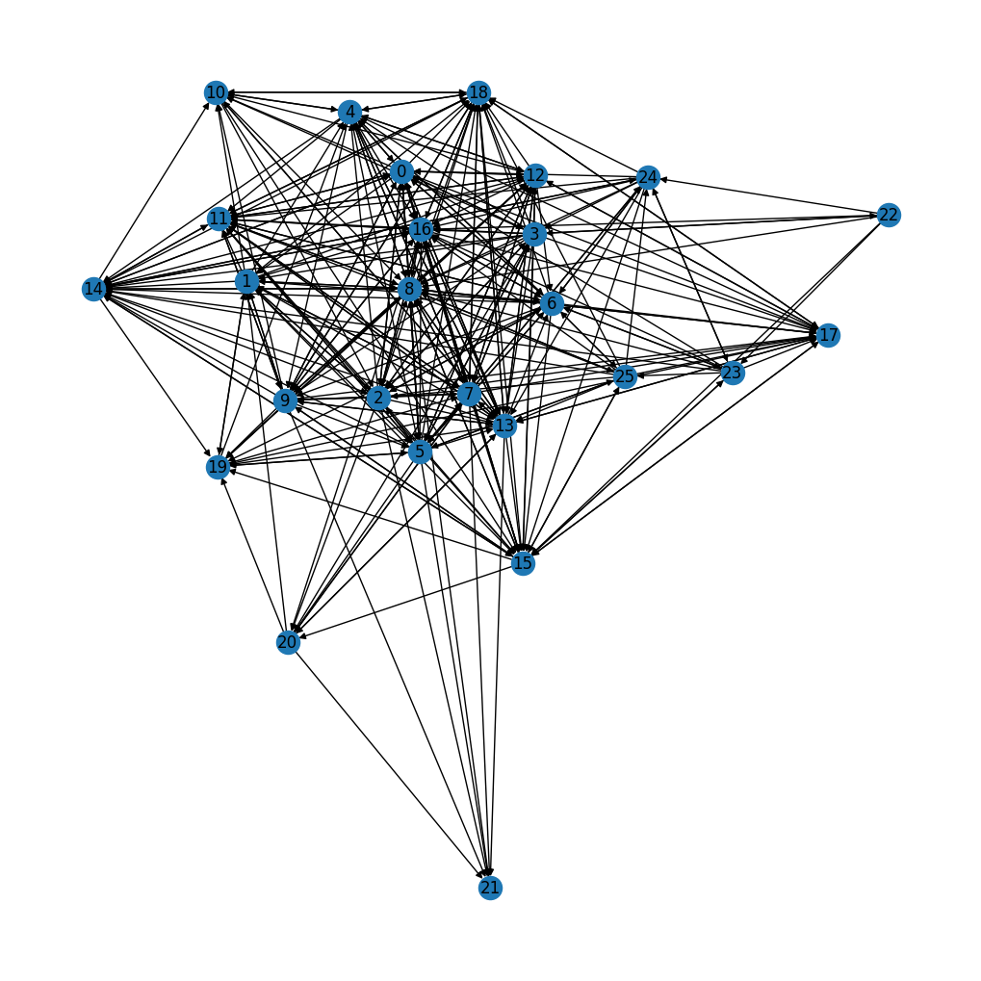
Challenging Event network graph Between Bisons no worry, I will zoom out the plot next slide!
Most of the nodes are clustered in the center of plot
The community has a solid hierarchy

Slide 4
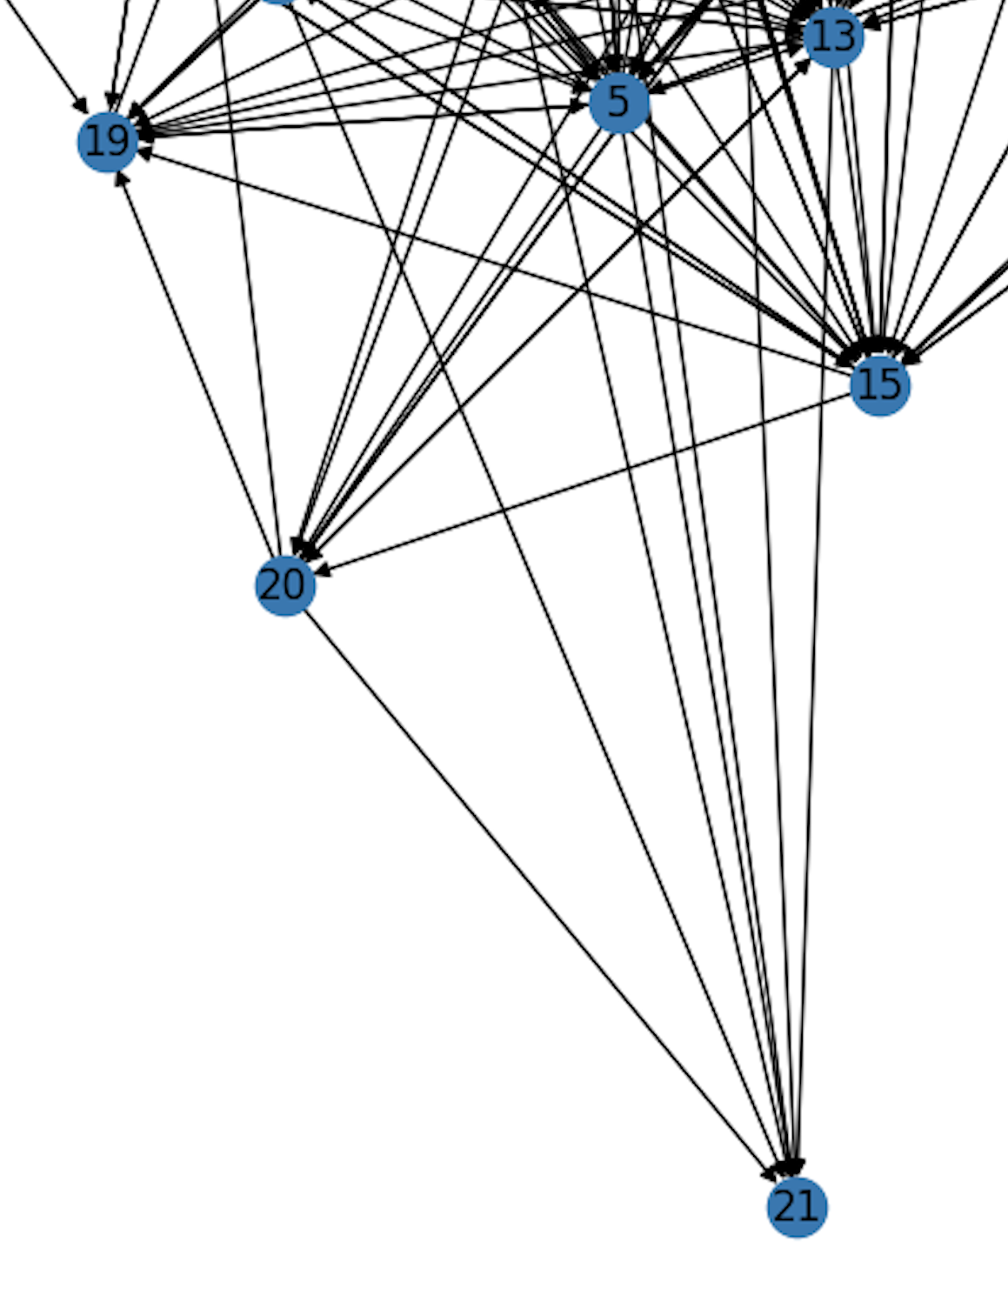
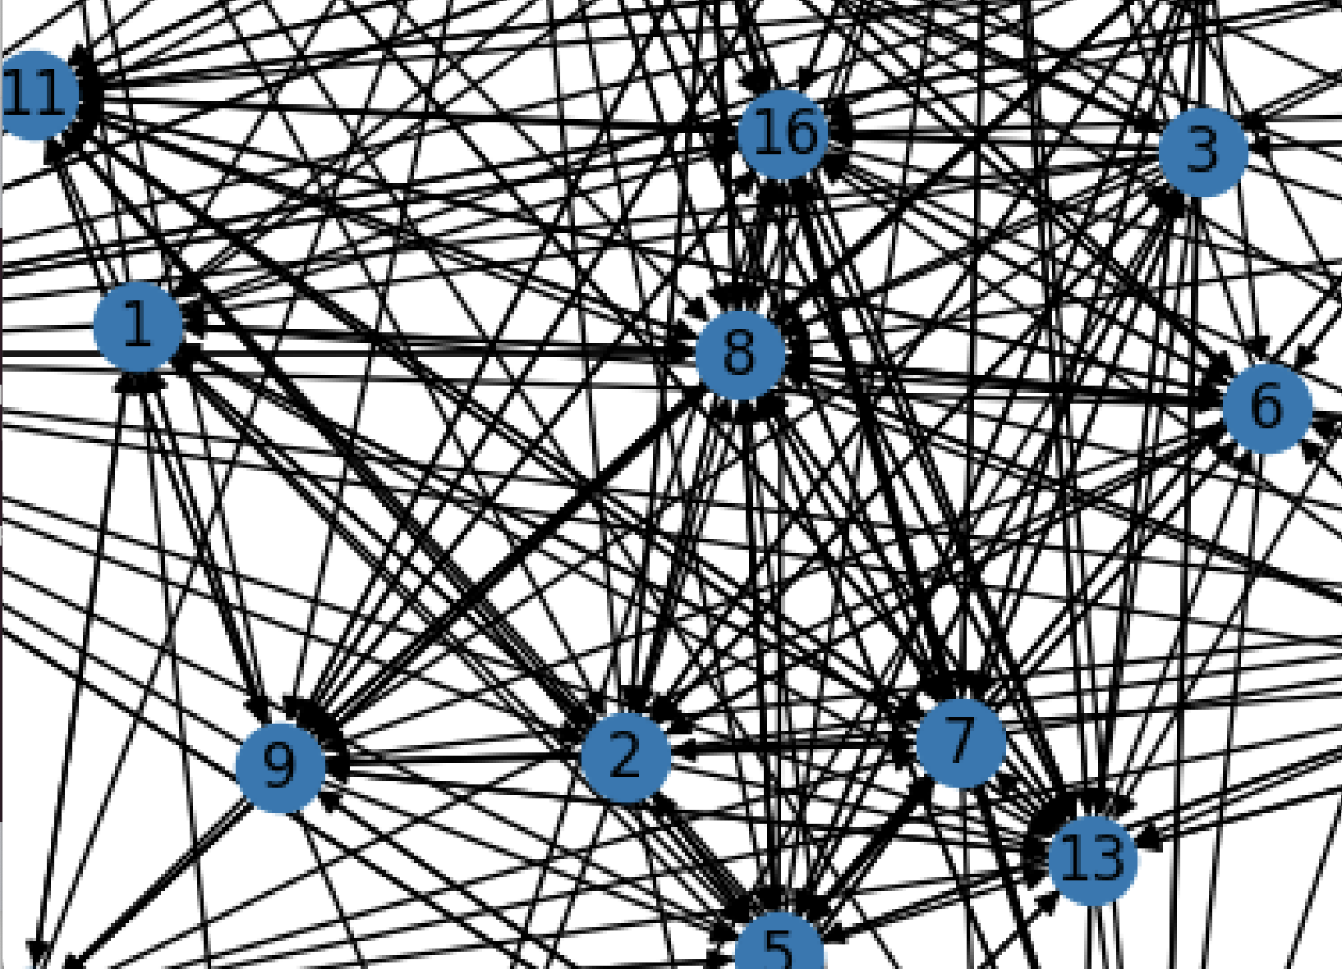
Node 8, 2, 7, 0, 5 seems the most Dominance individuals in the group Node 21, 20, 22 are the subordinate individuals.

Slide 5
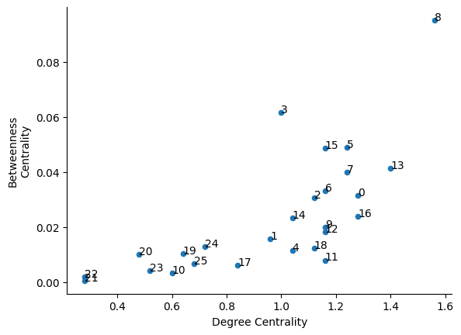
graph of betweenness centrality against degree centrality for a network of American bison
Node 8 is out-standing; This single should be the Alpha in the group

Slide 6
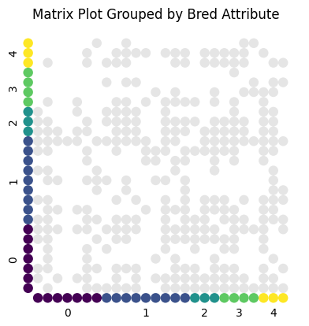
Matrix Plot Grouped By Bred Attribute
The distribution of the attribute seems normal distributed, is this means dominant has more breeding opportunities?

Slide 7
The Actual Breeding number of the observed Dom/Sub individuals
Node | Bred | Status
8 | 1 | Dominant
2 | 2 | Dominant
7 | 1 | Dominant
0 | 4 | Dominant
20 | 1 | Subordinate
21 | 0 | Subordinate
22 | 3 | Subordinate

Slide 8

Conclusion and Further step
Increasing the sample size for future research
Add on different bison community to build on the network cluster community
Trying to make 24h observation during the breeding season

Slide 9
Thank you!

