Slide 1

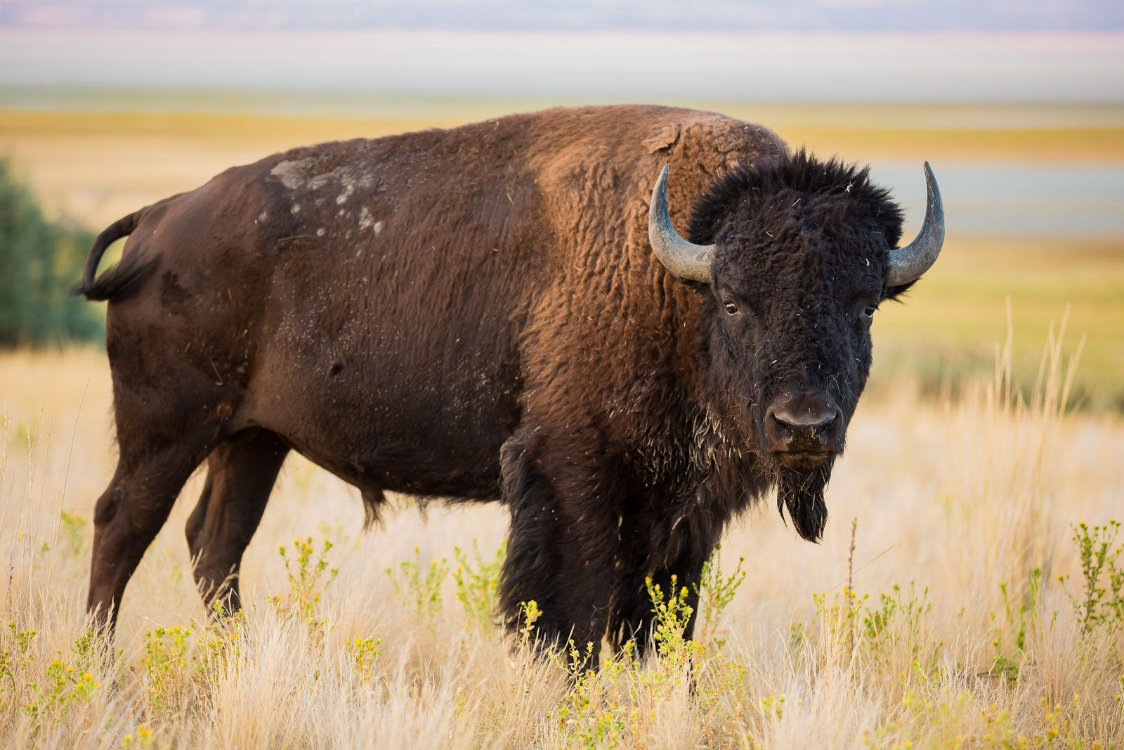
Does the dominant-subordinate relationship of male North American bison affect the number of breeding during the breeding season？
Speaker: Siyu Yang Data type: Network Data

Slide 2
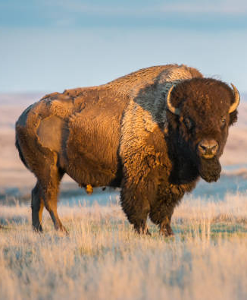
Dataset Overview
Collected by Prof. D. F Lott (1979)
Kind: Directed
Mode: Unipartite
Edges: 314, the edges factors are initiator(challenge initiator), the challenged and the event count between them. The edges shows the dominance relation between each bisons.
Nodes: 26 single bison, attribute include observed coordinate, age and breeding number.

Slide 3
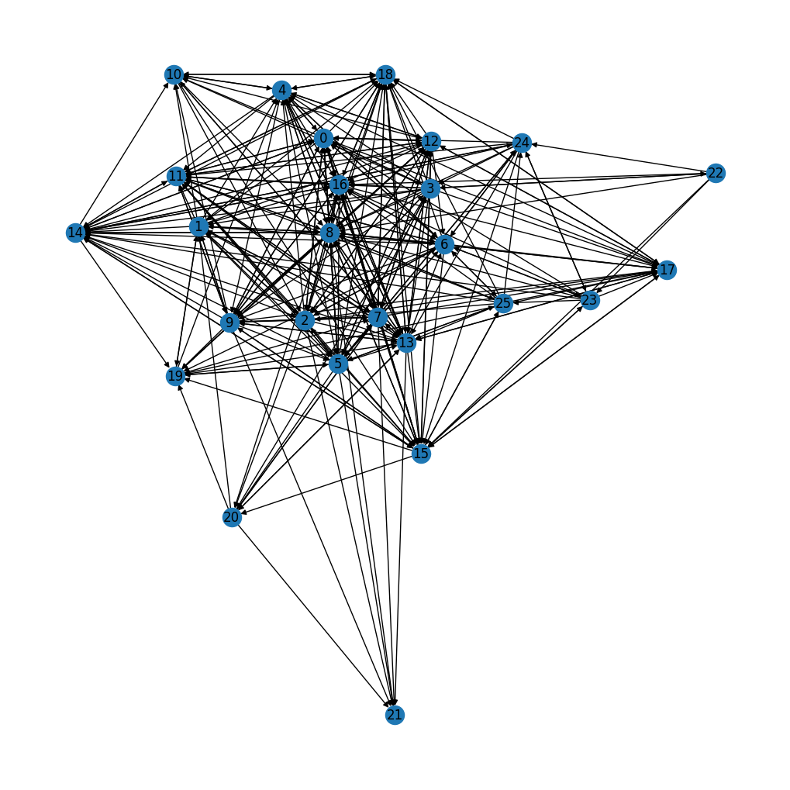
Challenging Event network graph Between Bisons no worry, I will zoom out the plot next slide!
Most of the nodes are clustered in the center of plot
The community has a solid hierarchy

Slide 4
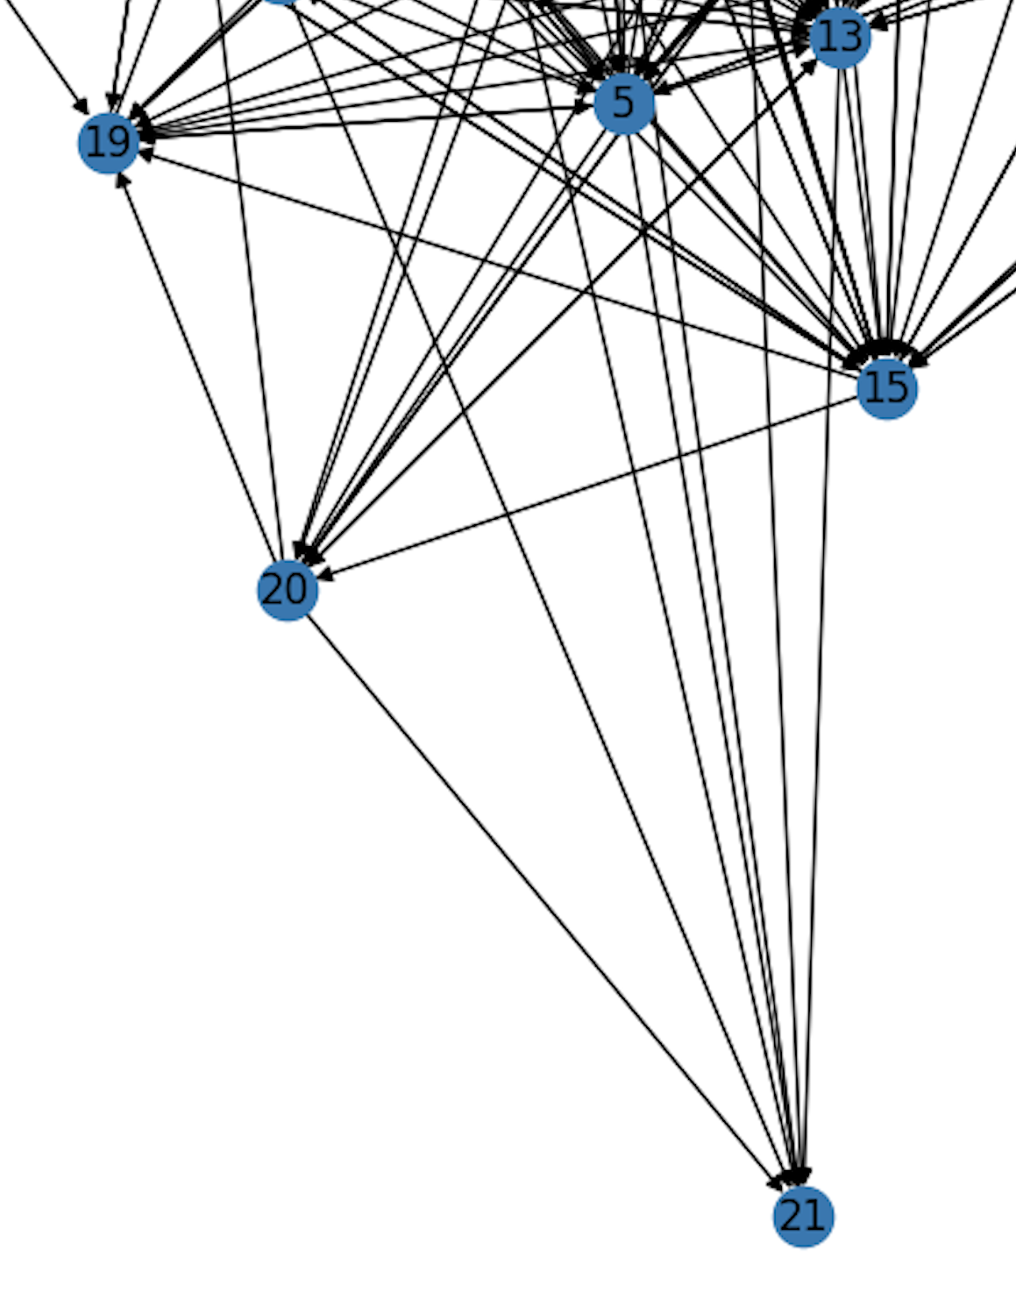
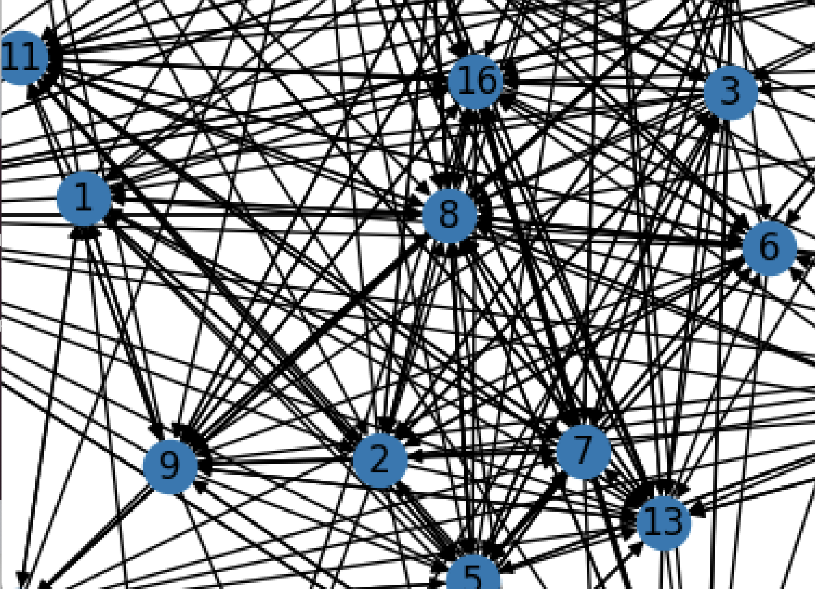
Node 8, 2, 7, 0, 5 seems the most Dominance individuals in the group Node 21, 20, 22 are the subordinate individuals.

Slide 5
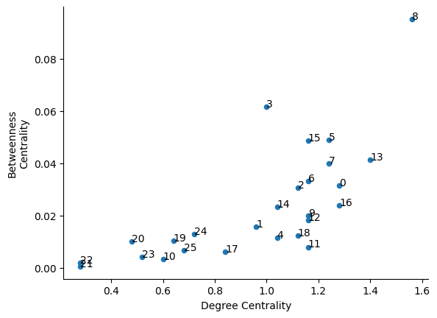
graph of betweenness centrality against degree centrality for a network of American bison
Node 8 is out-standing; This single should be the Alpha in the group

Slide 6
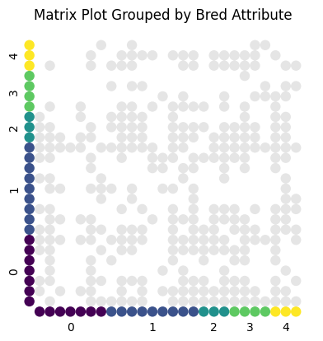
Matrix Plot Grouped By Bred Attribute
The distribution of the attribute seems evenly distributed, is this means dominant has more breeding opportunities?

Slide 7
The Actual Breeding number of the observed Dom/Sub individuals
Node | Bred | Status
8 | 1 | Dominant
2 | 2 | Dominant
7 | 1 | Dominant
0 | 4 | Dominant
20 | 1 | Subordinate
21 | 0 | Subordinate
22 | 3 | Subordinate

Slide 8

Takeaways
Increasing the sample size for future research
Add on different bison community to build on the network cluster community
Trying to make 24h observation during the breeding season

Slide 9
Thank you!

