Slide 1
Global Inflation
Presenter: Hexuan Fan

Slide 2
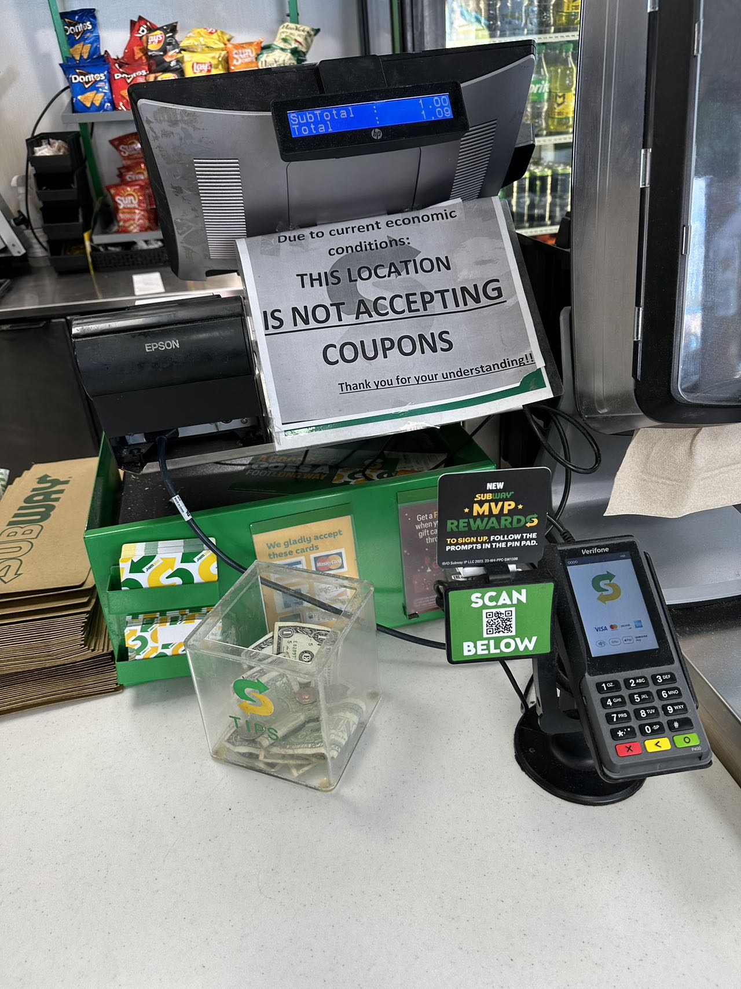
Motivation & Questions
Speaking of economic conditions, I consider inflation as a measurement that reflects the shift of economics.
Questions:
With the rapid global economic development starting from 1980s, how does global inflation changed over years?
What could be factors that affect the change of CPIs?

Slide 3
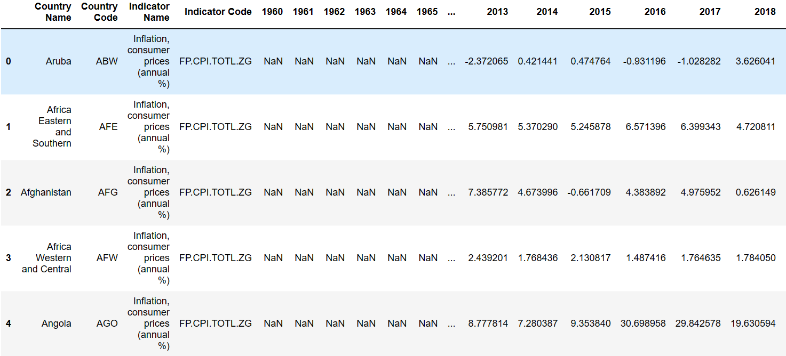
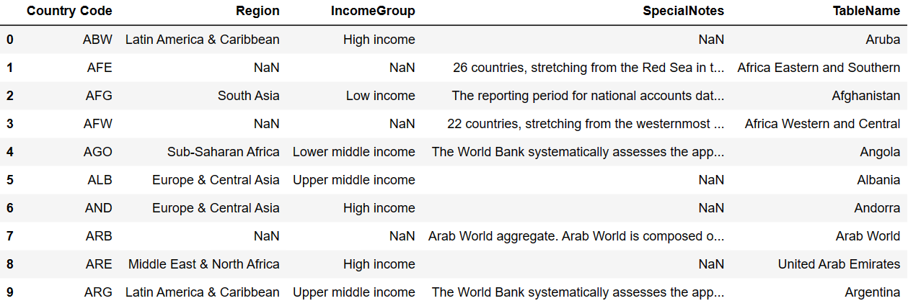
Data Description
Source:
International Monetary Fund (IMF)
Dataset used:
1. Inflation, consumer prices (annual %)
2. Gross national income (current US$)
Sheets used:
First two sheets for each dataset (each)
Variables used:
Country Name, Region, IncomeGroup, Annual Data from 1981 to 2022 (both CPI and GNI)

Slide 4
Indicators
Consumer Price Index (CPI)
CPI measures the monthly change in prices paid by consumer, is the most widely used measure of inflation.
Gross National Income (GNI)
GNI is the total income earned by a country's people and businesses, no matter where it was earned. It is used to measure and track a nation's wealth from year to year.

Slide 5
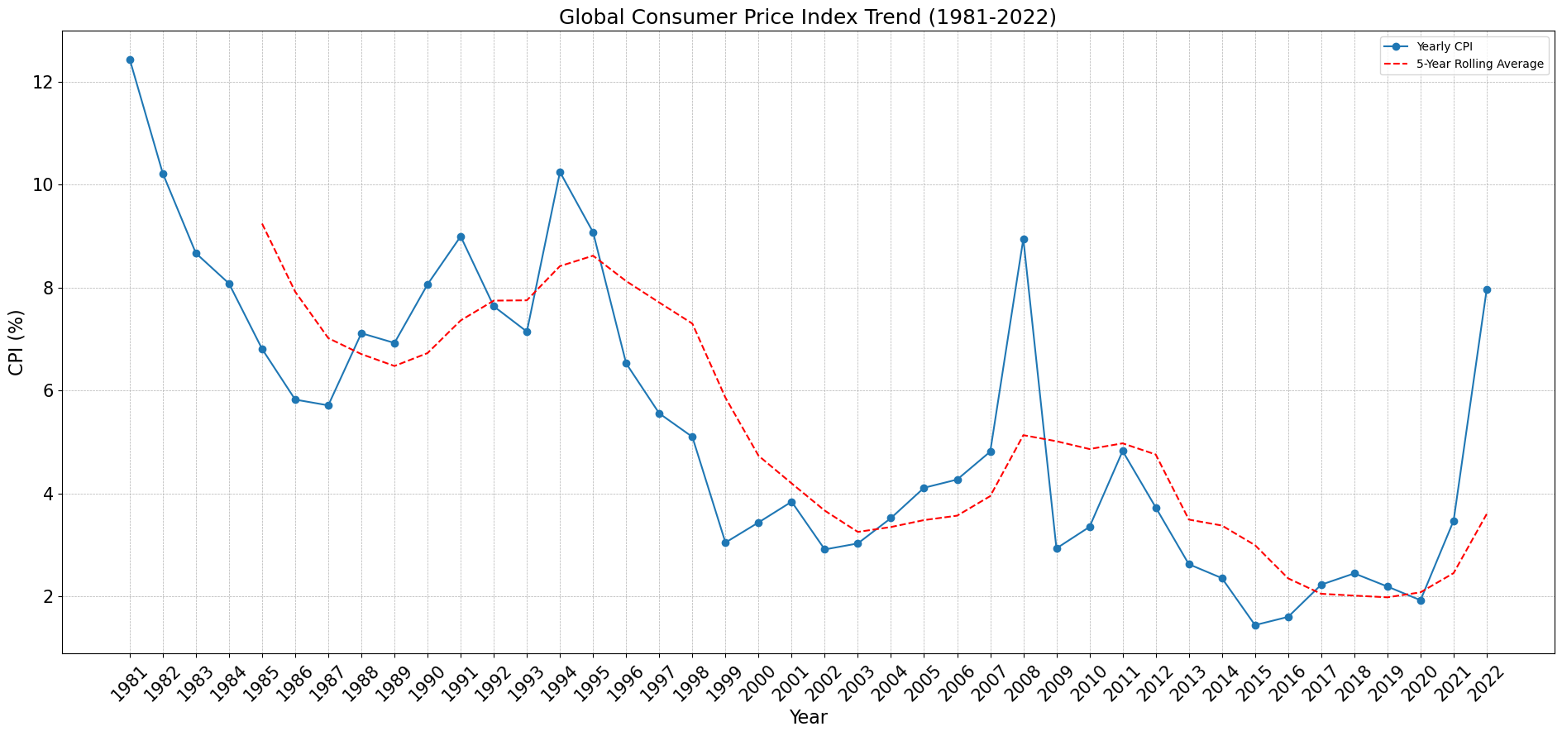
Overview

Slide 6
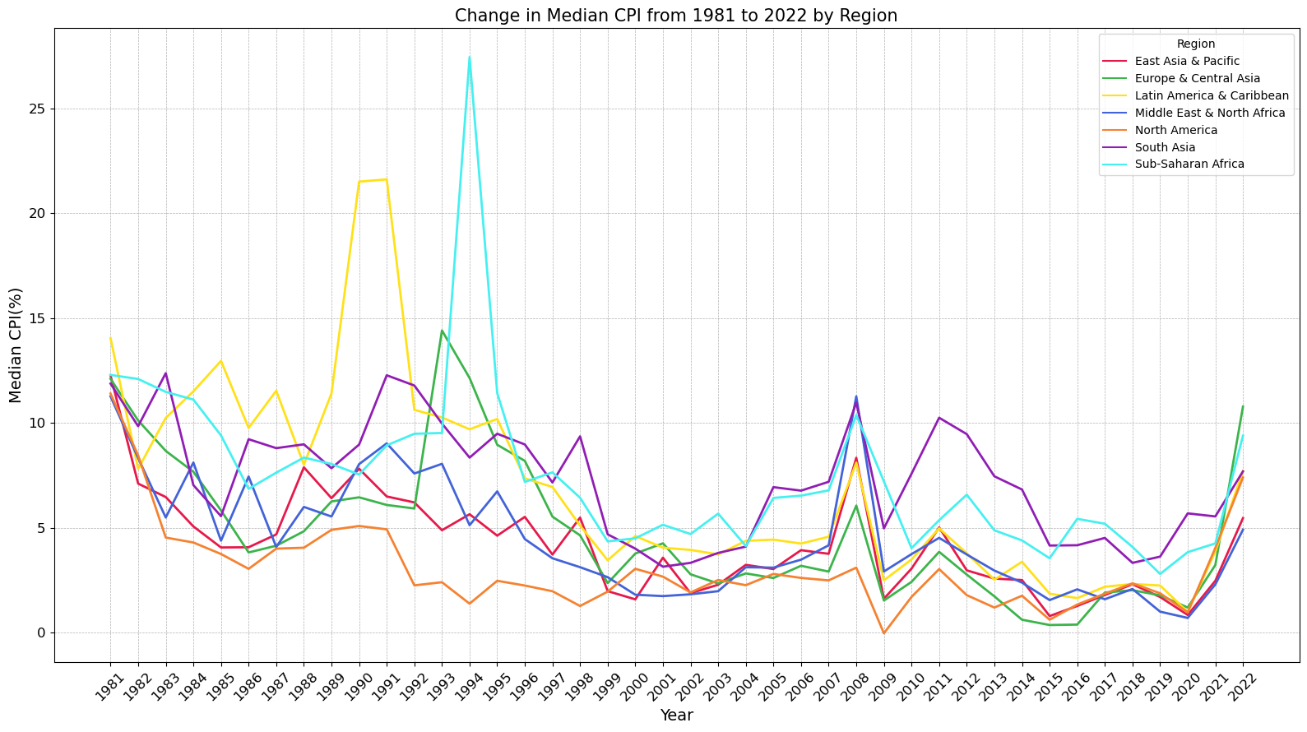
Region

Slide 7
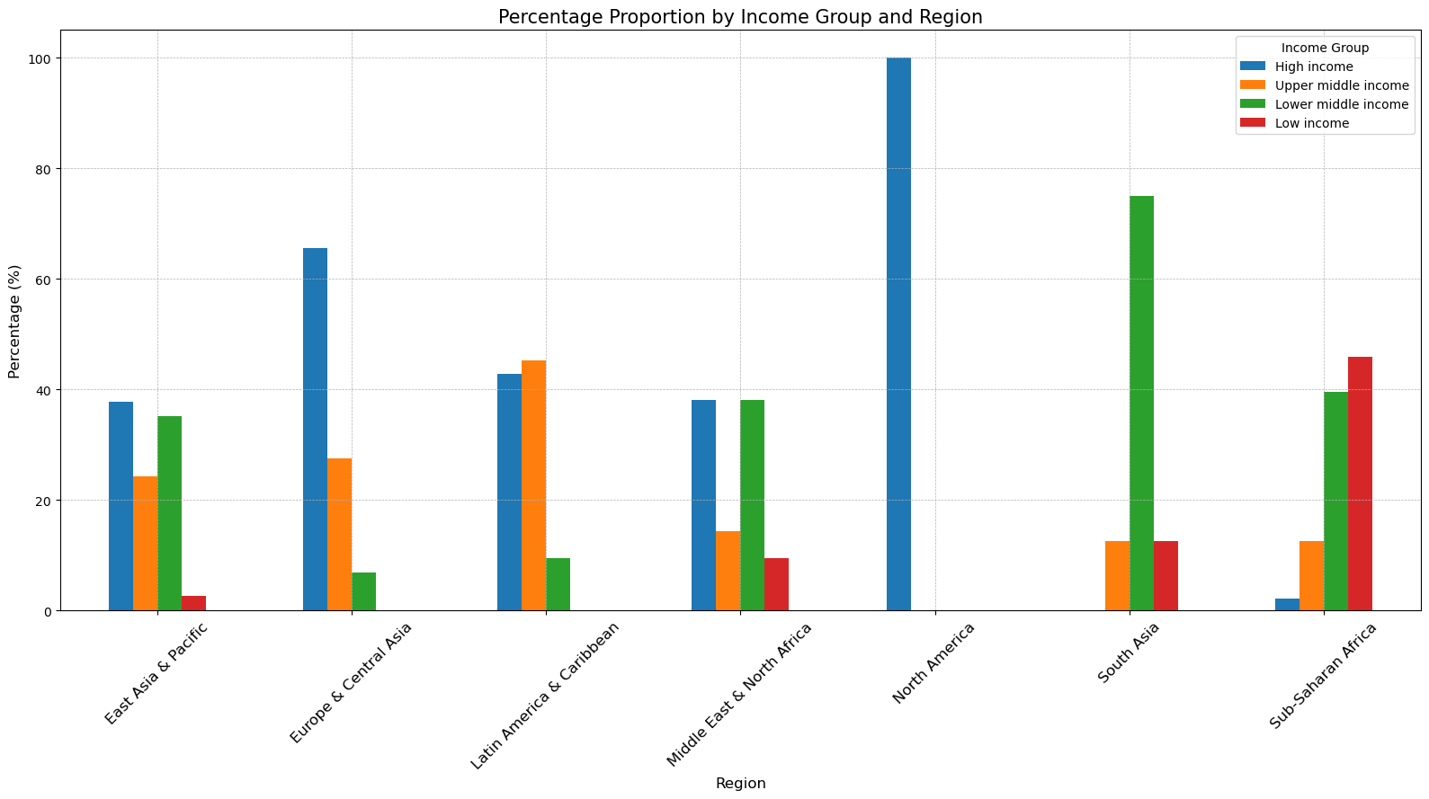
Region & Income

Slide 8
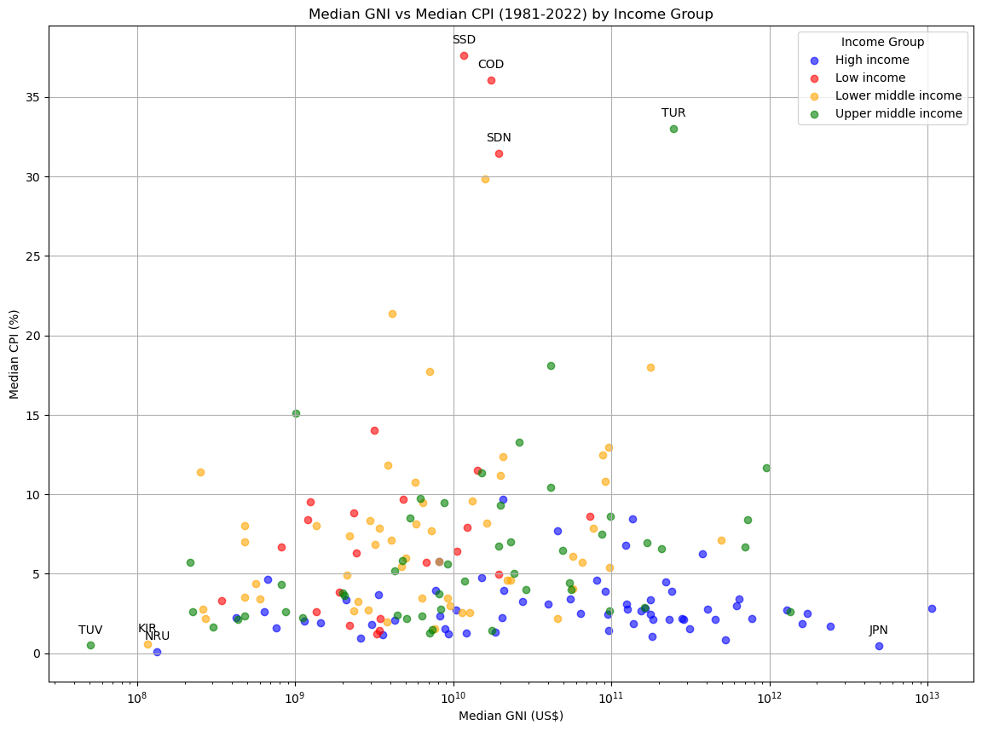
Income (scatter plot)
Observations:
High-income (blue points) countries mainly clustered at the bottom of the figure within 10%, and mostly within 5%
Low-income (red points) countries are more dispersed and with the most amount of top CPI countries.

Slide 9
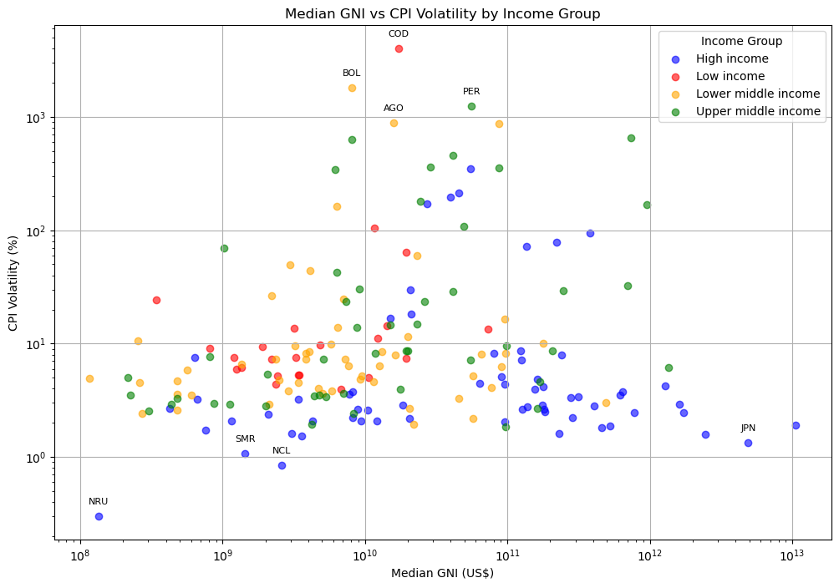
Income (scatter plot)
Observations:
High-income (blue points) countries are generally below countries that belong to other income groups on the same income level.
High-income (blue points) countries are still the most stable group among others.

Slide 10
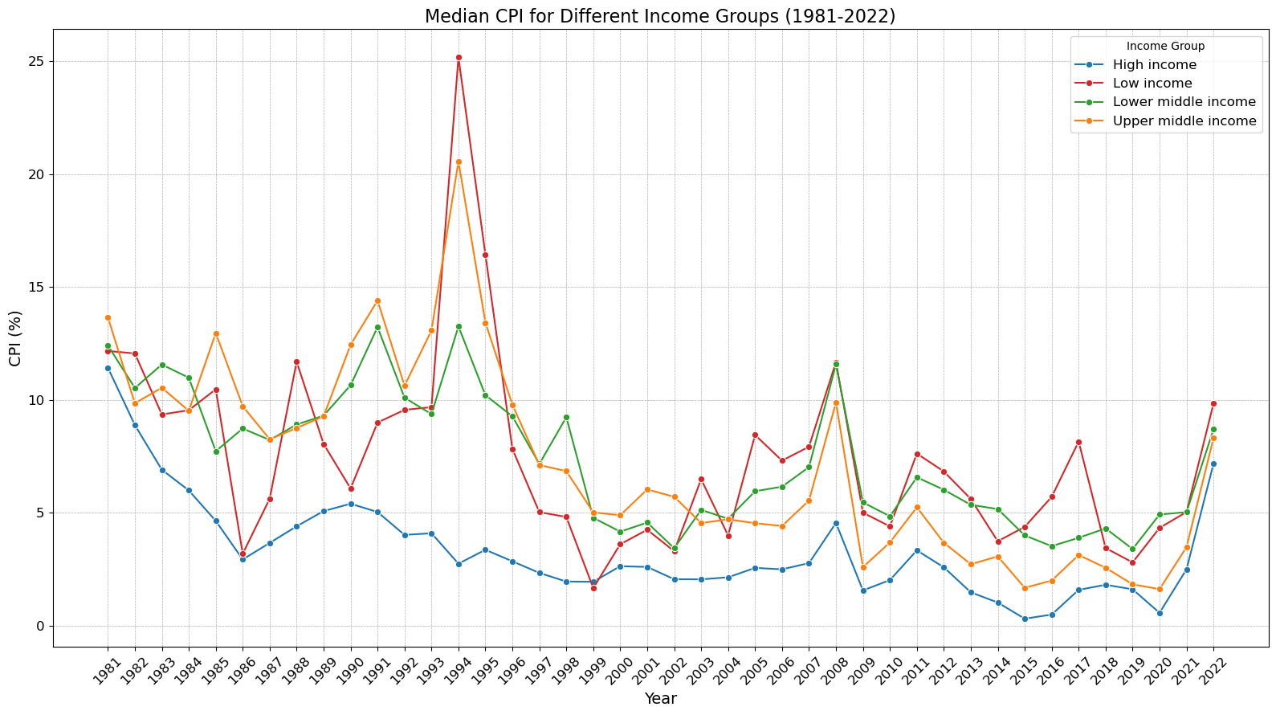
Income

Slide 11
Average Volatility (Standard Deviation)

Slide 12
Takeaways
Global inflation has been affected by large global events in past decades.
Countries that are categorized within the high-income group have the lowest overall CPI percentage among other income groups, and the change in CPI is also the most stable.
Income is highly related to the CPI performance, and it could be an influential factor in CPI changes as well.

