Slide 1

Amazon Reviews Subset of Amazon reviews from Cell Phones & Accessories Category
Keqing Liu

Slide 2
Motivation
Hidden Sentiments: Does the rating accurately reflect a customer's sentiment towards a product? Can we decode the emotions and sentiments behind a customer's review? What do they love or hate about a product that isn't captured by a mere star rating?

Slide 3
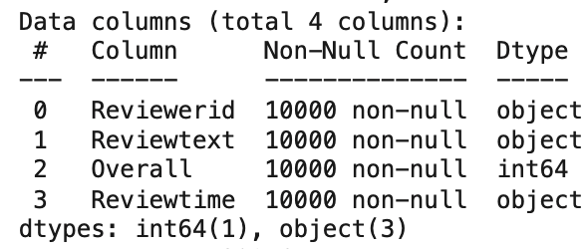
Data
Subset of Amazon reviews from the Cell Phones & Accessories category
Original dataframe: 194439 entries, 9 columns

Slide 4
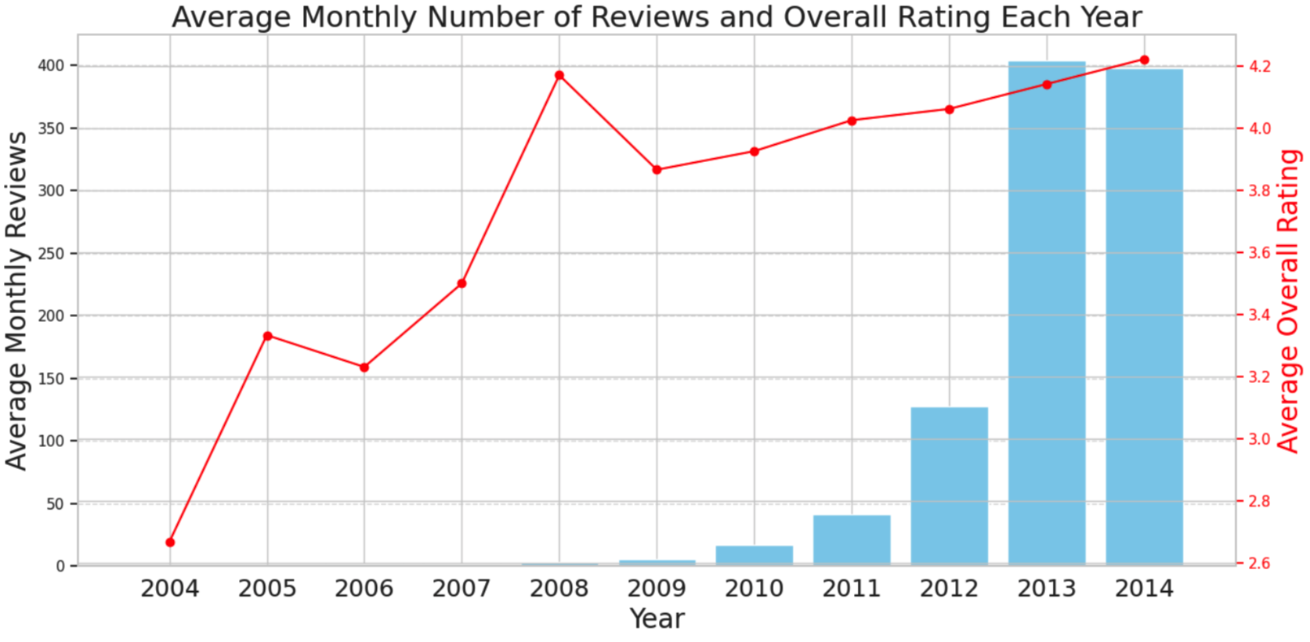

Slide 5
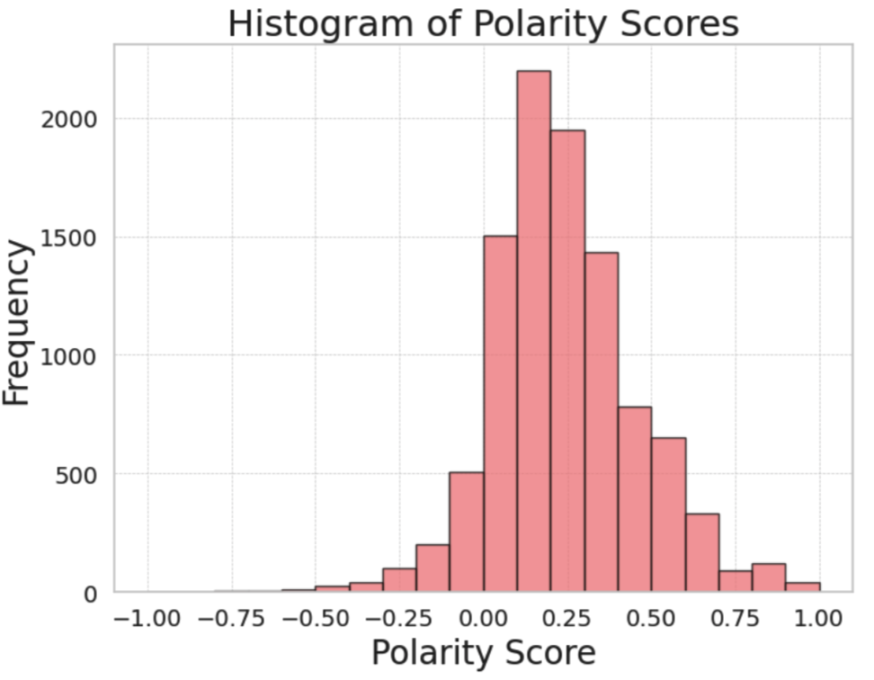
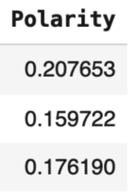
Polarity: How positive or negative a word is. -1 is very negative. +1 is very positive.

Slide 6
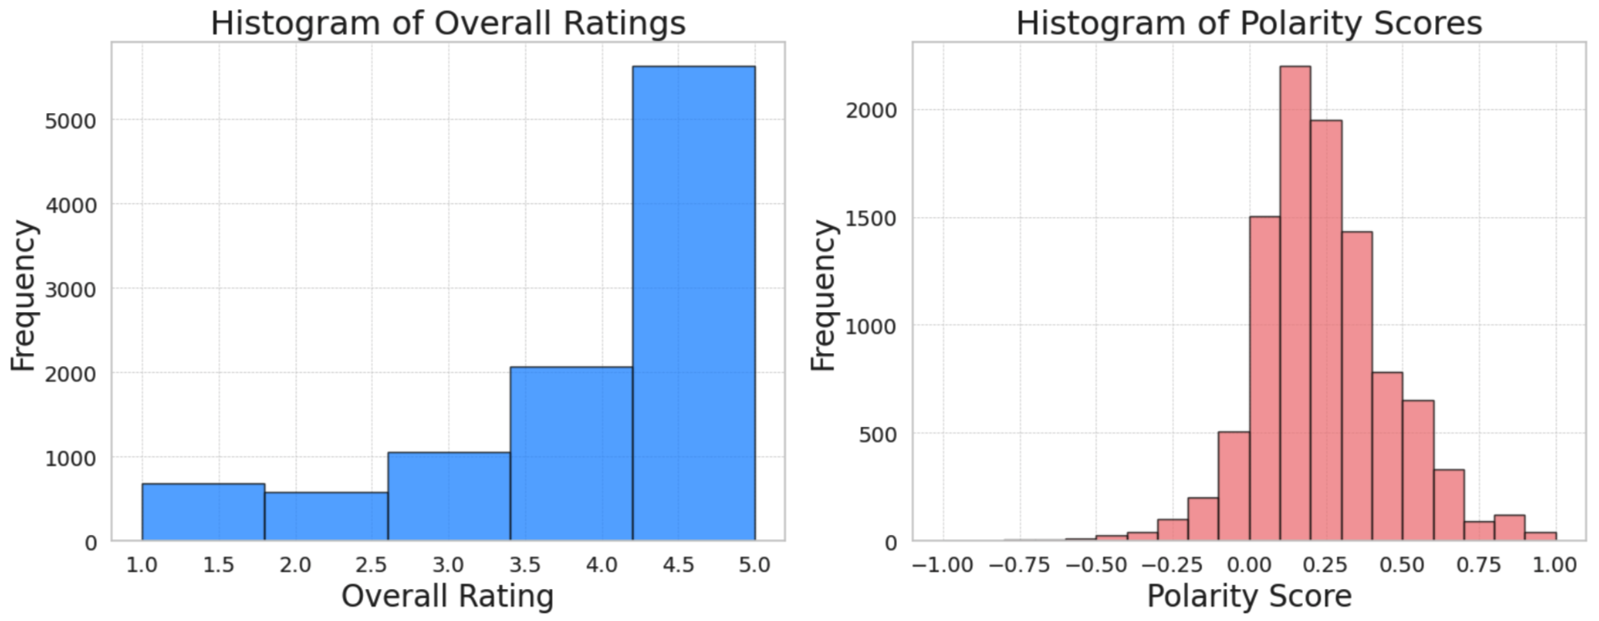
Star ratings are just the tip of the iceberg

Slide 7
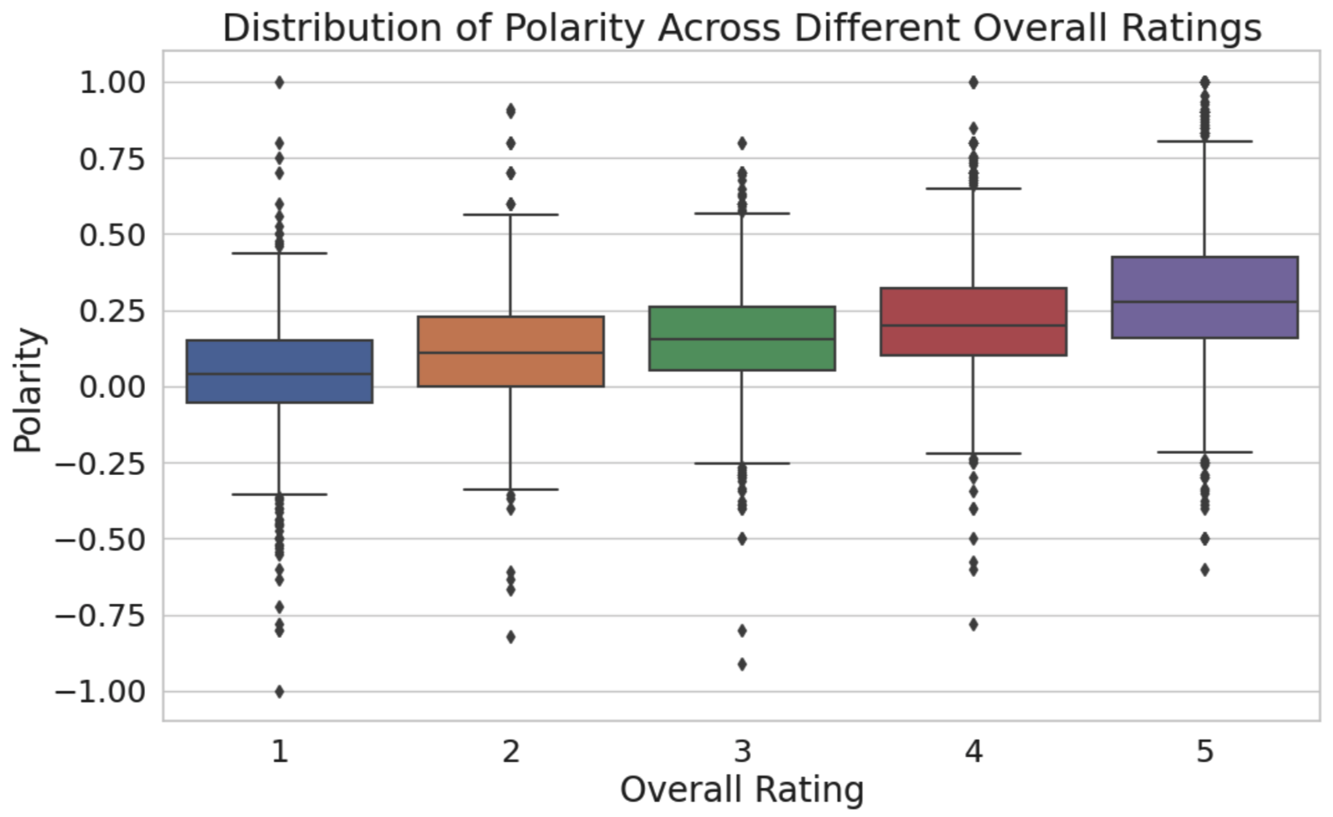

Slide 8
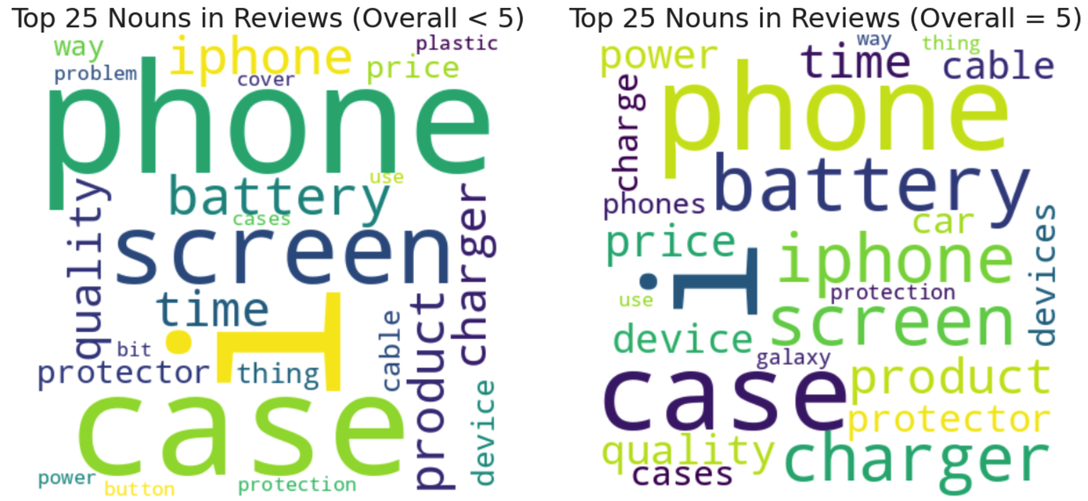

Slide 9
Takeaway
From 2004-2014, both review counts and the average rating increased. The rating eventually stabilized around 4.
Nearly half of reviews show not positive sentiments, revealing deeper purchase insights.
Overall rating positively correlates with polarity.
Both high and low rating groups frequently mention terms like 'battery' and 'price', suggesting these aspects are important. They are likely to view terms like'button' negatively, but terms like 'charge' positively.
Speculation: People might be inclined to give a product a positive rating but point out minor issues or areas of improvement in the reviews.

