Slide 1
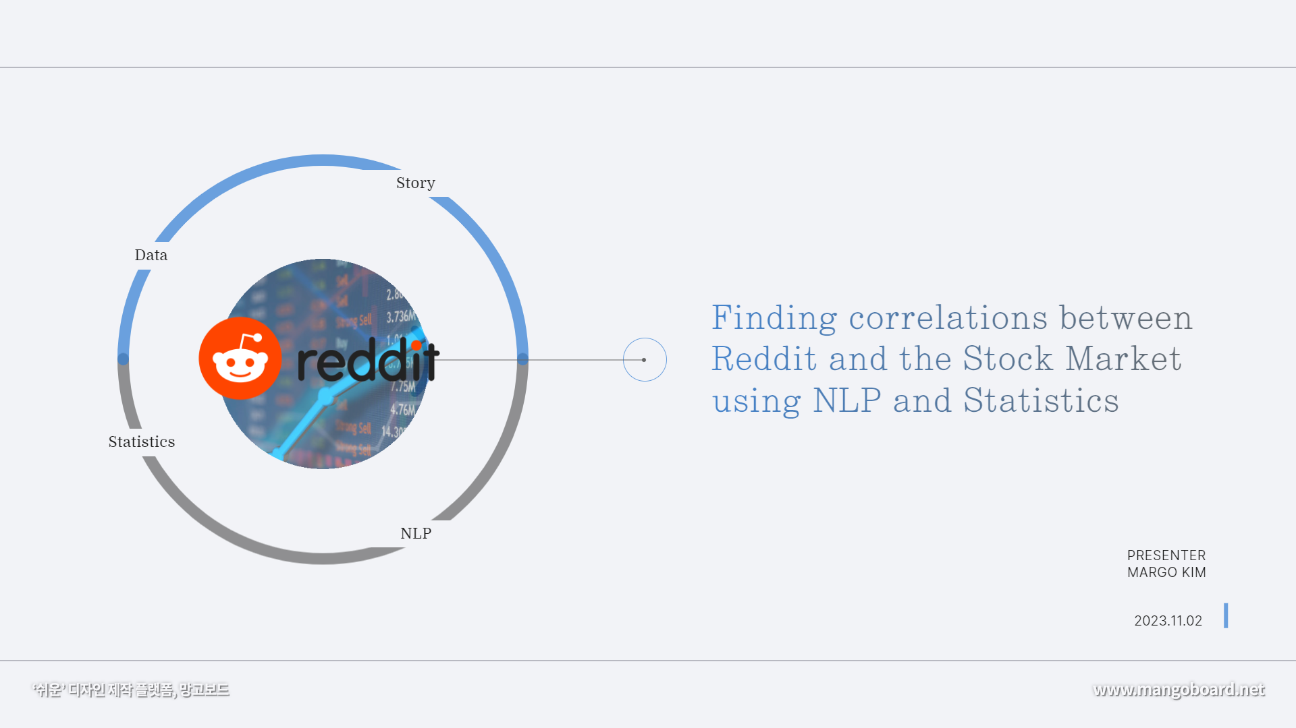

Slide 2
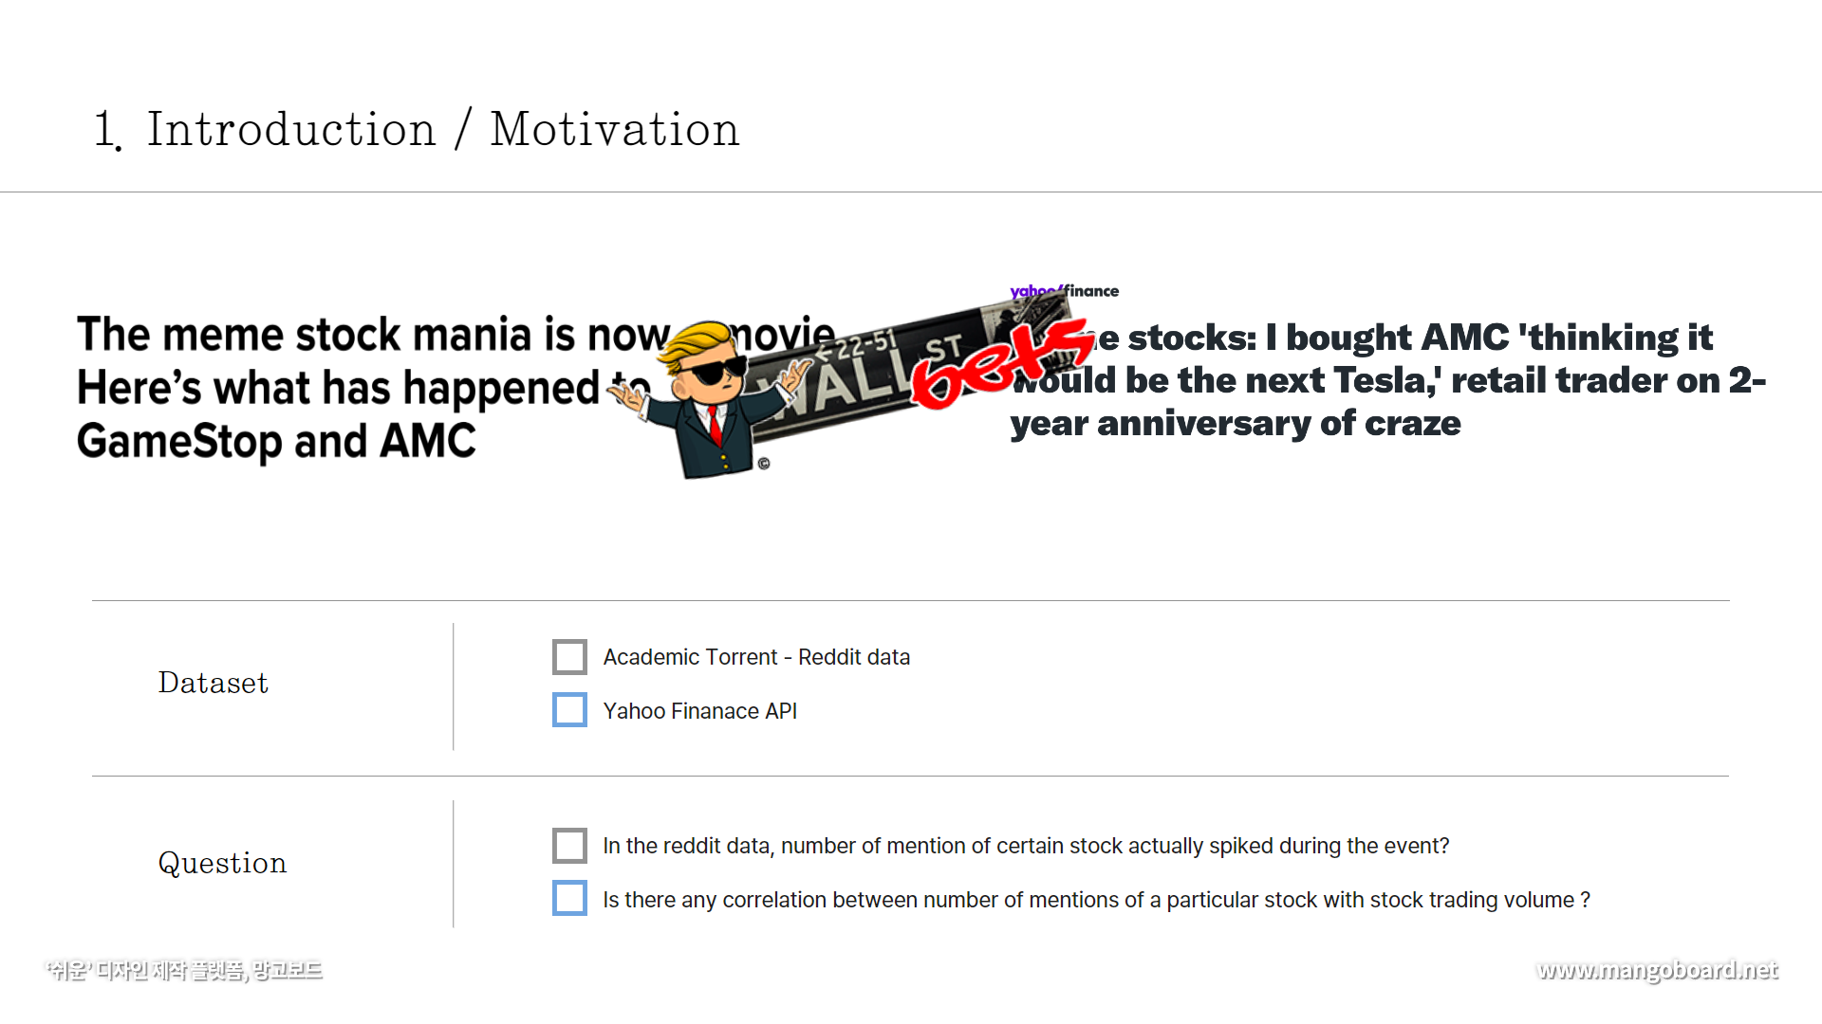

Slide 3
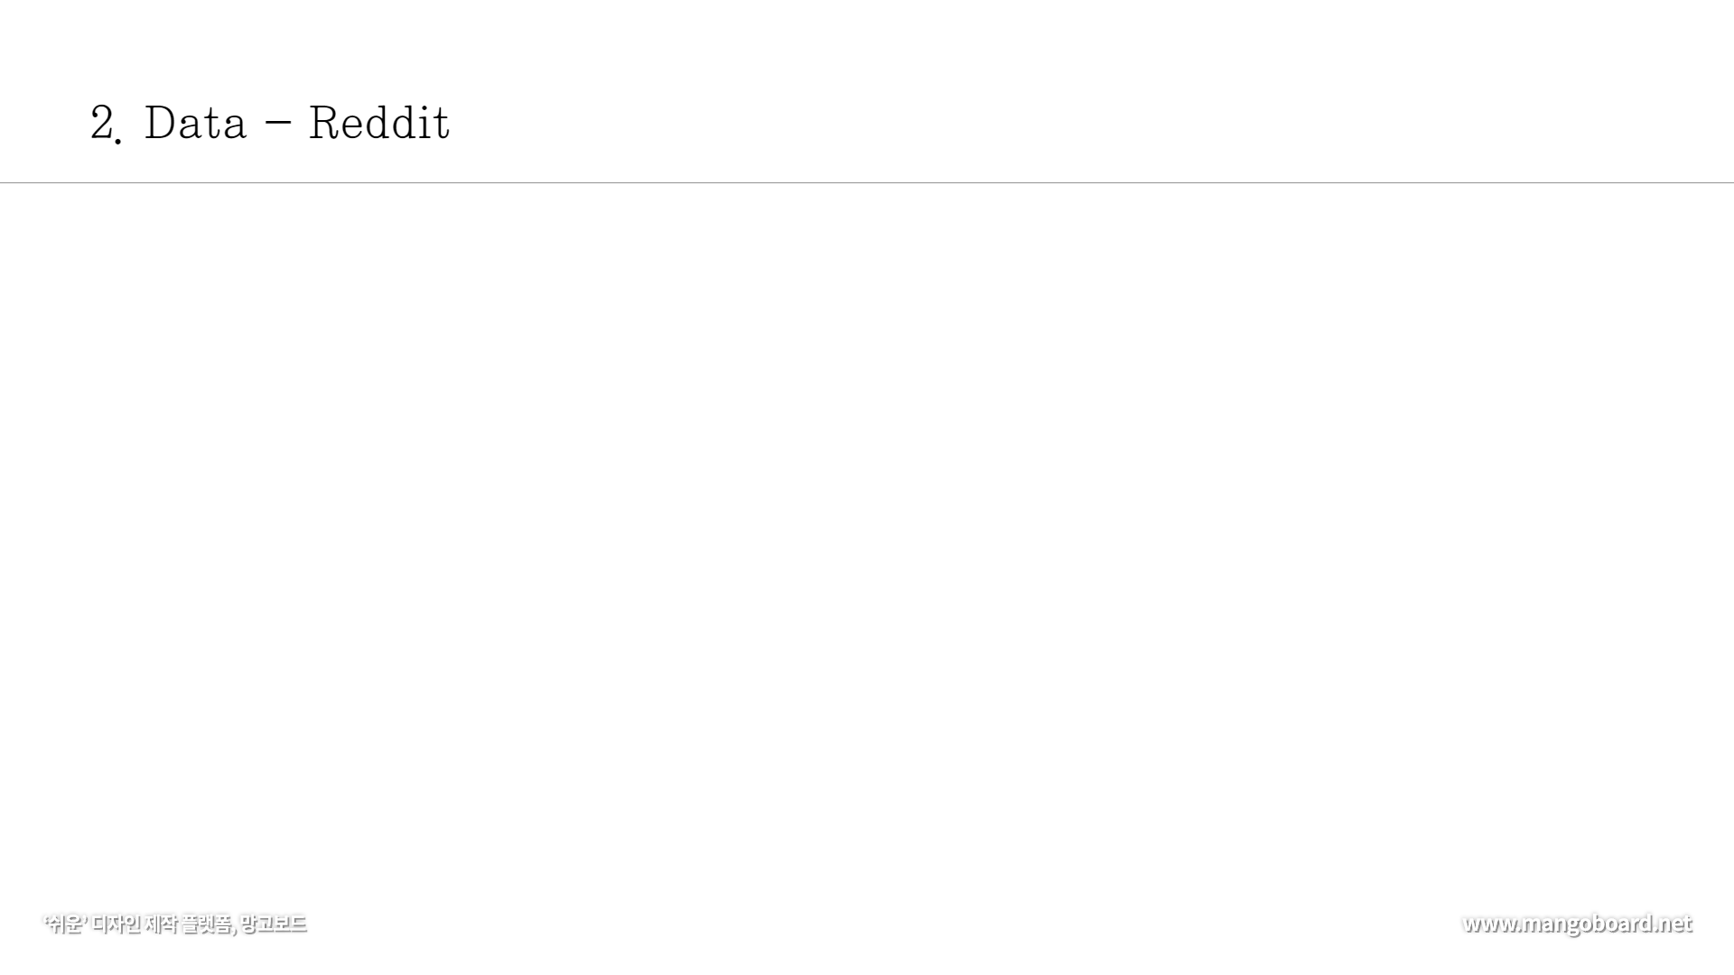
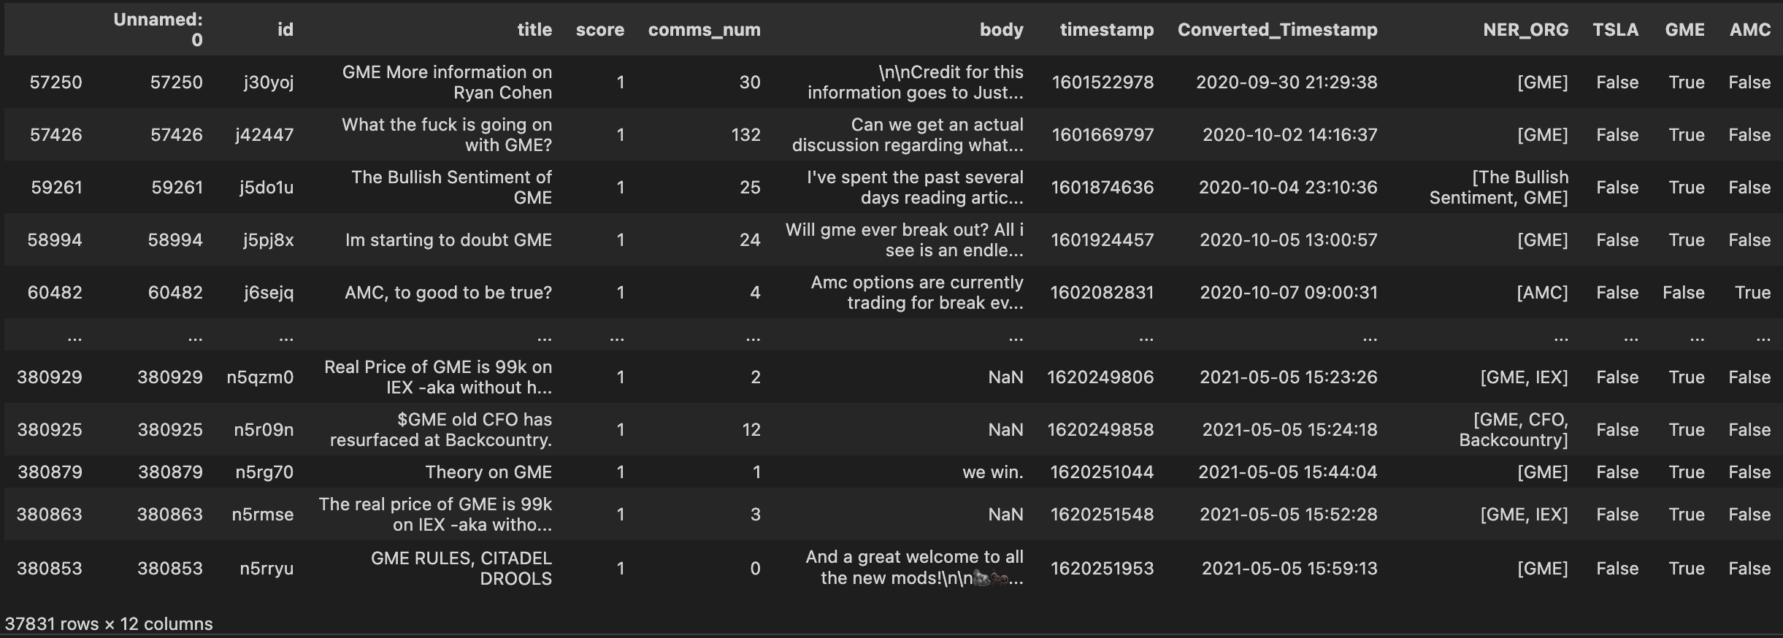
Original Reddit Data
Converting UTC to CST
Using Spacy for NER Task

Slide 4
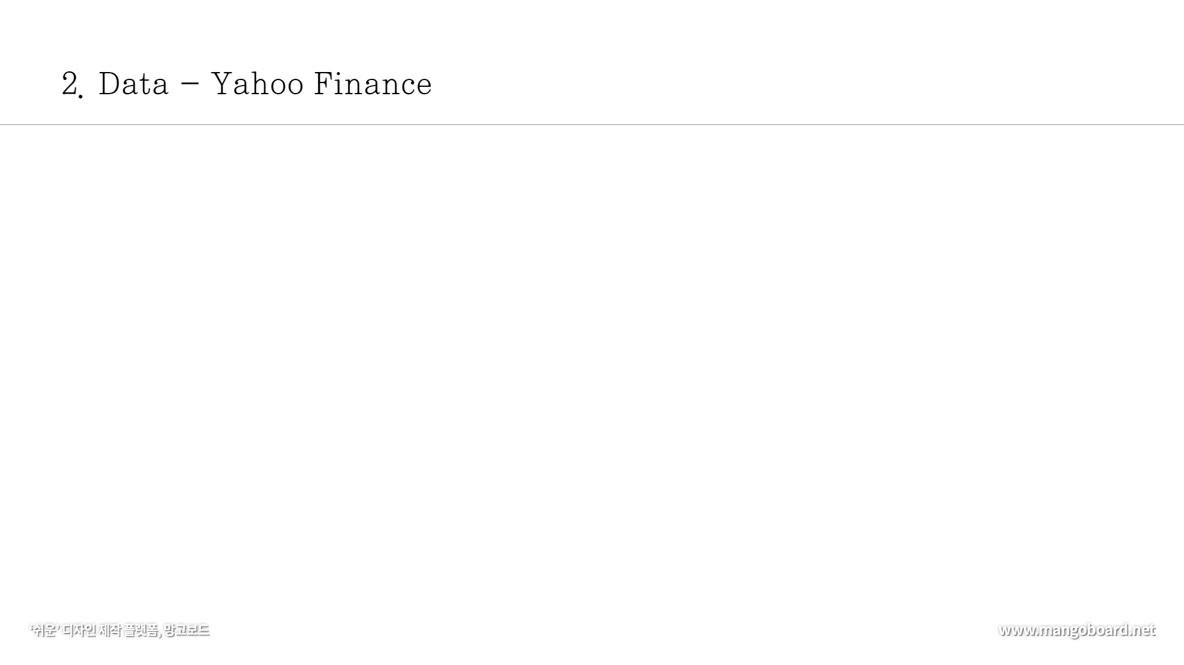
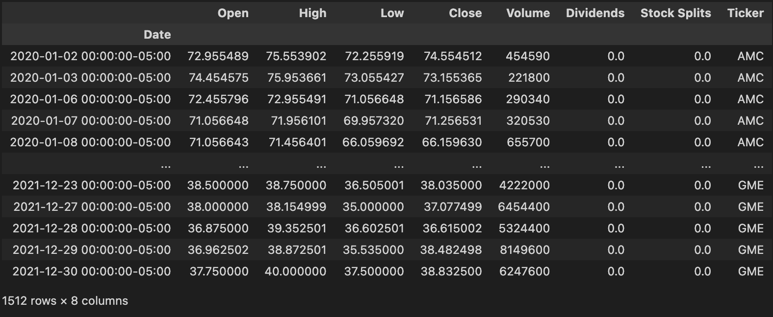
- Made a Yahoo Finanace API calls to gather financial information of certain stocks

Slide 5
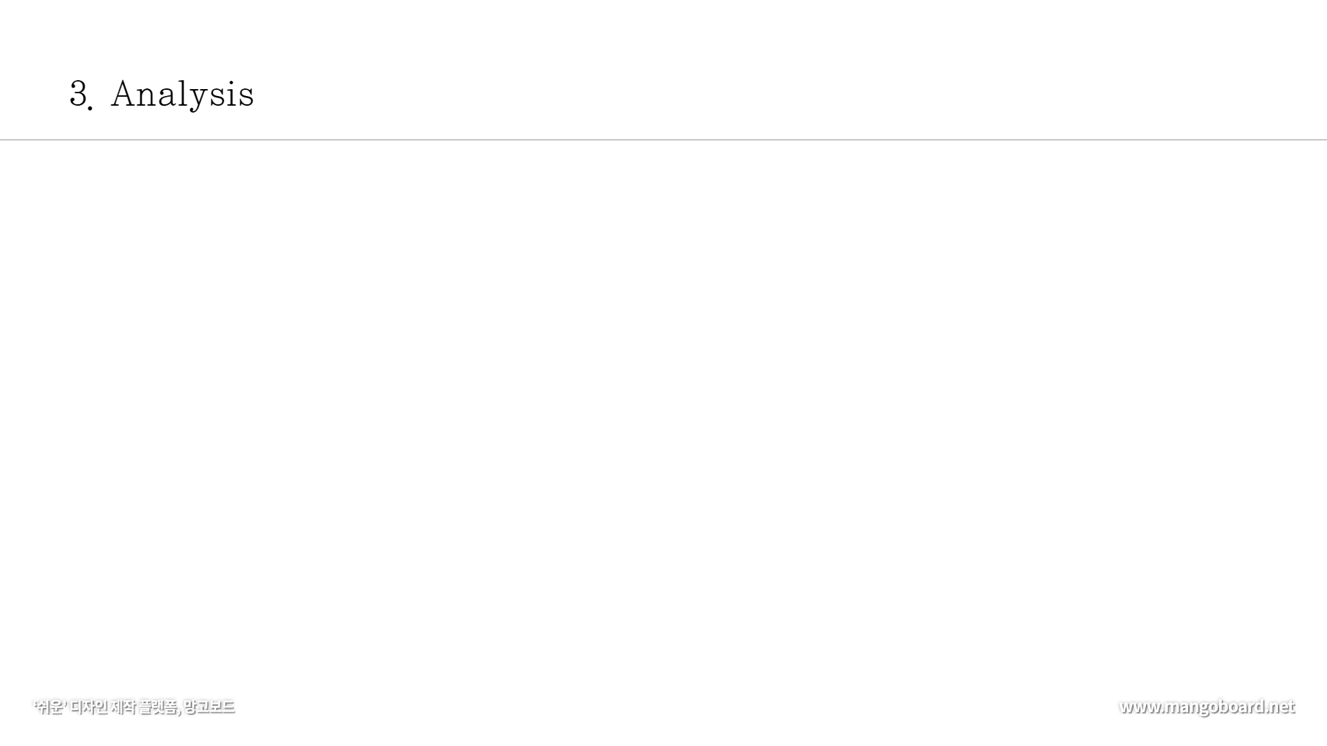
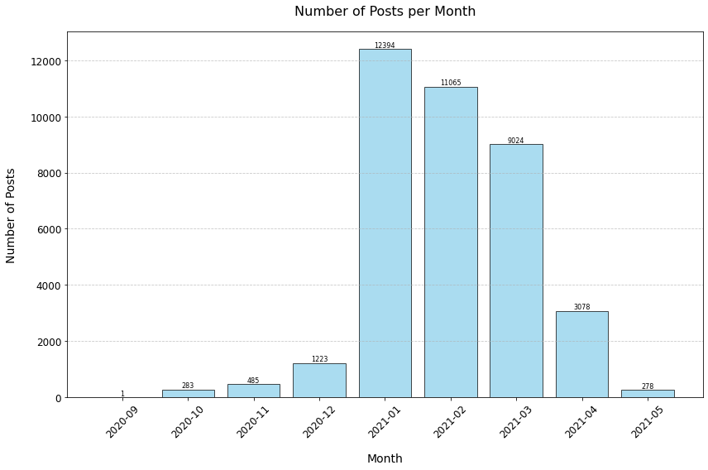
Reddit Activity Over Time
- Time Period :
The plot spans from Sept 2020 to May 2021 data that includes the period when r/wallstreetbets gained significant attention
- Data Represented:
The x-axis represents time, and the y-axis is a count metric, the number of Reddit post titles during the given period of time
- Volume of Activity and Variability:
The figure shows the trend of reddit activity over time. Peaks would indicate periods of high activity, where users frequently generated new posts on r/wallstreetbets.

Slide 6
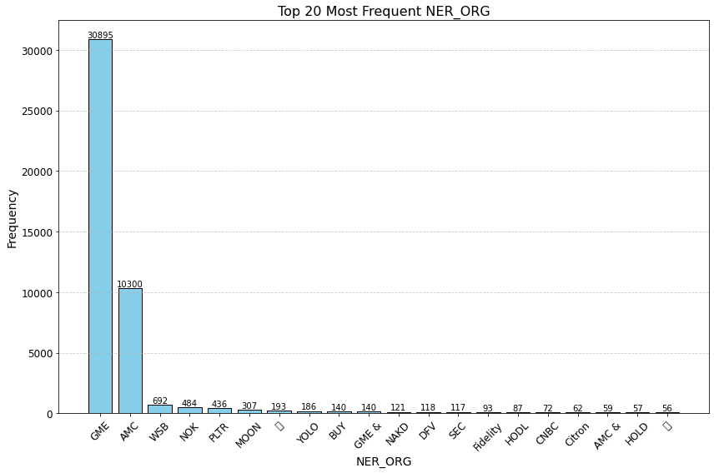
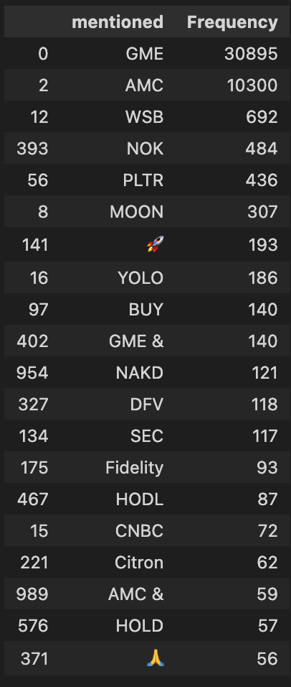
Top Organizations on Reddit
- Time Period :
The plot spans from Sept 2020 to May 2021 data that includes the period when r/wallstreetbets gained significant attention
- Data Presented:
The line graph represents this count over time, providing a visual representation of how often the stock was mentioned in the subreddit's titles.
- Significant Peaks:
The highest peaks might be related to the GameStop phenomenon in January 2021, where there was a massive surge in interest and activity related to certain stocks.
🚀
🙏

Slide 7
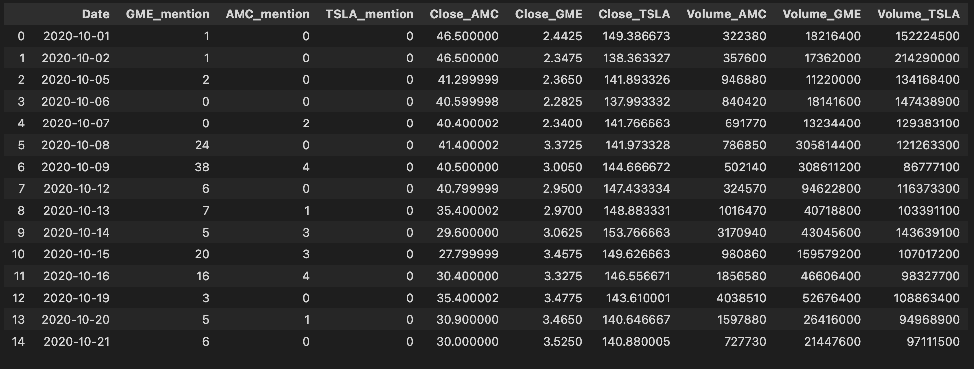
Join Key : Date
Number of Reddit Posts Mentioning Certain Stocks Per Day
Daily Closing Price and Stock Trade Volume of Each Stock

Slide 8
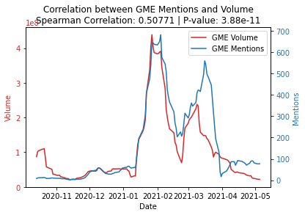
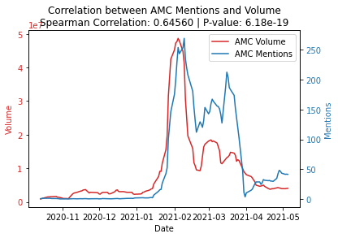
Correlation Between Reddit Posts and Trading Volume
Null Hypothesis: There is no correlation between the number of posts and the trading volume of meme stock
Alternate Hypothesis: There is a correlation between the number of posts and the trading volume of meme stock
Statistical Correlation
The Spearman correlation coefficients for both figures are over 0.5, which suggests a moderate to strong positive correlation
The p-values are significantly lower than the commonly accepted threshold of 0.05.
It is statistically appropriate to reject the null hypothesis that there is no correlation between the number of Reddit posts and the trading volume of the stock.

Slide 9

1. Presence of Correlation:
There is a moderate to strong positive correlation between the number of Reddit posts on r/wallstreetbets and the trading volume of the stocks in question. This is evidenced by Spearman correlation coefficients that are significantly greater than 0.
Further Implications
Market Dynamics:
The findings illustrate the changing dynamics of the stock market, where traditional indicators may now need to be considered alongside new data sources like social media sentiment and activity
2. Statistical Significance:
The p-values associated with these correlations are well below the standard alpha level of 0.05, suggesting that the correlations are statistically significant and not due to random chance.
Potential for Predictive Modeling:
The significant correlations indicate that there is potential for predictive modeling, where social media data could be used to forecast stock trading volumes.
3. Influence of Social Media:
The data supports the idea that social media activity, particularly on platforms like Reddit, can have a measurable impact on stock market behavior, influencing trading volumes.

