Slide 1

Distribution of DHL Facilities Across the USA
By Murad Aladdinzade

Slide 2
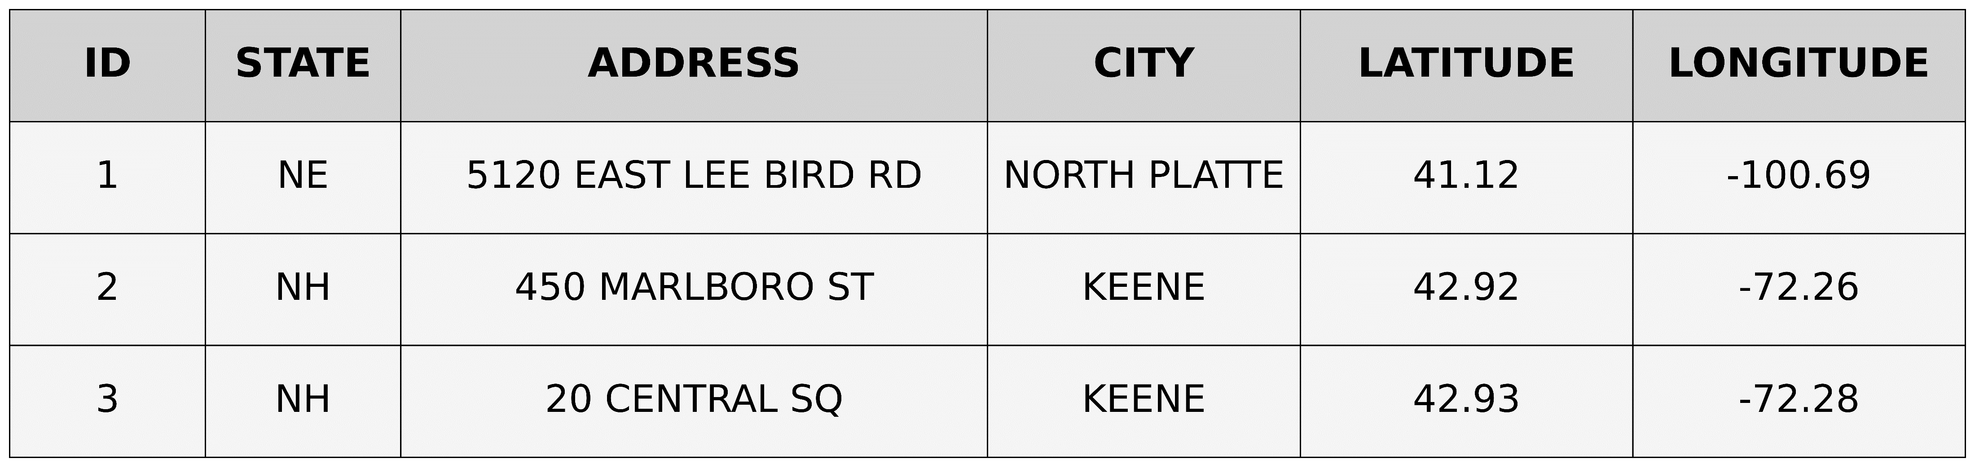
Overview of DHL Facilities in the USA in 2017
Total Number of Facilities 24,072
Total Number of Features 16
Source : Homeland Infrastructure Foundation-Level Data (HIFLD)

Slide 3
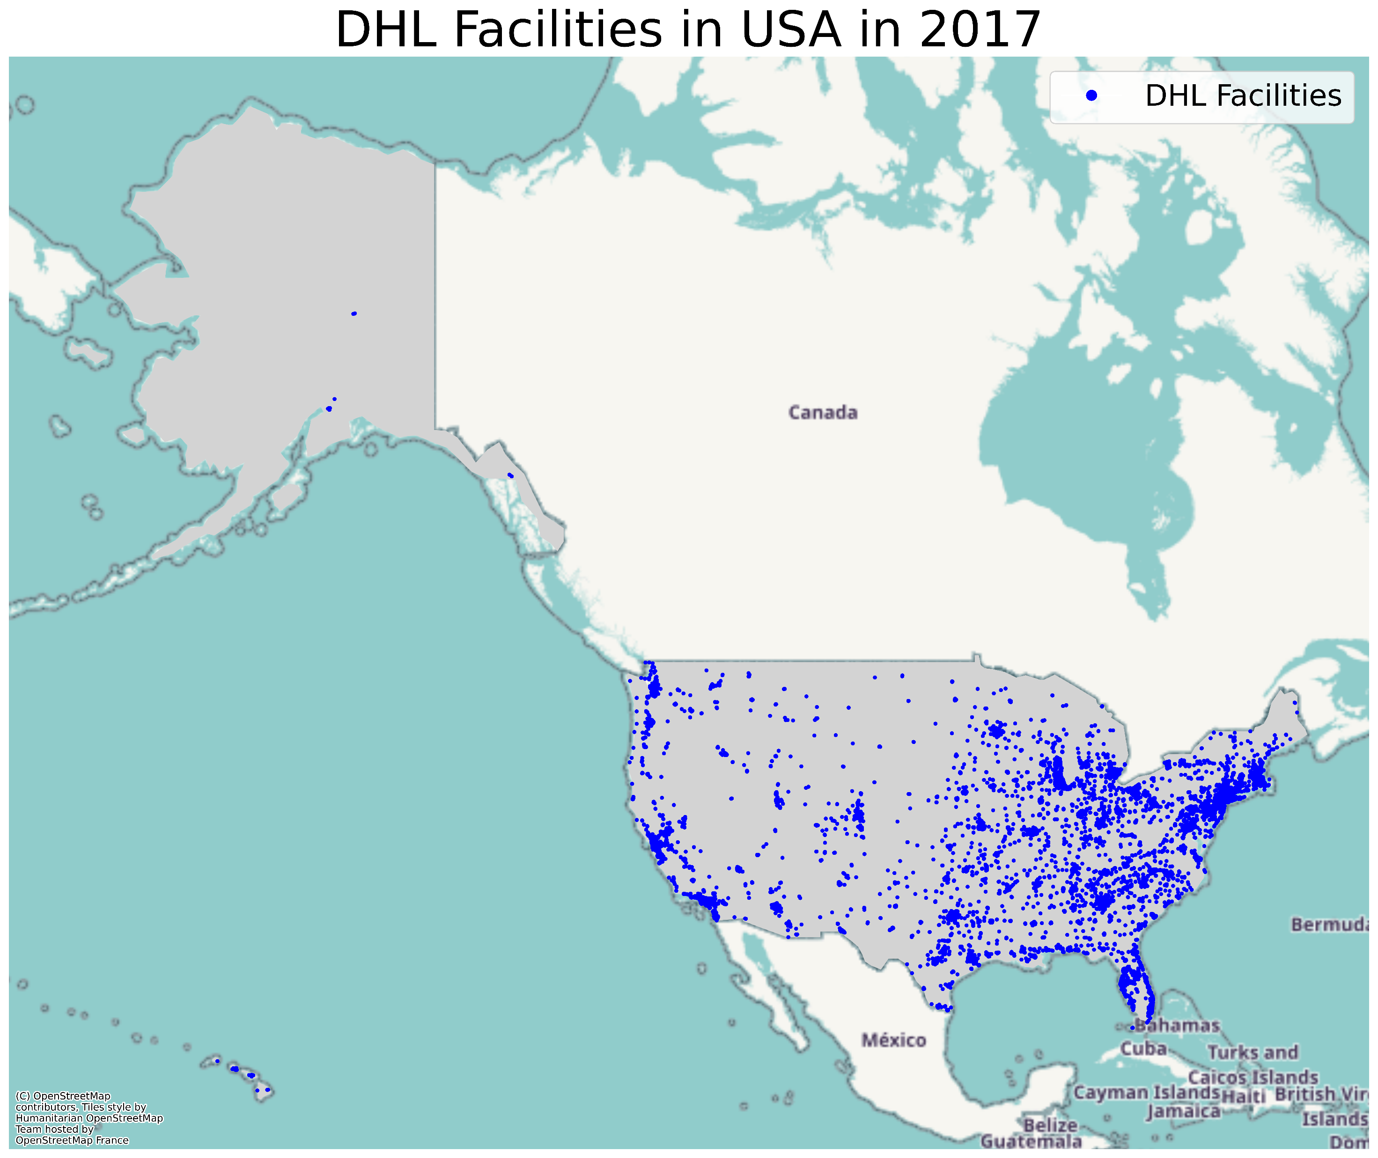

Slide 4
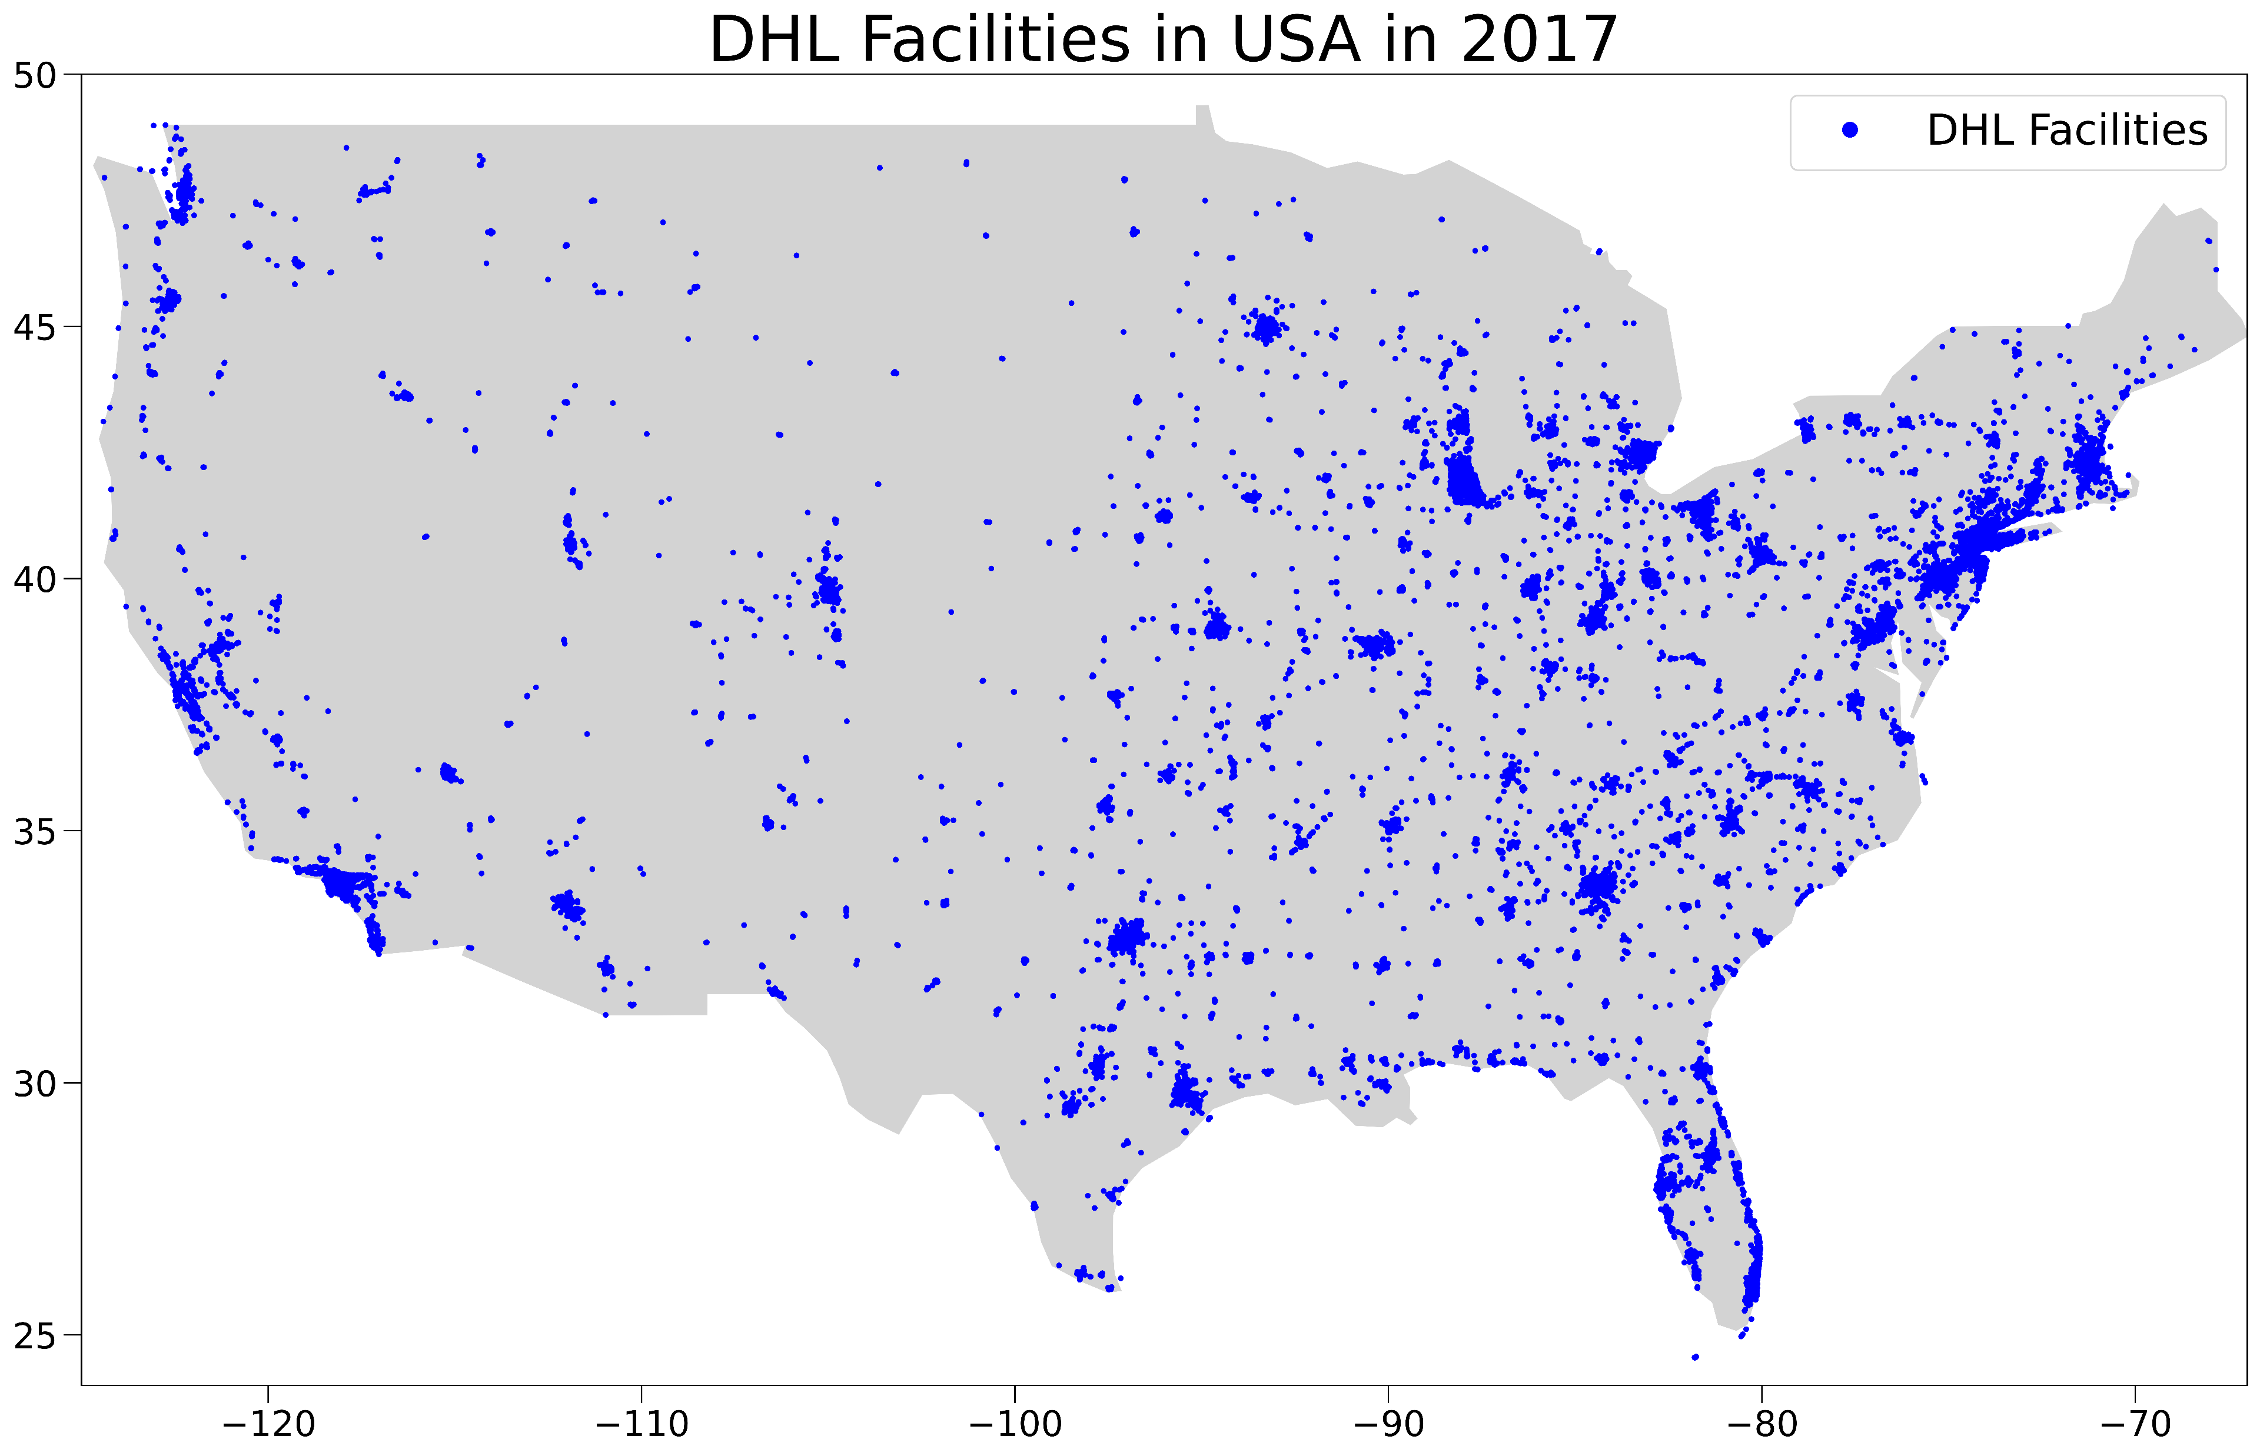

Slide 5
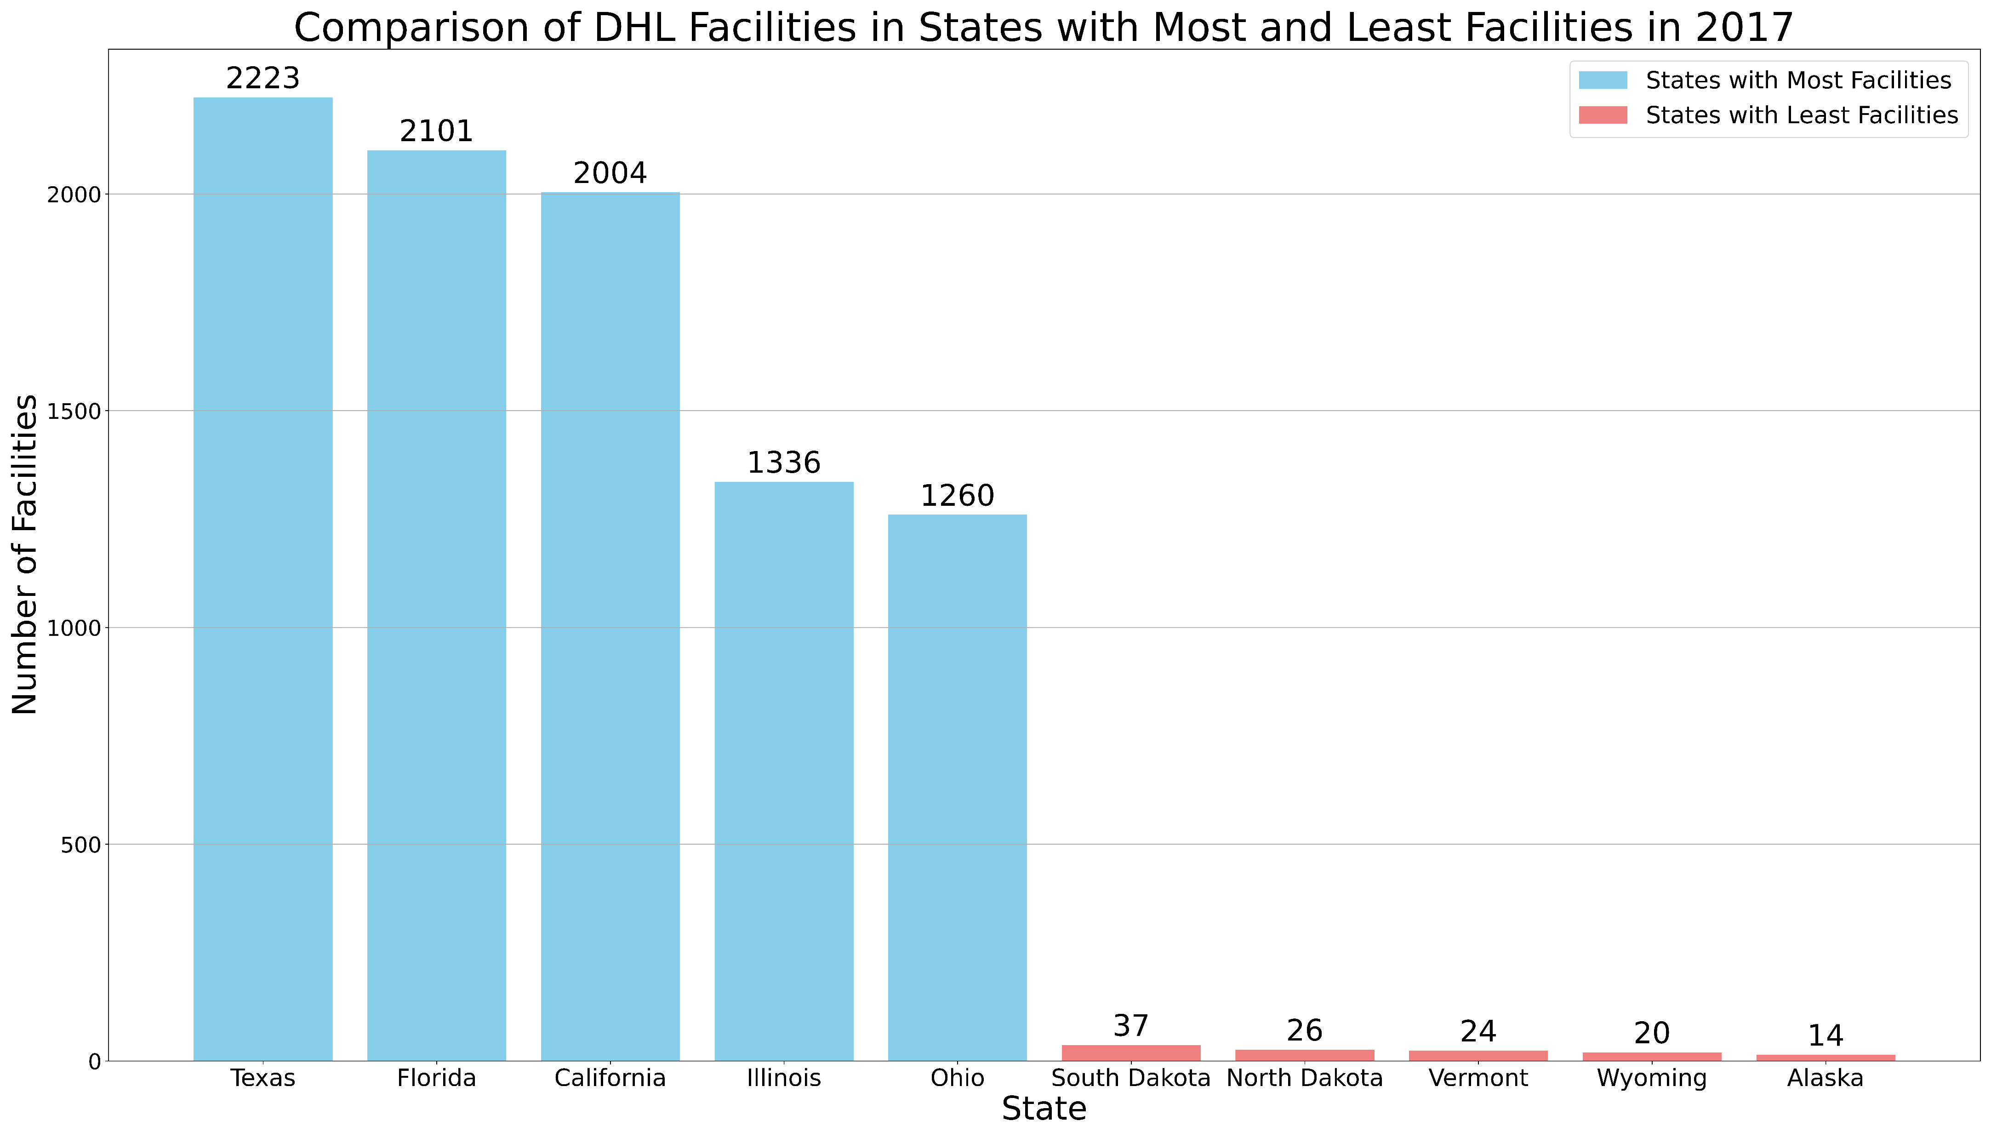

Slide 6
Thank You!

