Slide 1
Insights from the National Gallery of Art Collection
Silin

Slide 2
Motivating Questions
How does the diversity of the National Gallery of Art's collection change over time?
Where do the museum's artworks come from, and who gave them?

Slide 3
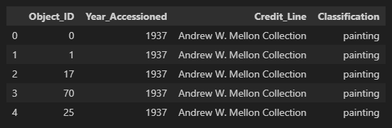
About Data

Slide 4
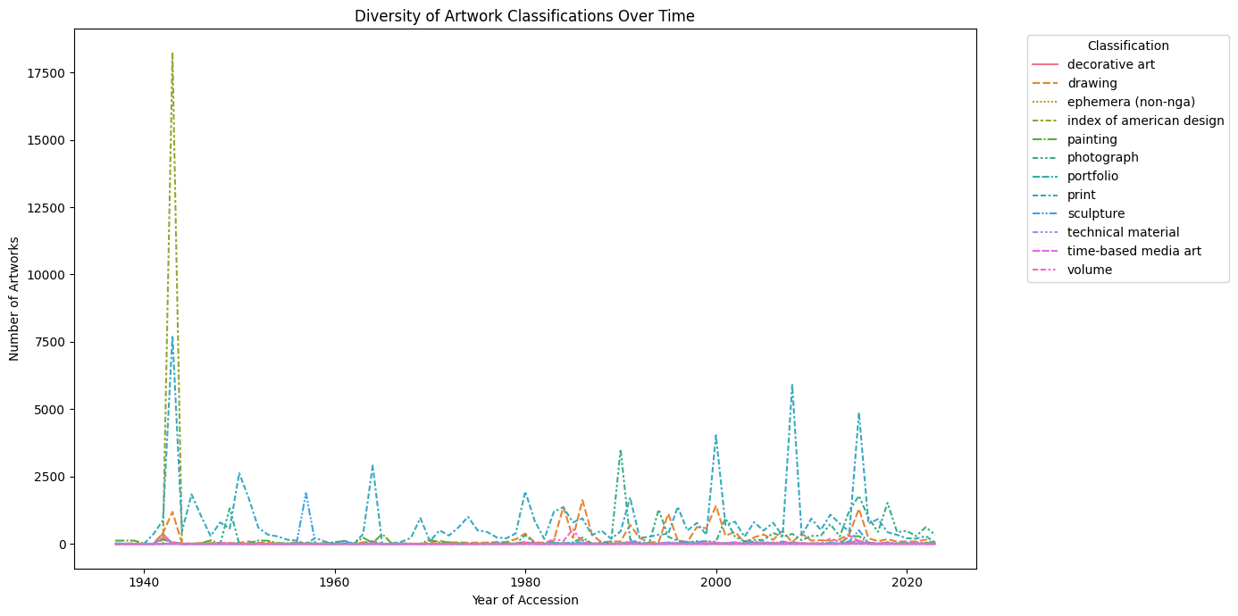

Slide 5
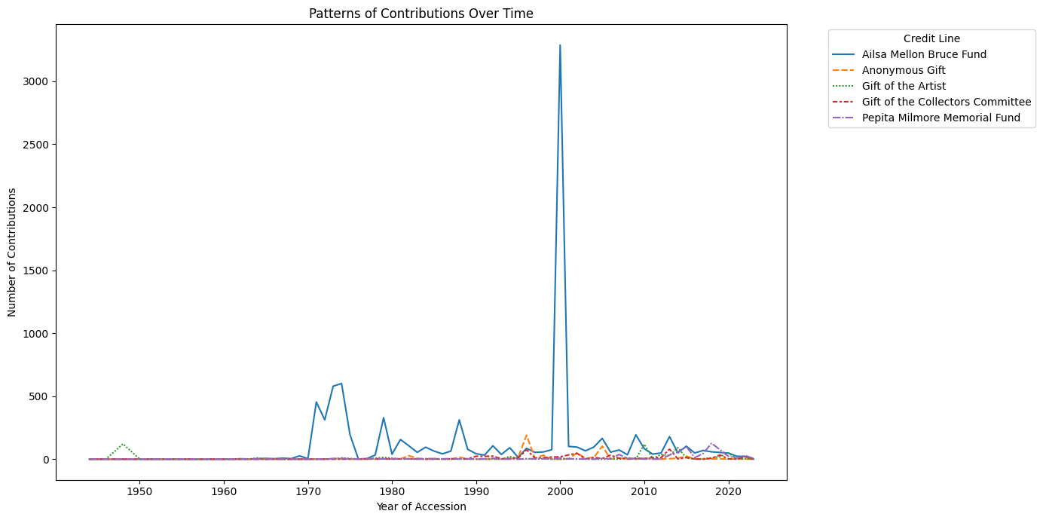

Slide 6
Key Takeaways
Current collection trends offer insights for future acquisition focus and donor engagement strategies.
The historical interplay of classifications and contributions sets a narrative for the museum's evolving cultural footprint.

Slide 7
Thank You!

