Slide 1
Introduction
Dataset: CGSS survey, the first comprehensive social survey in China, started in 2005 and release there data every 1 to 2 years(2 years delayed)
Planned to investigate pre-pandamic(2018) and post-pandamic(2021) data to find the income difference, but the 2021 data does not contain HALF of the provinces, so pass
Question: What is the changes of income in different regions of China from 2012 to 2018?

Slide 2
Data
CGSS2012 dataset: 11766 rows, 688 columns
CGSS2017 dataset: 12788 rows, 1031 columns
Each row represents a respondent, each column represents a question
The column I use in the two datasets are as follow:
CGSS2012: “a8a” column for income data, “a271” column for province names of the respondents
CGSS2018: “a8a” column for income data, “provinces” column for province names of the respondents
Population data comes from China Statistical Yearbook 2012 and 2018

Slide 3
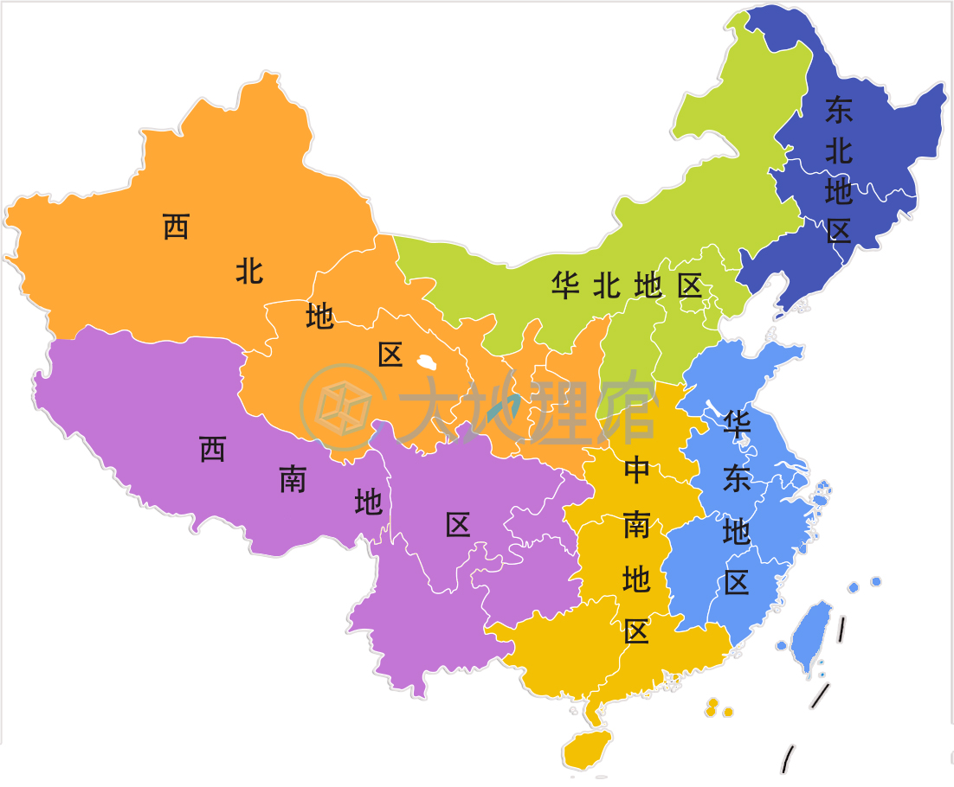

Slide 4
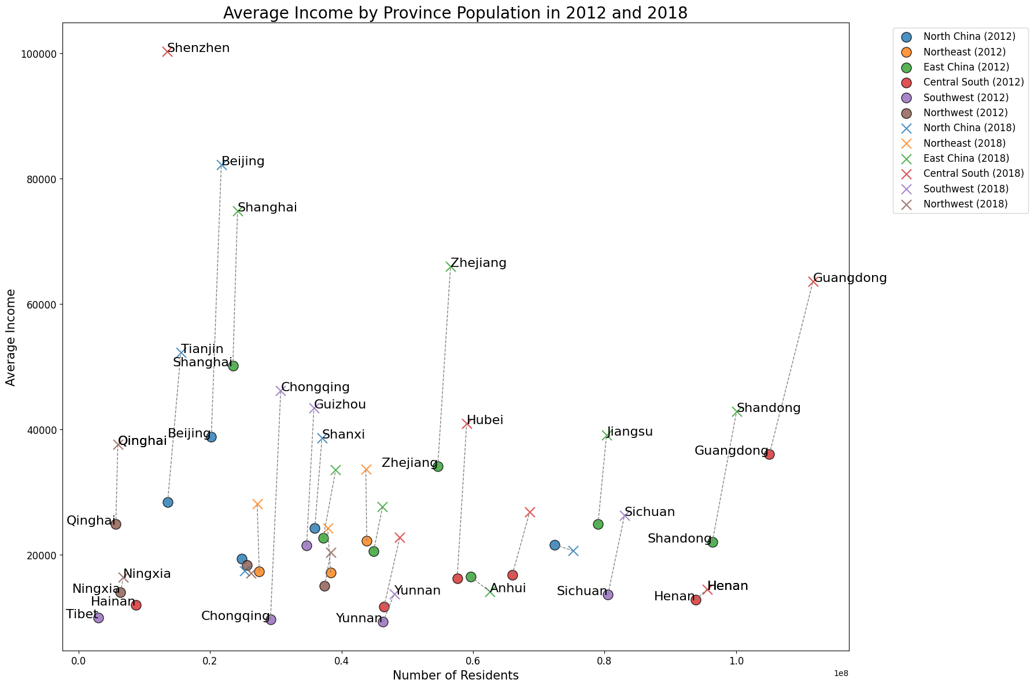
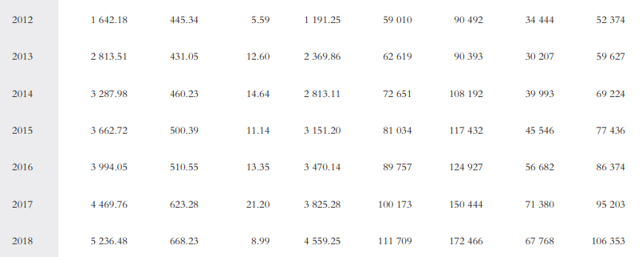
Fujian
Jilin
Jiangxi
Hunan
Guangxi
Inner Mongolia
Hebei
Gansu
Shaanxi

Slide 5
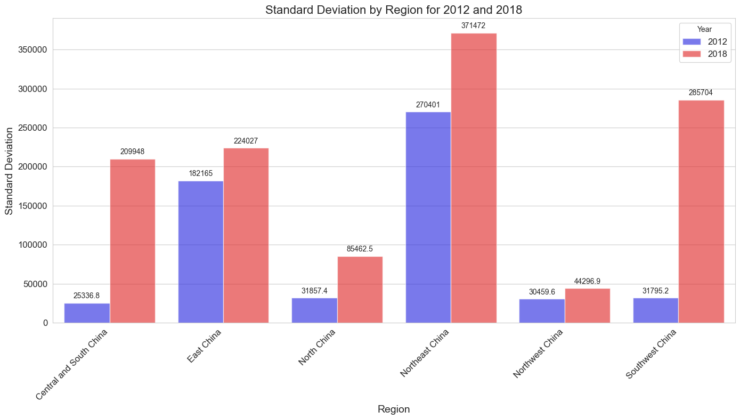

Slide 6
Table for Median Incomes by Regions for 2012 and 2018
Region | Median Income(2012) | Median income(2018) | Growth rate
North China | 21600.0 | 36000.0 | 66.666672
Southwest China | 6000.0 | 10000.0 | 66.666672
Northeast China | 13000.0 | 20000.0 | 53.846157
Central and South China | 10000.0 | 15000.0 | 50.000000
East China | 20000.0 | 30000.0 | 50.000000
Northwest China | 9860.0 | 10000.0 | 1.419878

Slide 7
Takeaway
①: Central and South China and Southwest China experienced the most extreme rise on Standard Deviation of income from 2012 to 2018, which can be interpreted by the rapid development of places like Chongqing city and Shenzhen city
②: Three provinces in Northeast China are the only three that have their population decreased while the growth of income is still decent
③: A possible trend is that in the rest 5 regions except Northeast, there are at least 1 province paying the price for the drastic growth of income for another province. Examples are Hebei province in North China, Henan province in Central and South China and Anhui province in East China. Maybe not a coincidence

