Slide 1

Analysis of Firearm Background Checks in the United States
By Aryaan Upadhyay

Slide 2
Motivating Questions
How has the demand for firearms in the United States changed over time?
Are there any notable trends in firearm background checks across different states?
What can the data on firearm background checks tell us about the patterns of firearm acquisition in the U.S.?

Slide 3
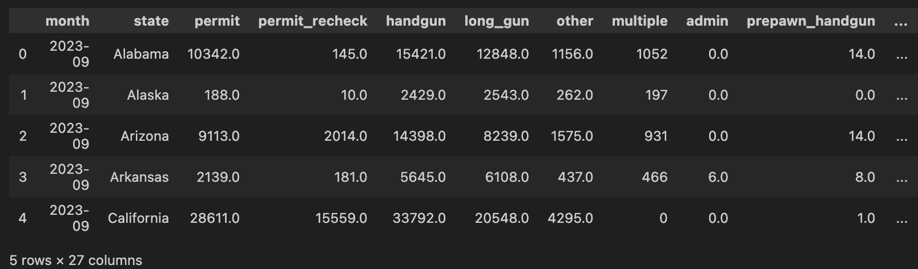
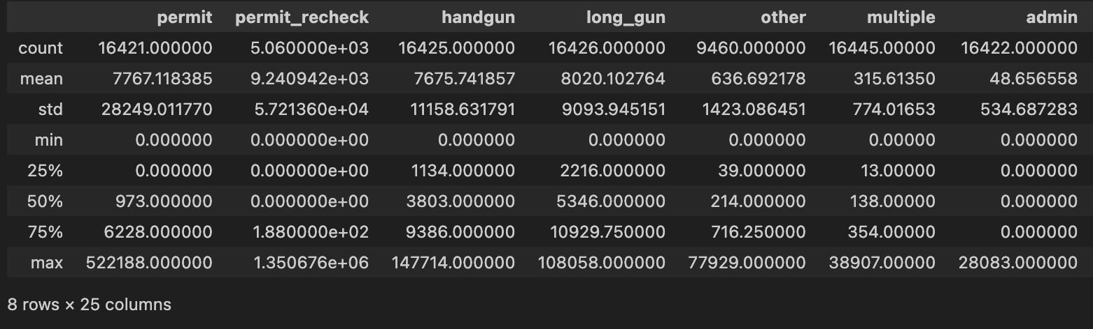
About the Data
Dataset is from NICS
Contains data from November 1st 1998 to September 1st 2023

Slide 4
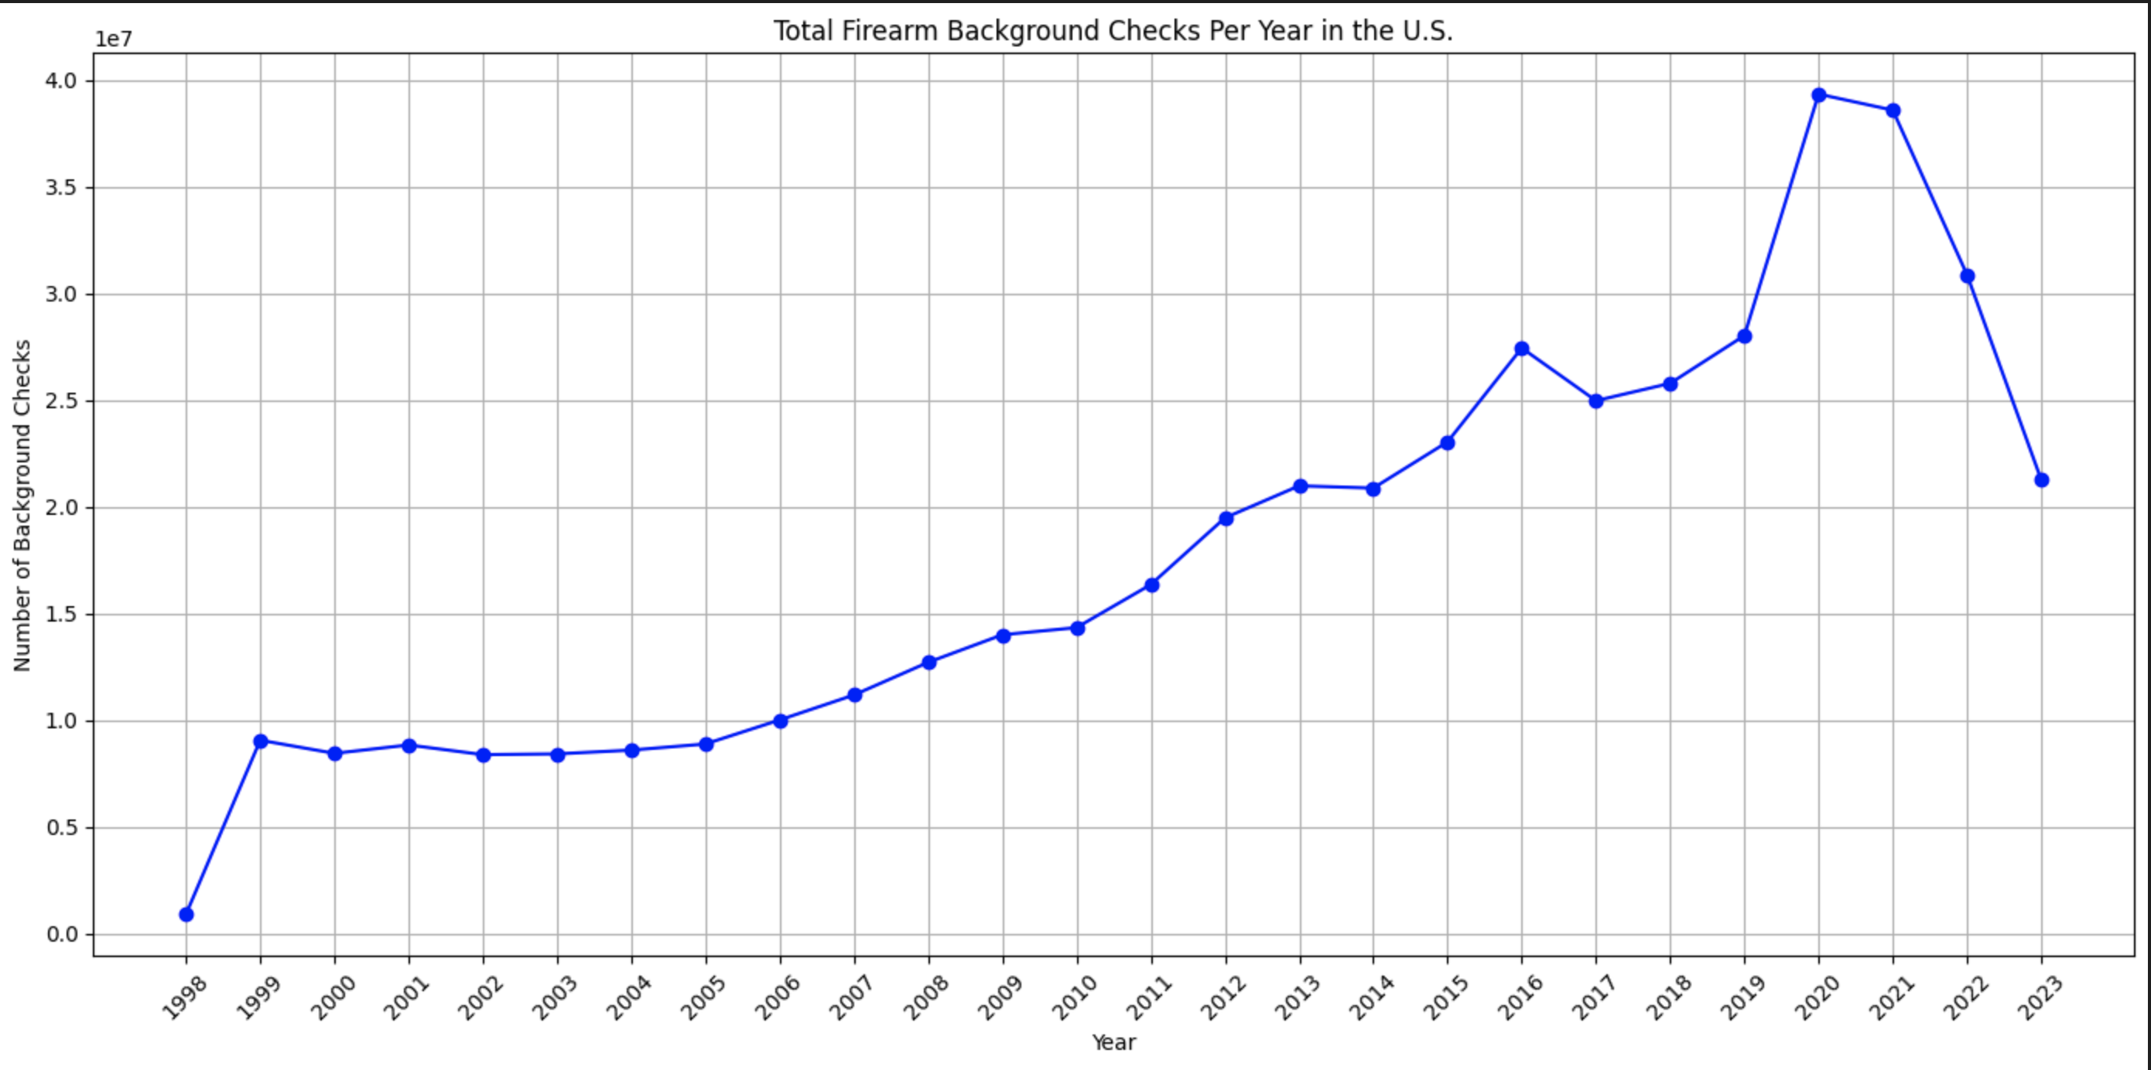
Firearm Background Checks Over the years

Slide 5
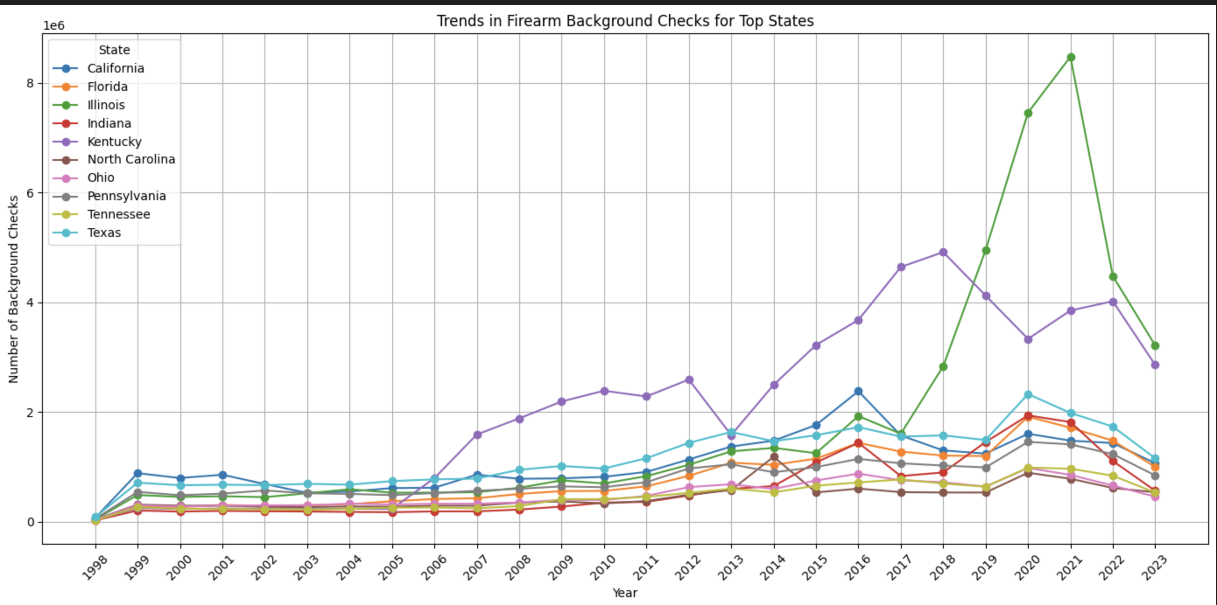
Firearm trends based on major states

Slide 6
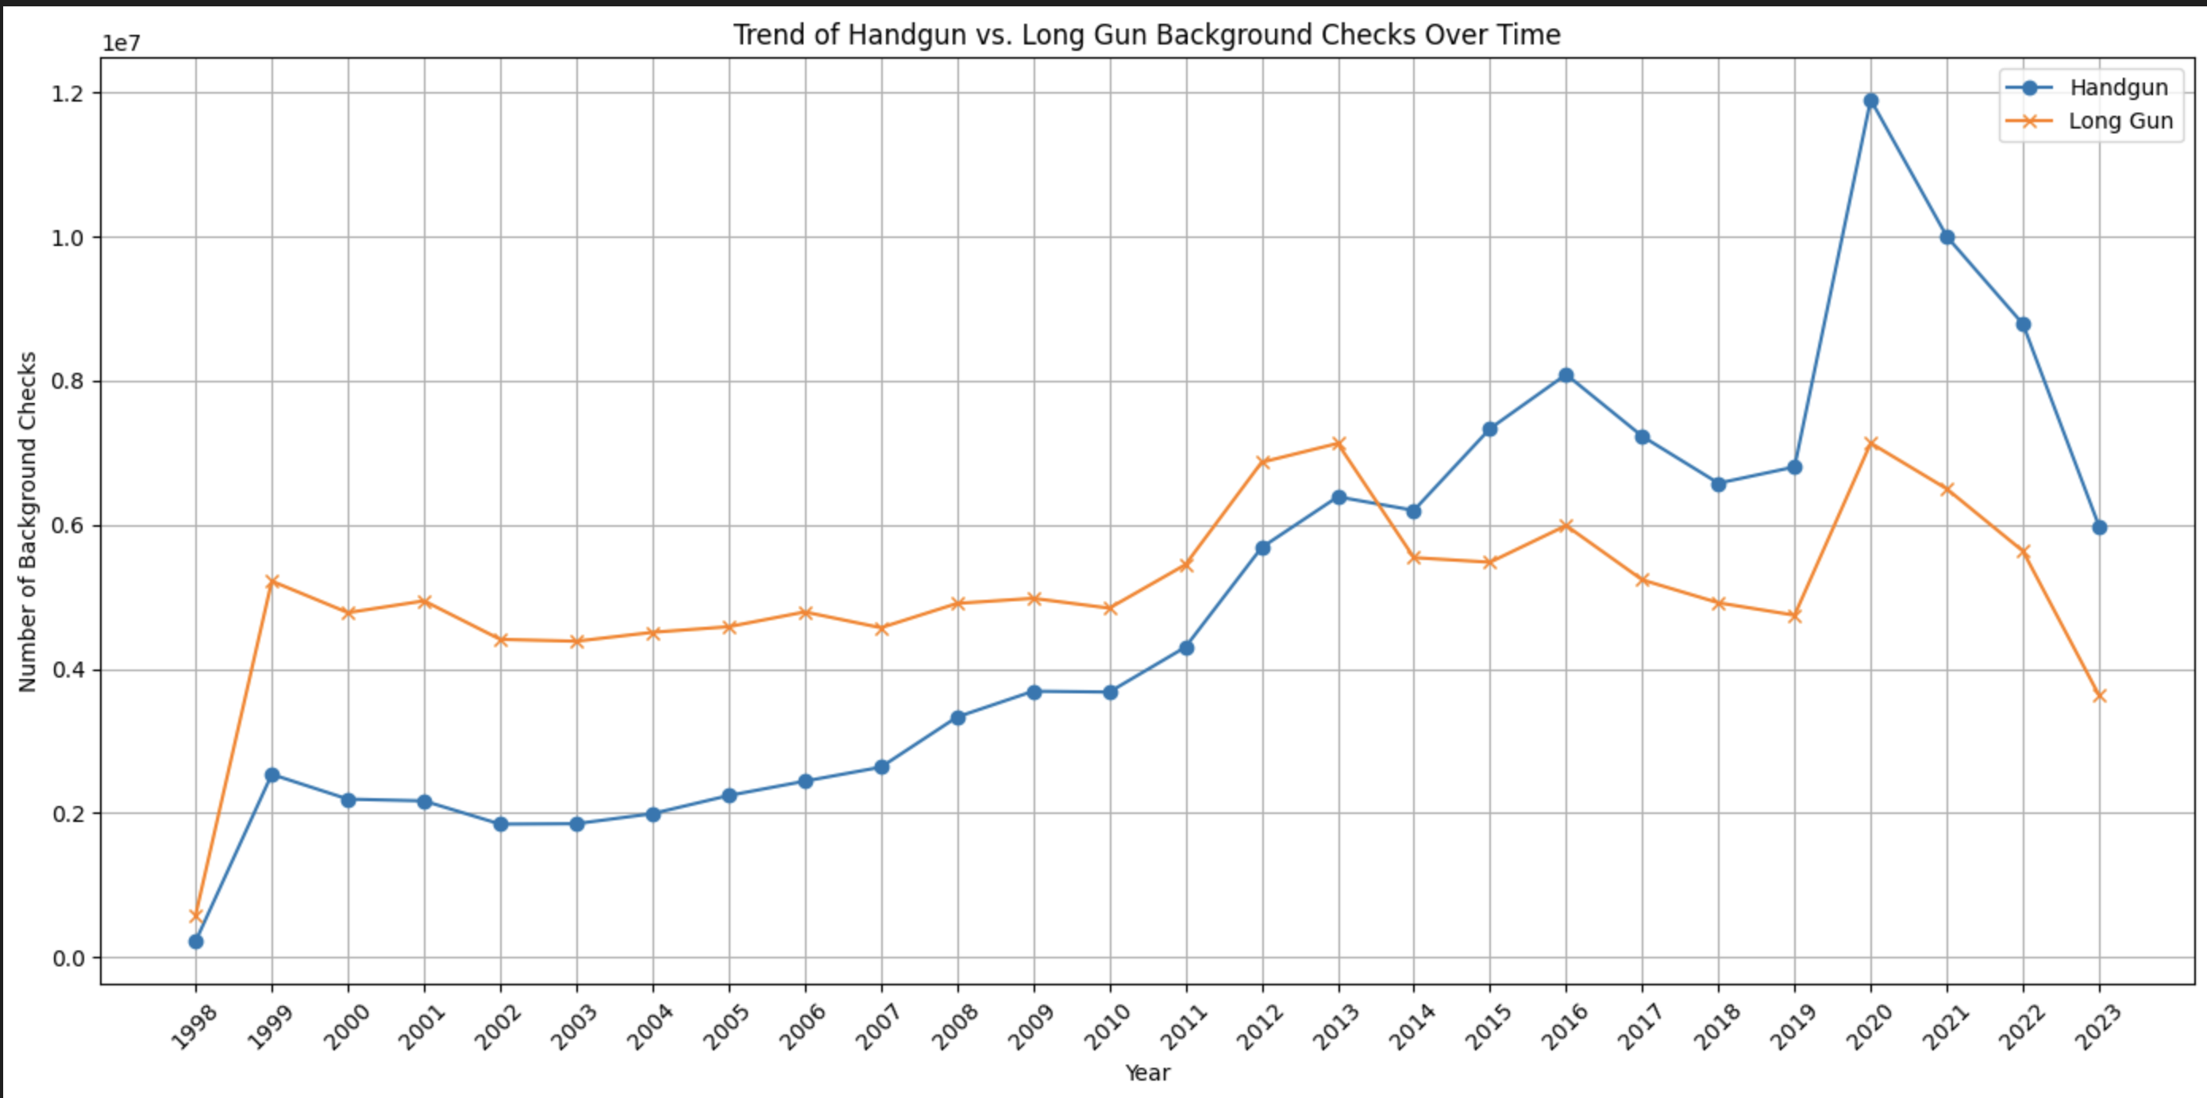
Handgun vs Long Gun Background Checks

Slide 7
Takeaways
Increased trend in overall sales of firearms
Major contributors continue to produce more guns
Shift from handguns to long guns

