Slide 1
Working Hours Analysis
Xiaohan Kuang

Slide 2
Introduction
GDP per capita reflects the average economic output and living standards in different regions.
This study explores the link between GDP per capita and the number of hours people work, trying to find common trends and differences across various places. The main goal is to find out if working longer hours is connected with higher GDP per capita, and how these patterns change around the world.

Slide 3
Data and Source
Data is sourced from the World Bank and the Penn World Table, renowned for their comprehensive economic databases. These sources provide a wealth of reliable, standardized economic data, allowing for accurate cross-country comparisons and analysis.
The datasets include variables such as GDP growth, GDP per capita, and annual working hours across various countries and regions over multiple years.

Slide 4
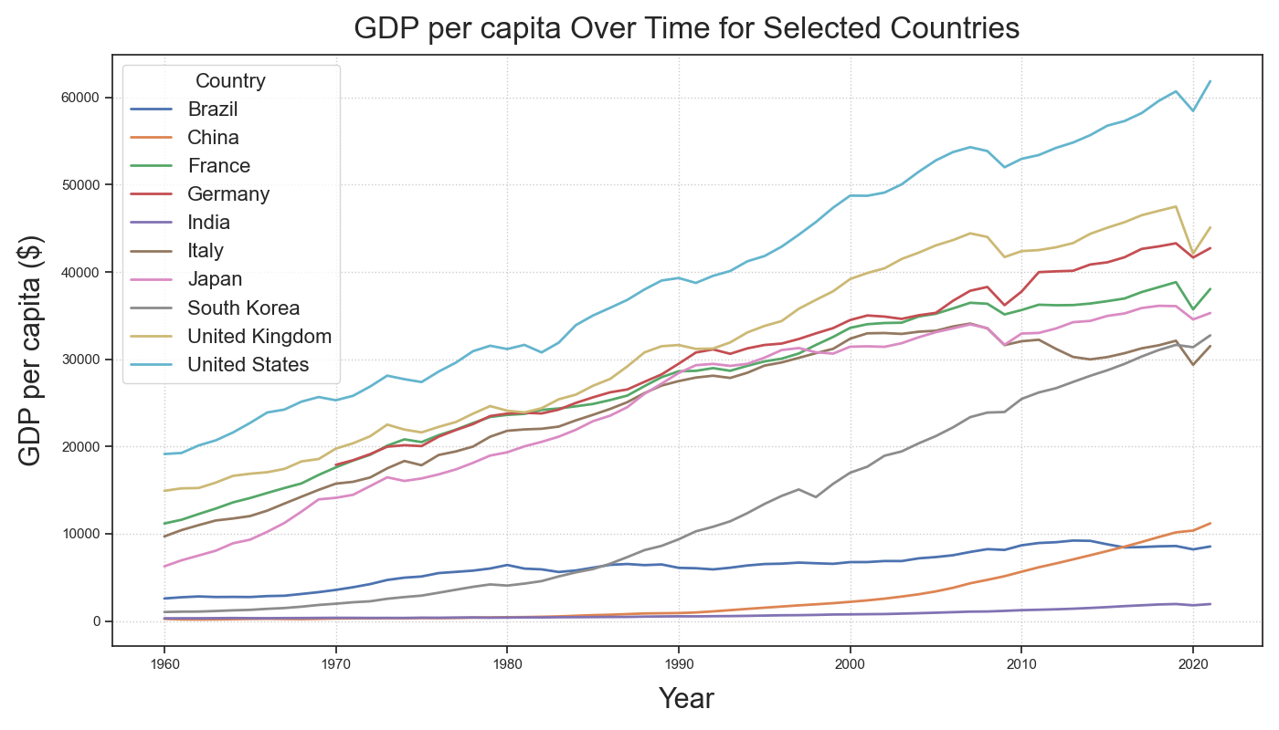
Annual GDP per capita
This chart presents the annual GDP per capita for various countries (the top 10 countries by GDP in 2021). While most featured countries show a GDP per capita above $30,000, demonstrating a positive trend, China, Brazil, and India are showing a comparatively slower growth, with figures hovering around or below $10,000.

Slide 5
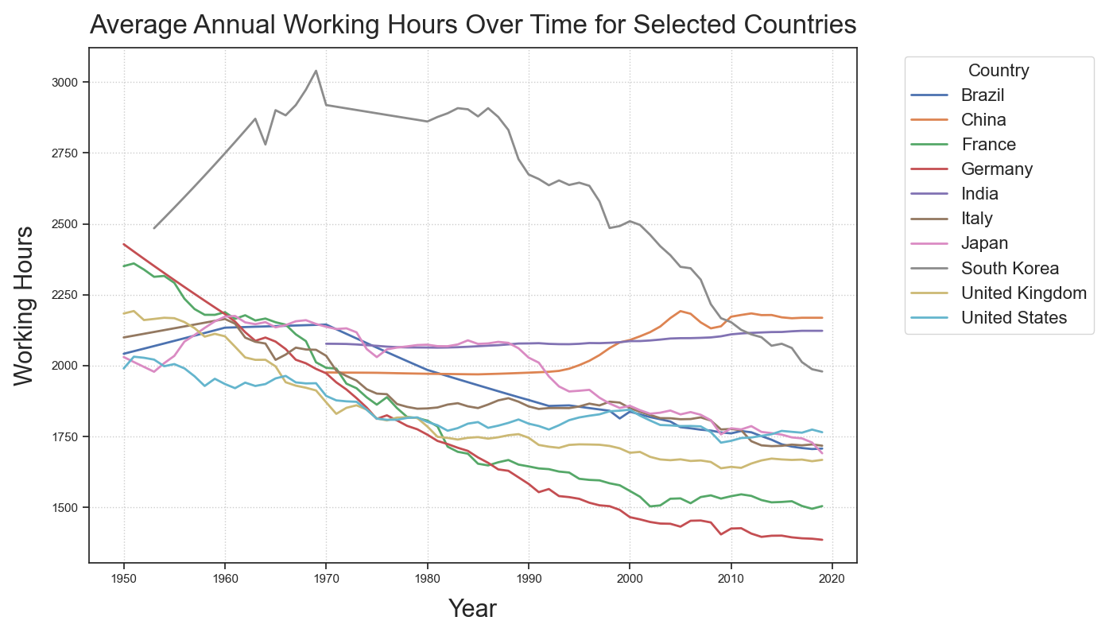
Average Annual Working Hours
This chart traces the changes of average annual working hours in different countries. An universal downtrend is evident, with most countries marking a significant decline in yearly labor hours. In contrast, China and India stand out as the sole exceptions, exhibiting a gradual increase in working hours.

Slide 6
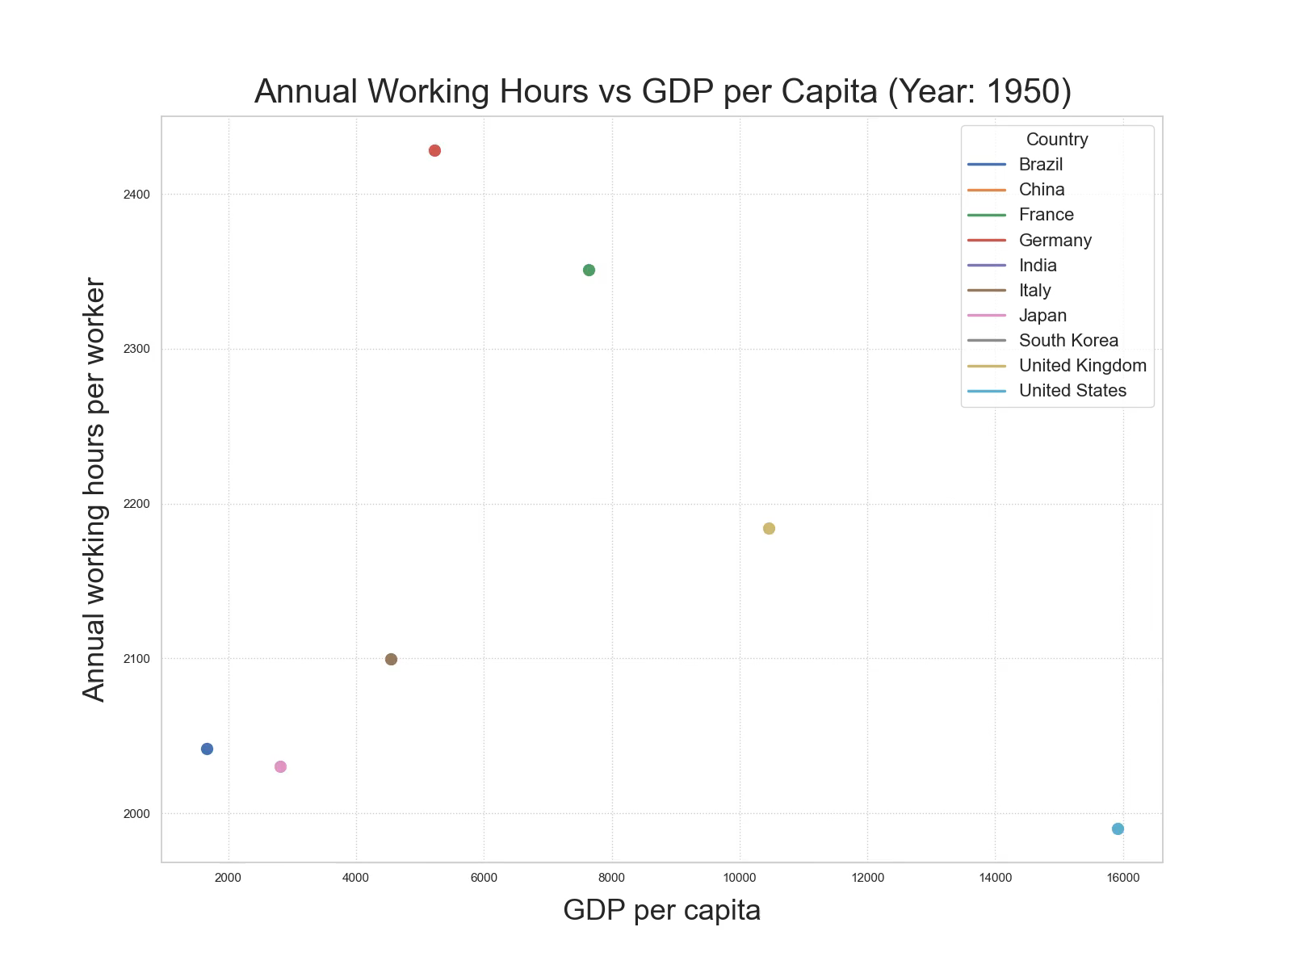
Annual Working Hours vs GDP per capita
The animated line plots show the correlation between annual working hours per worker and GDP per capita for each country, spanning from 1950 to 2019. In the majority of the selected countries, there is a noticeable trend: as working hours decrease, there's a corresponding increase in GDP per capita, which is showed on the x-axis. However, China and India do not exhibit a significant reduction in working hours over the years.

Slide 7
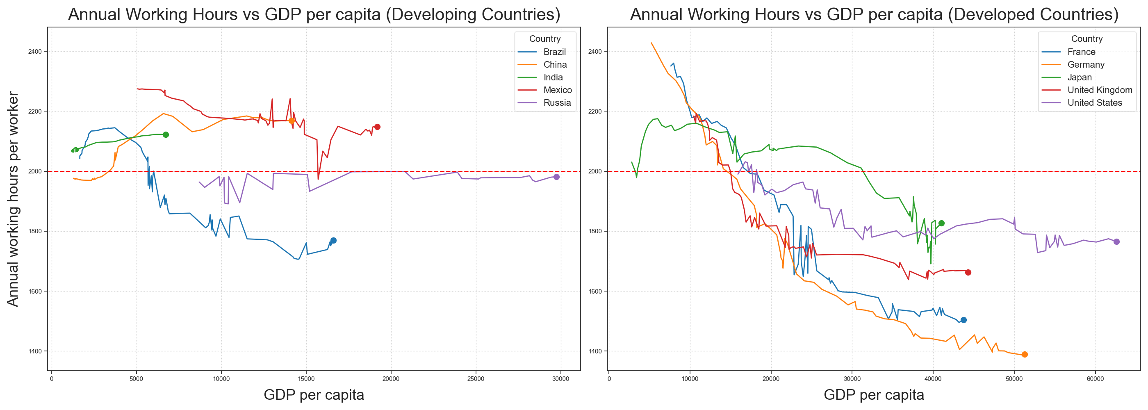
Comparative Analysis: Country (1950 ~ 2019)
This subplot shows the comparison among the top 5 economies in both developing and developed countries: workers in developed countries generally work in 1800 or fewer hours annually, aligning with higher GDP per capita. Conversely, workers in developing countries often meet or exceed 2000 hours, and this longer labor does not translate to a proportional increase in GDP per capita..

Slide 8
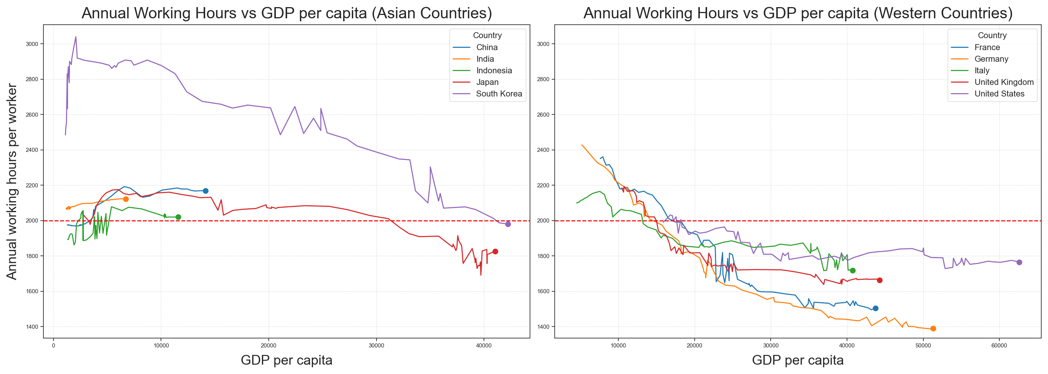
Comparative Analysis: Region (1950 ~ 2019)
This subplot shows the comparison among the top 5 economies in both Asian and Western countries. Notably, every selected Western country shows under 1800 working hours annually, paired with higher GDP per capita. In contrast, most Asian countries consistently approach or exceed 2000 hours.

Slide 9
Key Insights
Declining Working Hours:
Most countries show reduced working hours over the years, indicating the improved life quality and work efficiency.
Working Hours vs GDP per capita:
Most countries show a negative correlation between working hours and GDP per capita, with a few exceptions.
Developing vs. Developed Countries:
Developing countries average 2000 or more working hours annually, while developed countries are typically under 1800, highlighting economic and structural contrasts.
Regional Working Hour Differences:
Asian countries consistently report longer working hours compared to Western countries, suggesting cultural influences on work ethics.

Slide 10
Thanks!

