Slide 1
Working Hours Analysis
Xiaohan Kuang

Slide 2
Introduction
GDP per capita reflects the average economic output and living standards in different regions.
This study analyzes the link between GDP per capita and the number of hours people work, trying to find common trends and differences across various countries. The main goal is to find out if working longer hours is connected with higher GDP per capita, and how these patterns change around the world.

Slide 3
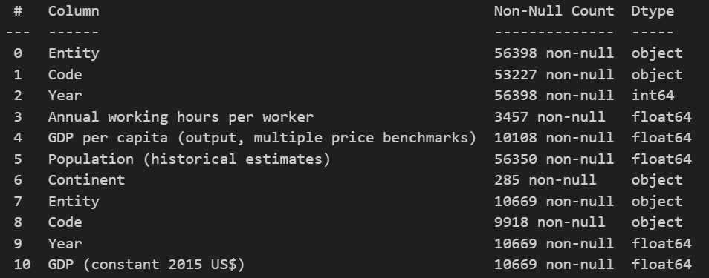
Data and Source
Data is sourced from the World Bank and the Penn World Table, renowned for their comprehensive economic databases. The datasets include variables such as GDP growth, GDP per capita, and annual working hours across various countries and regions over multiple years.

Slide 4
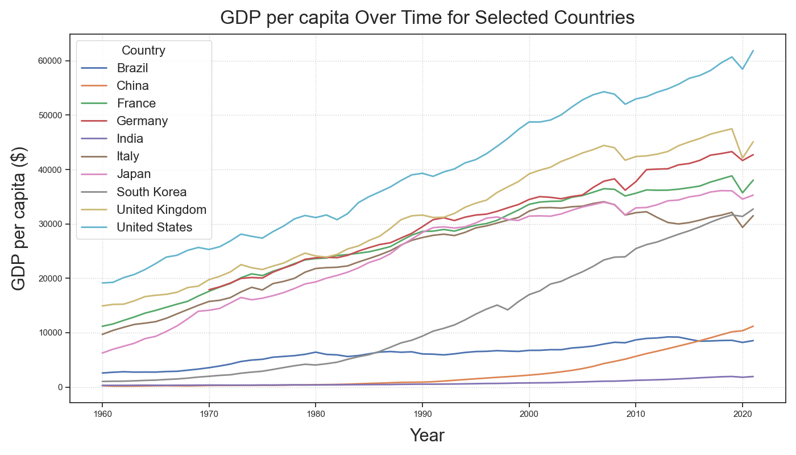
Annual GDP per capita
This chart presents the annual GDP per capita for various countries (the top 10 countries by GDP in 2021). While most featured countries show a GDP per capita above $30,000, demonstrating a positive trend, China, Brazil, and India are showing a comparatively slower growth, with figures hovering around or below $10,000.

Slide 5
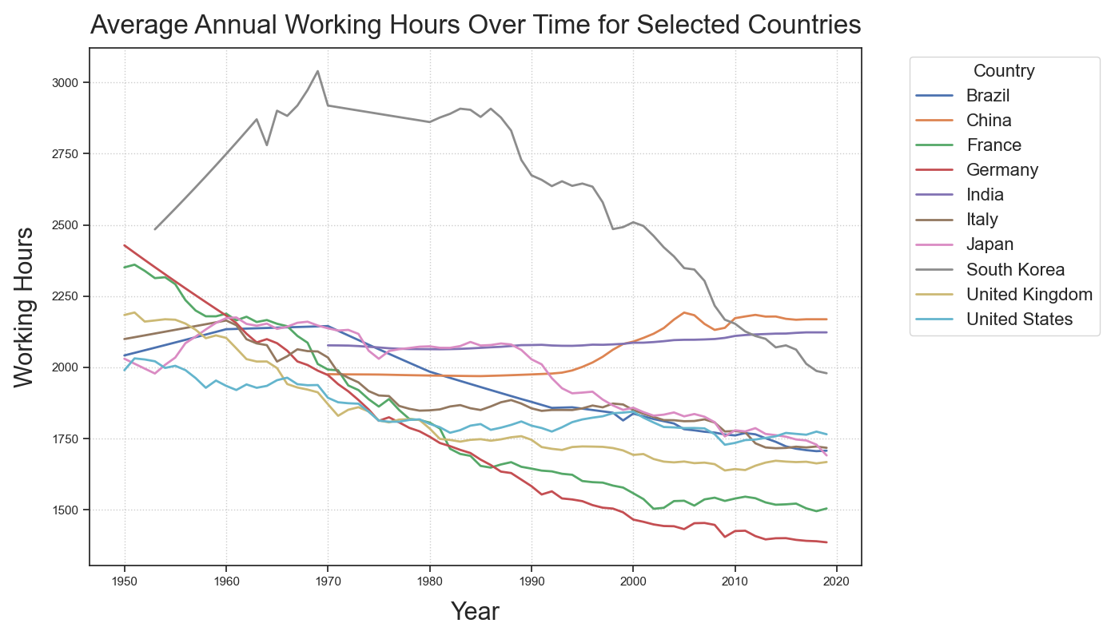
Average Annual Working Hours
This chart traces the changes of average annual working hours in different countries. An universal downtrend is evident, with most countries marking a significant decline in yearly labor hours. In contrast, China and India stand out as the sole exceptions, exhibiting a gradual increase in working hours.

Slide 6
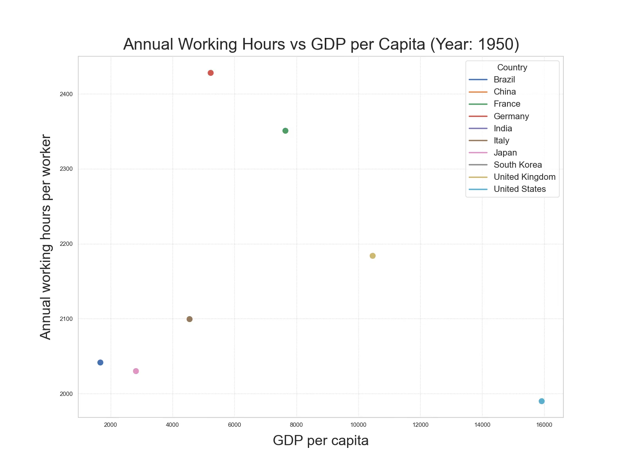
Annual Working Hours vs GDP per capita
The animated line plots show the correlation between annual working hours per worker and GDP per capita for each country, spanning from 1950 to 2019. In the majority of the selected countries, there is a noticeable trend: as working hours decrease, there's a corresponding increase in GDP per capita, which is showed on the x-axis. However, China and India do not exhibit a significant reduction in working hours over the years.

Slide 7
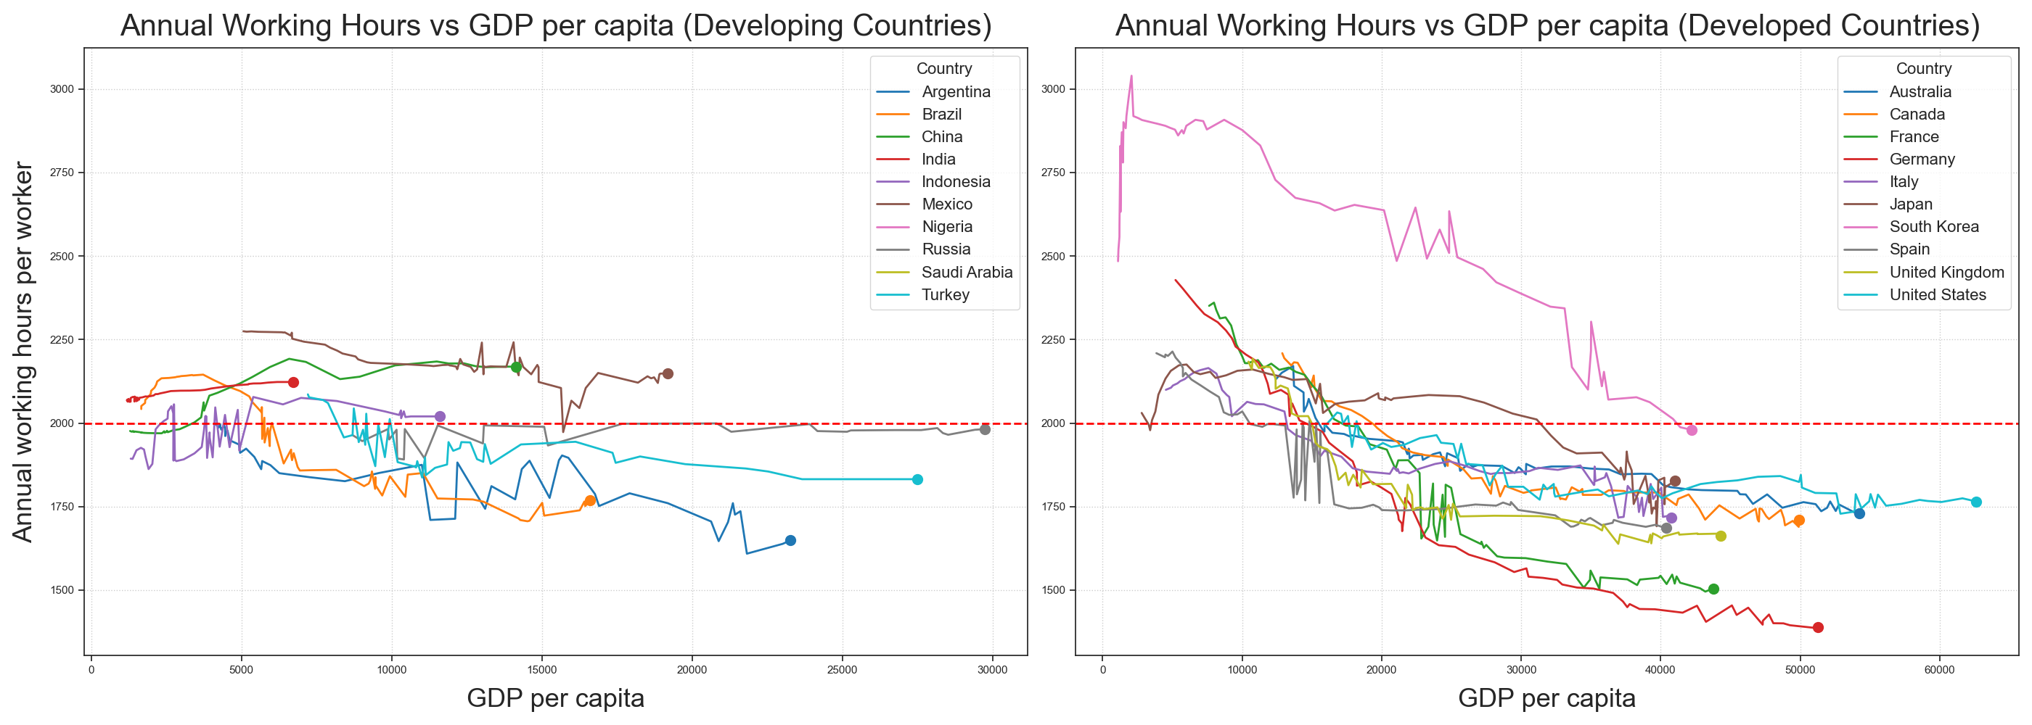
Comparative Analysis: Country (1950 ~ 2019)
This figure compares the top 10 economies from developing and developed countries. It highlights a slower GDP per capita growth and a less rapid decline in working hours for developing countries.

Slide 8
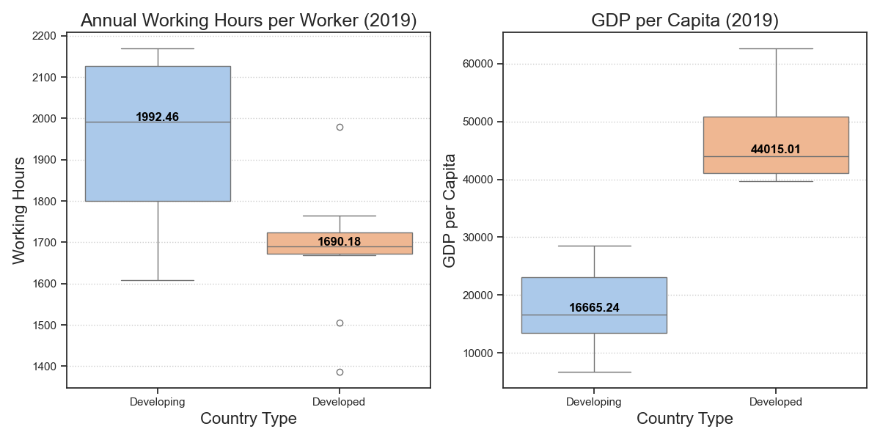
Comparative Analysis: Country (1950 ~ 2019)
The boxplot compares the distribution of annual working hours and GDP per capita for developing and developed countries in 2019. Workers in developed countries work around 1700 hours or fewer annually with higher GDP per capita. Conversely, workers in developing countries often meet or exceed 1900 hours without a proportional increase in GDP per capita.

Slide 9
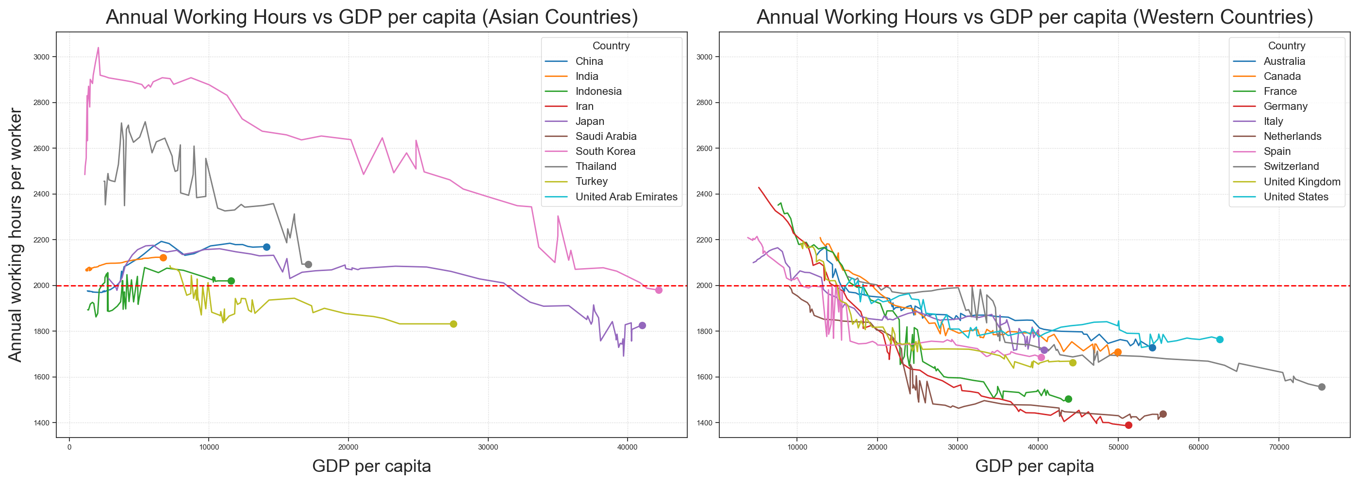
Comparative Analysis: Region (1950 ~ 2019)
This figure compares the top 10 Asian and Western economies. Western countries typically work under 1800 hours annually with a faster GDP per capita growth, while Asian countries often hover around 2000 hours with a moderate GDP per capita growth.

Slide 10
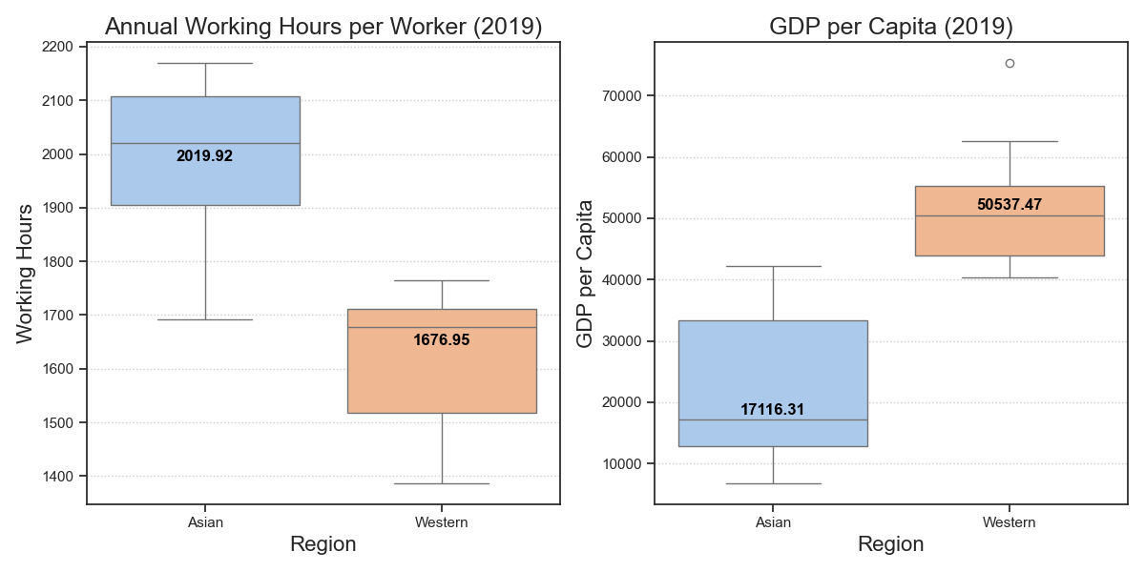
Comparative Analysis: Region (1950 ~ 2019)
The boxplot illustrates working hours and GDP per capita differences between Asian and Western countries in 2019. Western workers average 1700 hours or less annually and enjoy higher GDP per capita, while Asian workers often exceed 2000 hours without a corresponding GDP per capita surge.

Slide 11
Key Insights
Declining Working Hours:
Most countries show reduced working hours over the years, indicating the improved life quality and work efficiency.
Working Hours vs GDP per capita:
Most countries show a negative correlation between working hours and GDP per capita, with a few exceptions.
Developing vs. Developed Countries:
Developing countries average 2000 or more working hours annually, while developed countries are typically under 1800, highlighting economic and structural contrasts.
Regional Working Hour Differences:
Asian countries consistently report longer working hours compared to Western countries, suggesting cultural influences on work ethics.

Slide 12
Thanks!

