Slide 1
Exploring the Israeli-Palestinian Conflict 2000.10-2023.9
Mengzheng “Nami” Zhang
Notes:
Hello everyone. My name is Nami and today, I'll share insights into the human toll of the long-standing Israeli-Palestinian conflict. Before we start, some backgrounds.

Slide 2
Motivations and Questions
Brief history
In 2000, efforts towards peace: Camp David and Taba summit
In 2009, ceasefire between Israel and Hamas
2014 Gaza War
On 7 October 2023, Hamas attacks and violence escalates
Questions to Answer
"How have key historical events, like peace efforts and escalations, influenced the pattern of casualties in the conflict?“
"Given the accusations from both sides of committing war crimes, what does the data show about the nature and extent of these events?"
Notes:
The year 2000 marked significant efforts toward peace, including the Taba summit and the Camp David Summit led by US president Bill Clinton, and in 2009, a ceasefire was signed between Israel and Hamas. Despite these efforts, the conflict has seen various escalations. On 7 October 2023, with the attacks initiated by Hamas against Israel, we've witnessed a stark escalation in violence. This presentation aims to reflect on the enduring history of violence in the region. It's a chance to understand the impact on lives over the past two decades. We are going to answer the following questions:
1. How have key historical events, like peace efforts and escalations, influenced the pattern of casualties in the conflict?
2. Given the accusations from both sides of committing war crimes, what does the data show about the nature and extent of these events?

Slide 3
Dataset
Original sources: B’Tselem (The Israeli Information Center for Human Rights in the Occupied Territories), an independent, non-partisan organization, funded solely by donations
The dataset records each fatalities in the conflict, with age, gender, citizenship, and the circumstances of their death info.
To answer our questions, focus on dates, casualty figures, and allegations of war crimes, particularly at gender and age.
Notes:
Now it is time to introduce our dataset. It comes from B’Tselem (The Israeli Information Center for Human Rights in the Occupied Territories), which is an independent, non-partisan organization, funded solely by donations. The dataset records fatalities in the Israeli-Palestinian conflict, detailing each person's age, gender, citizenship, and the circumstances of their death. To answer our questions, we focus on dates, casualty figures, and allegations of war crimes, particularly looking at gender and age demographics.

Slide 4
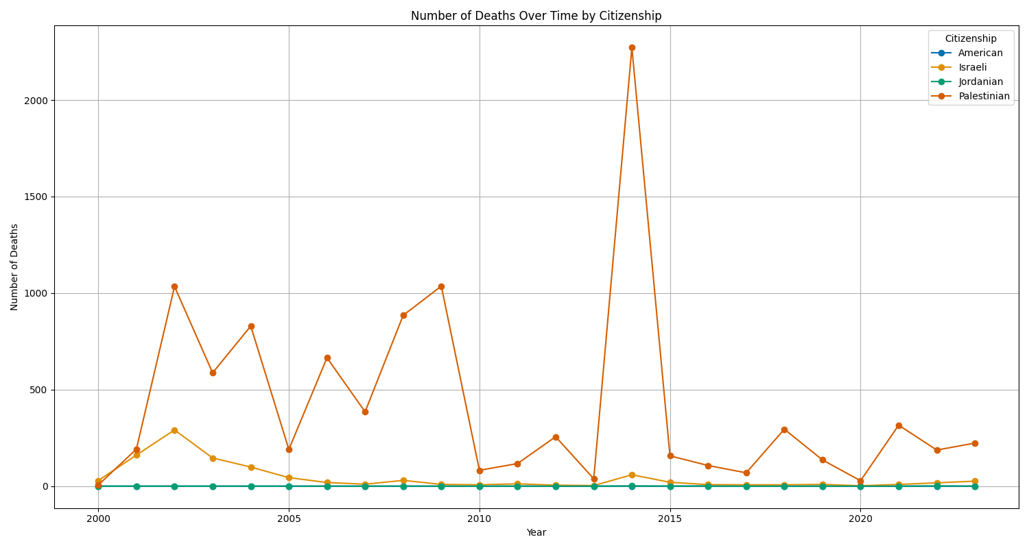
Death by Citizenship
Palestinian fatalities far outnumber the others
Peace in between 2010 and 2013
Peak at the Gaza War in 2014
Outliers matter!
Notes:
Let's start by looking at this line graph for death over time by citizenship. A line graph was chosen for its ability to track the progression of the conflict over time, showing us not just the peaks of violence but also the troughs of calm. It shows us the number of people who have lost their lives due to the conflict. Straight away, we can see that Palestinian fatalities far outnumber the others. We see a period of relative peace between 2010 and 2013 where fatalities dropped, which coincides with the attempts to renew peace talks and temporary ceasefires. The peaks in the graph align with periods of intense conflict, like the Gaza War in 2014, where we saw a tragic surge in deaths. You may also notice that we have two outliers in citizenship. I dug into the raw data and found their stories. One involves a Jordanian woman, who, after attending a wedding in Gaza, found herself unable to return home due to the Israeli blockade. The other is about a boy, a Palestinian-American dual citizen, accused of attacking Israeli security forces – though we don't have all the details. These incidents may not be significant in statistics, but they do remind us of the nature of this dataset: each number means a life!

Slide 5
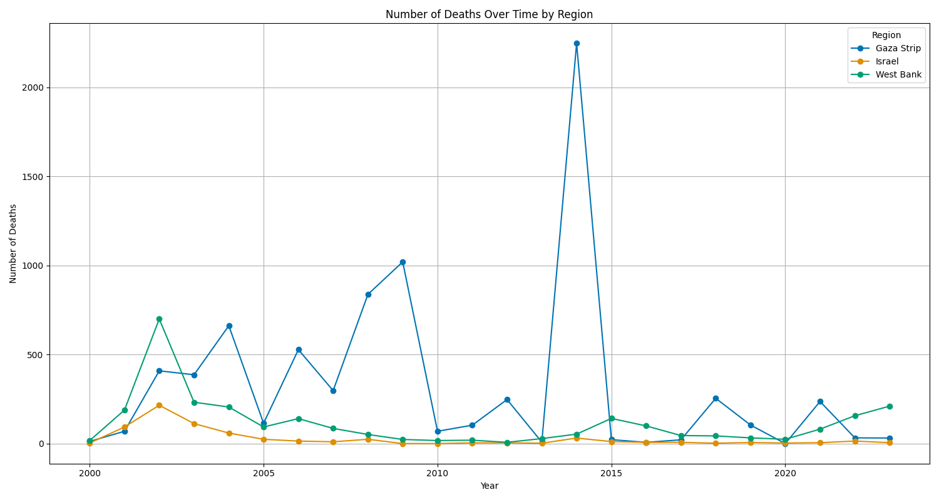
Death by Region
Gaza fatalities far outnumber the others
Gaza Peak at the Gaza War in 2014 (Again!)
West Bank safer(?) than Gaza as politicians took different approaches
Peace in between 2010 and 2013
Notes:
Let’s shift our focus to a line graph that illustrates fatalities based on region. I chose a line graph because of its emphasis on changes over time. The ups and downs on the graph help us see when the conflict has worsened and what the consequences have been. This chart categorizes the deaths within Israel, the West Bank, and the Gaza Strip over the 20-year timeline. You'll quickly notice the stark spikes in the Gaza Strip as a result of the devastating Gaza War. The contrasting lines for the West Bank and the Gaza Strip can also reflect the different approaches of the political groups in power: with Fatah in the West Bank generally pursuing diplomatic and peaceful engagements, whereas Hamas in Gaza has often resorted to armed conflict. Israel's line remains relatively lower throughout, highlighting the asymmetry in fatalities across these regions.

Slide 6
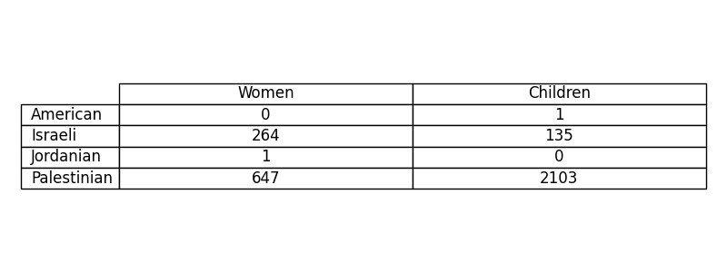
Examining Allegations of War Crimes
Numbers speak for themselves
Neither side is completely innocent!
Notes:
Now, let's tackle a tough topic: allegations of war crimes. Since our data only contains information about casualties, we will be looking at casualties of women and children. I'm presenting this information in a table because it's the clearest way to lay out the data for comparison. We see numbers that reflect reported cases from both sides. This table doesn't make any legal judgments; it's here to show us the data that's been collected on these serious allegations. It’s also clear that neither side has been innocent of their accusations.

Slide 7
Takeaway
Overview of Findings:
Significant disparity in casualties, with Palestinians facing the highest toll
Peace efforts from 2010 to 2013 led to noticeable reductions in fatalities
Political Influence on Violence:
Fatah's diplomatic engagements contrast with Hamas's armed responses
Data reflects the outcomes of different conflict resolution strategies
Looking Forward:
Data underscores the importance of peace efforts to reduce human suffering
Encourages continued dialogue and peaceful strategies for conflict resolution
Notes:
In conclusion, the data shows a clear trend: more Palestinians have died in the conflict, especially during heavy fighting like the 2014 Gaza War. However, there was a drop in deaths from 2010 to 2013, when there were efforts for peace. The different ways Fatah and Hamas handle the conflict also affect how many people die in each area. But remember, each number is a person with their own story. This data helps us understand the past and think about how to reduce violence in the future.

Slide 8
Source
Fatalities in the Israeli-Palestinian, Kaggle. By willian oliveira gibin and asaniczka.
https://www.kaggle.com/datasets/willianoliveiragibin/fatalities-in-the-israeli-palestinian

Slide 9
Thanks!

