Slide 1

Consumer Reviews on Amazon Products
Donna Nguyen​​
11/2/2023
Notes:
Want to stress on the part that these are products branded as made by amazon. A lot of stuff we buy on az are obviously sourced from other producers like bounty, dole but az has their own products bearing their labels. in 2018, it is reported that Amazon owns upwards of 70 of its own private-label brands — at least 60 of which were released in 2017 or later. It is said that private labels help to increase customer loyalty by making them exclusive to Amazon.

Slide 2

Introduction
Many of Amazon's private-label brands started in niche categories like batteries or pet carriers
Analyze Amazon’s most successful private categories
Discover insights into consumer review
Assist with machine learning models
​
Notes:
Many of Amazon's private-label brands started in niche categories like batteries or pet carriers. You see, other brands have to bid on search terms to secure the most visible listing positions at the top of Amazon’s product search results pages, sometimes Az They’re putting their own product right in the front of the line. Some say The approach violates Amazon’s mantra that every decision must put the customer first, other brands are saying. “would their brand be a better option for consumers?” are Az products automatically good bc they are Az?, well What are customer saying? What does Az mostly sell? Looking for a amazon consumer data set with Lot of potential insights we can get from. What are the most reviewed Amazon product category ? Potential: Map the keywords in the review text against the review ratings to help train sentiment models.​ Before we do something like that, first step would be to look at EDA

Slide 3

Data​
Sample of >28,000 consumer reviews for Amazon products (made by Amazon)
Kindle, Fire TV Stick, Amazon Basics (Tech accessories, household supplies…)
Products include Amazon in the Brand and Manufacturer field
Kaggle 2019

Slide 4
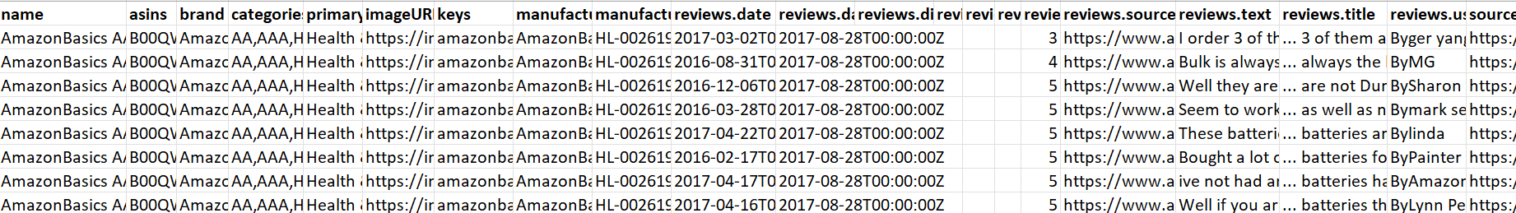
Data sample
Notes:
This data is about consumer reviews for Amazon products. Each row represents an individual product that was purchased- reviewed. Each column includes basic product information, rating, review text, and more for each product. Very extensive data. what parts of the dataset are necessary to answer the motivating question: categories, reviews rating, reviews text, reviews title. As we mentioned before, Amazon started with some really niche types. From this data we will explore some more consumer inisghts and EDA for potential sentiment analysis

Slide 5
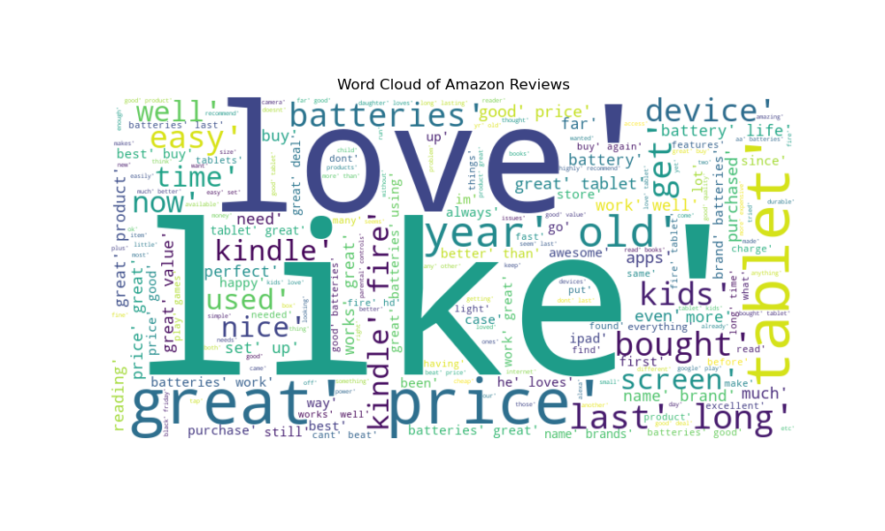
Notes:
This word cloud is about words used in reviews titles

Slide 6
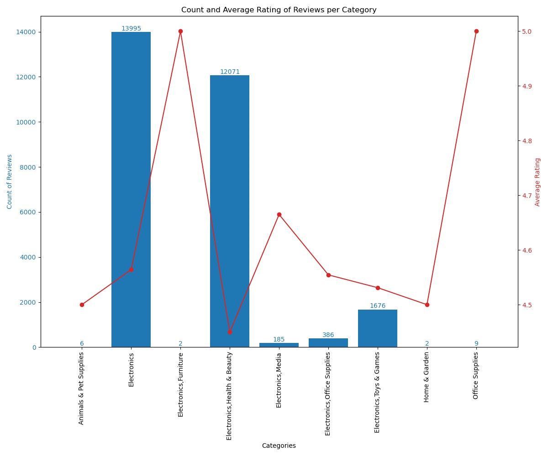
Category | Top 2 Words
Animals & Pet supplies | Perfect Size
Electronics | Great Tablet
Electronics, Furniture | Great Speaker
Electronics, Health & Beauty | Stars Five
Electronics, Media | Great Kindle
Electronics, Office supplies | Great Good
Electronics, Toy & Games | Great Kids
Home & Garden | Pan Holder
Office Supplies | Folder Perfect
Notes:
Table and graphs side by side for comsumer reviews broken down into each category. On the right the table contains top 2 words in reviews text by each category. Each row represents a category. For example…. Columns are …. On the left is a bar and line graph representing… Dual axes…Confirm positive reviews, avg higher than 4 across. Definitely heavy on mostly electronics stuff. These 2 categories. Earlier in the stage They decided to produce thousands of batteries, tablet, kindle and then maybe a couple dog crates or litter box hanging around. Even this electronics, health and beauty dept I look into the data and saw that those aren’t stuff you put on your face or bodies but are batteries for the stuff you put on your face and body….az has come along way since then besides these categories

Slide 7
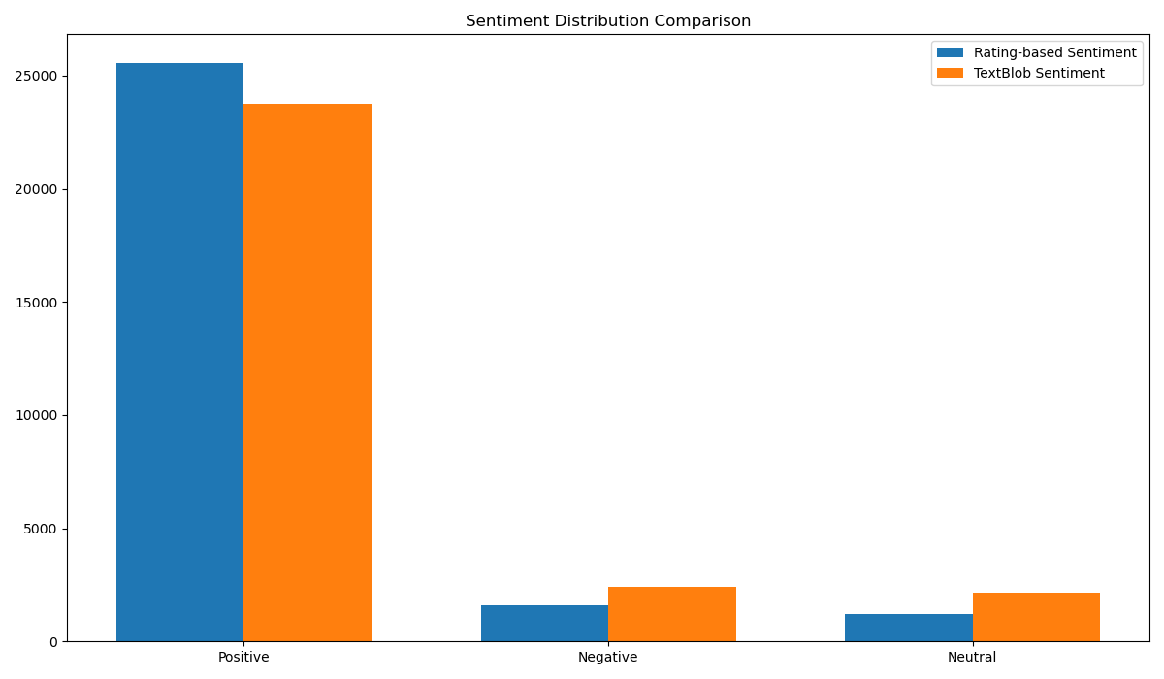
Sentiment Distribution
Count of Reviews
Notes:
The last plot we are going to look at is this… it counts the number of reviews by their sentiment by 2 methods. Polarity positive negative, good old reviews rating 4,5 vs 1,2. it confirms that these 2 ways are pretty consistent, mostly positive. From here we can see the data is Helpful train sentiment model and were infact utitlized this way

Slide 8

Key takeaways​
Niche categories
Good reviews overall​
“Success of Amazon consumer electronics products”​
Pathway to train sentiment model
Notes:
We saw the categories they operate in . Obviously Az has gone a long way from then, lot more categories food curtains. You see demonstrated here what some news had called the “Success of Amazon consumer electronics products”​ After initial EDA, the next step Map the keywords in the review text against the review ratings

