Slide 1
The impact of COVID-19 on the unemployment rate in the US
Yuhao Zhang

Slide 2
Motivation: Does COVID-19 have a significant impact on the unemployment rate in the US? Do you know what the unemployment rate in the US reached during the COVID-19 pandemic? Is the unemployment rate for young people more affected in the US? (Is age an important factor in the unemployment rate?)

Slide 3
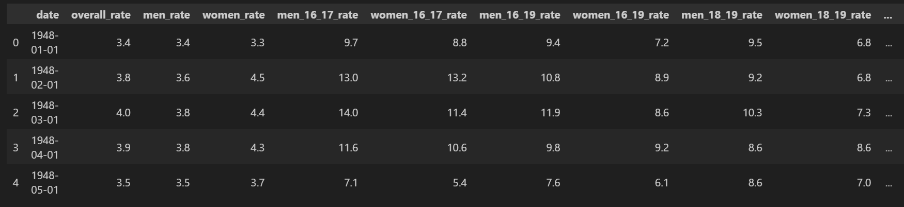
Data
This is a data table describing the unemployment rate from January 1948 to May 2023 in the US.
The variables include:
Date. （I need using）
Overall unemployment rates. （I need using）
Male and female unemployment rates.
Unemployment rates for specific age groups. （I need using）

Slide 4
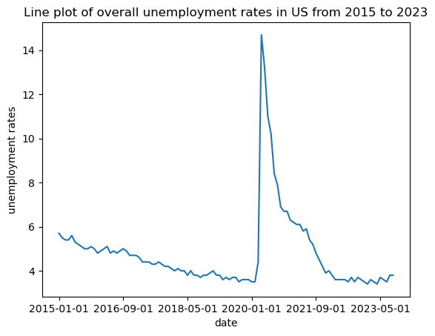
Analysis
The unemployment rate gradually decreased before 2020. During the epidemic, there is a sharp increase to a peak, and then rates fall significantly. After the epidemic, rates tend to stabilize.

Slide 5
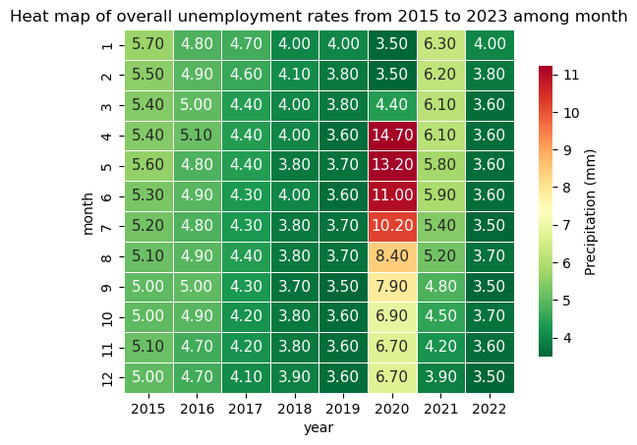
Analysis
Before the epidemic, the unemployment rate dropped from 5.7 to 3.5. But, during the epidemic, the rates are high. The peak was 14.7. After the epidemic, the unemployment rate remained stable at around 3.6.

Slide 6
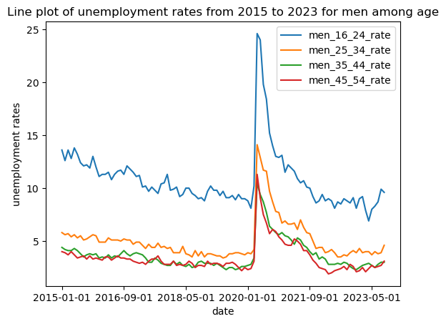
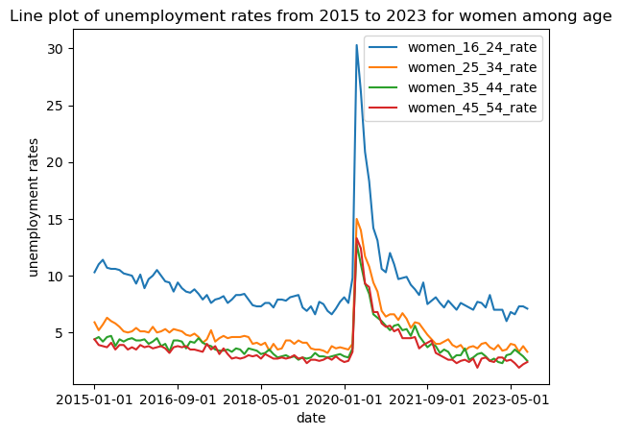
Analysis
The rate changes are consistent across different ages.
But the unemployment rate among young people is relatively high. The unemployment rate of older people is relatively low.

Slide 7
Takeaway
We can see that the epidemic has a significant impact on the unemployment rate, reaching a peak of 14.7. But with the disappearance of the epidemic, the unemployment rate has returned to normal. This event allows us to develop strategies to prevent future economic shocks.
And we know that the unemployment rate among young people is relatively high. There are many reasons.
Young people have relatively little work experience.
Young people's jobs are unstable.

Slide 8
Thank you!

