Slide 1
Unemployment rate
Yuhao Zhang

Slide 2
Motivation: Do you know what the unemployment rate in the US reached during the COVID-19 pandemic? Does COVID-19 have a big impact on the unemployment rate? Is age an important factor in the unemployment rate?

Slide 3
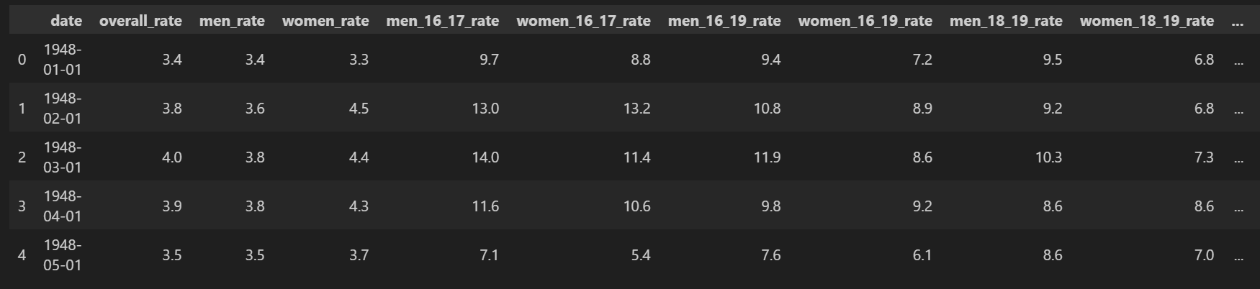
Data
This is a data table describing the unemployment rate from January 1948 to May 2023.
The variables include date, overall unemployment rates, male and female unemployment rates, and unemployment rates for specific age groups.

Slide 4
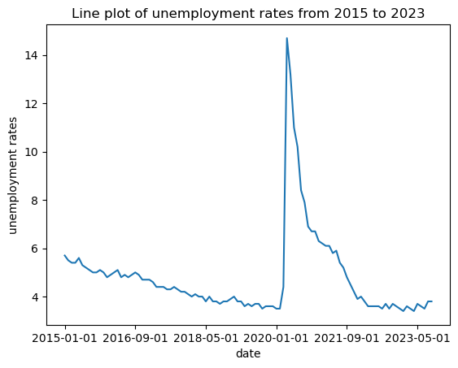
The unemployment rate gradually decreased before 2020. During the epidemic, there is a sharp increase to a peak, then rates fall significantly. After the epidemic, rates tends to stabilize.

Slide 5
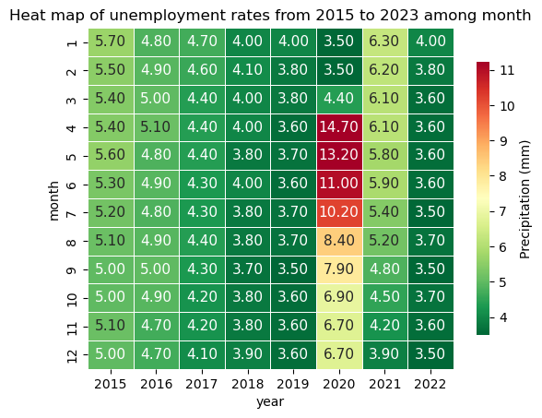
Before the epidemic, the unemployment rate dropped from 5.7 to 3.5. During the epidemic, the peak was 14.7. After the epidemic, the unemployment rate remained stable at around 3.6.

Slide 6
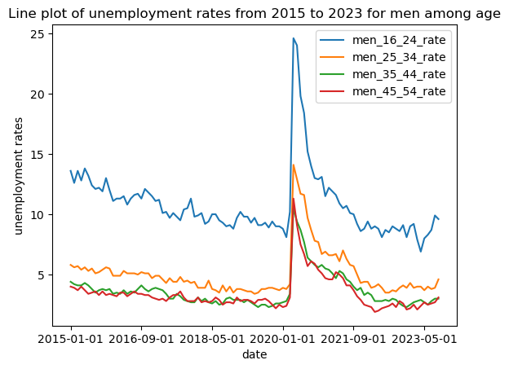
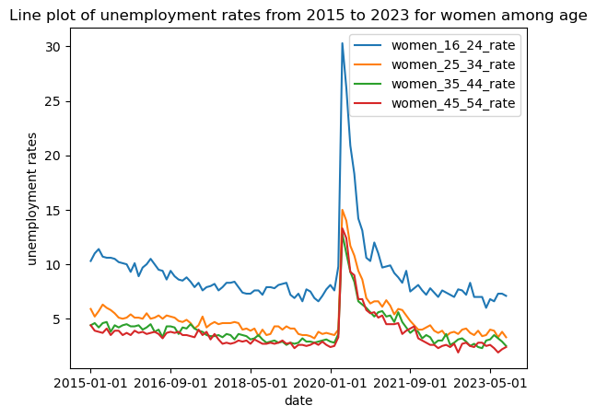
The rate changes are consistent across different ages.
But the unemployment rate among young people is relatively high. The unemployment rate of the elderly is relatively low.

Slide 7
Takeaway
We can see that the epidemic has a significant impact on the unemployment rate, reaching a peak of 14.7. This indicates that COVID-19 has a significant impact on the economy. But with the disappearance of the epidemic, the unemployment rate has returned to normal levels.
And we know that the unemployment rate among young people is relatively high. This may be because young people have unstable jobs. They will pursue their own ideas.

Slide 8
Thank you!

