Slide 1
Liquor Sales in Iowa
Tessora Stefan

Slide 2
Introduction & Motivation
I am the best at many things, but I am primarily the best at being an older sister.
My little brother and sister (twins) have recently started college, my sister at University of Texas and my brother at University of Iowa. Though only 18, my little brother has been coping with the distance from his twin the old fashioned way: with an Old Fashioned!
In this presentation, we will be asking a question that many college freshmen ask themselves every Friday night: how should I get inebriated? And we will be answering this question by finding the most cost-effective drink for my little brother that is sold in his now-home state of Iowa.

Slide 3
Data
The data is about liquor purchases in the state of Iowa for a certain time period. Each of the 12,591,077 rows in the original data represents the invoice for purchases of the same bottle of alcohol (i.e. a row could be one bottle of vodka, or two bottles of the same tequila, etc.). Each of the 24 columns is a different attribute of the purchase, such as the date purchased, the store the purchase was made at, the number of bottles purchased, the cost of the purchase and the type of alcohol itself.
We will be analyzing the alcohol available in the county of Johnson (where University of Iowa is located), using the cost and the amount of alcohol sold in order to determine the cheapest way to get sufficiently drunk. Also, I spliced the data to the first 2,000 rows in order to make the data more manageable for my computer.

Slide 4
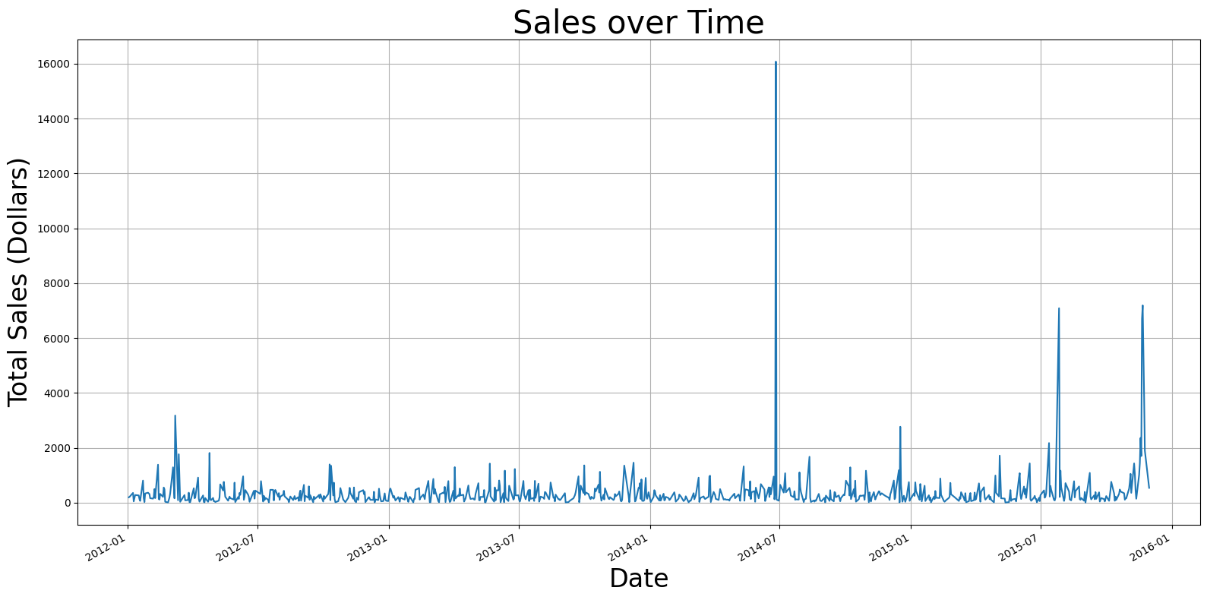
Analysis: Sales Over Time
This is a line graph showing liquor sales over time for all counties in Iowa between 2012 and 2016. The x-axis is the date of the purchase, ranging from 2012 to 2016. The y-axis is the total sales in dollars, ranging from $0 to $16,000. This plot shows that there are a couple outliers in the data in terms of how much liquor was bought when aggregated by day.
After visualizing this data, I decided to filter closer in on just Johnson County in Iowa, where the University of Iowa is located.

Slide 5
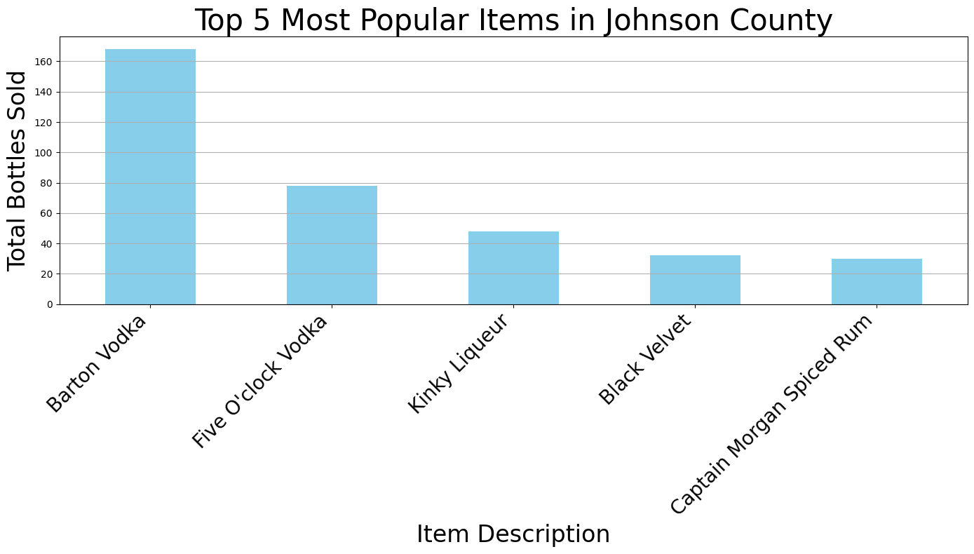
Analysis: Popular Items Johnson County
This bar chart shows the five most popular individual liquors purchased in Johnson County between 2012 and 2016. The x-axis shows the five different liquors that were most popular. The y-axis shows the total bottles sold within the timeframe of each bottle of liquor, ranging from 0 to more than 160 bottles sold. The plot shows a significant difference between Barton Vodka, the most popular liquor, and Five O’Clock Vodka, the second most popular liquor, by more than twofold.
Since clearly Barton Vodka is the most popular liquor, I would like to delve deeper into its price.

Slide 6
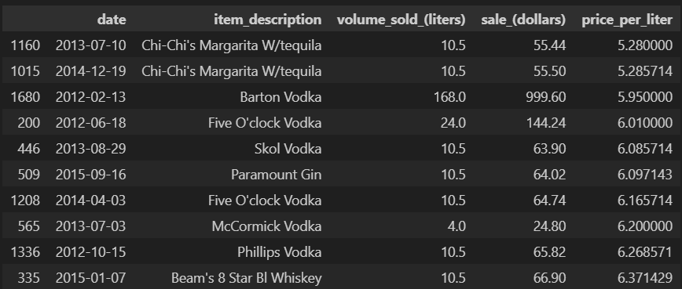
Analysis: Cheapest Alcohols
This table shows the cheapest liquors by price per liter in Johnson County, Iowa from 2012 to 2015. Each row represents a different purchase with its price per liter value. Each column represents a selected attribute about that purchase.
Here we see Chi-Chi’s Margarita with Tequila is the cheapest purchase by price per liter, but we see that Barton Vodka is a close second at $5.95 per liter. Considering Barton Vodka’s popularity and relative price, it is looking like a frontrunner for a recommendation from me to my brother.

Slide 7
Takeaway
The cheapest alcohol for a resident of Johnson County, based on the price per liter, appears to be "Chi-Chi's Margarita W/tequila" with a price of approximately $5.28 per liter. An obvious limitation of my analysis is that there was no data on the percentage alcohol by volume, so Chi-Chi’s Margarita most likely has a lower alcohol content than a bottle of Barton Vodka. Therefore, I will recommend Barton Vodka to my brother.

