Slide 1

Welcome to the Open Textbook Adoption Workshop Introductory Session
Facilitated by: Barbara Oldham
Claver Hategekimana, PhD
Wenatchee Valley College
September 17, 2010

Slide 2
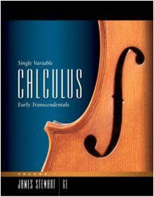

The Problem
High
Prices
New
Editions
new 6th
used 5th edition
$81.78
$213.95

Slide 3

The Problem
Prices rising
4x
Inflation
rate
Biology, 8e
with CengageNOW, Personal Tutor with SMARTHINKING, InfoTrac 2-Semester Printed Access Card
$213.95
Costly
Bundles

Slide 4

The Problem
Students spend
$900 +
per year

Slide 5


The Problem
Part 1:
Flawed market structure gives publishers too much power
Producer
Consumer

Slide 6

The Problem
Publisher
Student
Professor
Notes:
Flawed market structure gives publishers too much power

Slide 7



The Problem
Part 2:
Self-destructive business model drives publisher market abuses
Publisher
Bookstore
used books
Students
Notes:
Textbooks are bought and sold several times, but the publisher only profits on the first sale
hence the aforementioned problems with new editions bundles and high prices you cannot choose to stay with older edition

Slide 8
We need a solution that will:
Make the market more student-centric, without undermining faculty
Rework publishing models to be more efficient and sustainable

Slide 9
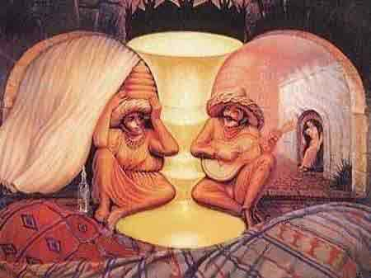
Solution: Look beyond traditional textbooks
How many women and men?

Slide 10
Develop a culture of sharing
Federal Law:
Faculty and staff must consider the least costly practices in assigning course materials, such as adopting the least expensive edition available.
Institutions must consider methods and open licensing options for effectively sharing digital content
WA Registration SHB1025: Requiring colleges to share educational technology and content
WA Registration SSHB1025: Requiring disclosure of certain information relating to higher education course material, including textbook ISBN
Creative Commons – New Copyright Choices – Some rights reserved

Slide 11
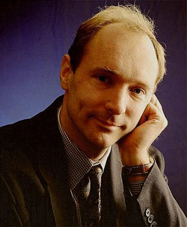

Collective intelligence
“If you put together a big enough and diverse enough group of people [.....] that group’s decisions will, over time, be intellectually superior to the isolated individual, no matter how smart or well-informed he is”
~ James Surowiecki
cc Steve Wheeler, University of Plymouth, 2010
“We need diversity of thought in the world to face the new challenges.”
~ Sir Tim Berners-Lee
http://thekaoseffect.com/

Slide 12
Solution: Open Educational Resources
Digitized materials, offered freely and openly for educators, students, to use and re-use for teaching, learning and research.

Slide 13

Community College Open Textbook Project Goal
Identify, organize, and support the production and use of high quality, accessible and culturally relevant Open Textbooks for community college students
Reduce the cost of textbooks!

Slide 14

Community College Consortium for Open Educational Resources
Joint effort to develop and use open educational resources and open textbooks in community college courses
cccoer.wordpress.com

Slide 15
























CCCOER Membership
84 colleges from AZ, CA, IA, MD, NV, NY, OH, TX, WA, Ontario
Notes:
CCCOER Membership

Slide 16
Open resources initiatives
Open Courses of:
Yale University,
MIT,
OpenCourseWare Consortium,
OpenLearn of Open University,
Academic Earth,
Open courses backed by research
Community College Consortium for Open Educational Resources,
Open Educational Resources Center for California
California free digital textbook initiative
Washington, Open course project

Slide 17
Ralph Dawes!
Washington, Open course project

Slide 18

What is an open textbook
Modifiable by the instructor
Digital, Modular
Adaptable
Low cost to the students
Usually free for those with computers and internet access
Printable for free or a small fee (costs for ink and paper)
Sometimes available in bound copies for $10-$40
Labeled for reuse by MrKCoolsPhotostream

Slide 19
What makes a textbook open?
A textbook becomes open when it’s copyright holder grants usage rights to the public through an open license

Slide 20
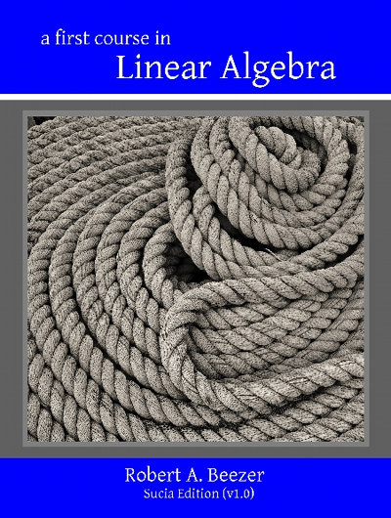
Open Textbooks
Who pays the author?
A First Course
in Linear Algebra
By Robert A. Beezer
http://linear.ups.edu
Personal motivations
Sabbatical time/grant funding
Some colleges: Count open textbooks toward tenure
PDF: FREE
Online: FREE
Print: $27.95

Slide 21
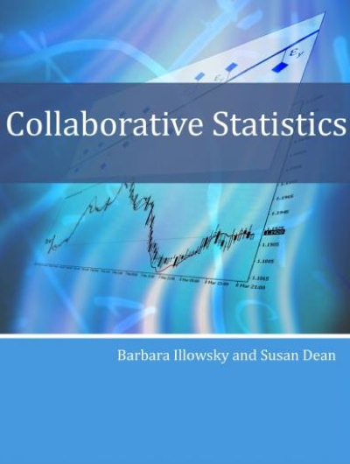
Open Textbooks
Quality
Collaborative Statistics
By B. Illowsky & S. Dean
cnx.org/content/col10522
A consortium of 80+ community colleges is pooling resources to write and review texts
Rice University founded CNX.org, a platform that hosts open textbooks
PDF: FREE
Online: FREE
Print: $31.98

Slide 22
Open Textbooks
Government funding
A new bill introduced by Sen. Durbin (D-IL) would create a federal grant program to create open textbooks through the NSF
The WA community college system received state funding to create open curriculum & texts for the 80 highest enrollment courses.

Slide 23


Open Textbooks
Publishers
Online: FREE
PDF: $24.99
Print: $29.99
Open Textbooks by EXPERT AUTHORS
Free Online. Affordable Offline. Rewritable Anytime.
Notes:
The first publisher of open textbooks is Flat World Knowledge. They launched their first titles in spring 2009, and now are adopted at more than 400 schools.

Slide 24
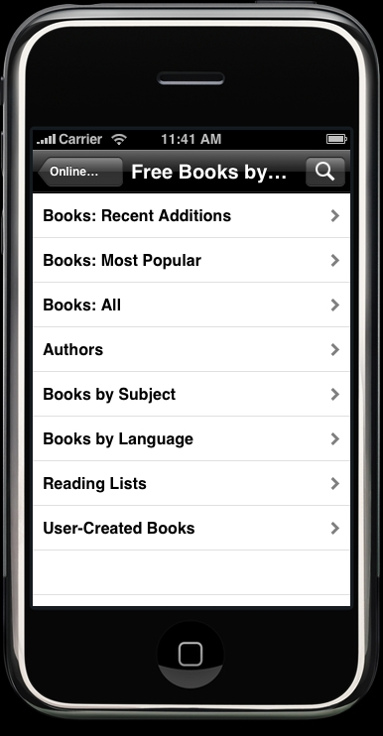
Open Textbooks
Distribution
Digital formats
Printed format
Campus bookstore
Print on Demand
Proprietary – Flatworld
http://images.lexcycle.com/screenshots/feedbooks_library.jpg

Slide 25

Why so urgent?
Consider One High
Enrollment Course:
English Composition I
37,226 enrollments / year
X $100 textbook
= $3.7 Million + (cost to students)
What if we looked at 100, 200, 300 high enrollment courses?

Slide 26
Challenges & Misconceptions
Resistance of end users to change
Accessibility compliance - UDL
Lack of materials in some disciplines
Management issues: Lab, bookstore, Internet
You get what you pay for
No free lunch (except here)

Slide 27
Steps to Open Textbook Adoption
Easy as 1 2 3
DISCOVER
SELECT
Evaluate
Customize, remix, and organize
ADOPT & USE
Disseminate
Print
Digital formats

Slide 28








Slide 29
Where to find open textbooks
Flat World Kowledge: www.flatworldknowledge.com
Lulu: www.lulu.com/
Orange Grove: www.theorangegrove.org
The Assayer: www.theassayer.org
College Open Textbooks: www.collegeopentextbooks.org
Connections: www.cnx.org
MERLOT: www.merlot.org
OER Commons: www.oercommons.org
Wikibooks: www.wikibooks.org
Community College Consortium for Open Educational Resources (CCCOER): oerconsortium.org
Full length movies, animation and demonstration
NROC, National Repository of Online Courses www.montereyinstitute.org/nroc/
HippoCampus: www.hippocampus.org (animation/demonstration)
Slideshare: www.slideshare.net
VIMEO: www.vimeo.com (Movies)
Youtube EDU: www.youtube.com/edu

Slide 30
CC by
Student PIRGs
(Public Interest Research Groups),
Erik Christensen

Slide 31
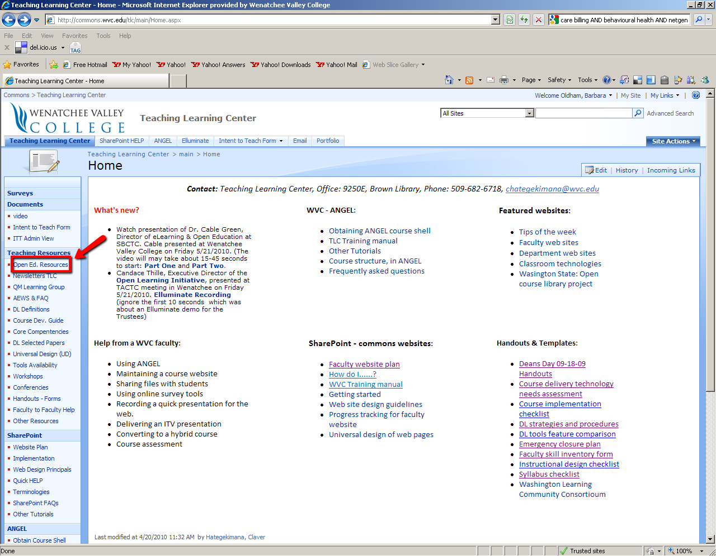
For Hot Links go to commons.wvc.edu/tlc

