Slide 1

Creative Commons
License Basics
April 20, 2010
Sue Gallaway, Centralia College
Seattle Open Textbook Adoption Workshop

Slide 2

All Rights Reserved
Notes:
All familiar with copyright restrictions – the default is All Rights Reserved
We all create content in digital form, easily shared with others, easily remixed
What if the creator of the content wants to share his or her stuff, adding to the cultural, scientific, and educational content available to everyone for free?

Slide 3

Some Rights Reserved
Notes:
CC makes it easy to share and to use content that the copyright owner allows in advance
The content creator has the ability to state in advance the use conditions that he or she will allow
Very simply put, the creator says I’m reserving some rights – not all rights

Slide 4
What is Creative Commons?
creativecommons.org
Notes:
Click on link or image to play video (the 2nd one on the page)

Slide 5
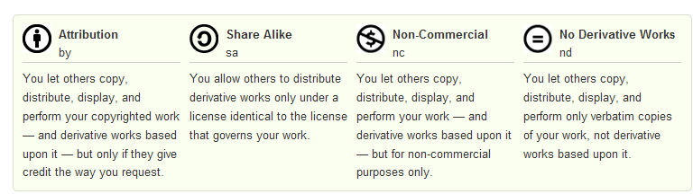
CC License Conditions
“Saving the world from failed sharing”
http://creativecommons.org/about/licenses/
Notes:
Four basic conditions that you can apply to the use of your work
by - Attribution or give credit; the major cc licenses are all attribution licenses, meaning you can set conditions for use but credit must always be given
sa – the product of any use of your work must be shared with the same license applied
nc – use is grant for “non-commercial” purposes; more on non-commercial later
nd – no modification of the work allowed

Slide 6




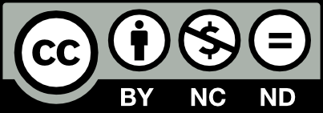
The Six Main CC Licenses
cc by
cc by-nc-sa
cc by-nc-nd
cc by-nc
cc by-sa
cc by-nd
More accommodating
More restrictive
http://creativecommons.org/about/licenses/
Notes:
together, you can apply these conditions to create licenses
more uses accommodated with cc by license, down to most restrictive uses at the bottom with cc by-nc-nd
ask participants to state what the licenses are

Slide 7
Activity: Find your match!
CC
License
Logo
CC License
Meaning
Notes:
(Distribute blue and green cards.)
On the green cards are the 6 main CC licenses we just reviewed. On the blue cards are what those licenses mean.
At my signal, you all have 2 minutes to find the person with the card that matches what you have in your hand, logo to meaning or vice versa. Only two people per match.

Slide 8
Activity: Time Remaining
2:00
1:50
1:40
1:30
1:20
1:10
1:00
:50
:40
:30
:20
:10
Time’s Up

Slide 9
How did you do?
Attribution only
Attribution
cc by
This license lets others distribute, remix, tweak, and build upon your work, even commercially, as long as they credit you for the original creation. This is the most accommodating of licenses offered, in terms of what others can do with your works licensed under Attribution.
http://creativecommons.org/about/licenses/

Slide 10
How did you do?
Attribution
Apply the same license
Attribution Share Alike
cc by-sa
This license lets others remix, tweak, and build upon your work even for commercial reasons, as long as they credit you and license their new creations under the identical terms. This license is often compared to open source software licenses. All new works based on yours will carry the same license, so any derivatives will also allow commercial use.
http://creativecommons.org/about/licenses/

Slide 11
How did you do?
Attribution
No modification
Attribution No Derivatives
cc by-nd
This license allows for redistribution, commercial and non-commercial, as long as it is passed along unchanged and in whole, with credit to you.
http://creativecommons.org/about/licenses/

Slide 12
How did you do?
Attribution
Non-commercial use
Attribution Non-Commercial
cc by-nc
This license lets others remix, tweak, and build upon your work non-commercially, and although their new works must also acknowledge you and be non-commercial, they don’t have to license their derivative works on the same terms.
http://creativecommons.org/about/licenses/

Slide 13
How did you do?
Attribution
Non-commercial use
Apply the same license
Attribution Non-Commercial Share Alike
cc by-nc-sa
This license lets others remix, tweak, and build upon your work non-commercially, as long as they credit you and license their new creations under the identical terms. Others can download and redistribute your work just like the by-nc-nd license, but they can also translate, make remixes, and produce new stories based on your work. All new work based on yours will carry the same license, so any derivatives will also be non-commercial in nature.
http://creativecommons.org/about/licenses/

Slide 14
How did you do?
Attribution
Non-commercial use
No modification
Attribution Non-Commercial No Derivatives
cc by-nc-sa
This license is the most restrictive of the six main licenses, allowing redistribution. This license is often called the “free advertising” license because it allows others to download your works and share them with others as long as they mention you and link back to you, but they can’t change them in any way or use them commercially.
http://creativecommons.org/about/licenses/
Notes:
Take to webpage after discussion of this slide.
Show that each license has both a “license deed” and the legal code

Slide 15
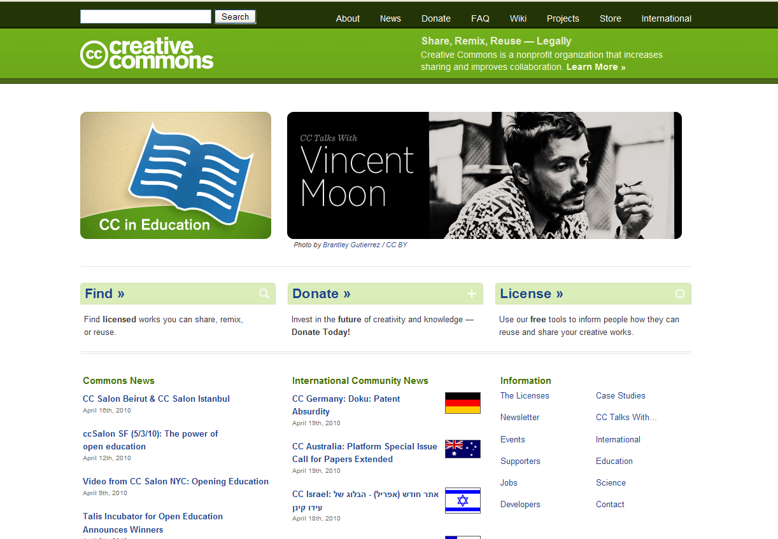
Licensing your work
http://creativecommons.org
Notes:
Creating a license is easy!

Slide 16
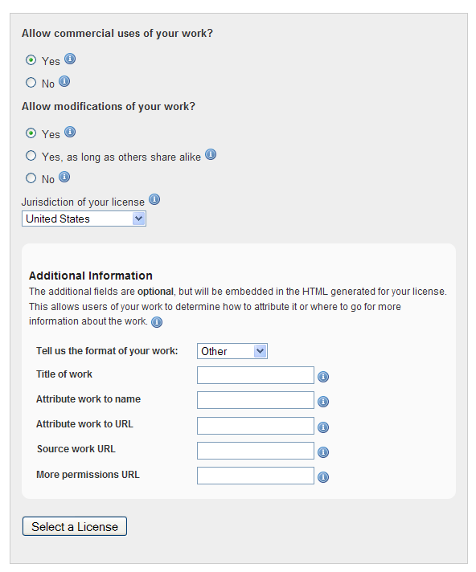
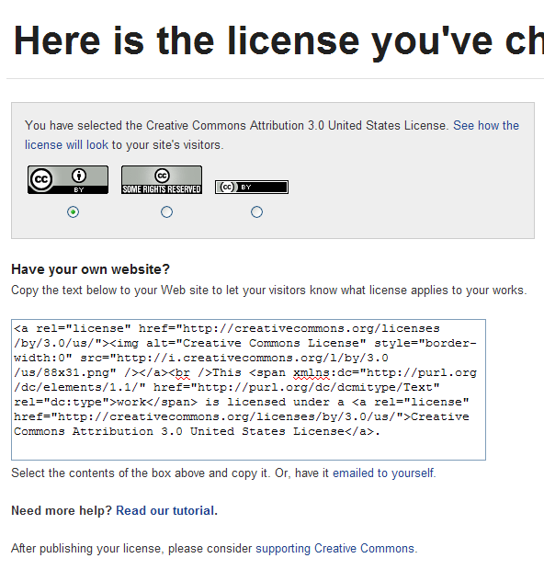
Licensing your work
http://creativecommons.org
Notes:
Answer some questions, click on “select a license” and there you go

Slide 17
About non-commercial use
-nc is incompatible with growing body of free content
-nc may rule out basic and beneficial uses
-nc supports current copyright terms
-nc will not likely increase your chance to profit
If you want widespread use then apply the broadest license possible
The Case for Free Use: Reasons Not to Use a Creative Commons –nc License
http://freedomdefined.org/Licenses/NC
Notes:
As creators of educational content, we have a tendency to lean towards the nc condition for our licenses.
There are probably some good reasons you may want to select that condition, but be sure that you know what you are choosing
Because it’s just about impossible to go back and change your license after you’ve released your work into the wild, select carefully
Here are some ideas to think about from a group that supports broad licenses. They are not saying don’t ever choose –nc…just be aware
incompatible
Millions use open content every day
Wikimedia Commons doesn’t even allow contributions that have an NC condition
Basic uses
posting work on sites that have advertising or serve up Google Ads
CC says that’s okay, depending on how the advertising is done
what about the small site owner that uses a subscription model for additional content
Copyright terms
do you want your work restricted for well past your death? If you choose –nc, you stipulate the time

