Slide 1
Link to powerBI and other files
https://github.com/VUGANEZAPATRICE/ihuzoAssignment
https://drive.google.com/drive/folders/1NZ9KaZ9OXx5NEz_wl2p9m5ek5tpujIQQ?usp=share_link

Slide 2
SIMBA SUPERMARKET SALES ANALYSIS by VUGANEZA Patrice

Slide 3
OBJECTIF
Using my skills in Business Intelligen Power BI or Tableau to analyze the performance of Simba Supermarket and identify areas for improvement

Slide 4
STEPS
Getting dataset from desktop and loading it into power bi desktop
Cleaning Data using power Bi query editor tool
Using report view to build report and dashboard
Respond to each reseach question
Recommendation

Slide 5
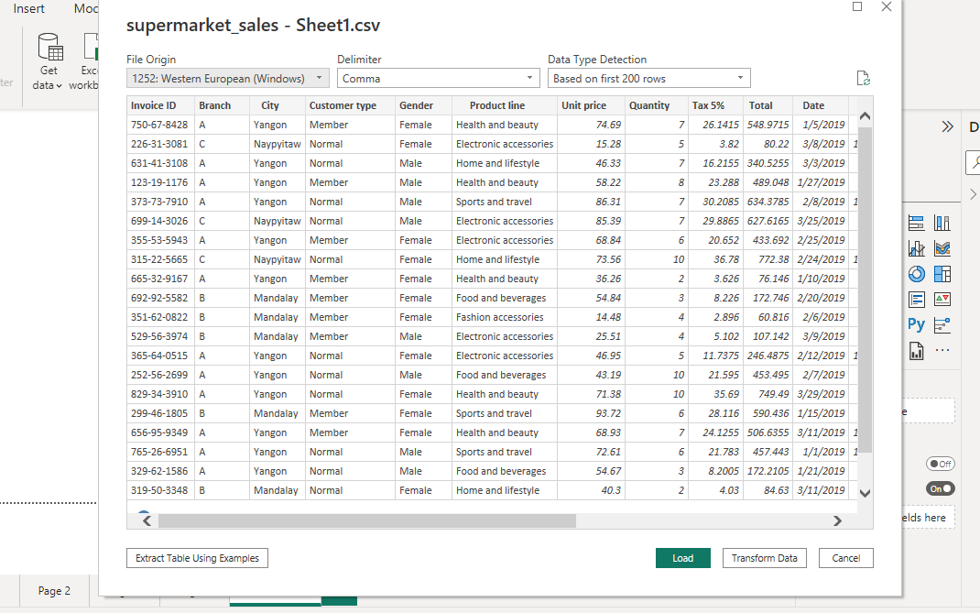
I. Getting dataset from desktop and loading it into power bi desktop

Slide 6
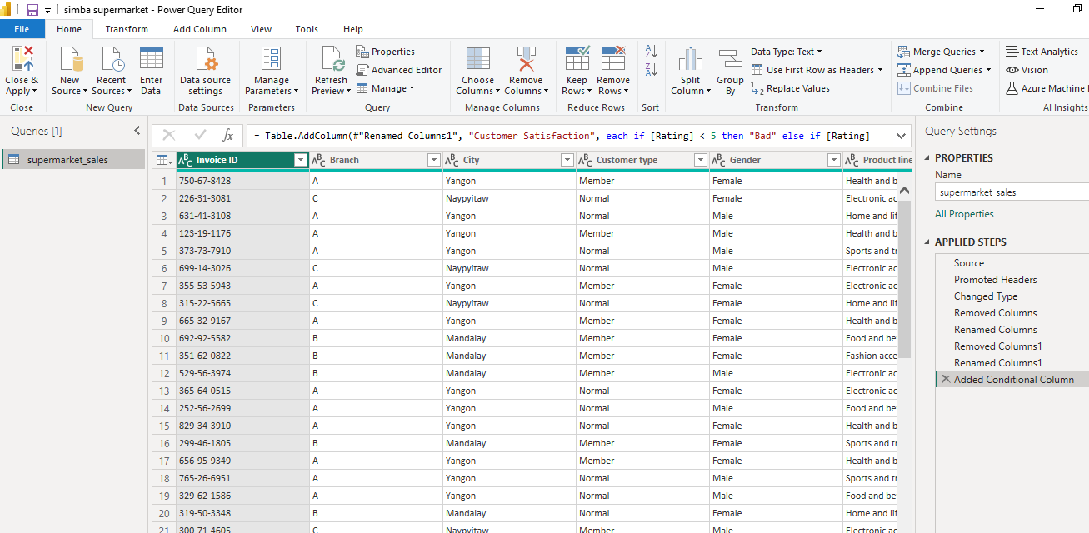
ii. Cleaning Data using power Bi query editor tool
Rremoving unnecessary columns

Slide 7
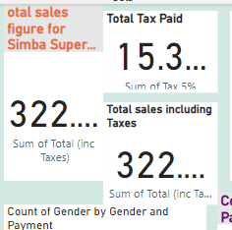
Iii. Using report view to build report and dashboard
1. Total Sales Figures for the super market
There are two kind of sales : The following figure is showing « total sales without tax » and the one with 5% of tax.

Slide 8
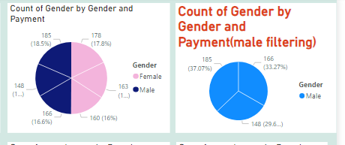
iv. Popular payment method among males customers
This was done using pie chart : the following shows that « ewallet method » is very popular for male gender (18% or 185)

Slide 9
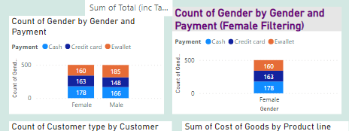
iv. Popular payment method among females
The very popular payment method for females is « cash » as shown in figure below: it is used by 178 females among 501wich is a higher percentage.

Slide 10
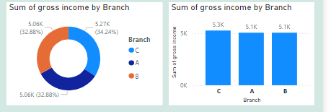
Branch with highest gross income
The analysis has shown the branch that owns the highest gross income is B with a percentage 32.88% (figure below)

Slide 11
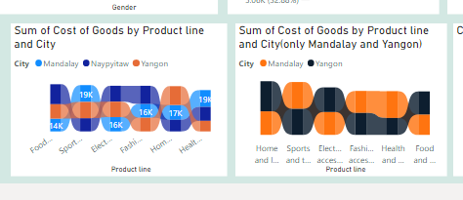
highest cost of goods sold in yangon or mandalay city
By looking at figure below for analyzing cost of goods sold by prouct line ,
This shows that by considering the region , the product with the highest cost of goods sold in Mandalay is « sports and travel (19,036.038) » and that of yangon is « home and lifestyle (21,349.71) »

Slide 12
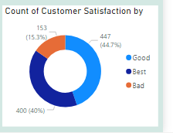
Satisfaction of customers
Finally customer satisfaction was measured using rating and 44.7% of customers rated the service as « good » and 40% as « Best » and finally 15.3% rated « bad ».
N.B. rating rate was from zero to ten and [0-4.999] ➔Bad, [5-7.4] ➔Good, [7.5-10]➔BEST

Slide 13
REcommendation
The company is performing very well but few recommendations should be given about customer satisfaction. Even 40% of customers are happy with service and 44.7 are very happy (rated Best) the 15.3% of customers are still rating as “bas” and it is a high percentage that needs to decrease . By looking at ewallet payment mode, home and life style and mondalay city to improve service as these present a high number of unsatisfaction by considering satisfaction field

