Slide 1
StockSense
AI
Sales forecasts and stock suggestions for a fictional mini market
Store 1 5 products 7-day forecast
STOCKSENSE AI
01
Notes:
Proposed speaker: Morris. About 30 seconds. Introduce StockSense AI and the fictional retailer.

Slide 2
PROBLEM
The weekly stock decision
How much should the manager order before next week’s sales are known?
Too little stock
Too much stock
Missed sales
Money tied up in inventory
STOCKSENSE AI
02
Notes:
Proposed speaker: Zama. About 90 seconds. The business process is assumed for a fictional retailer. No real savings have been measured.

Slide 3
SCOPE
A small, clear prototype
1
5
7
fictional store
anonymous products
forecast days
The app turns these forecasts and entered stock values into an order suggestion.
STOCKSENSE AI
03
Notes:
Proposed speaker: Senamile. About 90 seconds. Explain the five anonymous products and the historical demonstration.

Slide 4
DATASET
The sales data
913,000
9,130
rows in the source file
rows in our selected store and items
Daily sales from 2013 to 2017
No product names, stock levels, prices or supplier records are supplied.
STOCKSENSE AI
04
Notes:
Proposed speaker: Mick. About 90 seconds. Source: Kaggle Store Item Demand Forecasting Challenge, https://www.kaggle.com/competitions/demand-forecasting-kernels-only/data. The raw file was audited locally.

Slide 5
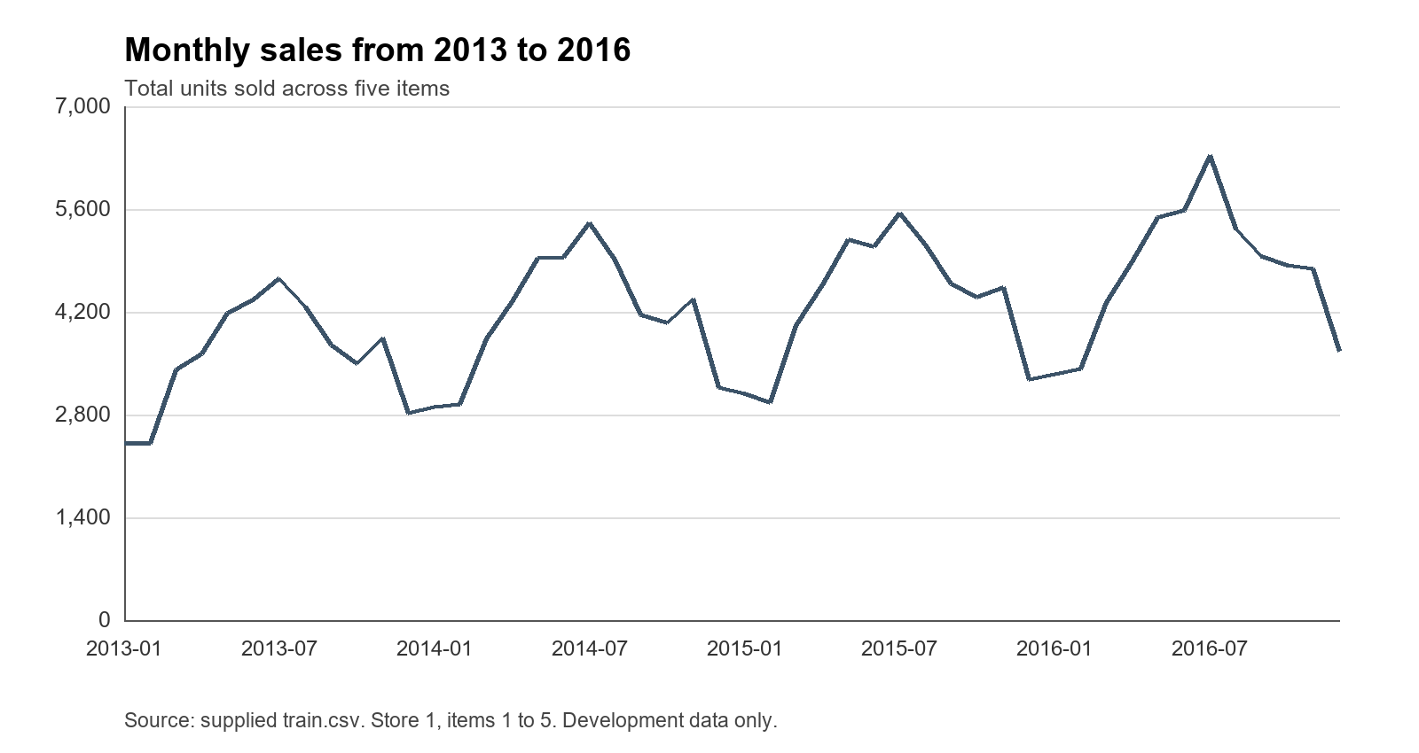
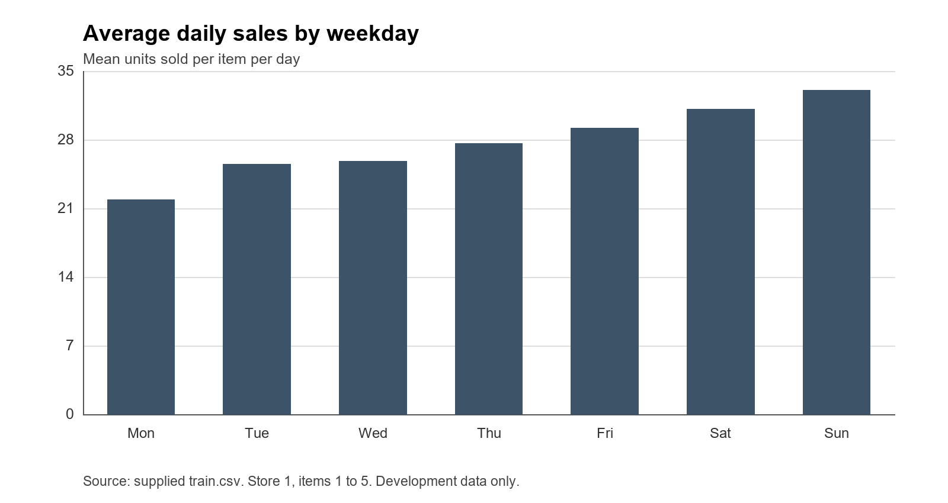
EXPLORE
Sales patterns before testing
Monthly sales totals
Average by weekday
STOCKSENSE AI
05
Notes:
Proposed speaker: Percy. About 60 seconds. Both charts use Store 1, Item 1–5 and 2013–2016 only. Data source: Kaggle Store Item Demand Forecasting Challenge. Explain that pattern does not prove its cause.

Slide 6
METHOD
Time split and methods
2013–15
2016
2017
Fit the models
Select by daily MAE
Final test
Compared: last-week repeat, random forest and a small LSTM
STOCKSENSE AI
06
Notes:
Proposed speaker: Neo. About 90 seconds. Each method is scored on the same 52 weeks per item. We selected using 2016, then froze the choice before 2017.

Slide 7
2016 VALIDATION
Random forest won validation
Daily mean absolute error (units)
STOCKSENSE AI
07
Notes:
Proposed speaker: Ungakimi. About 60 seconds. Daily MAE: benchmark 6.320, LSTM 5.439, random forest 4.911. Lower is better. Source: frozen local comparison.

Slide 8
2017 FINAL TEST
The result held on the final test
23.3% lower daily error than the weekly benchmark
LSTM had the lowest weekly-total error (17.343 units).
STOCKSENSE AI
08
Notes:
Proposed speaker: Ungakimi. About 90 seconds. Daily MAE: benchmark 6.273, LSTM 5.411, random forest 4.812. Weekly-total MAE: benchmark 18.427, random forest 17.973, LSTM 17.343. The 23.3% is a relative daily MAE reduction, not accuracy.

Slide 9
DEEP LEARNING
A small LSTM comparison
28
16
7
past sales days
LSTM units
predicted days
It had better weekly totals overall, while random forest had lower daily error.
STOCKSENSE AI
09
Notes:
Proposed speaker: Neo. About 90 seconds. The model has 28 sales inputs, one 16-unit LSTM layer and seven outputs. It did not win the selected daily error measure.

Slide 10
STOCK PLANNING
How the order number is calculated
77.52
forecast units during coverage
+ 10 buffer = 87.52 target
50 available, 0 outstanding
Suggest ordering 38 units
STOCKSENSE AI
10
Notes:
Proposed speaker: Morris. About 90 seconds. Demonstration input for Product 1: 50 available, 0 outstanding, two-day lead, three-day review, 10 buffer. First-five-day forecast 77.52. Target 87.52. Order ceiling(87.52 minus 50)=38. Stock data is entered manually.

Slide 11
TEXT ASSISTANT
Ask StockSense
“What will Product 1 sell next week?”
The assistant identifies the request type, then reads the saved forecast.
5 supported request types
Forecast, order, recent sales, model results and help
STOCKSENSE AI
11
Notes:
Proposed speaker: Sibongiseni. About 90 seconds. TF-IDF and logistic regression classify five intents. Answers retrieve saved forecast or stock objects. Another item uses its own forecast; stock answer needs fresh inputs.

Slide 12
EVIDENCE
Prototype checks
79
automated tests passed
24/25
8/8
supported requests recognised
unrelated requests rejected
STOCKSENSE AI
12
Notes:
Proposed speakers: Buhle and Wandile. About 90 seconds. Office copy passed all 79 tests on 16 October 2026, with no skips. Earlier personal-PC rehearsal passed 45 tests. Assistant fresh check: 24/25 supported, 8/8 unrelated rejected. Human usability review is pending.

Slide 13
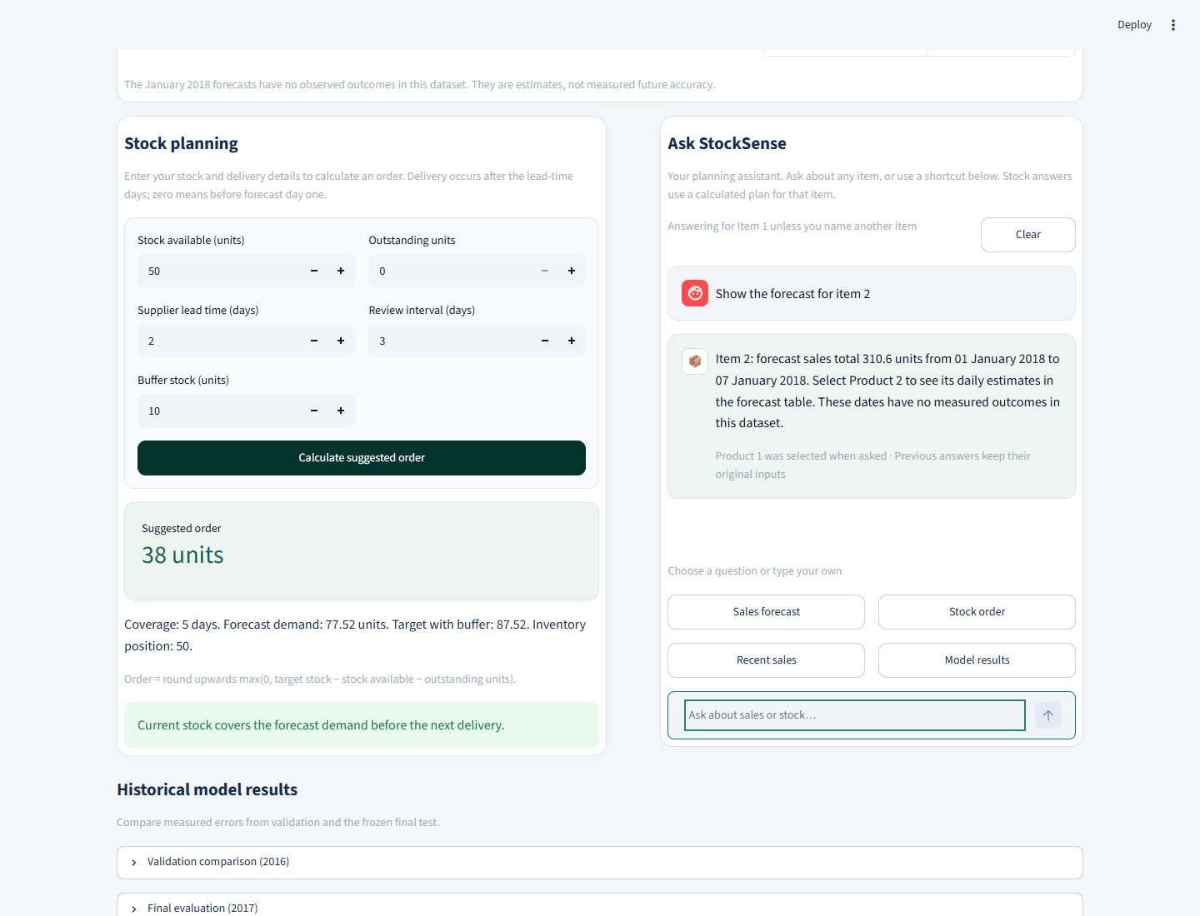
DEMONSTRATION
Live prototype walkthrough
01 Select a product
02 View seven days
03 Enter stock
04 Ask a question
STOCKSENSE AI
13
Notes:
Proposed speakers: Sibongiseni and Morris. About three minutes. Select Product 1, show seven dated forecasts, calculate the 38-unit example, ask about another product, show comparisons. If live app fails use screenshot and backup recording.

Slide 14
CONCLUSION
What we can conclude
Random forest had the lowest daily test error.
The app turns forecasts into a clear order calculation.
Real savings and January 2018 accuracy remain unmeasured.
Questions
STOCKSENSE AI
14
Notes:
Proposed speaker: Senamile. About 60 seconds, then five minutes of questions. Random forest had the lowest daily test error. LSTM had the lowest weekly-total error. No real savings or January 2018 accuracy have been measured.

