Slide 1
StockSense AI
Retail sales forecasting and stock planning
VUT AI Solutions
Business Analysis 3.2 AIBUY3A
1
Notes:
0:00-0:30. Proposed speaker Morris. Introduce the fictional retailer and the local demonstration. All speaking assignments require member confirmation.

Slide 2
The retail ordering problem
Manual ordering lacks a consistent estimate for the period ahead.
Too little stock can create shortages. Too much can tie up money.
The manager keeps control of the ordering decision.
2
Notes:
0:30-2:00. Proposed speaker Zama. Explain the fictional business assumption. No verified local retailer or savings claim. Report sections 1-3.

Slide 3
Business objectives and scope
Seven daily forecasts for store 1, items 1-5
A stock suggestion with visible assumptions
One local page with a short text assistant
Real inventory benefits need a business trial.
3
Notes:
2:00-3:30. Proposed speaker Senamile. Explain success criteria and the limited scope. Mention no supplier orders, live inventory or paid language model. Human usability target remains pending.

Slide 4
The sales dataset
913,000 source rows from 2013-2017
9,130 selected rows with complete daily histories
Fields: date, store, item and sales
Anonymous item IDs and manually entered stock inputs
4
Notes:
3:30-5:00. Proposed speaker Mick. Source https://www.kaggle.com/competitions/demand-forecasting-kernels-only/data . Explain validation, missing-day rejection, hashes and sales versus unconstrained demand. Source audit reproduced on personal PC.

Slide 5
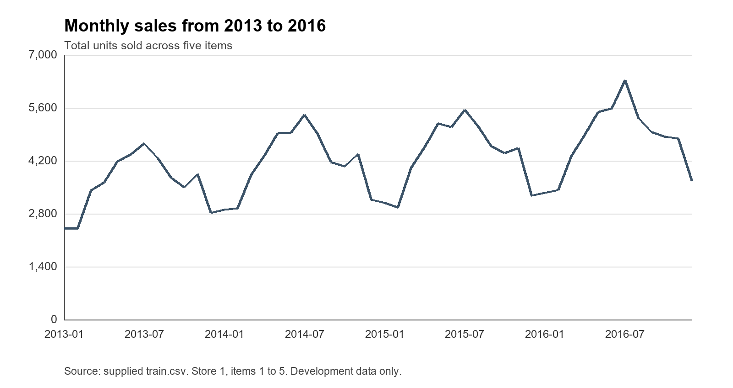
Sales patterns in development data
Annual total
43,208 in 2013
56,943 in 2016
5
Notes:
5:00-6:00. Proposed speaker Percy. Chart uses store 1 items 1-5, 2013-2016. Source docs/drafts/assets/monthly_sales.png, independently recalculated annual totals 43,208 to 56,943. Describe repeated pattern without inventing a cause.

Slide 6
Forecasting methods and fair evaluation
Weekly benchmark repeats matching weekdays.
Random forest uses sales lags, recent means and calendar inputs.
Small LSTM uses chronological sales sequences.
Fit 2013-2015, select on 2016, refit through 2016, test 2017.
6
Notes:
6:00-7:30. Proposed speaker Neo. Sources https://otexts.com/fpp3/simple-methods.html and https://scikit-learn.org/stable/modules/generated/sklearn.ensemble.RandomForestRegressor.html . Explain one model per item, seven outputs and different model inputs. Selection lock protects frozen choice.

Slide 7
2016 validation selected random forest
Method | Daily MAE | Daily RMSE | Weekly-total MAE
Weekly benchmark | 6.320 | 8.217 | 18.758
Random forest | 4.911 | 6.596 | 19.797
Small LSTM | 5.439 | 7.227 | 17.280
Errors in units. The method choice stayed fixed before 2017 scoring.
7
Notes:
7:30-8:30. Proposed speaker Ungakimi. Source local artifacts/forecasters/comparison.json, reproduced values match office summary to 3 decimals. All methods score 52 complete weeks per item, 1,820 daily predictions. Exclude Dec 30-31. Daily MAE determines selection. Weekly result favours LSTM.

Slide 8
2017 final test
Method | Daily MAE | Daily RMSE | Weekly-total MAE
Weekly benchmark | 6.273 | 8.218 | 18.427
Random forest | 4.812 | 6.387 | 17.973
Small LSTM | 5.411 | 7.261 | 17.343
Random forest lowers daily MAE by about 23.3%.
LSTM has the lowest overall weekly-total error.
8
Notes:
8:30-10:00. Proposed speaker Ungakimi. Source local final-test.json and docs/final-model-results.md. Score Jan 1-Dec 30, exclude Dec 31. Random forest daily MAE reduction is about 23.3%, not accuracy. Forest weekly error worse than benchmark on items 3 and 4. No tuning on final test.

Slide 9
The small LSTM experiment
28 sales inputs, 16 LSTM units, seven outputs
1,271 trainable parameters per item
Training-only scaling and validation early stopping
Frozen refit epochs: 39, 50, 12, 50 and 21
9
Notes:
10:00-11:30. Proposed speaker Neo. Sources https://keras.io/api/layers/recurrent_layers/lstm/ and https://keras.io/api/callbacks/early_stopping/ . Adam 0.001, MSE, batch32, no shuffle, cap50. No calendar features. Final refit excludes 2017 from scaling and callbacks. Explain weaker daily result honestly.

Slide 10
Stock planning
Coverage = lead time + review interval, up to seven days
Target = forecast over coverage + buffer
Order = round upwards max(0, target - stock - outstanding)
A shortage warning checks sales before delivery.
10
Notes:
11:30-13:00. Proposed speaker Morris. Source stocksense/inventory.py. Lead2 arrives before day3, lead0 before day1. Example item1 default first5 demand77.52 plus10 buffer minus50 stock yields38 units. Outstanding units arrive after lead time and cannot cover earlier shortages.

Slide 11
NLP and the text assistant
TF-IDF word features and logistic regression recognise five intents.
Templates retrieve the same forecast and stock objects shown on screen.
Fresh check: 24/25 supported requests, 8/8 unrelated requests rejected.
11
Notes:
13:00-14:30. Proposed speaker Sibongiseni. Source docs/assistant-results.md, resources/assistant_questions.json and local evaluation.json. TF-IDF https://scikit-learn.org/stable/modules/generated/sklearn.feature_extraction.text.TfidfVectorizer.html . Five intents forecast,reorder,history,performance,help. Threshold0.35 chosen on validation. Small curated check, one historical-demand miss, no retuning.

Slide 12
Personal PC verification
45 automated tests passed with no skips
All five items, stock rules and assistant consistency checked
AppTest initial render 7.29 seconds
Warm selections 0.20-0.23 seconds
12
Notes:
14:30-16:00. Proposed speaker Buhle and Wandile. Source docs/personal-pc-rehearsal.md. Personal Python3.14.6 versus office3.12.14, same pinned package versions. Timings from one AppTest run, not browser latency. Frozen data/evaluation hashes unchanged. Human review remains pending.

Slide 13
Application demonstration
Select an item and inspect seven dated estimates.
Calculate an order, then show invalid coverage and a shortage.
Ask for the forecast and open both historical evaluation tables.
13
Notes:
16:00-19:00. Proposed speaker Sibongiseni with Morris. Live app http://localhost:8501 . Use item1 defaults, order38, then lead6 review3 invalid, stock0 lead2 shortage. Ask Show the sales forecast. Use backup visuals if server fails. January2018 has no outcomes. Do not retrain during demo.

Slide 14
Findings and remaining evidence
The local prototype works and random forest meets the daily error criterion.
LSTM shows a weekly-total trade-off worth investigating.
Human review, signed declarations and Grammarly evidence remain.
Questions
14
Notes:
19:00-20:00. Proposed speaker Senamile. Then five minutes questions. No guaranteed savings, stockout reduction, general chatbot accuracy or measured2018 accuracy. Confirm campus slot and arrive30min early. Brief source BA3.2Project_2026.pdf pages2-3,6-7.

