Slide 1
StockSense
AI
A team walkthrough
The app, the stock calculation and the models
STOCKSENSE AI
01
Notes:
Welcome the group. This is a teaching session for the current prototype. Plan roughly 40 minutes: about 15 minutes on the app, 15 on models and evidence, then 10 on practice. Slides 31 and 32 are reference pages. The fictional retailer is Sunrise Mini Market. Every member should leave able to explain a feature in their own words. Project source: app.py, stocksense/ui.py. App captured locally on 12 October 2026.

Slide 2
GROUP MEETING
What everyone should understand
01
Read the forecast and explain its dates.
02
Calculate a stock order and explain the warning.
03
Explain what each model does.
04
Interpret the results and answer a lecturer’s question.
STOCKSENSE AI
02
Notes:
Ask the group which part currently feels hardest. Use this to decide where to slow down. By the end, each member should explain what an estimate means, calculate the example, distinguish the forecasting models from the question classifier, and explain the model results. The agenda is flexible and includes live demonstration pauses.

Slide 3
BUSINESS PURPOSE
The manager’s stock decision
How many units should Sunrise Mini Market order?
The app estimates demand.
The manager enters stock and delivery details, then reviews the suggestion.
STOCKSENSE AI
03
Notes:
Use a familiar example: a small shop manager needs enough units to meet expected demand until the next review and delivery. Too little may miss sales, while too much ties up money. Our prototype supports this decision with a sales forecast and a transparent calculation. The case is fictional. We have not measured real savings, real stockouts or profits. Project source: data/prepared/store_1_items_1_to_5.csv and docs/report.md. Dataset: https://www.kaggle.com/competitions/demand-forecasting-kernels-only/data

Slide 4
SALES DATA
Our dataset and scope
1
5
7
fictional store
anonymous products
forecast days
913,000 source rows. 9,130 rows in our chosen scope.
Daily sales from 2013 to 2017
STOCKSENSE AI
04
Notes:
The source train.csv has 913,000 rows: 10 stores, 50 items, daily sales from 2013 through 2017. We use Store 1 and Items 1 to 5, giving 9,130 rows. Sunrise Mini Market is the fictional name we chose for the case study. Product numbers preserve the anonymous item IDs. They do not identify real milk, bread or other named products. The source does not supply inventory or supplier records. Project source: data/prepared/store_1_items_1_to_5.csv and docs/report.md. Dataset: https://www.kaggle.com/competitions/demand-forecasting-kernels-only/data

Slide 5
A SMALL EXAMPLE
What one data row means
Date | Store | Item | Sales (units)
2013-01-01 | 1 | 1 | 13
2013-01-02 | 1 | 1 | 11
2013-01-03 | 1 | 1 | 14
13 means units sold on that date.
Stock levels, prices and supplier details require separate inputs.
STOCKSENSE AI
05
Notes:
Read the first row aloud: on 1 January 2013, Store 1 sold 13 units of Item 1. A time series is the same item’s observations in date order. Sales are observed units sold. We use sales as a proxy for demand because we have no evidence of unmet demand. The row does not tell us the product name, stock available, price or supplier delay. These are real rows from our chosen dataset. Project source: data/prepared/store_1_items_1_to_5.csv and docs/report.md. Dataset: https://www.kaggle.com/competitions/demand-forecasting-kernels-only/data

Slide 6
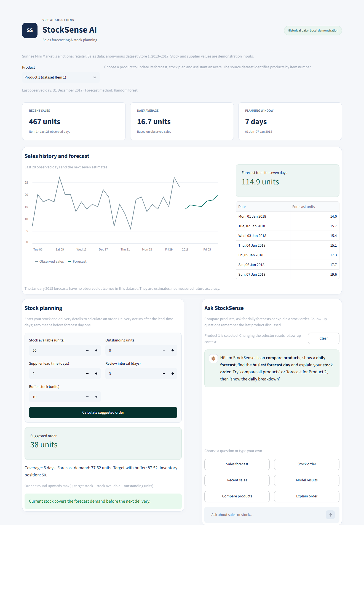
APP TOUR
The system at a glance
01
Product selection and recent sales
02
History and seven-day forecast
03
Stock planning and warnings
04
Questions and model results
STOCKSENSE AI
06
Notes:
Open the actual app and point to these four areas in order. The screenshot shows the current Product 1 example with the 38-unit order. The lower part contains the historical model-result expanders. Product selection and recent KPIs appear above the chart. The chatbot and planner use the same selected product unless the question names another product. Project source: app.py, stocksense/ui.py. App captured locally on 12 October 2026.

Slide 7
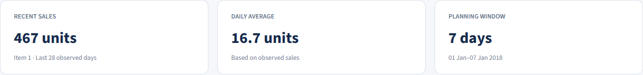
READING THE DASHBOARD
Product selection and the summary
Recent sales: the last 28 observed days.
Daily average: recent total divided by 28.
The Product selector updates the view and resets old context.
STOCKSENSE AI
07
Notes:
Select Product 1 during the live explanation. Recent sales equals the sum of its final 28 observed daily values, 467 units. Daily average is 467 divided by 28, about 16.7 units. The planning window is seven forecast days. Changing the product changes these values and the forecast. It clears a stale stock calculation and resets follow-up context. Old chat messages keep their original inputs and labels. KPI means key performance indicator, or a summary measure. Project source: app.py, stocksense/ui.py. App captured locally on 12 October 2026.

Slide 8
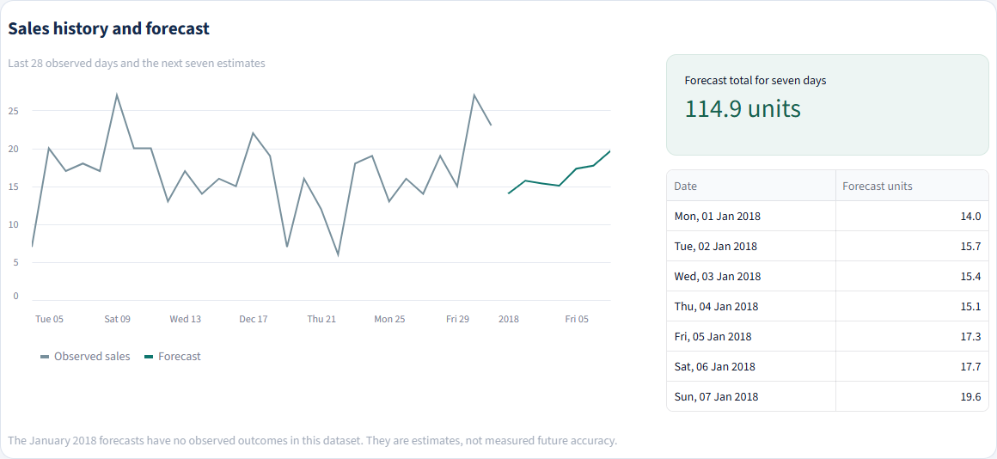
THE CHART
History and forecast
Cutoff: 31 Dec 2017, the last observed day.
Horizon: seven forecast days, 1–7 Jan 2018.
STOCKSENSE AI
08
Notes:
Grey is observed sales for the last 28 available days. Teal is the next seven estimates from the selected random forest. The last observed day is 31 December 2017. The forecast horizon is 1 to 7 January 2018. Those outcomes are absent from our dataset, so we cannot score this displayed forecast. The daily table gives the actual date next to each estimate. The lines show units rather than currency. Project source: app.py, stocksense/ui.py. App captured locally on 12 October 2026. Project source: stocksense/random_forest.py and artifacts/forecasters/random_forest.joblib.

Slide 9
PRODUCT 1 EXAMPLE
The daily forecast in units
Date | Forecast units
Mon, 01 Jan 2018 | 14.0
Tue, 02 Jan 2018 | 15.7
Wed, 03 Jan 2018 | 15.4
Thu, 04 Jan 2018 | 15.1
Fri, 05 Jan 2018 | 17.3
Sat, 06 Jan 2018 | 17.7
Sun, 07 Jan 2018 | 19.6
114.9
forecast units for the week
Totals use unrounded estimates. Orders round up to whole units.
STOCKSENSE AI
09
Notes:
These values come from the saved current random forest. Total: 114.87188037061834 units, displayed as 114.9. The daily forecasts are fractional because they represent average expected quantities. Do not round every daily estimate before calculating the stock plan. The order rounds up only at the final step. The displayed one-decimal rows add to 114.8, while the unrounded predictions sum to 114.9 when rounded, so small apparent sum differences are display rounding. Project source: stocksense/random_forest.py and artifacts/forecasters/random_forest.joblib.

Slide 10
STOCK PLANNING
The five stock inputs
Input | Plain-English meaning | Default
Stock available | Units physically in the shop now | 50 units
Outstanding units | Units already ordered and expected | 0 units
Supplier lead time | Forecast days before the next delivery | 2 days
Review interval | Days between stock reviews | 3 days
Buffer stock | Extra units above forecast demand | 10 units
“Calculate suggested order” applies the entered values.
STOCKSENSE AI
10
Notes:
These are manual demonstration inputs, since Kaggle has no stock or supplier data. Stock available means units physically on hand. Outstanding units are already ordered and expected, and are added to inventory position. Lead time is the number of forecast days before the next delivery. The app assumes delivery after those days. A lead time of zero means delivery before forecast day 1. Review interval is the time until the next review. Buffer stock is extra units chosen by the user, not a statistically calculated service-level buffer. Project source: stocksense/inventory.py and the saved random forest forecast for Product 1 at 31 December 2017.

Slide 11
WHY THE ORDER USES FIVE DAYS
Coverage and delivery timing
2 lead days + 3 review days = 5 coverage days
Day | Mon 1 | Tue 2 | Wed 3 | Thu 4 | Fri 5 | Sat 6 | Sun 7
Forecast | 14.0 | 15.7 | 15.4 | 15.1 | 17.3 | 17.7 | 19.6
Timing | Before delivery | Before delivery | Review coverage | Review coverage | Review coverage | Outside coverage | Outside coverage
Five-day demand = 77.52 units
STOCKSENSE AI
11
Notes:
Coverage equals lead time plus review interval. For the default example, 2 plus 3 gives 5 forecast days. Sum Monday to Friday demand, then add the buffer. Delivery occurs after the two lead-time days, so the order does not fix a shortage during Monday and Tuesday. Saturday and Sunday remain visible forecast days but do not belong to this five-day order calculation. Explain this carefully: the weekly forecast total and the coverage demand can be different numbers. Project source: stocksense/inventory.py and the saved random forest forecast for Product 1 at 31 December 2017.

Slide 12
WORKED CALCULATION
Why the app suggests 38 units
77.52
38
five-day forecast demand
units to order
+ 10 buffer = 87.52 target
50 available + 0 outstanding = 50 position
87.52 − 50 = 37.52
Rounded up
STOCKSENSE AI
12
Notes:
Work through the calculation slowly with Product 1 and the defaults. Coverage demand is 77.51696678502094. Add 10 units to get target stock 87.51696678502094. Inventory position is 50 available plus zero outstanding, or 50. The gap is 37.51696678502094. An order must use whole units, so the app uses ceiling to get 38. Ceiling means round up, and max with zero prevents a negative order. The app uses full-precision forecasts for the arithmetic. Project source: stocksense/inventory.py and the saved random forest forecast for Product 1 at 31 December 2017.

Slide 13
A SECOND PRODUCT 1 SCENARIO
The warning before delivery
Before the delivery | Units
First two days’ forecast demand | 29.8
Stock physically available | 5.0
Potential shortage | 24.8
The new order is 83 units.
An order arriving later cannot cover earlier sales.
STOCKSENSE AI
13
Notes:
Keep Product 1 and the 2-day lead time, but set stock available to 5, outstanding to zero, review to 3 and buffer to 10. First two days predict 29.755561310335686 units. Only five units are on hand, leaving forecast shortage 24.755561310335686, displayed as 24.8. Target stays 87.51696678502094, and the order rises to ceiling of 82.51696678502094, or 83. That later order cannot cover the earlier shortage. Outstanding units affect the position, but do not count as stock already on the shelf. Project source: stocksense/inventory.py and the saved random forest forecast for Product 1 at 31 December 2017.

Slide 14
SAFEGUARDS
Checks that protect the calculation
01
Whole, non-negative units and days.
02
Lead time + review interval must be at most 7 days.
03
Enough stock can give an order of 0 units.
04
A new product needs its own submitted stock calculation.
STOCKSENSE AI
14
Notes:
Show one invalid case during the demo: lead 6 and review 3, totaling 9, which exceeds the seven available forecast days. The app rejects it and removes the old order result. Inputs must be non-negative whole numbers. Review interval must be at least one day. If the target is already covered, the suggested order is zero. Changing the product or submitted inputs invalidates a stale calculation. The chatbot asks for a new submitted stock calculation for another product. Form changes take effect through the Calculate button. Project source: stocksense/inventory.py and the saved random forest forecast for Product 1 at 31 December 2017. Project source: app.py, stocksense/ui.py. App captured locally on 12 October 2026.

Slide 15
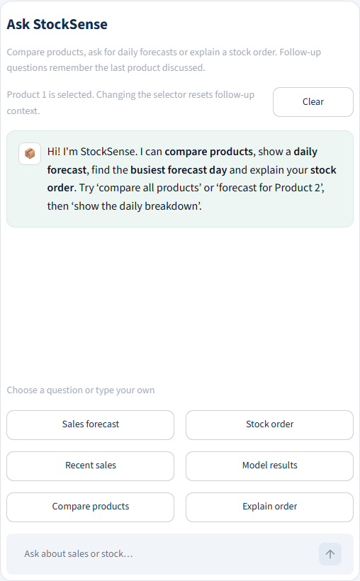
THE QUESTION ASSISTANT
Ask StockSense
“Compare all products”
“Which day has the highest forecast?”
“What does buffer stock mean?”
“Explain my suggested order”
STOCKSENSE AI
15
Notes:
Show the six shortcuts, then type a question. The shortcuts cover a sales forecast, a stock order, recent sales, model results, product comparisons and an order explanation. The chat can answer a question about an item other than the selected one, but a stock plan remains product-specific. It can show busiest and quietest forecast days, a named date or weekday, and simple definitions. Clear erases the transcript and follow-up focus while retaining the current stock plan. The app retains the newest 40 messages, or 20 question-and-answer turns. Project source: stocksense/assistant.py, app.py, resources/assistant_questions.json and artifacts/assistant/evaluation.json.

Slide 16
A CONVERSATION EXAMPLE
Follow-up questions and product focus
Question | What the assistant uses
“Forecast for Product 2” | Product 2: 310.6 forecast units
“And Product 3?” | Product 3: 178.7 forecast units
“Show the daily breakdown” | Product 3: seven dated estimates
“Why?” after calculating an order | The submitted order’s calculation
Clear resets the chat focus. The selector also resets it.
STOCKSENSE AI
16
Notes:
This example was checked in the running app. Product 1 can remain selected while the question names Product 2. The answer uses Product 2’s forecast, not Product 1’s. Asking And Product 3 changes conversation focus to Product 3. Show the daily breakdown then refers to Product 3 and provides seven dated values. Ask Which is the busiest forecast day for a maximum. A product-selector change or Clear resets this focus. A multi-product comparison followed by an ambiguous daily request asks which product you mean. Previous transcript answers remain historical messages with their original selection captions. Project source: stocksense/assistant.py, app.py, resources/assistant_questions.json and artifacts/assistant/evaluation.json.

Slide 17
A DIFFERENT MODEL WITH A DIFFERENT JOB
How the chatbot understands a question
01
Words become numeric features using TF-IDF.
02
Logistic regression predicts the request type.
03
Product rules and follow-ups identify the relevant data.
04
The answer uses actual forecast and stock results.
STOCKSENSE AI
17
Notes:
Explain the difference between predicting a number and classifying a question. TF-IDF means term frequency–inverse document frequency. It turns words and pairs of words into numeric features, giving common generic words less influence. Logistic regression chooses a request category from the features. Despite its name, this model is used here for classification. The training set has 60 labelled questions across forecast, reorder, history, performance and help. Validation selected confidence threshold 0.35. Product/date rules and conversation context also help route questions. Response templates retrieve current forecast, history, stock or metric data. Project source: stocksense/assistant.py, app.py, resources/assistant_questions.json and artifacts/assistant/evaluation.json.

Slide 18
WHAT THE ASSISTANT CAN EXPLAIN
Useful answers and clear limits
Request | Where the answer comes from
Forecast or busiest day | The item’s seven forecast values
Recent sales | The item’s observed sales history
Order and “why?” | Its submitted stock plan
Model results | Saved validation and final-test metrics
A definition or help | Supported explanations and example questions
Intent confidence concerns the question category.
STOCKSENSE AI
18
Notes:
Comparisons use the same seven forecast dates for every item. Recent-sales comparisons can use a requested window up to 28 days. Dates outside the available forecast and unsupported products require clarification. Stock answers require a plan for the relevant item. The system is a focused local question assistant, with no general language-model service or paid API. It does not know real product names, prices, profits, current weather or live transactions. Confidence is confidence in the request category. It is not a probability that the numerical sales forecast will be correct. The held-out classifier record is 24 out of 25 supported examples correct and 8 out of 8 unrelated examples rejected, a small test rather than evidence for every possible question. Project source: stocksense/assistant.py, app.py, resources/assistant_questions.json and artifacts/assistant/evaluation.json.

Slide 19
MODEL OVERVIEW
The three forecasting methods
Method | How it forecasts | Role
Weekly seasonal naive | Copies the same weekday from last week | Simple benchmark
Random forest | Averages predictions from many trees | Selected forecast
Small LSTM | Learns from a sequence of daily sales | Comparison model
The chatbot classifies questions. These methods forecast units.
STOCKSENSE AI
19
Notes:
These methods answer the same forecasting question for the same items and seven-day horizon. Weekly seasonal naive repeats last week and is a benchmark rule. Random forest is the selected supervised machine-learning regressor. A small LSTM is a deep-learning sequence model we compared. The chatbot classifier is a separate model and does not generate these sales estimates. Each trained forecasting method has one model per item. All use only information available at their forecast origin. Project source: stocksense/random_forest.py and artifacts/forecasters/random_forest.joblib. Project source: stocksense/lstm.py and artifacts/forecasters/selection-lock.json. Project source: artifacts/forecasters/comparison.json, artifacts/forecasters/final-test.json and stocksense/evaluation.py.

Slide 20
THE BENCHMARK
Weekly seasonal naive
Day | Last week observed | Next week forecast
Monday | 10 units | 10 units
Tuesday | 12 units | 12 units
Wednesday | 9 units | 9 units
Thursday | 11 units | 11 units
Illustration: the same rule repeats for all seven weekdays.
STOCKSENSE AI
20
Notes:
Seasonal means a repeated calendar pattern. Naive means a simple repeat rule. If the previous Monday sold 10 units, the next Monday gets a 10-unit forecast. Likewise for every other weekday. These values are an illustration, not current app outputs. The method trains no parameters. It gives us a fair reference: a more complex method should show a useful improvement over something this simple. It may miss a trend or a sudden change. The actual implementation copies the most recent seven observed days into the next week. Project source: stocksense/forecasting.py and stocksense/evaluation.py.

Slide 21
THE SELECTED METHOD
Random forest
100
decision trees per product
Inputs: 28 past sales values, recent averages and known calendar dates.
The forest predicts all seven daily values together.
STOCKSENSE AI
21
Notes:
A decision tree learns splits such as recent sales above or below a learned value. We are describing the mechanism, not claiming a specific actual split. A forest trains many trees on resampled training examples, then averages their predictions. Our regressor directly returns seven daily values together. It does not recursively feed tomorrow’s prediction back into the following forecast. Inputs: all 28 past daily sales values, means over 7, 14 and 28 days, and sine/cosine encodings for the weekday and day of year of each of the seven target dates. That is 59 numeric features. Calendar dates are known beforehand. One separate forest serves each item. Settings: 100 trees, maximum depth 10, minimum leaf size 3 and seed 42. Project source: stocksense/random_forest.py and artifacts/forecasters/random_forest.joblib.

Slide 22
THE DEEP-LEARNING COMPARISON
LSTM: Long Short-Term Memory
28
16
7
past daily values
LSTM memory units
daily outputs
One small neural network per product
Sales values only. Training scales the values before learning.
STOCKSENSE AI
22
Notes:
LSTM stands for Long Short-Term Memory. It is a recurrent neural-network layer that learns what information to retain while reading an ordered sequence. Our small model receives 28 daily sales values in chronological order, uses one 16-unit LSTM layer and a Dense output layer with seven values. It has 1,271 trainable parameters and one separate model per product. It uses no calendar features. We standardize using a mean and standard deviation calculated from training observations, then convert predictions back to units. It uses Adam at learning rate 0.001 and mean squared error loss, batch size 32, no shuffling, up to 50 epochs with validation early stopping patience 5. The final refit uses the validation-selected epoch counts. Project source: stocksense/lstm.py and artifacts/forecasters/selection-lock.json.

Slide 23
A FAIR TIME-BASED COMPARISON
Training, validation and final testing
Period | Purpose
2013–2015 | Initial model fitting
2016 | Validation selects the method and settings
Through 2016 | Refit with the selected settings
2017 | Final test of the frozen choices
52 complete weeks per product in each evaluation year
STOCKSENSE AI
23
Notes:
Training teaches parameters using 2013 to 2015 sales. Validation in 2016 selects the method and settings. We chose the random forest by lowest overall daily validation MAE. Then we refit forecasting models using data through 2016 with settings frozen. The 2017 final test evaluates the frozen choices. Each evaluation year scores 52 complete weeks per item: 364 daily values per item or 1,820 across five items. Model weights stay fixed during testing while observed history advances each week. At each origin the model sees only earlier actual values. It never sees the future seven outcomes that it is about to predict. Final evaluation covers 1 January to 30 December 2017, with the incomplete final day excluded. Project source: artifacts/forecasters/comparison.json, artifacts/forecasters/final-test.json and stocksense/evaluation.py.

Slide 24
AN ERROR METRIC
MAE: average forecast mistake
Day | Observed | Forecast | Absolute error
Day 1 | 10 | 12 | 2
Day 2 | 20 | 17 | 3
(2 + 3) ÷ 2 = 2.5 units
Illustration. Smaller error is better.
STOCKSENSE AI
24
Notes:
MAE is Mean Absolute Error. First subtract the observed value from the prediction, then ignore the sign. Average those absolute differences. For this two-day illustration, errors are 2 and 3 units. Their average is 2.5 units. We care about magnitude because over- and underestimates should not cancel when measuring daily accuracy. Lower MAE is better on the same data, products and dates. MAE 4.812 means an average absolute daily error of about 4.8 units across the scored values. It is not 4.8 percent and does not mean every prediction misses by exactly that amount. Project source: artifacts/forecasters/comparison.json, artifacts/forecasters/final-test.json and stocksense/evaluation.py.

Slide 25
WHY ERROR MEASURES CAN DIFFER
RMSE and weekly-total MAE
Root Mean Squared Error
Two-day illustration | Actual | Forecast
Day 1 | 10 | 12
Day 2 | 20 | 18
Total | 30 | 30
Larger mistakes receive more weight.
Previous slide’s example: 2.55 units
Weekly-total MAE compares seven-day totals.
Daily MAE = 2 units. Total error = 0.
STOCKSENSE AI
25
Notes:
RMSE means Root Mean Squared Error. For the preceding two-day illustration, square errors 2 and 3 to get 4 and 9, average them to 6.5, then take the square root: about 2.55 units. Squaring makes larger mistakes matter more. Weekly-total MAE sums predicted values for a week, sums its actual values, compares the totals, and averages the absolute differences over weeks. Errors on separate days can cancel in a weekly total even when daily forecasts are imperfect. The right-hand example simplifies this to two days: observed 10 and 20, forecast 12 and 18. Daily MAE is 2 while the two-day total error is zero. The real metric uses seven days. This explains why the daily and weekly rankings can differ. Project source: artifacts/forecasters/comparison.json, artifacts/forecasters/final-test.json and stocksense/evaluation.py.

Slide 26
FROZEN 2017 EVALUATION
Random forest’s daily test error
23.3% lower daily MAE than the benchmark
STOCKSENSE AI
26
Notes:
Selection came from 2016 validation, before this 2017 test. Random forest validation MAE was 4.911, LSTM 5.439 and the benchmark 6.320. These bars show final daily test MAE: benchmark 6.273, LSTM 5.411, random forest 4.812 units. Compute relative error reduction using the benchmark as the denominator: about 23.3 percent. Call this lower daily MAE, not 23.3 percent accuracy or 76.7 percent accuracy. Results aggregate all five products across the same 1,820 daily predictions. They do not prove equal performance for every item. Project source: artifacts/forecasters/comparison.json, artifacts/forecasters/final-test.json and stocksense/evaluation.py.

Slide 27
ALL ERRORS IN UNITS. SMALLER IS BETTER
The recorded model results
Period and method | Daily MAE | Daily RMSE | Weekly-total MAE
2016 Weekly benchmark | 6.320 | 8.217 | 18.758
2016 Random forest | 4.911 | 6.596 | 19.797
2016 Small LSTM | 5.439 | 7.227 | 17.280
2017 Weekly benchmark | 6.273 | 8.218 | 18.427
2017 Random forest | 4.812 | 6.387 | 17.973
2017 Small LSTM | 5.411 | 7.261 | 17.343
LSTM has the lowest weekly-total error. Daily MAE chose random forest.
STOCKSENSE AI
27
Notes:
Open both Historical model results expanders in the app. These are the recorded aggregate numbers, rounded to three decimal places, in units. Daily validation MAE determined the choice. LSTM has the lowest weekly-total MAE in both years. Random forest has the lowest daily MAE and RMSE in both years. We retain the frozen selection instead of switching after seeing the test. No model wins every measure. If the sole business objective were weekly total accuracy, that would require a separately planned experiment and selection criterion. Project source: artifacts/forecasters/comparison.json, artifacts/forecasters/final-test.json and stocksense/evaluation.py.

Slide 28
LIMITS THE TEAM SHOULD EXPLAIN
What our evidence supports
01
A historical comparison of forecasting errors.
02
A stock suggestion from the values we enter.
03
A focused assistant that reads the system’s results.
04
Real savings and January 2018 accuracy remain unmeasured.
STOCKSENSE AI
28
Notes:
Do not claim real savings or successful supplier orders. We use historical anonymous sales and a fictional business. Sales may miss unfulfilled demand because the dataset does not measure lost sales. Stock, delivery and buffer are assumptions entered by the user. The 2017 final test has observed outcomes, whereas the January 2018 displayed week does not. The app has no automatic supplier ordering, point-of-sale integration or live inventory feed. The assistant’s small classifier test does not prove broad conversational reliability. Human usability feedback must come from actual users rather than invented comments. Project source: data/prepared/store_1_items_1_to_5.csv and docs/report.md. Dataset: https://www.kaggle.com/competitions/demand-forecasting-kernels-only/data Project source: artifacts/forecasters/comparison.json, artifacts/forecasters/final-test.json and stocksense/evaluation.py. Project source: stocksense/assistant.py, app.py, resources/assistant_questions.json and artifacts/assistant/evaluation.json.

Slide 29
FIVE-MINUTE PRACTICE
A live demonstration everyone can repeat
01
Select Product 1 and explain the dates.
02
Read its seven daily forecasts and total.
03
Calculate the default 38-unit order.
04
Change stock to 5 and explain the delivery warning.
05
Compare products and try a follow-up question.
06
Open the 2016 and 2017 model results.
STOCKSENSE AI
29
Notes:
Allow five minutes. First select Product 1 and explain the historical dates. Read its 114.9-unit week. With default stock 50, outstanding 0, lead 2, review 3, buffer 10, calculate 38. Change stock to 5 and calculate again to show 83 and the 24.8-unit shortage before delivery. Restore stock 50 and recalculate. Ask Compare all products, then Forecast for Product 2, And Product 3, Show the daily breakdown. Open both model-result expanders. Do not retrain models during this demonstration. If the office app is unavailable from another PC, run the repository’s Streamlit application on that PC using its own local dataset and saved setup. Project source: app.py, stocksense/ui.py. App captured locally on 12 October 2026.

Slide 30
A SHORT KNOWLEDGE CHECK
Questions for the group
01
Why does the order use 77.52 units instead of 114.9?
02
Does a daily MAE of 4.812 mean 95.188% accuracy?
03
Why did we choose random forest when LSTM has a lower weekly error?
04
What does the chatbot need before suggesting another product’s order?
STOCKSENSE AI
30
Notes:
Give the group two minutes before showing the answers through your explanation. Answer 1: the coverage window is five days, not the whole seven-day horizon, and stock inputs also matter. Answer 2: it means average absolute error in units, not a percentage of accuracy. Answer 3: the frozen choice used 2016 daily MAE, where random forest was better. LSTM’s weekly-total metric measures a different objective. Answer 4: a submitted calculation for that product with its stock and delivery inputs is required. Invite members to point to the relevant screen rather than recite definitions. Ask a different member to answer each question.

Slide 31
REFERENCE
Model terms in plain English
Term | Meaning in this project
AI and machine learning | AI is the broad field. Machine learning learns from examples.
Regression | Predicting a number, such as daily units sold
Classification | Predicting a category, such as a question’s intent
Feature | An input, such as a past sales value or weekday
Target | The known value a model learns to predict
Lag | A previous sales value, such as yesterday’s sales
Ensemble | Several models combined, such as the forest’s trees
Deep learning | Learning with neural networks, such as our LSTM
STOCKSENSE AI
31
Notes:
Use this as a reference page rather than reading every line aloud. Artificial intelligence is a broad term. Machine learning learns patterns from examples. Our forecast models perform supervised regression using past inputs and known numeric targets. Features are inputs, targets are outputs during training, and an ensemble combines models. Deep learning uses neural networks with learned internal representations. The LSTM is the neural-network model used here. Chat intent classification predicts a category instead of a numeric sales quantity. Project source: stocksense/random_forest.py, stocksense/lstm.py and stocksense/assistant.py.

Slide 32
REFERENCE
Training and evaluation terms
Term | Plain-English meaning
Epoch and batch | Epoch: a training pass. Batch: a group for one update.
Optimizer and loss | The update method and the error it tries to reduce
Scaling | Putting training values onto a comparable numeric scale
Hyperparameter | A chosen setting, such as tree count or learning rate
Overfitting | Learning training detail that does not generalize well
Data leakage | Using future information when predicting earlier dates
Inference | Running a trained model to produce an answer
Confidence threshold | Minimum score before accepting a question category
STOCKSENSE AI
32
Notes:
Use these definitions if members ask about the report’s technical settings. An epoch is one pass through training examples. A batch is the group used for one optimization update. Adam is the optimizer adjusting neural-network weights. MSE is the LSTM training loss and squares prediction errors. Scaling transforms sales using training mean and standard deviation; prediction values return to units. Overfitting means good fit to training examples but poor future generalization. Leakage means using information from after the prediction boundary. Inference means running a trained model to obtain an output. Threshold concerns the intent classifier, not the numerical forecast. Hyperparameters are settings chosen before fitting, such as tree count or learning rate. Sources: stocksense/lstm.py, stocksense/random_forest.py, stocksense/assistant.py, docs/report.md.

Slide 33
AFTER THE WALKTHROUGH
Each member’s next contribution
One feature. One explanation.
Each member demonstrates something and answers a question.
The group records its actual decisions and follow-up work in GitHub.
STOCKSENSE AI
33
Notes:
Finish by having each member choose a feature or model and explain it in their own words using the app. If two people choose the same feature, one explains it and the other asks a question. Record real meeting decisions in the existing GitHub Discussion. Members should add their own observations and completed work to the relevant issues. A co-author credit records contribution to a change; it does not substitute for actual discussion or demonstrated understanding. Note unresolved questions so the team can correct the report, poster or submitted slides where necessary. The reference slides are available for revision.

