Slide 1

Linked Lists
History Project
By System React

Slide 2
TABLE OF CONTENTS
01
Stages of realization
02
Programs we used
03
Our goal
04
Flow chart of our program

Slide 3
OUR TEAM
Scrum Trainer
Frontend Developer
Backend Developer
QA
Velimir Dimitrov
Teodora Kompanska
Mariya Kostova
Danislav Todorov

Slide 4
01
Stages of realization

Slide 5
First Stage
Second Stage
Third Stage
Stages of realization
Planning
Realization
Presenting our project

Slide 6
02
Programs we used

Slide 7






Programs we used

Slide 8
03
Our goal

Slide 9

Our goal

Slide 10
04
Flowchart of our program

Slide 11
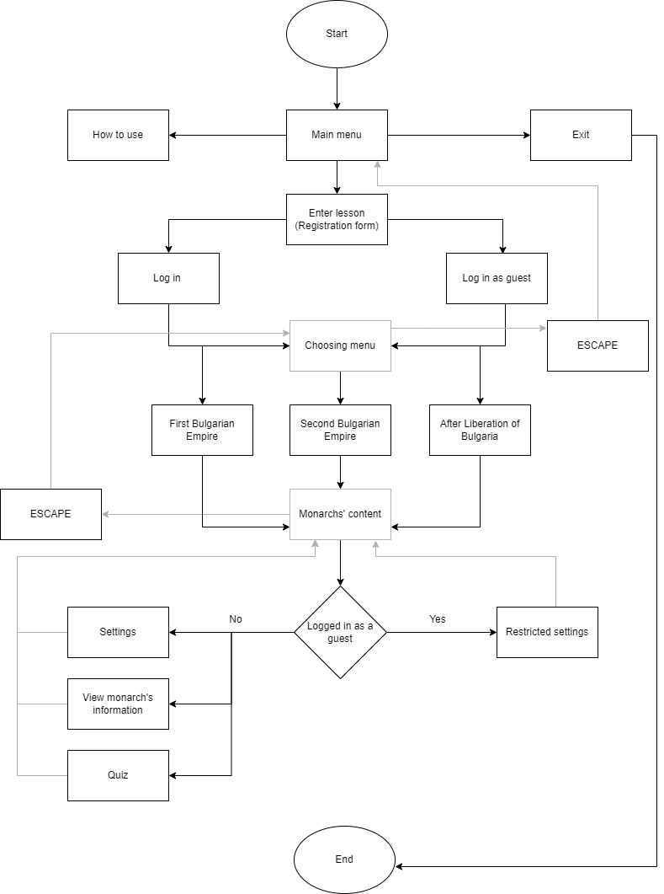
Flowchart

Slide 12
Thank you for your attention!

