Slide 1
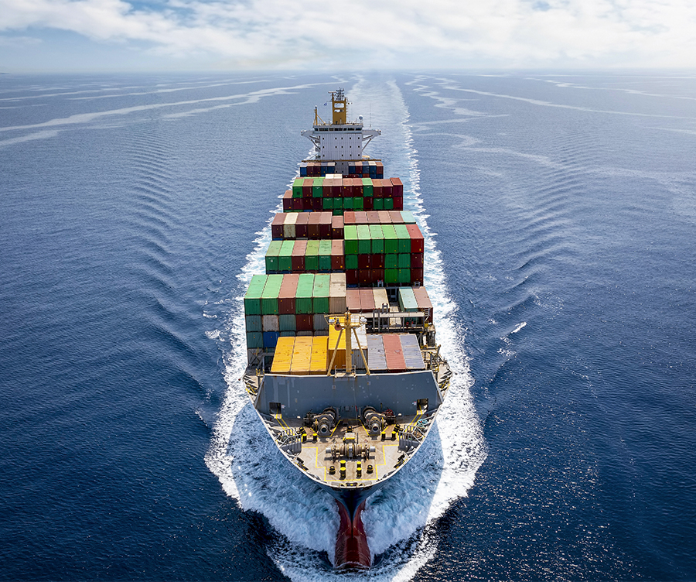

Shipping Cost Analysis
By :
VVS Kushwanth Reddy
Data Scientist (7 Years)
BTech Chemical Eng, Adv Mgmt in Business Analytics
kushwanth777@gmail.com
9619045522

Slide 2
Case Study
Problem Statement
Business Objective
EASTMAN Company wants to understand the shipping cost that they are paying to shipping companies to transport their chemicals, fibers and Plastics from their warehouses to existing and new customers
Obtain a model that will estimate shipping cost (column “Cost”) for new selections of input variables. Assume we could change route class and priority if desired. The data provided includes all possible shipment origins but not all future shipment destinations as we regularly get new customers.
Determine if there are any outliers in the historical data suggesting a higher-than-expected shipping cost that would warrant a follow-up with transportation suppliers regarding their rates.

Slide 3

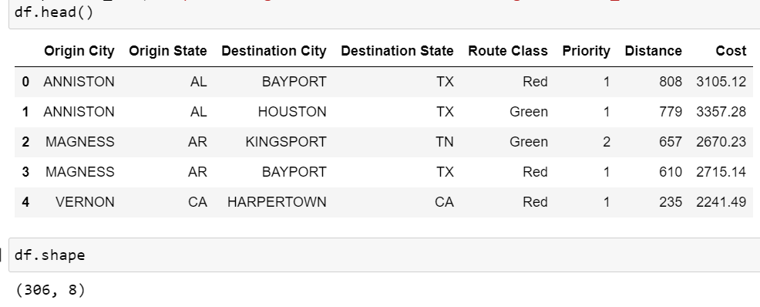
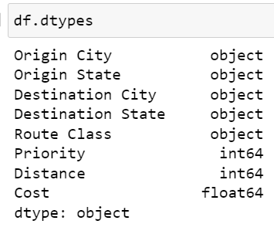
Exploratory Data Analysis
Entire data features can be broadly divided into below 3 subgroups.
Origin information.
Destination Information.
Navigation Information.
Dataset has total of 306 rows and 8 columns
There are No missing values in the dataset
Y Variable(Dependent) = Cost
X Variables(Independent) = 2 Numeric and 5 Categorical Variables

Slide 4
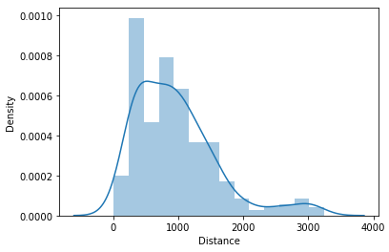
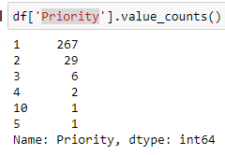
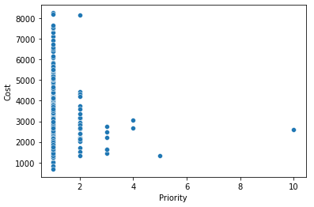
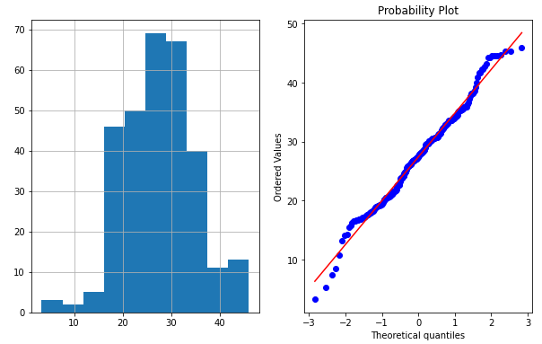
Numerical Feature Analysis
There are 2 Numerical Variables: 1.Distance and 2.Priority
Distance feature is not a Gaussian distribution
Applying Box –Cox transformation made it a Gaussian distribution
Priority feature has Discrete Values(1,2,3..) and not continuous variable
Let's Convert this from Integer data type to Categorical(Object) data type
Most of the records have Priority-1.there is not much variance in the Variable
Distance (Pdf)
Distance

Slide 5
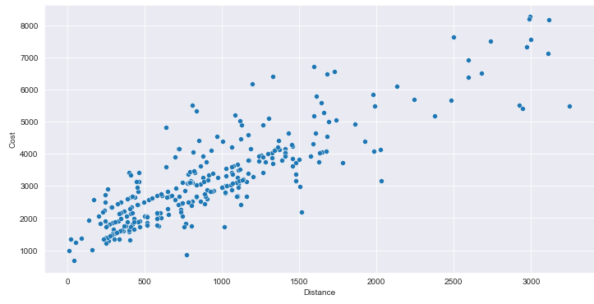
Correlation
Correlation is a statistical term describing the degree to which two variables has linear relationship.
Distance feature is highly Positively correlated(0.86) with Cost Variable
Distance vs Cost Scatter plot clearly shows Linear relationship
Outliers may exist in both Distance and Cost features
Will apply Inter Quartile Range (IQR) to identify Outliers
Correlation=0.86

Slide 6
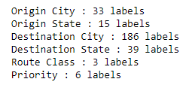
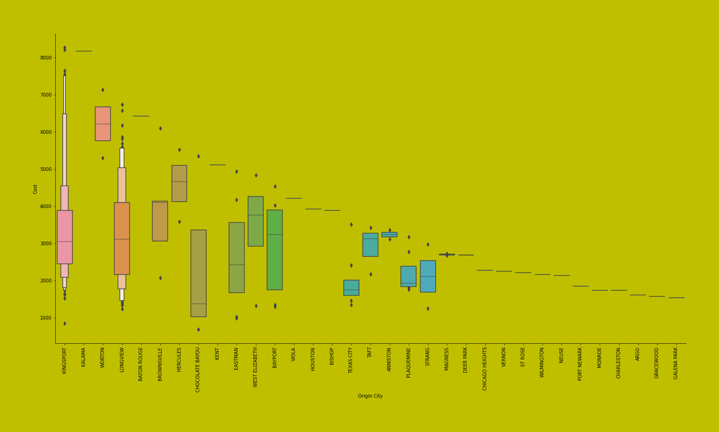
Categorical Features Analysis
There are huge number of Levels in all categorical values especially in Destination City(due to multiple customers.
Priority doesn’t have much spread in the data
Origin Cities could be EASTMAN company Warehouses
Few Origin cities like
Kingsport
Longview have capability to send to multiple customers with Huge Cost Range
Origin City Vs Cost

Slide 7
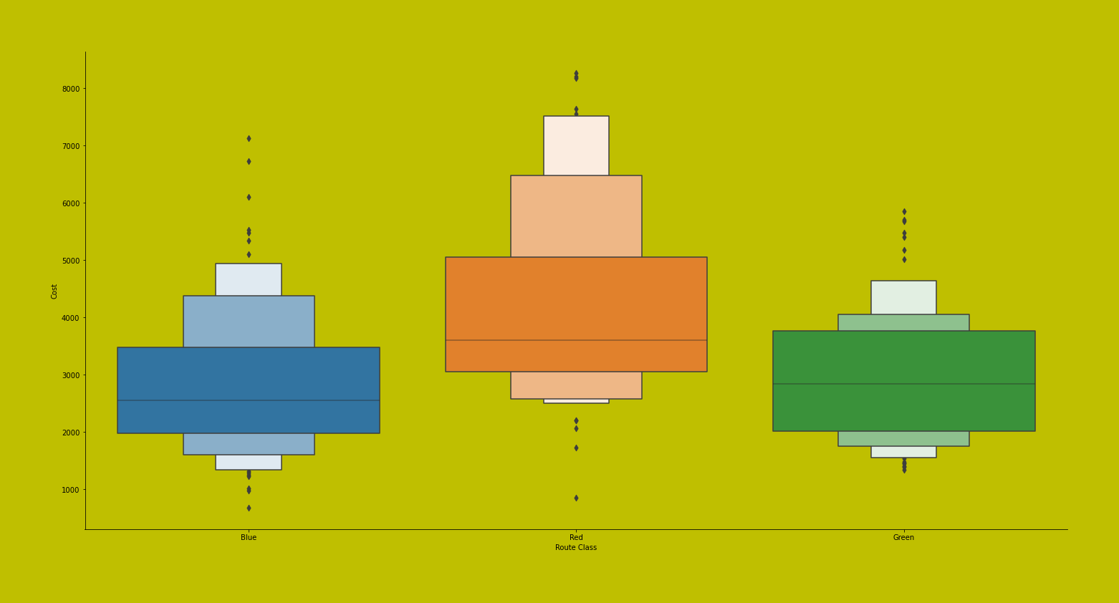
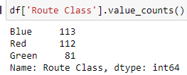
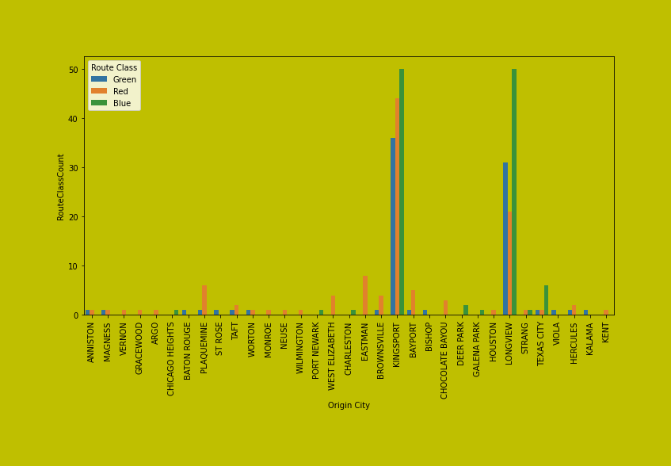
Categorical Features Analysis
Route Class Vs Cost
Route Class has 3 levels where Blue, Red is almost equal and Green is relatively less.
Is Route Class ordinal categorical variable?
Assuming it is not for this use case
Origin City VS Route class count aggregation plot doesn’t give much information
All Categorical features are converted to One hot encoding features before fitting on any model
Origin City vs Route Class Count

Slide 8
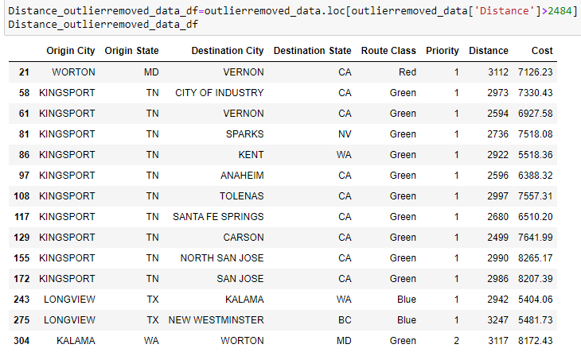
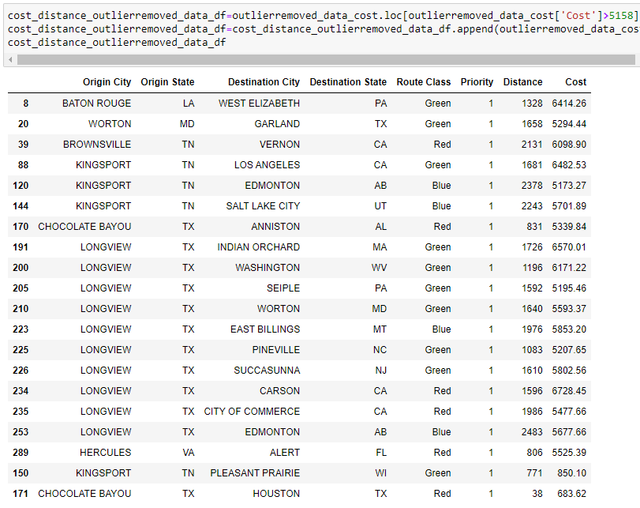
Outliers -Distance and Cost
Applying Inter Quartile Range(IQR) on Distance and Cost Column to identify Records which is more than Upper and Lower range from dataset

Slide 9
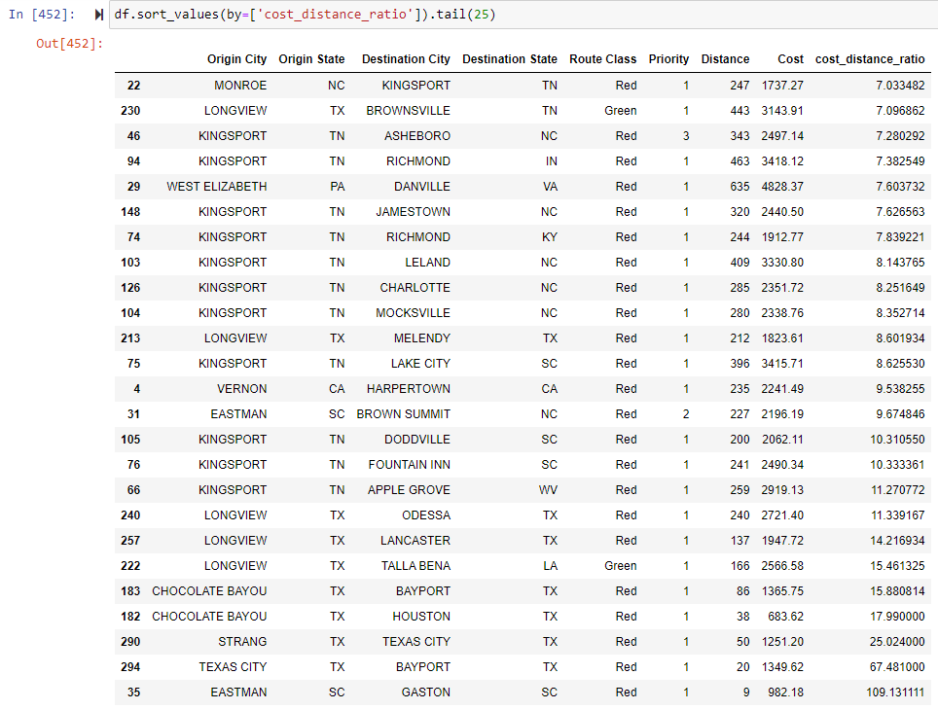
Objective 2 Findings
Did Feature engineering by creating new feature ‘cost_distance_ratio’ by Cost/Distance
Assuming if ‘cost_distance_ratio’ >7 is higher-than-expected shipping cost .
These Routes and transactions need a follow-up with transportation suppliers regarding their rates.

Slide 10



Objective 1- ML Model Design
Data is divided as Training and Testing data 5 fold Cross validation Split
80%
20%
Use Training data for Model Training and check performance on test set
Dataset
(272)
Training
(246)
Model
Training
Testing
(26)
Final Model
Model
Accuracy
Performance
Metrics
Measure MAE,MSE and RMSE of the model and perform model parameter tuning to increase performance

Slide 11
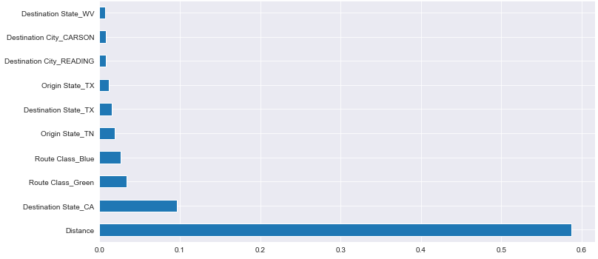
Feature Importance
Building a statistical model on 245 features doesn’t give desired results and make any model complex. So Will have to find important features
After applying Random Forest Regressor to find important features
In top 10 important features , Distance variable clearly takes the major stake

Slide 12
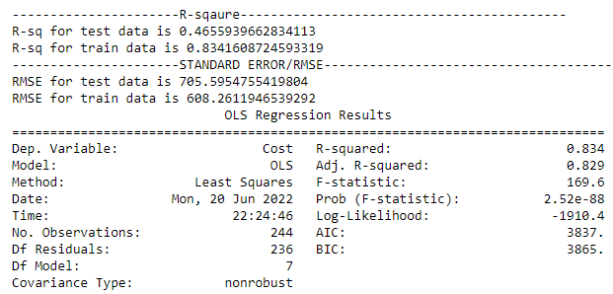
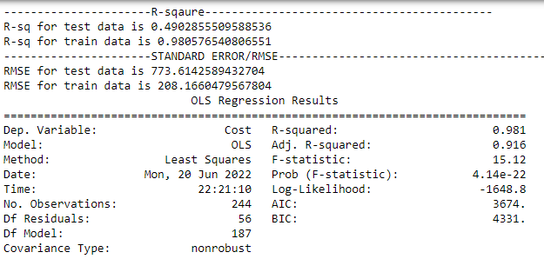
Model-1&2 Linear Regression
Applying standard scaler on ‘Distance’
Using all 278 independent variables to fit the model.
Using top 10 independent features instead of 278 features to fit the model.

Slide 13
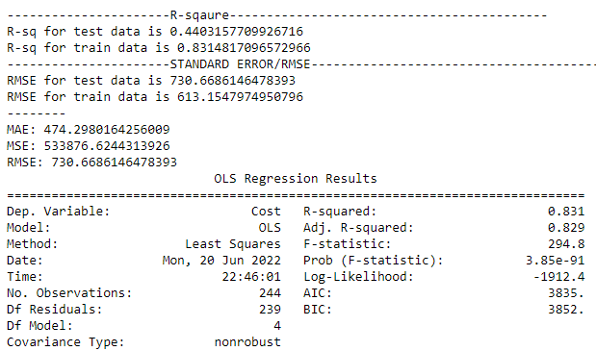
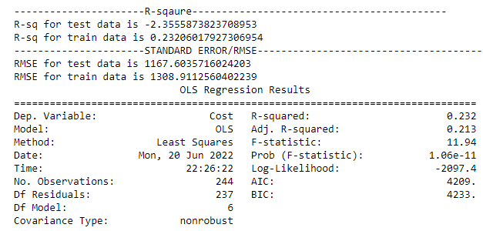
Model-3&4 Linear Regression
Using 6 independent variables to fit the model.
Using top 9 independent features by dropping most important ‘Distance’ feature to fit the model.

Slide 14
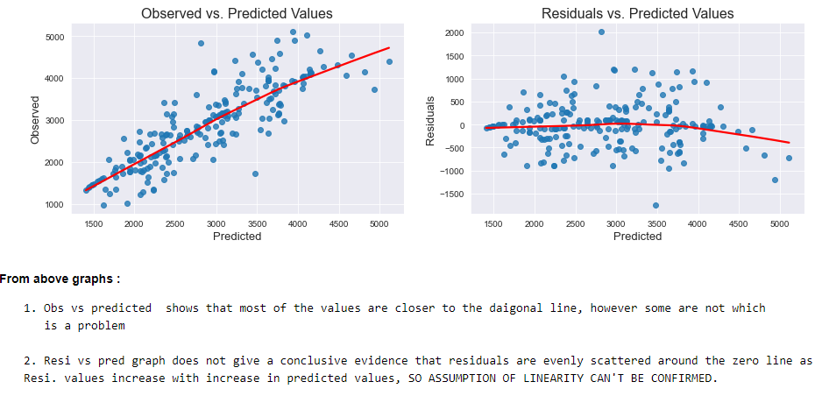
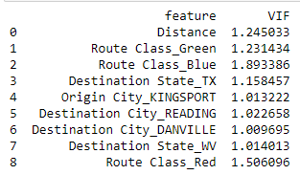
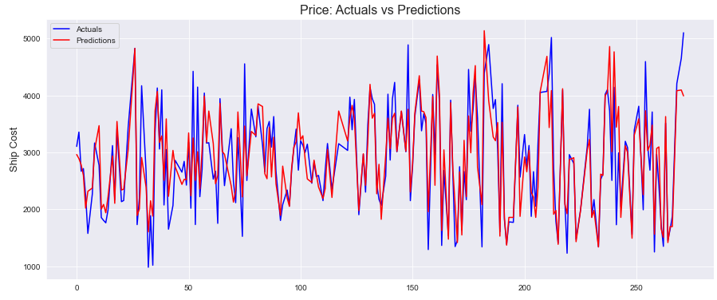
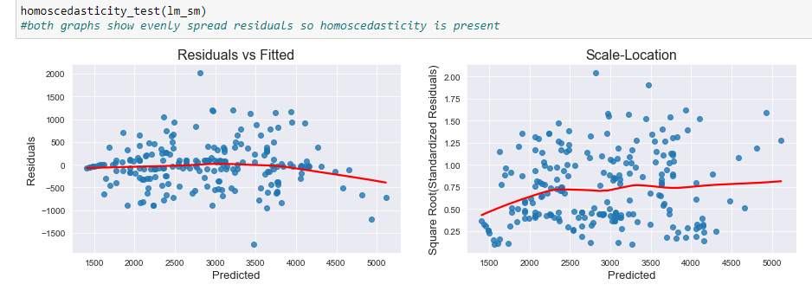
Linear Regression Model Evalution-with 6 imp Features
Observations on Multi collinearity== As VIF is <2..So no Multi collinearity in X

Slide 15
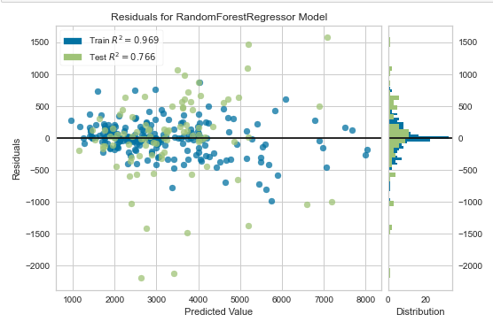
Summary
Conclusion
Linear Regression with top 4-5 important features is good to have for a simple model
Random Forrest Algorithm with all independent features has done reasonably well
Random Forrest Algorithm using all independent features with 10-Fold cross validation and Hyper parameter is better among the models built
Auto ML
Model | MAE | RMSE | R2
Random Forrest (CV, Hyper Parameter Tuning) | 466 | 642 | 0.82
Random Forrest | 464 | 700 | 0.61
Linear Regression | 474 | 730 | 0.44

Slide 16
Conclusion
Follow up& Further Work
Could have tried AutoML’S to see how different models are performing .
Select top 5 frequent “Destination City” and group by rest of the cities as 1 to reduce no of classes from 186 to 6 and then apply Model to see if it helps
If Possible, Collect more data and more numerical Features Periodically and retrain the model to identify new patterns and new customer segments.
Dumped final model in pickle format which can be used to deploy
Measure the Metrics periodically to monitor model performance.
Few more features like which could help like
Categorical =Incoterms-FAS(Free Alongside ship),FOB,CFR,CIF
Chemical tanker weight with material weights (5,000 tonnes deadweight (DWT) to 35,000 DWT ??
Breakup of cost feature
Any other charges like demurrages?
Insurance etc..

Slide 17
Thank You!!!

