Slide 1
Token Generation Campaign 101

Slide 2
Definition of goals
Figure out which sector the project fits in
Is the project realizable
What is the technology needed to fulfill this project
Who are the people that you are/will be working with on this project
What are the metrics to scientifically share the project idea

Slide 3
Team Role definition
Who are the people you will found the project with
Clearly define roles: CEO/CTO/COO/CFO/CMO
Figure out where you will get together to get things done

Slide 4
Team Role definition
Content Creator: almost impossible
Bounty Manager: very difficult
Community Management: also cover Russian, Chinese and Arabic markerts
Marketing: LinkedIn, Medium, Facebook, Github, Gitter, Telegram,Wechat, Bitcoin Talk, Twitter

Slide 5
Team Role definition
Growth Hacking
Business Development: bridge tech and business parts to sell!
Design: to execute your vision
Finding a good designer is hard!

Slide 6
Team Role definition
Where will the project be founded/incorporated
Singapore
Liechtenstein
Switzerland
Estonia
Gibraltar
Bulgaria?

Slide 7
Reward Definition
Split the pie equally!
there are 100% of tokens; something like a 80/20, or 90/10 split = 85% of tokens will go out to the community; 5% market making; the last 10% are split in 1/4th each for 1. founders, 2. people from early stages, 3. advisors, 4. future employees/bounties/rewards/etc.

Slide 8
LEGAL
Find a good legal team!
Make sure they are aware of crypto/willing to adapt
Do not make any moves without their approval
Make sure to know which jurisdictions you will operate in/from
Again: Listen to your lawyers!

Slide 9
Feedback round
Different perspectives from peers, not directly involved in your project, but who are from the crypto space
Shop your whitepaper around
Keep it on the low, use trusted people
Your team
Advisors
Early supporters

Slide 10
Website
Original designs only! = set money aside for a proper, professional website
Be careful with web designers! = keep them close and monitor their work
Make your site and your dashboard as secure as possible!

Slide 11
Secutiry
Most important part of any project
Make sure that all your information is secure
Use encryption
2FA authentication/hardware keys
Involve a security advisors (if possible)

Slide 12
International Setup
Your team is your most valuable asset!
Make sure to have as many people of the team gathered at one point (preferably one office) in the beginning
Developers are more flexible but still good to keep close to the project base
Maintain balance: let people be creative, but also monitor their work
Try different tools to manage your project

Slide 13
ANN Thread on btc Talk
Keep it simple!
Project announcement
People involved
Tech insight
Whitepaper
BASIC INFO

Slide 14
Creation of social media channels
Reserve domains, handles, etc. in time
Test where you will get most resonance
Try different channels. Don’t be afraid, learn from the results
Set clear guidelines as to company values and communication
Listen to critique!

Slide 15
Content, Content, Content
Content is the fuel that will allow your product to be distributed via different media channels
Make sure to have qualitative content
Have a native speaker check your content

Slide 16
Crowdsale announcement
Comes after spending some time building your community, engaging with them, creating content
Detail what the project will consist of, how the funds will be distributed, what they are going to be used for, what is the timeline, milestones identified, main people involved
Share information on media outlets, but don’t overdo it!

Slide 17
Marketing and Public relations plan
Have a clearly detailed plan
Timeline with milestones and clear separation of tasks
Everybody needs to have the special communication channels, so divide these between your marketing team

Slide 18
Technical support (Wallet, Ux, Smart contract)
Be very thorough with the smart contract; execute it properly; fix bugs
Pay somebody to do it for you is the most effective option
Introduce bountires, so more people from the community can help you

Slide 19
Party time
Have a community (>100 people)
Have a functioning website/email support
Have a WELL tested, SECURE and ready to go smart contract for the crowdsale/contribution campaign/tokensale
Have done your pre-sales, if you are doing that
Keep the best media posts, right before

Slide 20
Party time
Have people ready in all channels to support, when all hell breaks loose
Have funds aligned in real time with some open API
Set clear rules to your crowdsale (start, finish, how much to raise, soft/hard cap)
Have slept enough to stay focused!

Slide 21
Aeternity
2 part contribution campaign
Phase 1: 3 days capped in time
Phase 2: 21 mio CHF
Clear guidelines
Well built and audited wallet

Slide 22
SALt
Tokens as collateral for cash loans = the beginning of digital assets credit market
successfully completed key milestones positioning itself much further along in development by securing: a bank partnership, a license to take out loans and a key partnership with Bank of Mauritius
Currently, they are on course to release the SALT platform

Slide 23
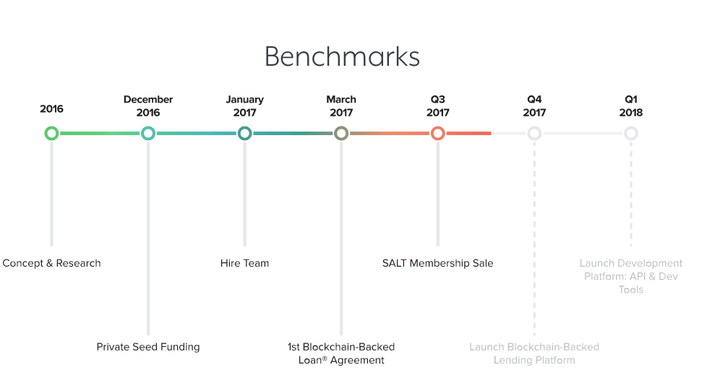
Salt

Slide 24
Onecoin
textbook scam from start to finish
no information a token was ever created; team had little concrete to show contributors, and no working prototype
April 24th, Indian authorities raided a OneCoin meeting. 18 were jailed, but not before OneCoin scammed investors out of 350 million
they accepted funding in standard currency, not BTC or ETH

Slide 25
Enigma
security and cryptography coin, that boasted about its new encryption methods
mailing list, website, and Slack accounts were all hacked ahead of the company’s ICO. Hackers used Slack to reach out to investors about a fake early ICO; $500 000 gone
CEO’ account had no two-factor authentication - a must for wallets and exchanges

Slide 26
Parity
a hacker exploited a vulnerability in Parity’s Multisig Wallets, netting $30M. Using a flaw in the code and a two-step process, the hacker cracked what was thought to be a safe wallet
took Ether from multi-signature wallets containing funds from Edgeless, Swarm City, and Aeternity
good hackers managed to return most of the Ethers
Junior developer “killed” contracts worth over 513k ETH

